Slide 1
Jolly Grammar
6b-33

Slide 2
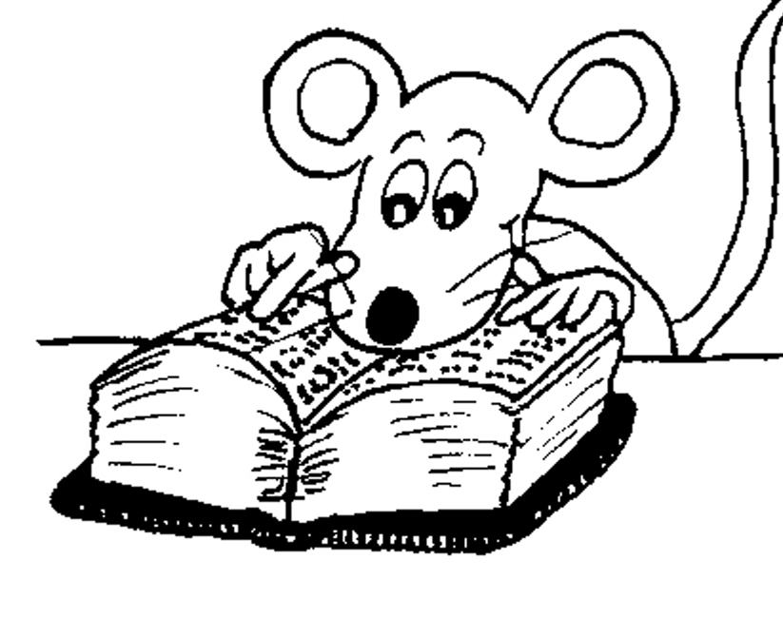
Let’ review
Homophones.

Slide 3
effect
affect

Slide 4
wary
weary

Slide 5
accept
except

Slide 6
quite
quiet

Slide 7
Let’s review!

Slide 8
/oa/
goat
snow
note
soldier
toe
brooch
sewn
mauve

Slide 9
<ere>
here /air/
there /air/
sphere /ear/
cereal /ear/
mere /ear/
coherence /ear/
atmosphere /ear/
somewhere /air/
werewolf /ear/ /air/
/oa/
goat
snow
note
soldier
toe
brooch
sewn
mauve

Slide 10
Activity Page:
Spelling
<ere>
Sound
/oa/

Slide 11
Spelling List

Slide 12
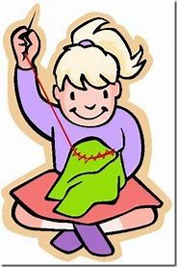
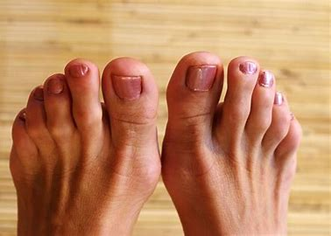
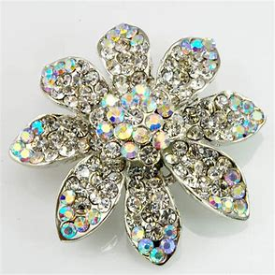
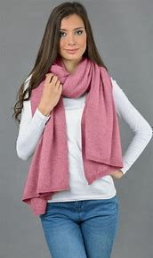
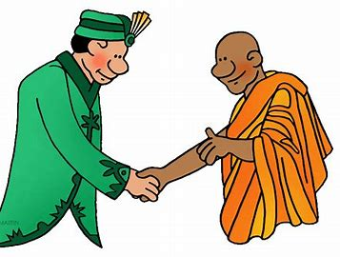
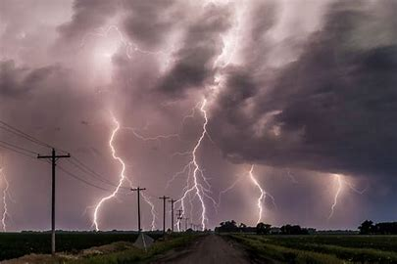
toe brooch sewn
severe revere cashmere

Slide 13
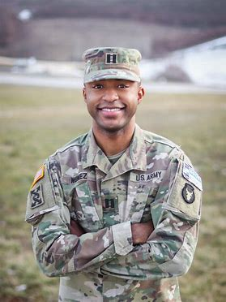
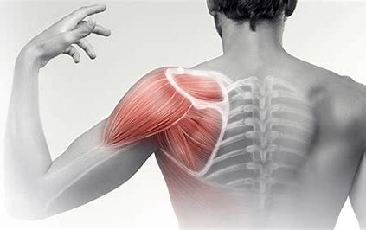
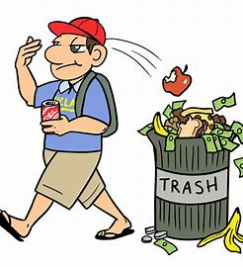
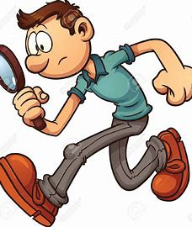
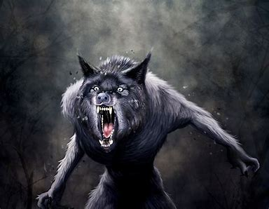
shoulder soldier mauve
werewolf anywhere wherever

Slide 14
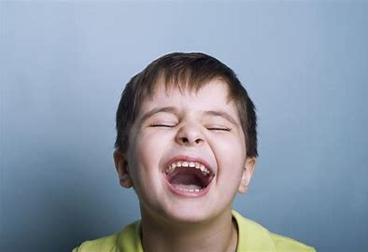
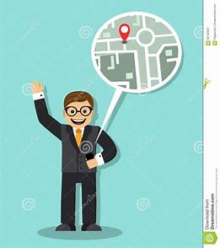
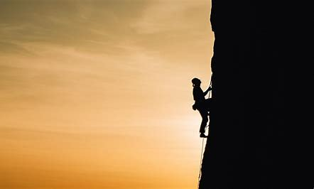
sincere therefore interfere
persevere whereupon whereabouts

Slide 17
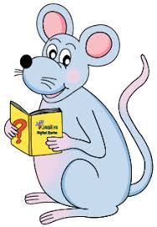
Add the missing letters.

Slide 18
Match
the spelling words and the sounds.

Slide 19
/air/
/oa/
/ear/

Slide 20
/air/
werewolf
anywhere
wherever
therefore
whereupon
whereabouts
/oa/
toe
brooch
sewn
shoulder
mauve
soldier
/ear/
severe
revere
cashmere
werewolf
sincere
interfere
persevere

Slide 21
Parsing and completing the wall.

Slide 22
The soldier had a severely broken toe.
Subject
soldier
The
Verb
had
Object
toe
a severely broken
(active)

Slide 23
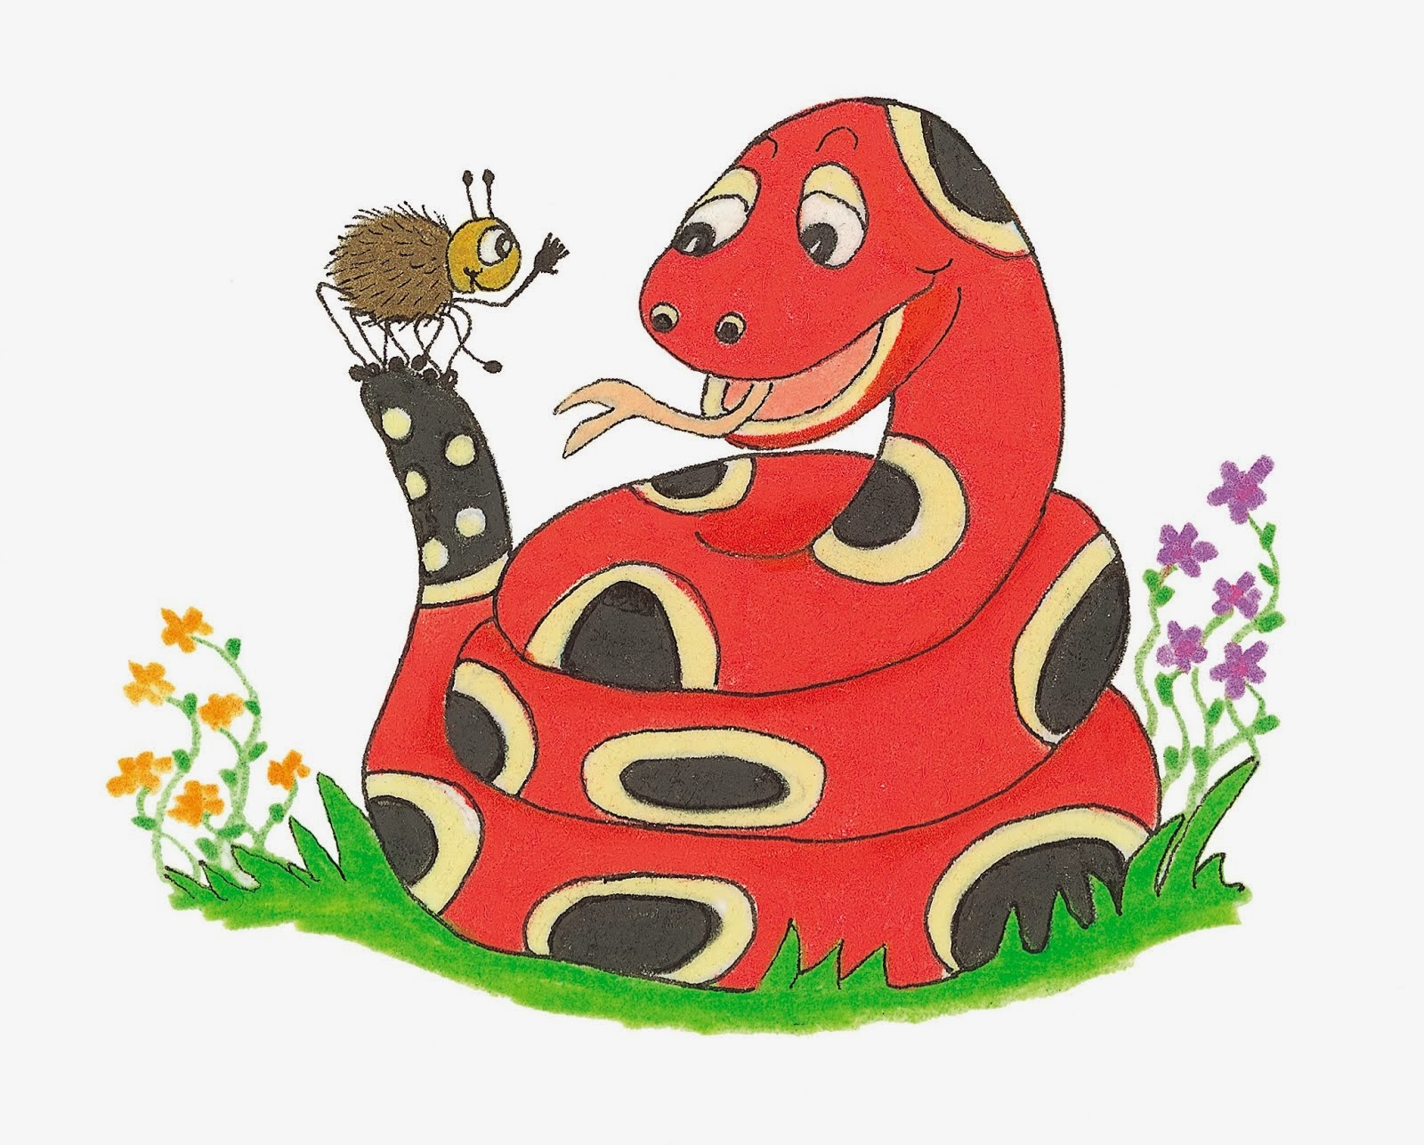
Dictation

Slide 25
The mauve buttons had been sewn on securely.

Slide 26
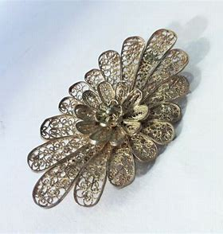
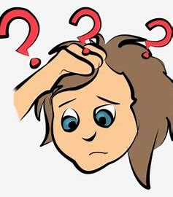

Slide 27
“I cannot find my brooch anywhere,” I admitted.

Slide 29
She draped her cashmere scarf over her shoulders.

Slide 30
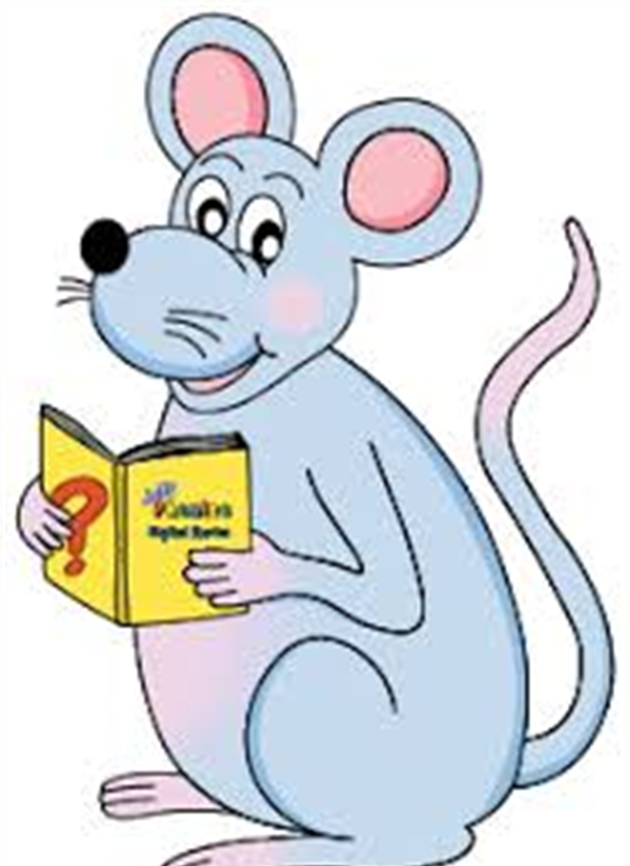
Assignment
Learn Words in the List

Slide 31
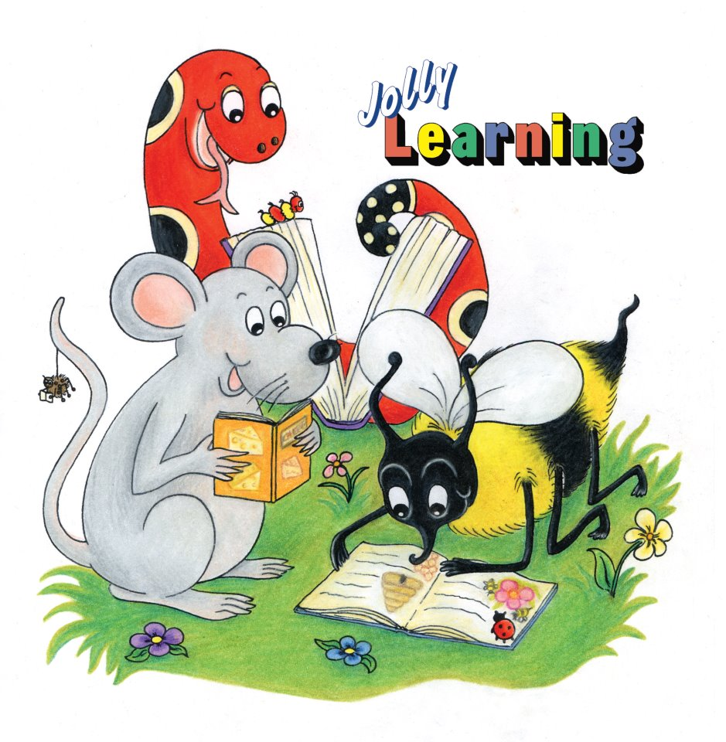
See you
next time!

