Slide 1
Jolly Grammar
6b-32

Slide 2
Spelling Test 34

Slide 3
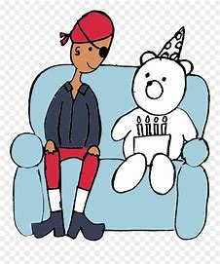
actually

Slide 4
actually
probably

Slide 5
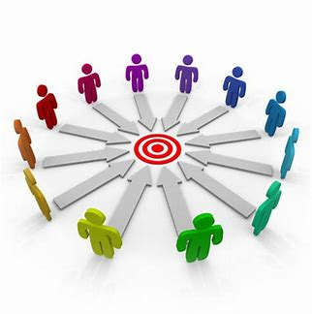
actually
probably
centrally

Slide 6
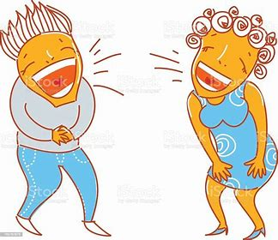
actually
probably
centrally
heartily

Slide 7
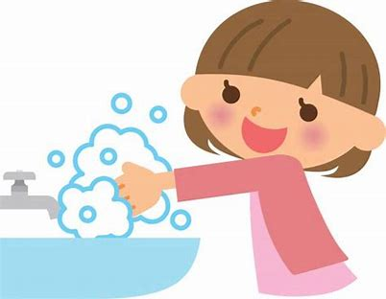
actually
probably
centrally
heartily
frequently

Slide 8
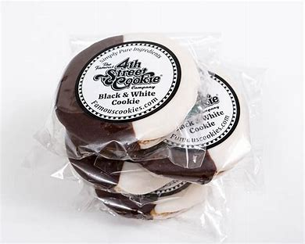
actually
probably
centrally
heartily
frequently
individually

Slide 9
actually
probably
centrally
heartily
frequently
individually
7. excellently

Slide 10
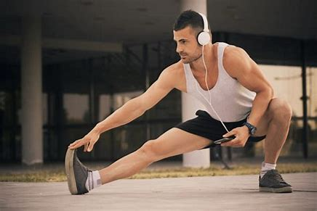
actually
probably
centrally
heartily
frequently
individually
7. excellently
8. physically

Slide 11
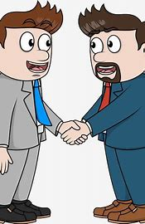
actually
probably
centrally
heartily
frequently
individually
7. excellently
8. physically
9. sincerely

Slide 12
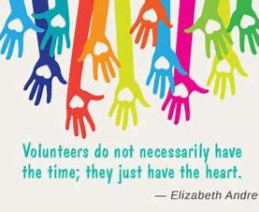
actually
probably
centrally
heartily
frequently
individually
7. excellently
8. physically
9. sincerely
10. necessarily

Slide 13
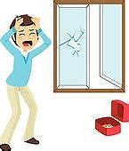
actually
probably
centrally
heartily
frequently
individually
7. excellently
8. physically
9. sincerely
10. necessarily
11. desperately

Slide 14
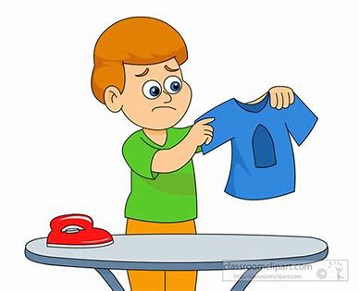
actually
probably
centrally
heartily
frequently
individually
7. excellently
8. physically
9. sincerely
10. necessarily
11. desperately
12. accidentally

Slide 15
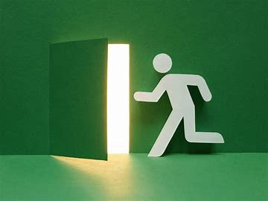
actually
probably
centrally
heartily
frequently
individually
7. excellently
8. physically
9. sincerely
10. necessarily
11. desperately
12. accidentally
13. immediately

Slide 16
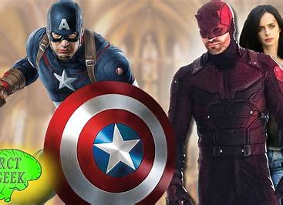
actually
probably
centrally
heartily
frequently
individually
7. excellently
8. physically
9. sincerely
10. necessarily
11. desperately
12. accidentally
13. immediately
14. marvellously

Slide 17
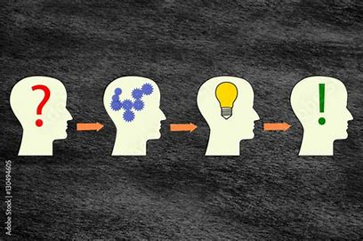
actually
probably
centrally
heartily
frequently
individually
7. excellently
8. physically
9. sincerely
10. necessarily
11. desperately
12. accidentally
13. immediately
14. marvellously
15. symbolically

Slide 18
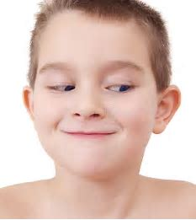
actually
probably
centrally
heartily
frequently
individually
7. excellently
8. physically
9. sincerely
10. necessarily
11. desperately
12. accidentally
13. immediately
14. marvellously
15. symbolically
16. mischievously

Slide 19
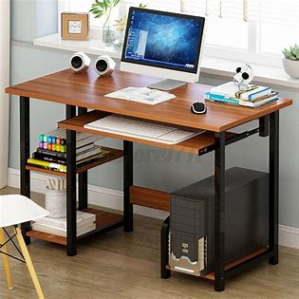
actually
probably
centrally
heartily
frequently
individually
7. excellently
8. physically
9. sincerely
10. necessarily
11. desperately
12. accidentally
13. immediately
14. marvellously
15. symbolically
16. mischievously
17. systematically

Slide 20
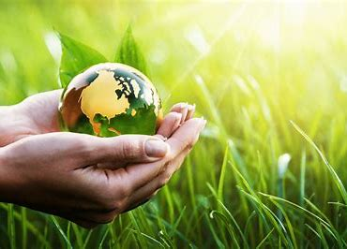
actually
probably
centrally
heartily
frequently
individually
7. excellently
8. physically
9. sincerely
10. necessarily
11. desperately
12. accidentally
13. immediately
14. marvellously
15. symbolically
16. mischievously
17. systematically
18. environmentally

Slide 21
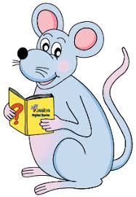
Let’s Review Homophones.

Slide 22
・our, hour and are

Slide 23
・our, hour and are
・Their, there and they’re

Slide 24
・our, hour and are
・Their, there and they’re
・Your and you’re

Slide 25
・our, hour and are
・Their, there and they’re
・Your and you’re
・Its and it’s

Slide 26
・our, hour and are
・Their, there and they’re
・Your and you’re
・Its and it’s
・Where, wear and were

Slide 27
Homophone
Mix-up

Slide 28
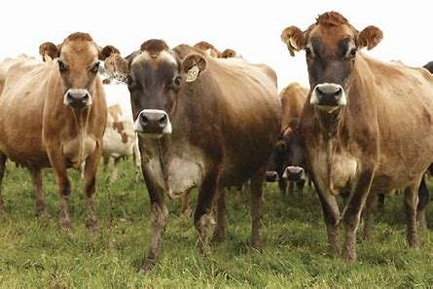
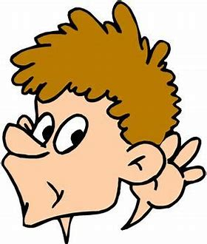
herd
heard

Slide 29
who’s
whose

Slide 30
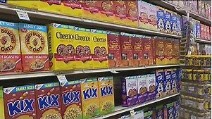
serial
cereal

Slide 31
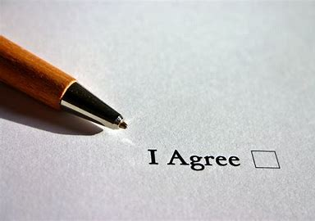
ascent
assent

Slide 32
ascent
assent

Slide 33
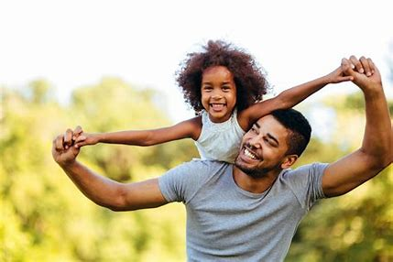
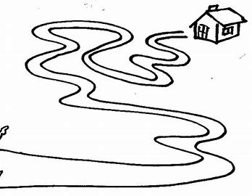
father
farther

Slide 34
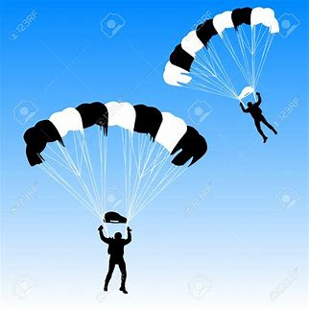
dissent
descent

Slide 35
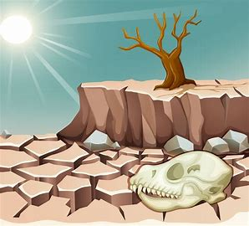
draft
draught

Slide 36
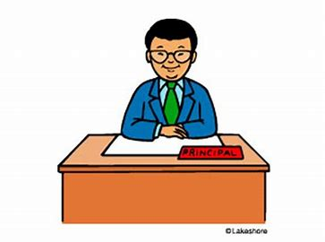
principle
principal

Slide 37
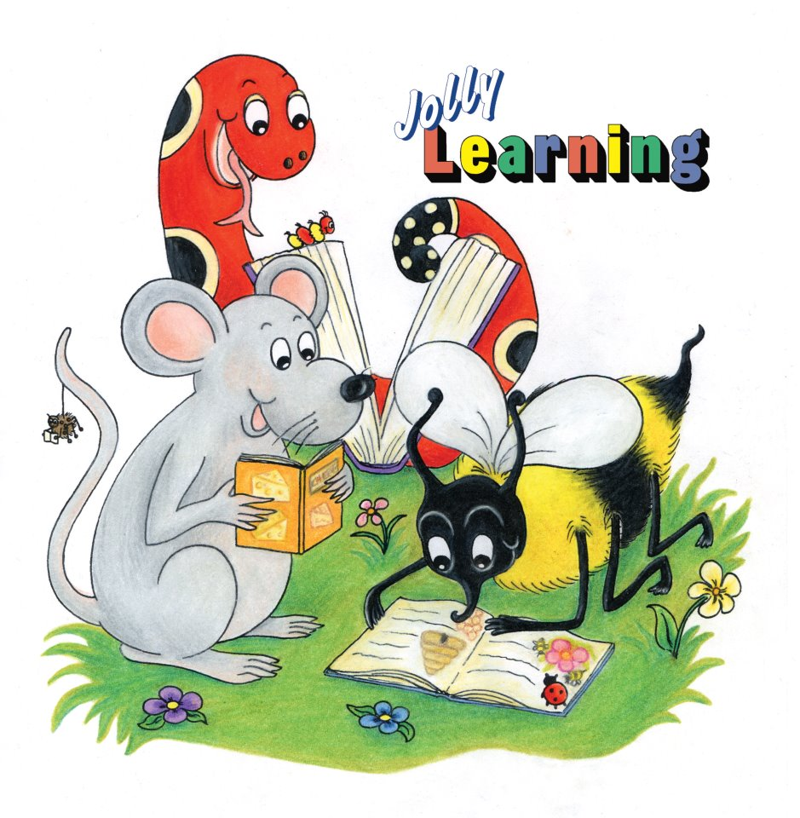
See you
next time!

