Slide 1
Jolly Grammar
6b-29

Slide 2
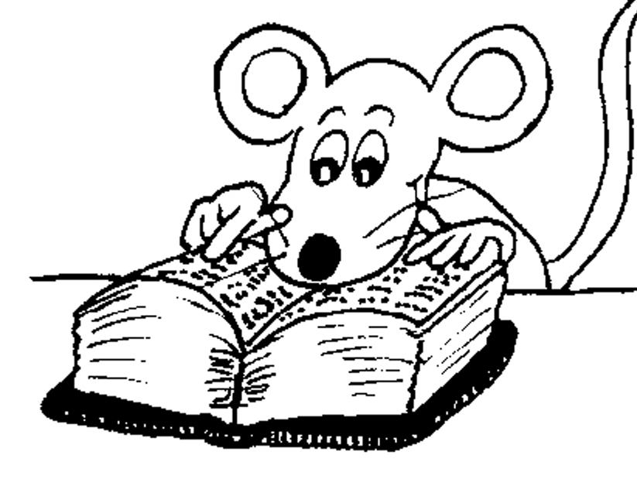
Let’ review
Formal and informal synonyms.

Slide 3
Let’s review!

Slide 4
imagine

Slide 5
image
imagine

Slide 6
image
imagine
imagery
imaginary
imagination
imaginative
imaginatively
imaginable

Slide 7
image
imagine
imagery
imaginary
imagination
imaginative
imaginatively
imaginable

Slide 8
image
imagine
imagery
imaginary
imagination
imaginative
imaginatively
imaginable

Slide 9
image
imagine
imagery
imaginary
imagination
imaginative
imaginatively
imaginable

Slide 10
image
imagine
imagery
imaginary
imagination
imaginative
imaginatively
imaginable

Slide 11
image
imagine
imagery
imaginary
imagination
imaginative
imaginatively
imaginable

Slide 12
image
imagine
imagery
imaginary
imagination
imaginative
imaginatively
imaginable

Slide 13
image
imagine
imagery
imaginary
imagination
imaginative
imaginatively
imaginable

Slide 14
image
imagine
imagery
imaginary
imagination
imaginative
imaginatively
imaginable

Slide 15
Let’ review homophones.

Slide 16
Let’ review.
homo phones
same sound

Slide 17
lose
lightning
breath
desert
angle
island
loose
lightening
breathe
dessert
angel
Ireland

Slide 18
Activity Page:
Commonly Confused Words

Slide 19
Spelling List

Slide 20
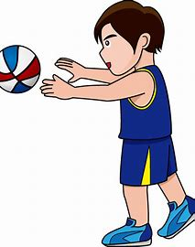
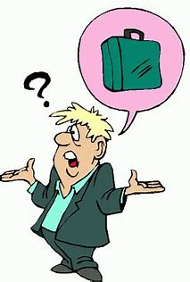
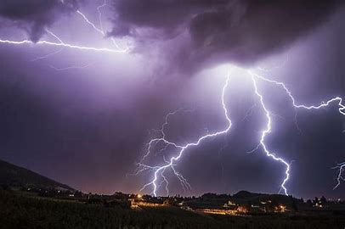
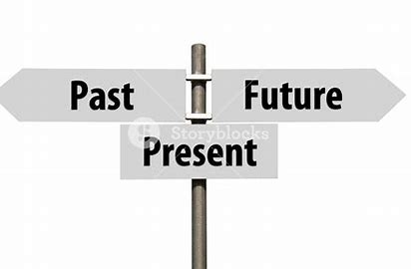
passed lose lightning
past loose lightening

Slide 21
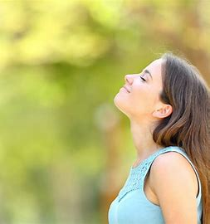
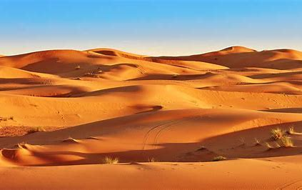
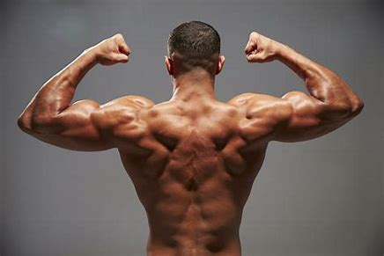
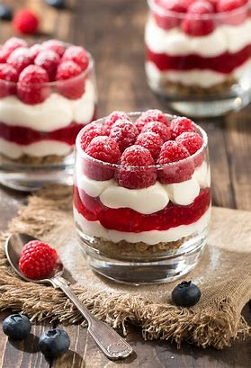
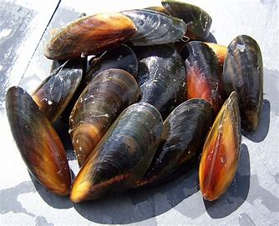
breath desert muscle
breathe dessert mussel

Slide 22
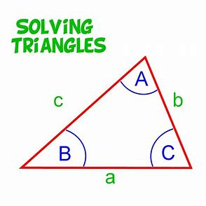
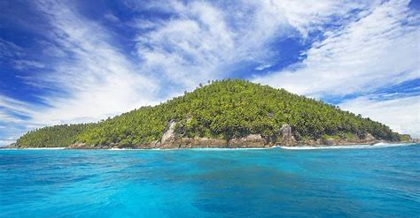
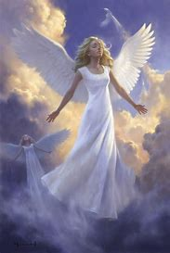
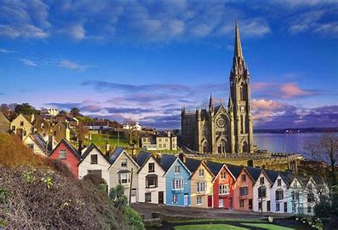
angle island stationary
angel Ireland stationery

Slide 25
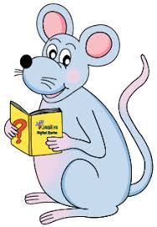
Write the meanings.

Slide 26
Draw a picture.

Slide 27
angel
desert
lightning
stationery

Slide 28
Parsing and completing the wall.

Slide 29
The old oak tree was struck (by lightning).
Subject
tree
The old oak
Verb
was struck
by lightning
Object
(passive)

Slide 30
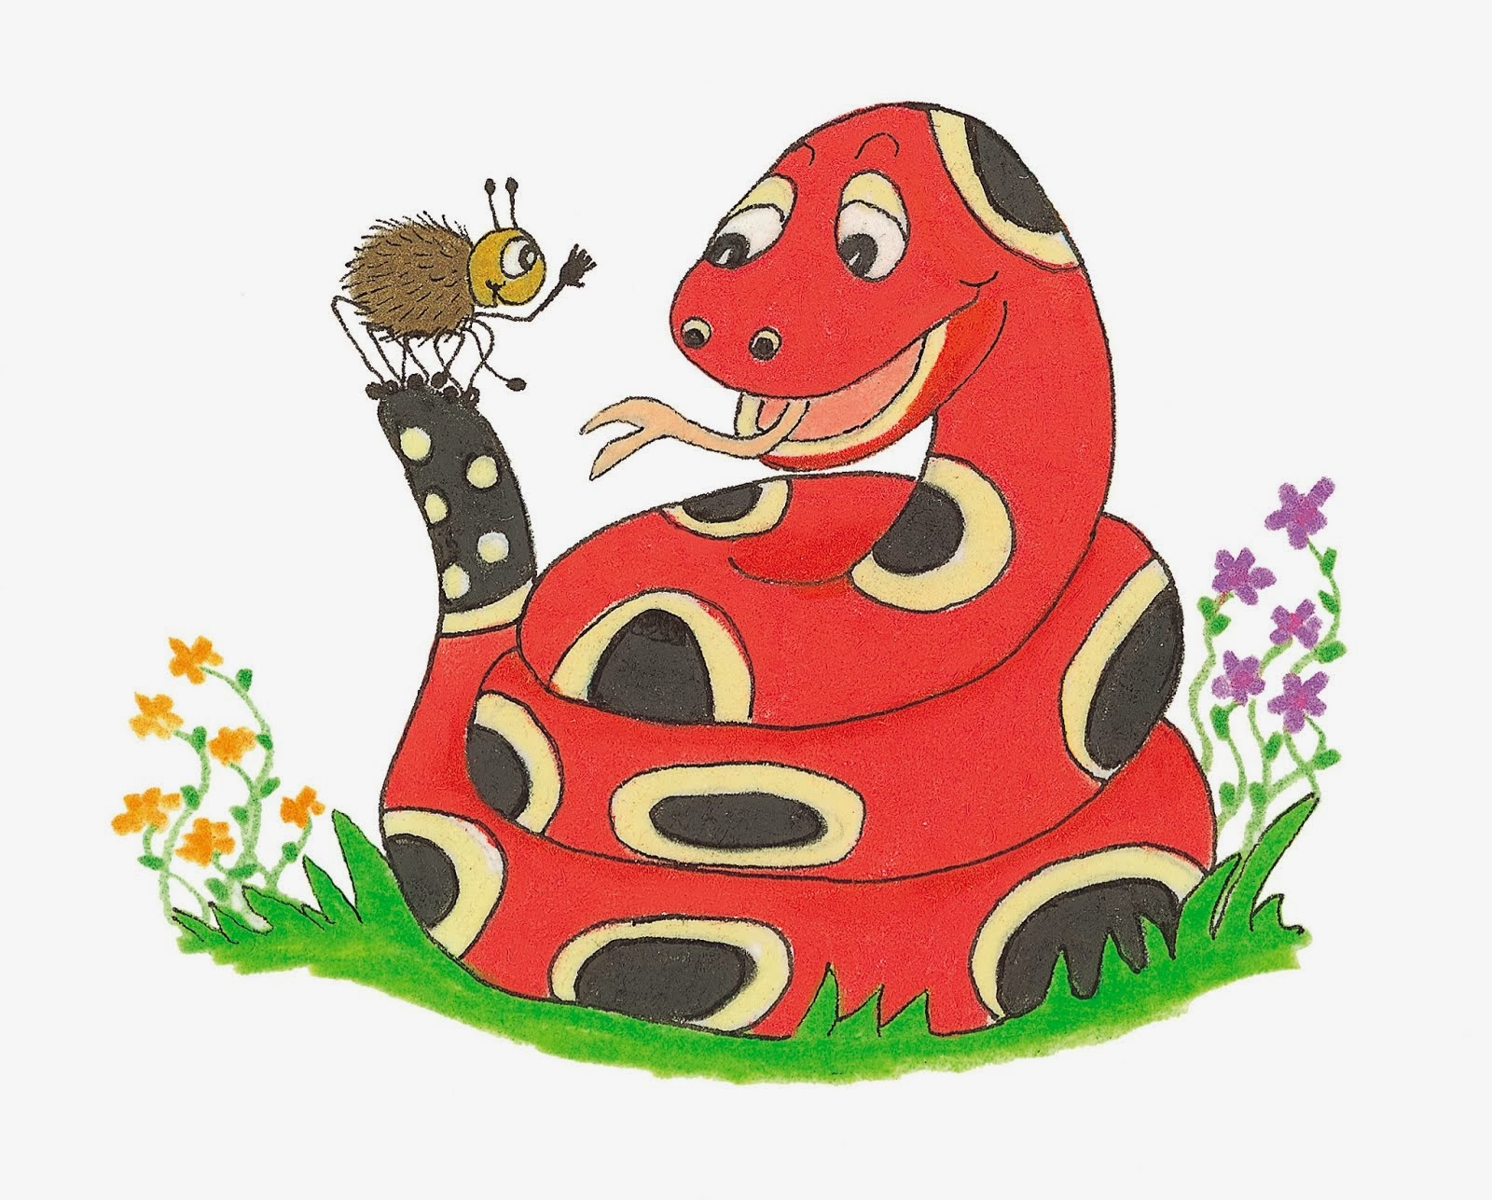
Dictation

Slide 31
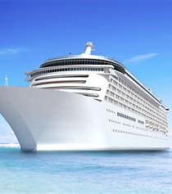
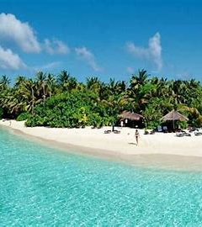

Slide 32
The ship sailed past the desert island.

Slide 34
How many angles are there in a triangle?

Slide 35
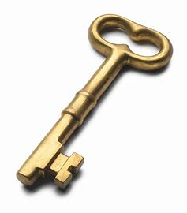
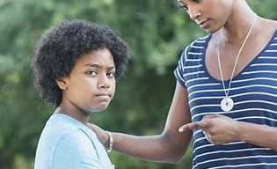

Slide 36
“Don’t lose that key,” warned my mother.

Slide 37
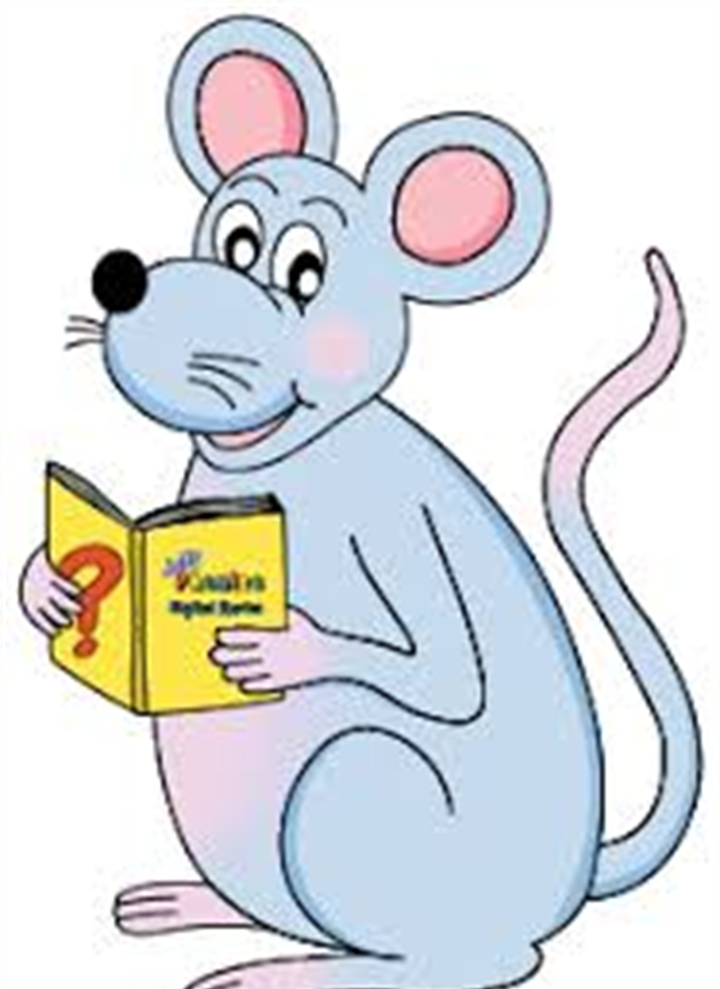
Assignment
Learn Words in the List

Slide 38
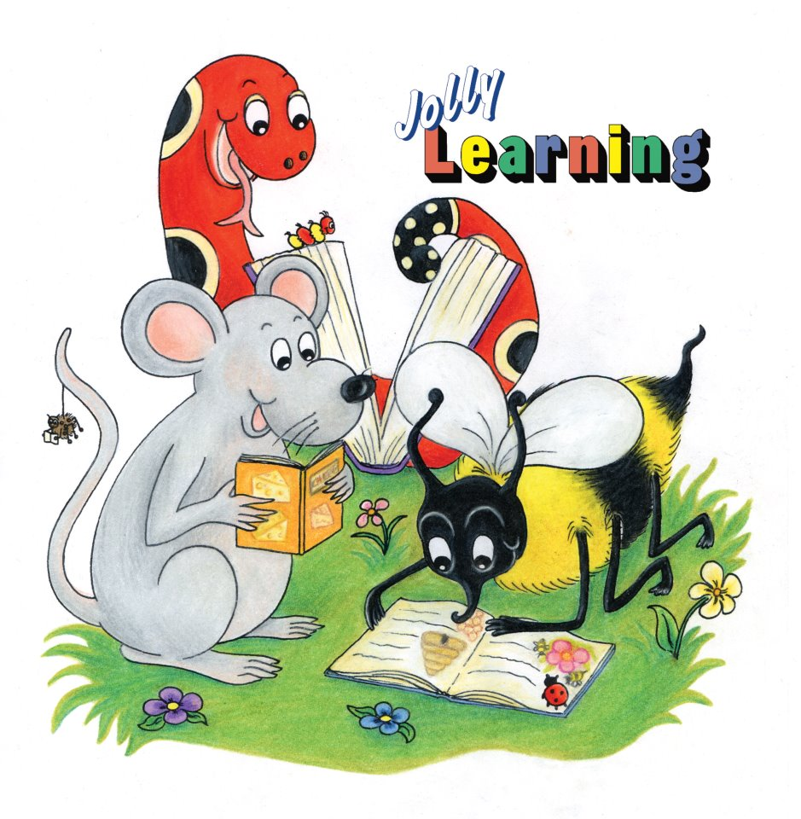
See you
next time!

