Slide 1
Jolly Grammar
6b-24

Slide 2
Spelling Test 30

Slide 3
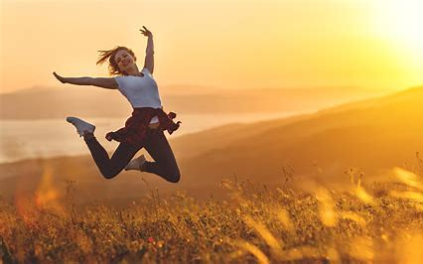
enjoyable

Slide 4
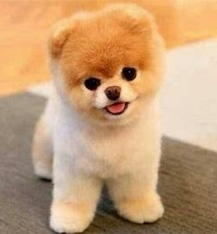
enjoyable
adorable

Slide 5
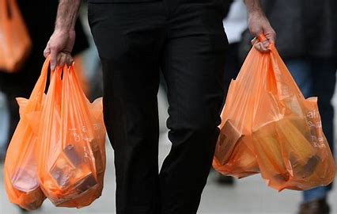
enjoyable
adorable
avoidable

Slide 6
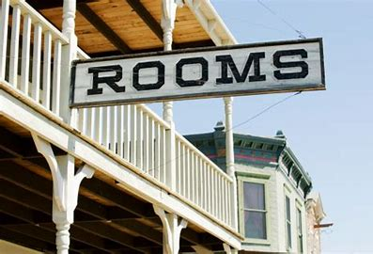
enjoyable
adorable
avoidable
available

Slide 7
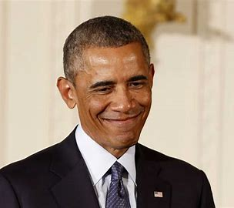
enjoyable
adorable
avoidable
available
notable

Slide 8
enjoyable
adorable
avoidable
available
notable
reasonable

Slide 9
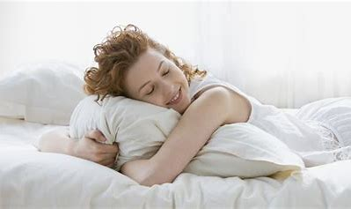
enjoyable
adorable
avoidable
available
notable
reasonable
7.comfortable

Slide 10
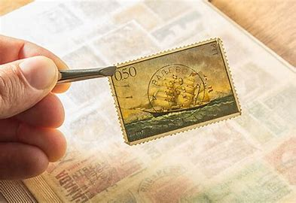
enjoyable
adorable
avoidable
available
notable
reasonable
7.comfortable
8. valuable

Slide 11
enjoyable
adorable
avoidable
available
notable
reasonable
7.comfortable
8. valuable
9. reliable

Slide 12
enjoyable
adorable
avoidable
available
notable
reasonable
7.comfortable
8. valuable
9. reliable
10. suitable

Slide 13
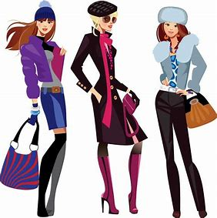
enjoyable
adorable
avoidable
available
notable
reasonable
7.comfortable
8. valuable
9. reliable
10. suitable
11. fashionable

Slide 14
enjoyable
adorable
avoidable
available
notable
reasonable
7.comfortable
8. valuable
9. reliable
10. suitable
11. fashionable
12. understandable

Slide 15
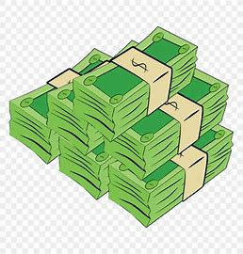
enjoyable
adorable
avoidable
available
notable
reasonable
7.comfortable
8. valuable
9. reliable
10. suitable
11. fashionable
12. understandable
13. considerable

Slide 16
enjoyable
adorable
avoidable
available
notable
reasonable
7.comfortable
8. valuable
9. reliable
10. suitable
11. fashionable
12. understandable
13. considerable
14. recognisable

Slide 17
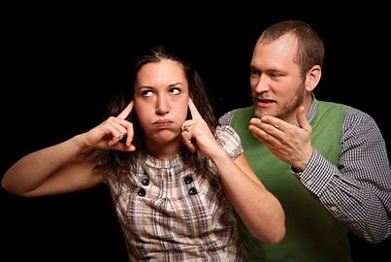
enjoyable
adorable
avoidable
available
notable
reasonable
7.comfortable
8. valuable
9. reliable
10. suitable
11. fashionable
12. understandable
13. considerable
14. recognisable
15. persuadable

Slide 18
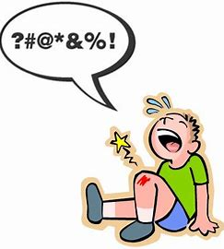
enjoyable
adorable
avoidable
available
notable
reasonable
7.comfortable
8. valuable
9. reliable
10. suitable
11. fashionable
12. understandable
13. considerable
14. recognisable
15. persuadable
16. tolerable

Slide 19
enjoyable
adorable
avoidable
available
notable
reasonable
7.comfortable
8. valuable
9. reliable
10. suitable
11. fashionable
12. understandable
13. considerable
14. recognisable
15. persuadable
16. tolerable
17. applicable

Slide 20
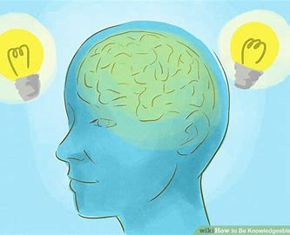
enjoyable
adorable
avoidable
available
notable
reasonable
7.comfortable
8. valuable
9. reliable
10. suitable
11. fashionable
12. understandable
13. considerable
14. recognisable
15. persuadable
16. tolerable
17. applicable
18. knowledgeable

Slide 21
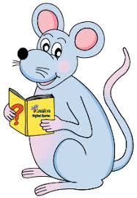
Let’s Revise Sentences

Slide 22
・Types of sentences
Simple : having a subject and verb
I have a dog.
Compound : consisting of two simple sentences
I have a dog and he has a cat.
Complex : containing a main clause and
a dependent clause
I had a dog when I was younger.

Slide 23
・Types of sentences
Statement : stating facts
I have a dog.
Questions : asking for information
Do you have pet?
Exclamation : making an exclamation
You have so many pets!

Slide 24
・Types of sentences
Positive : expression what it is
I have a dog.
Negative : expressing what is not
You do not have a dog.
The baby will not sleep.

Slide 25
Do you know
Simon Says

Slide 26
Simon says…
Sit down.
Clap your hands.
Stamp your feet.

Slide 27
Simon says…
Sit down.
Clap your hands.
Stamp your feet.
Imperative sentence

Slide 28
Sit down. Clap your hands. Stamp your feet.
Imperative sentence

Slide 29
Sit down. Clap your hands. Stamp your feet.
Imperative sentence
Warnings: Be aware of the dog!

Slide 30
Sit down. Clap your hands. Stamp your feet.
Imperative sentence
Warnings: Be aware of the dog!
Instructions: Stir in the flour gradually.

Slide 31
Sit down. Clap your hands. Stamp your feet.
Imperative sentence
Warnings: Be aware of the dog!
Instructions: Stir in the flour gradually.
Advice: Use a sharp knife

Slide 32
Sit down. Clap your hands. Stamp your feet.
Imperative sentence
Warnings: Be aware of the dog!
Instructions: Stir in the flour gradually.
Advice: Use a sharp knife
Suggestions: Try the apple pie.

Slide 33
Sit down. Clap your hands. Stamp your feet.
Imperative sentence
Warnings: Be aware of the dog!
Instructions: Stir in the flour gradually.
Advice: Use a sharp knife
Suggestions: Try the apple pie.
Invitations: Come and see us soon.

Slide 34
Sit down. Clap your hands. Stamp your feet.
Imperative sentence
Warnings: Be aware of the dog!
Instructions: Stir in the flour gradually.
Advice: Use a sharp knife
Suggestions: Try the apple pie.
Invitations: Come and see us soon.
Requests: Help me, please.

Slide 35
Sit down. Clap your hands. Stamp your feet.
Imperative sentence
Warnings: Be aware of the dog!
Instructions: Stir in the flour gradually.
Advice: Use a sharp knife
Suggestions: Try the apple pie.
Invitations: Come and see us soon.
Requests: Help me, please.
(negative)
Do not disturb. Don’t disturb

Slide 36
Imperatives

Slide 37
Positive & negative imperatives

Slide 38
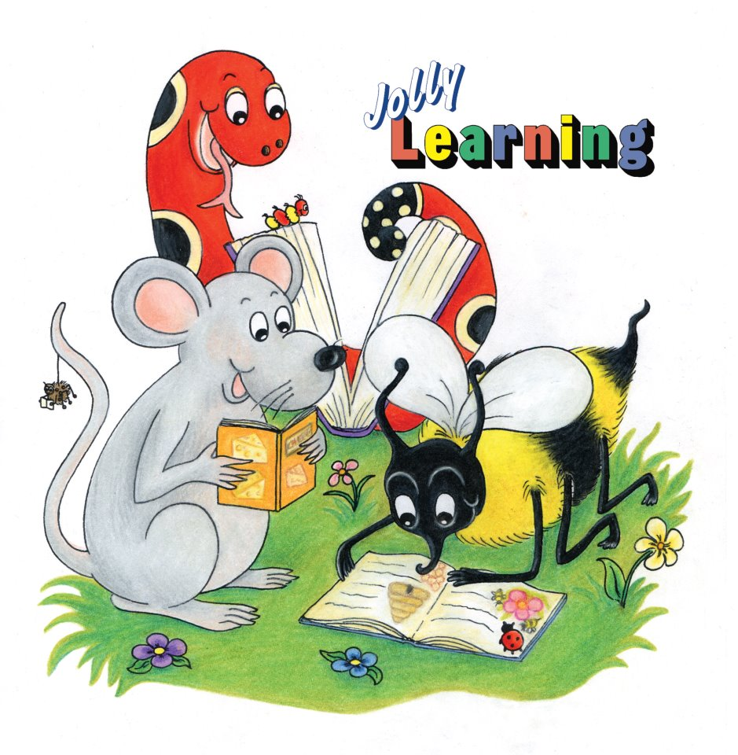
See you
next time!

