Slide 1
Jolly Grammar
6b-17

Slide 2
structure
figure
future
measure
feature
furniture
moisture
vulture

Slide 3
structure
figure
future
measure
feature
furniture
moisture
vulture schwa

Slide 4
Activity Page:
Spelling
<our>

Slide 5
journey
four
tour
flour

Slide 6
journey
four
tour
flour
colour
flavour
neighbour

Slide 7
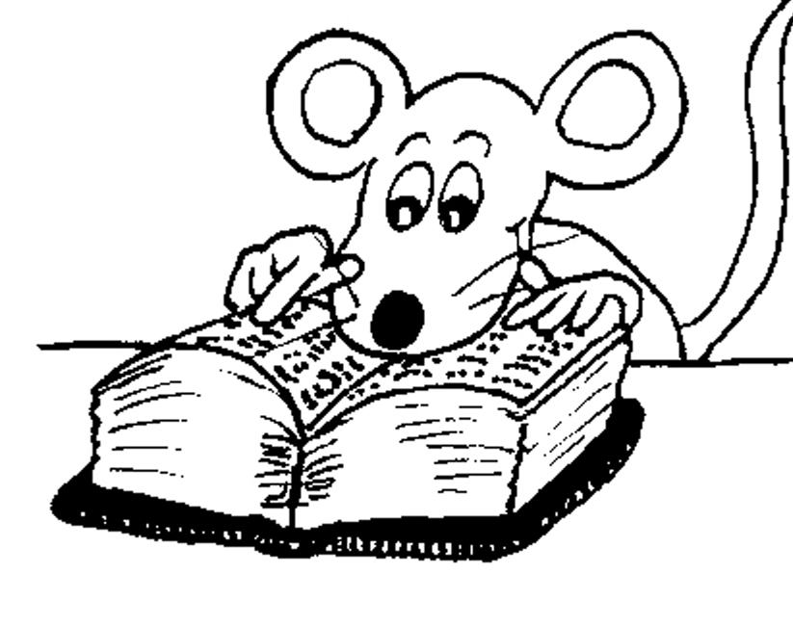
Spelling List

Slide 8
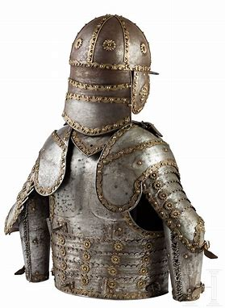
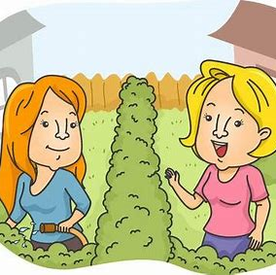
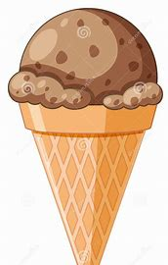
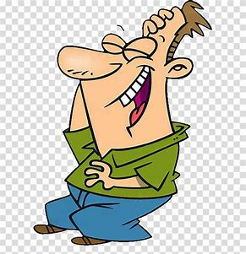
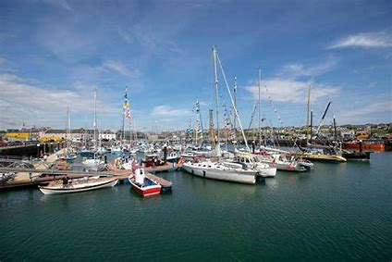
armour favour flavour
humour harbour rumour

Slide 9
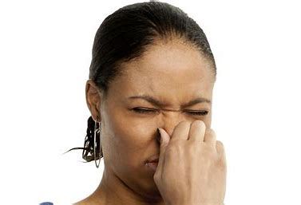
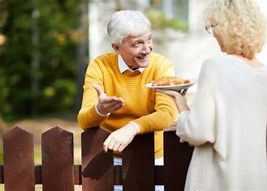
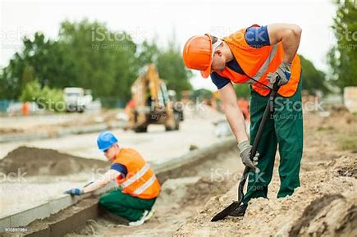
odour clamour colourful
neighbour labourer vigour

Slide 10
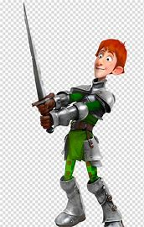
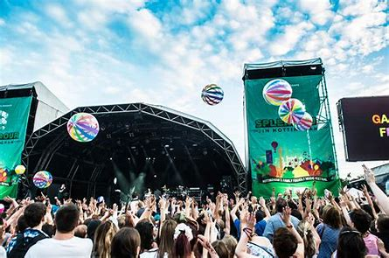
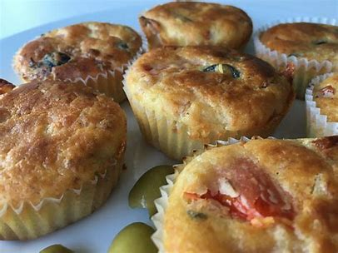
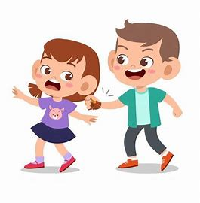
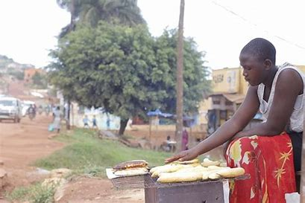
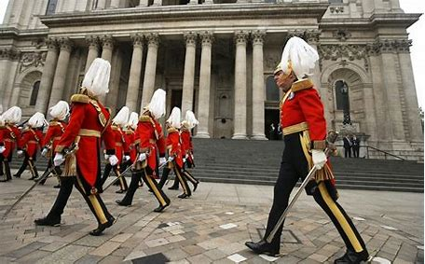
valour savoury splendour
behaviour endeavour honourable

Slide 13
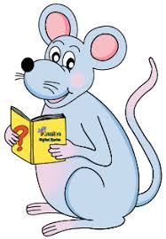
Unscramble the letters.

Slide 14
Positive to Negative

Slide 15
This cheese does not have an unpleasant odour.

Slide 16
This cheese does not have an unpleasant odour.
I do not like this flavour of ice cream.

Slide 17
This cheese does not have an unpleasant odour.
I do not like this flavour of ice cream.
The ships did not sail into the harbour.

Slide 18
This cheese does not have an unpleasant odour.
I do not like this flavour of ice cream.
The ship did not sail into the harbour.
They often do not hear the rumours about the old house.

Slide 19
This cheese does not have an unpleasant odour.
I do not like this flavour of ice cream.
The ship did not sail into the harbour.
They often do not hear the rumours about the old house.
You neighbour does not do the gardening everyday.

Slide 20
Parsing and completing the wall.

Slide 21
The splendid armour was worn
(by the king) (in battle).
Subject
armour
The splendid
Verb
was worn
by the king/
in battle
Object
(passive)

Slide 22
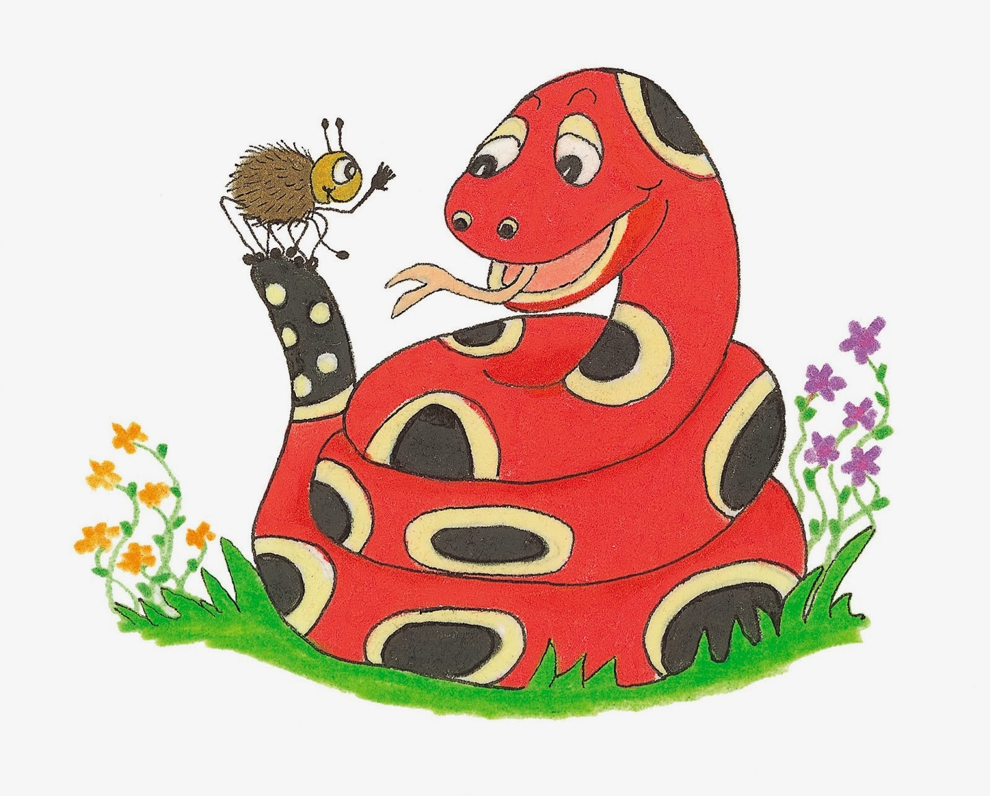
Dictation

Slide 24
“Can you do me a favour?” I asked my neighbour.

Slide 25
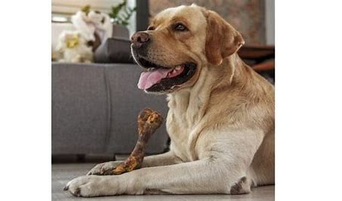

Slide 26
Always reward your pet for good behaviour.

Slide 27
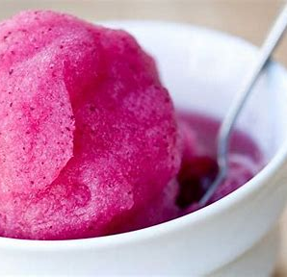

Slide 28
The sorbet had an interesting colour and flavour.

Slide 29
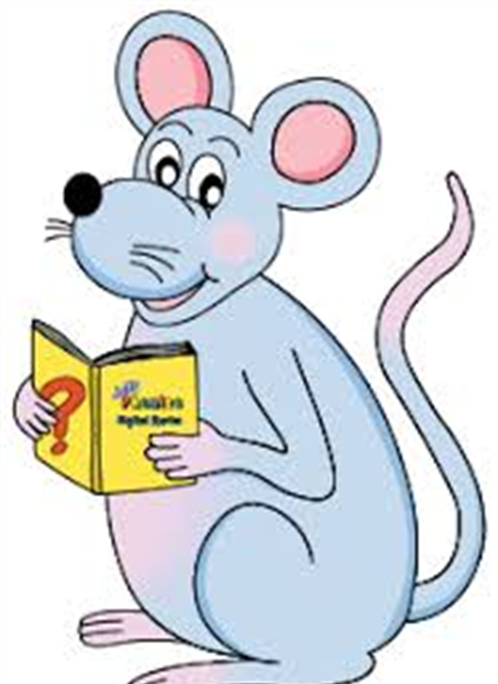
Assignment
Learn Words in the List

Slide 30
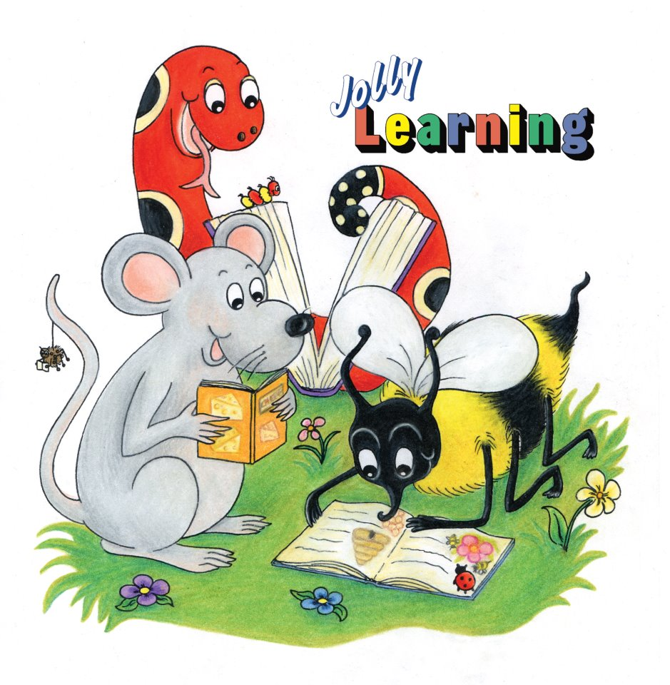
See you
next time!

