Slide 1
Jolly Grammar
6b-12

Slide 2
Spelling Test 24

Slide 3
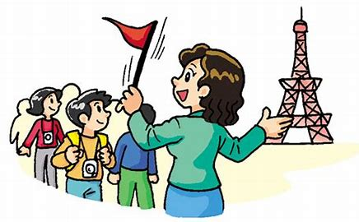
guide

Slide 4
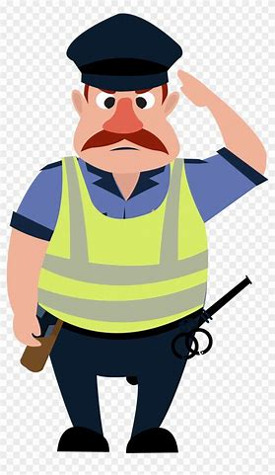
guide
guard

Slide 5
guide
guard
guess

Slide 6
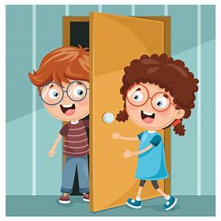
guide
guard
guess
guest

Slide 7
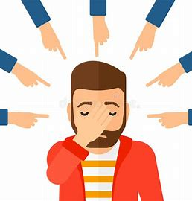
guide
guard
guess
guest
guilt

Slide 8
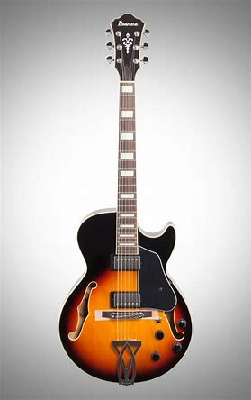
guide
guard
guess
guest
guilt
guitar

Slide 9
guide
guard
guess
guest
guilt
guitar
7. language

Slide 10
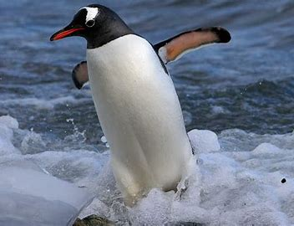
guide
guard
guess
guest
guilt
guitar
7. language
8. penguin

Slide 11
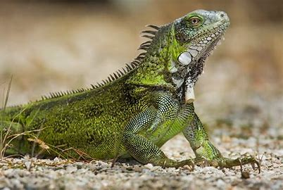
guide
guard
guess
guest
guilt
guitar
7. language
8. penguin
9. iguana

Slide 12
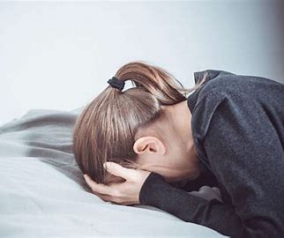
guide
guard
guess
guest
guilt
guitar
7. language
8. penguin
9. iguana
10. anguish

Slide 13
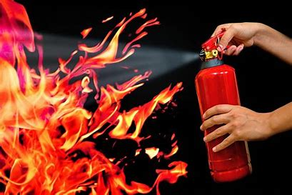
guide
guard
guess
guest
guilt
guitar
7. language
8. penguin
9. iguana
10. anguish
11. extinguish

Slide 14
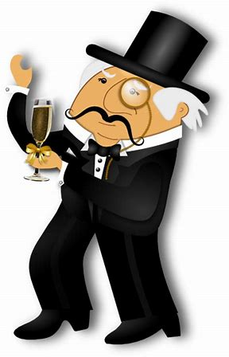
guide
guard
guess
guest
guilt
guitar
7. language
8. penguin
9. iguana
10. anguish
11. extinguish
12. distinguished

Slide 15
guide
guard
guess
guest
guilt
guitar
7. language
8. penguin
9. iguana
10. anguish
11. extinguish
12. distinguished
13. guarantee

Slide 16
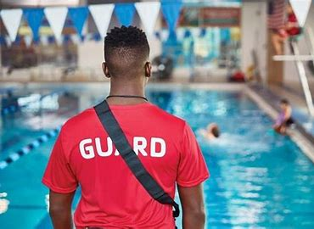
guide
guard
guess
guest
guilt
guitar
7. language
8. penguin
9. iguana
10. anguish
11. extinguish
12. distinguished
13. guarantee
14. lifeguard

Slide 17
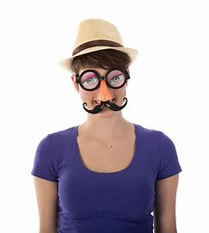
guide
guard
guess
guest
guilt
guitar
7. language
8. penguin
9. iguana
10. anguish
11. extinguish
12. distinguished
13. guarantee
14. lifeguard
15. disguise

Slide 18
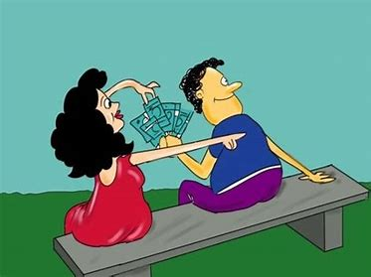
guide
guard
guess
guest
guilt
guitar
7. language
8. penguin
9. iguana
10. anguish
11. extinguish
12. distinguished
13. guarantee
14. lifeguard
15. disguise
16. beguile

Slide 19
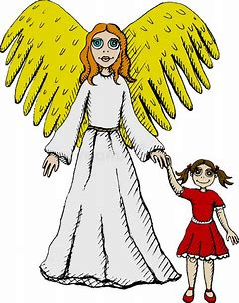
guide
guard
guess
guest
guilt
guitar
7. language
8. penguin
9. iguana
10. anguish
11. extinguish
12. distinguished
13. guarantee
14. lifeguard
15. disguise
16. beguile
17. guardian

Slide 20
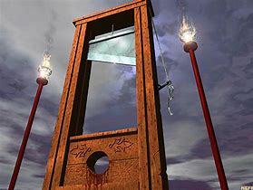
guide
guard
guess
guest
guilt
guitar
7. language
8. penguin
9. iguana
10. anguish
11. extinguish
12. distinguished
13. guarantee
14. lifeguard
15. disguise
16. beguile
17. guardian
18. guillotine

Slide 21
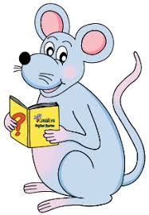
Let’s revise
Sentences and Phrases.

Slide 22
Sentence ・must make sense
・start with a capital letter
・contain a subject and verb
・end in a full stop, question
mark, or exclamation mark

Slide 23
Sentence ・must make sense
・start with a capital letter
・contain a subject and verb
・end in a full stop, question
mark, or exclamation mark
Phrase ・group of words
・make sense
・no subject & verb

Slide 24
Let’s revise
Noun phrases and prepositional phrases.

Slide 25
The big blue ball landed
in the muddy puddle.

Slide 26
The big blue ball landed
in the muddy puddle.

Slide 27
The big blue ball landed
in the muddy puddle.
noun phrase

Slide 28
The big blue ball landed
in the muddy puddle.
noun phrase
prepositional phrase

Slide 29
The big blue ball landed
in the muddy puddle.
noun phrase
prepositional phrase
(often acts as adverbs)

Slide 30
at the drop of a hat

Slide 31
at the drop of a hat

Slide 32
Dan is happy to go swimming
at the drop of a hat.

Slide 33
Dan is happy to go swimming
at the drop of a hat.
Dan is waiting for someone to drop a hat before he can go swimming.

Slide 34
Dan is happy to go swimming
at the drop of a hat.
Dan is waiting for someone to drop a hat before he can go swimming.

Slide 35
Dan is happy to go swimming
at the drop of a hat.
Dan is waiting for someone to drop a hat before he can go swimming.
Dan loves swimming so much that he will go immediately, given the chance.

Slide 36
Dan is happy to go swimming
at the drop of a hat.
Dan is waiting for someone to drop a hat before he can go swimming.
Dan loves swimming so much that he will go immediately, given the chance.
idiom

Slide 37
Idioms
Phrases or expressions that are used to describe something in a lively, vivid way.
They have special meaning that is not conveyed by the actual words used, but they have figurative meaning that is different to the literal meaning.

Slide 38
Idioms
Phrases or expressions that are used to describe something in a lively, vivid way.
They have special meaning that is not conveyed by the actual words used, but they have figurative meaning that is different to the literal meaning.

Slide 39
in a nutshell
in the doghouse
to lend a hand
to play it by ear
to pull your leg
to rain cats and dogs
to rock the boat
Idioms
pain in the neck
a tall story
to beat about the bush
by the skin of your teeth
to cost an arm and a leg
down in the dumps
to get cold feet
to have a bee in your bonnet

Slide 40
Idioms

Slide 41
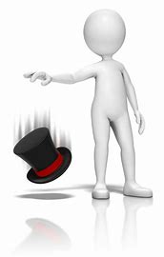
at a drop of a hat
immediately/
without delay

Slide 42
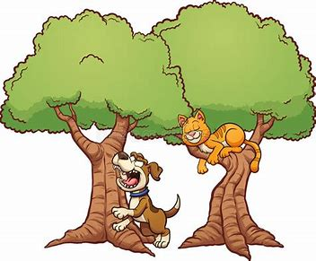
to bark up the wrong tree
to be mistaken

Slide 43
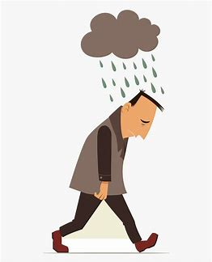
under the weather
unwell, sad,
lack of energy

Slide 44
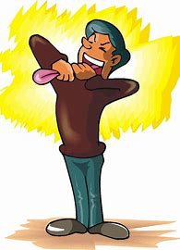
to hold your tongue
to keep quiet

Slide 45
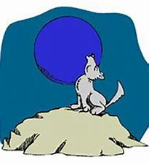
once in a blue moon
very rarely
not very often

Slide 46
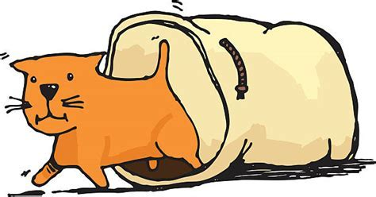
to let the cat out of the bag
to reveal someone’s secret

Slide 47
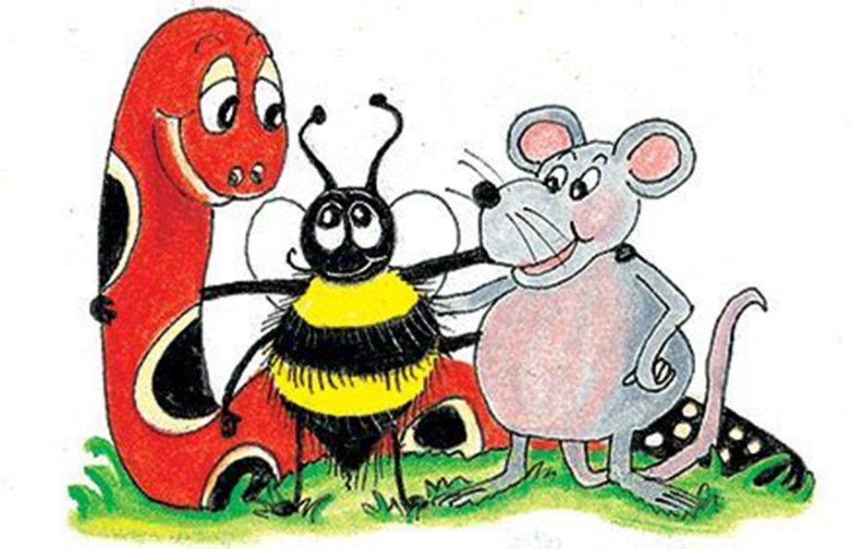
tickled pink:
out of the blue:
hold your horses:
in hot water:
a piece of cake:
in the dark:
Name:
Jolly Grammar 6b-12 Idioms

Slide 48
See you
next time!

