Slide 1
Jolly Grammar
6b-7

Slide 2
pneumonia
psalm
receipt
psyche
prompt
pneumatic
pseudo
ptarmigan

Slide 3
Activity Page:
<ui> and <u> for the /i/ Sound

Slide 4
Spelling List

Slide 5
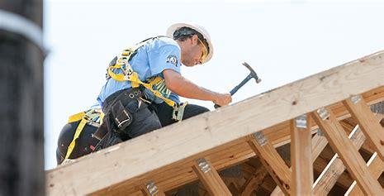
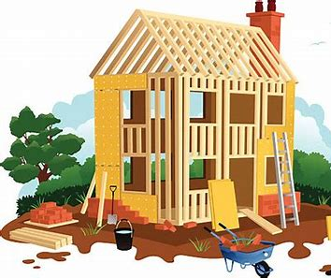
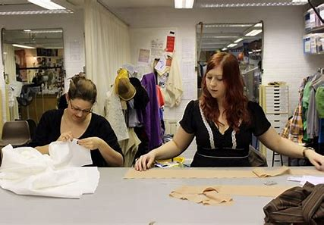
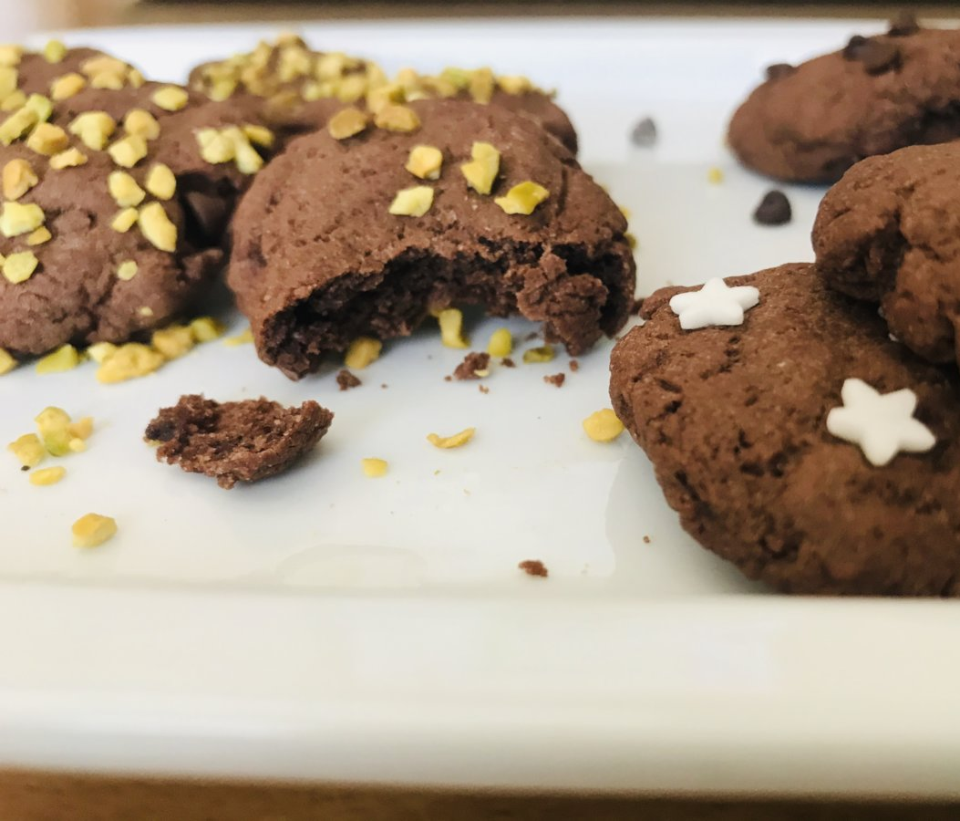
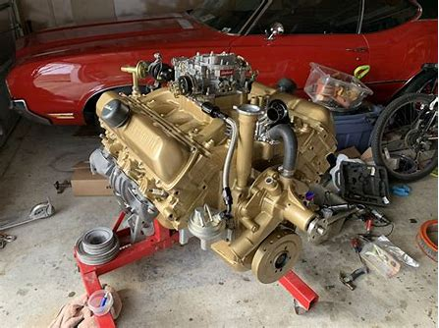
build built busy
busily biscuit rebuilt

Slide 6
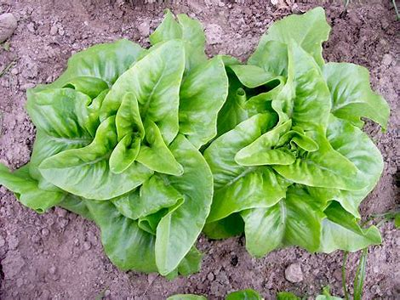
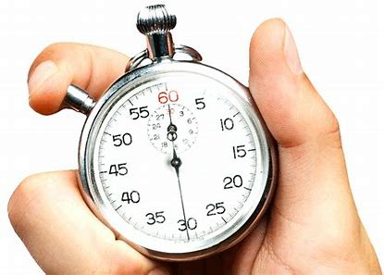
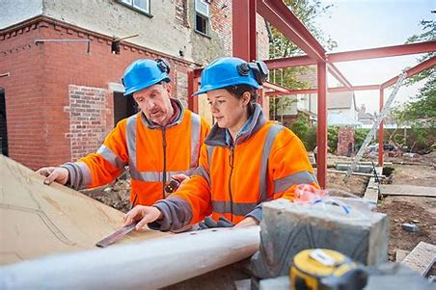
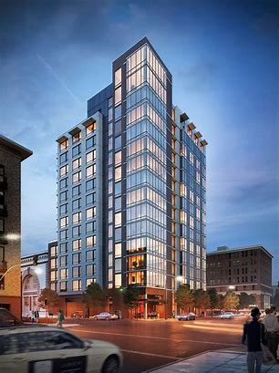
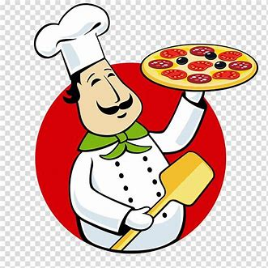
lettuce minute builder
building cuisine business

Slide 7
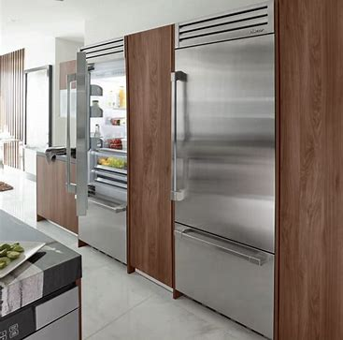
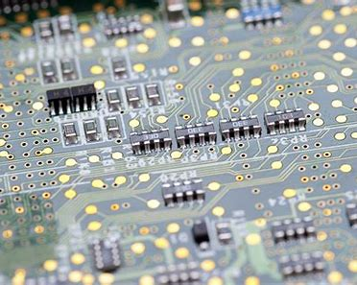
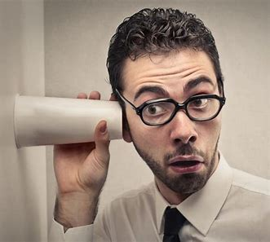
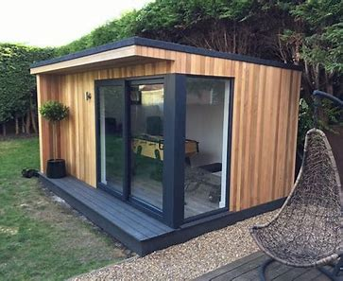
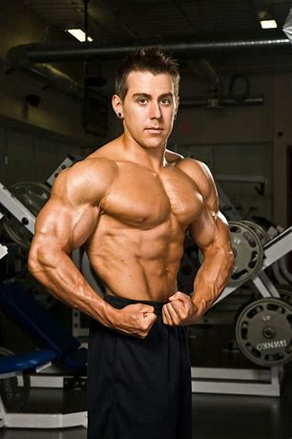
built-in circuit busybody
businesslike outbuilding bodybuilder

Slide 9
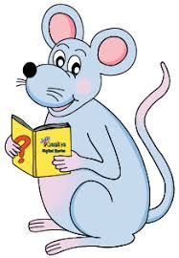
Find the words in the spelling list.

Slide 10
‘Busy’ related words

Slide 11
busily
business
busybody
businesslike

Slide 12
Write the comparative and superlative.

Slide 13
Comparative
Superlative
busy
straight
subtle
numb
great
feisty
weird
prompt
handsome

Slide 14
Comparative
busier
Superlative
busiest
busy
straight
subtle
numb
great
feisty
weird
prompt
handsome

Slide 15
Comparative
busier
straighter
Superlative
busiest
straightest
busy
straight
subtle
numb
great
feisty
weird
prompt
handsome

Slide 16
Comparative
busier
straighter
subtler
Superlative
busiest
straightest
subtlest
busy
straight
subtle
numb
great
feisty
weird
prompt
handsome

Slide 17
Comparative
busier
straighter
subtler
number
Superlative
busiest
straightest
subtlest
numbest
busy
straight
subtle
numb
great
feisty
weird
prompt
handsome

Slide 18
Comparative
busier
straighter
subtler
number
greater
Superlative
busiest
straightest
subtlest
numbest
greatest
busy
straight
subtle
numb
great
feisty
weird
prompt
handsome

Slide 19
Comparative
busier
straighter
subtler
number
greater
feistier
Superlative
busiest
straightest
subtlest
numbest
greatest
feistiest
busy
straight
subtle
numb
great
feisty
weird
prompt
handsome

Slide 20
Comparative
busier
straighter
subtler
number
greater
feistier
weirder
Superlative
busiest
straightest
subtlest
numbest
greatest
feistiest
weirdest
busy
straight
subtle
numb
great
feisty
weird
prompt
handsome

Slide 21
Comparative
busier
straighter
subtler
number
greater
feistier
weirder
prompter
Superlative
busiest
straightest
subtlest
numbest
greatest
feistiest
weirdest
promptest
busy
straight
subtle
numb
great
feisty
weird
prompt
handsome

Slide 22
Comparative
busier
straighter
subtler
number
greater
feistier
weirder
prompter
handsomer
Superlative
busiest
straightest
subtlest
numbest
greatest
feistiest
weirdest
promptest
handsomest
busy
straight
subtle
numb
great
feisty
weird
prompt
handsome

Slide 23
Parsing and completing the wall.

Slide 24
The ancient buildings were built
(in the twelfth century).
Subject
buildings
The ancient
Verb
were built
in the twelfth century
Object
(passive)

Slide 25
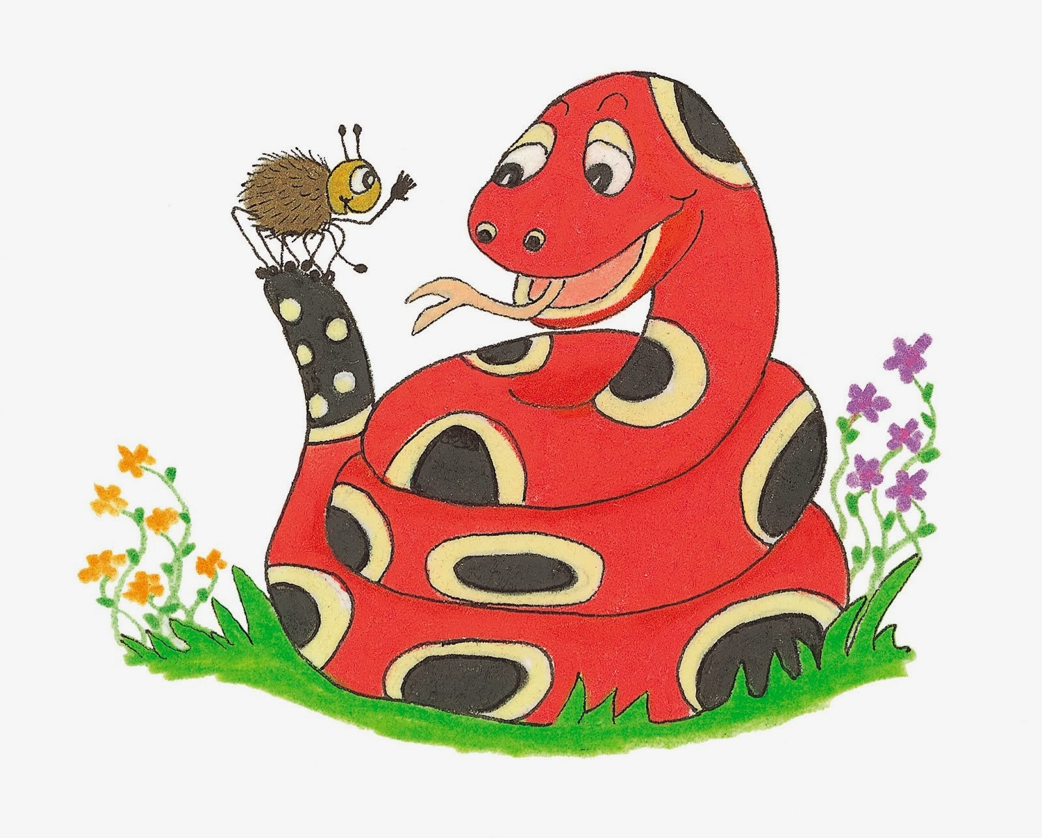
Dictation

Slide 26
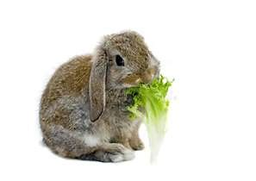

Slide 27
The rabbit was busily munching a juicy lettuce.

Slide 29
The bodybuilder was flexing his huge muscles.

Slide 30
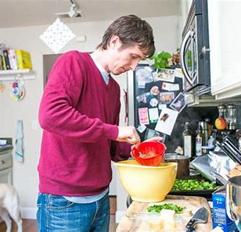

Slide 31
“The biscuits will be ready in five minutes,” said Dad.

Slide 32
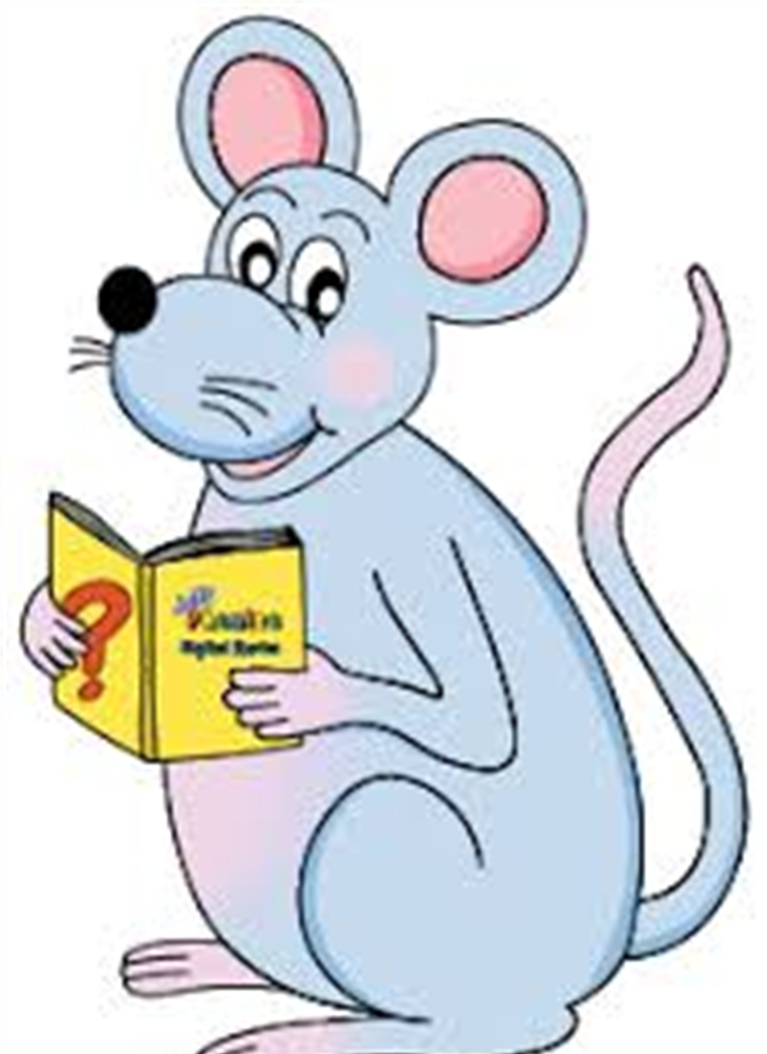
Assignment
Learn Words in the List

Slide 33
See you
next time!

