Slide 1
Jolly Grammar
6b-6

Slide 2
Spelling Test 21

Slide 3
psalm

Slide 4
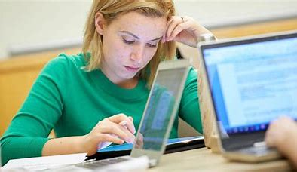
psalm
psyche

Slide 5
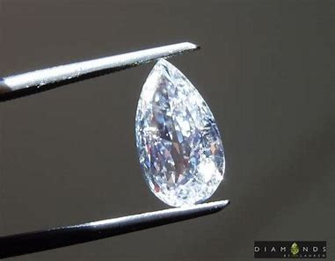
psalm
psyche
pseudo

Slide 6
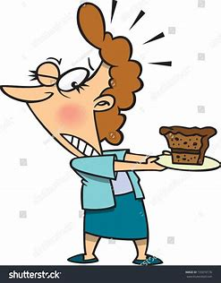
psalm
psyche
pseudo
tempt

Slide 7
psalm
psyche
pseudo
tempt
prompt

Slide 8
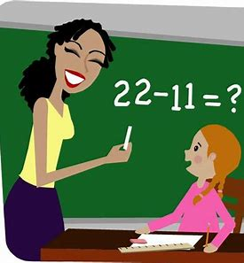
psalm
psyche
pseudo
tempt
prompt
attempt

Slide 9
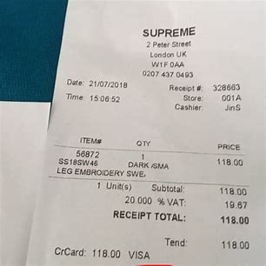
psalm
psyche
pseudo
tempt
prompt
attempt
7. receipt

Slide 10
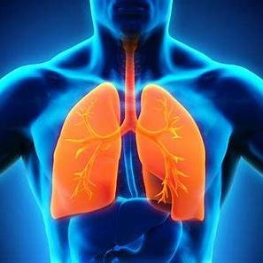
psalm
psyche
pseudo
tempt
prompt
attempt
7. receipt
8. pneumonia

Slide 11
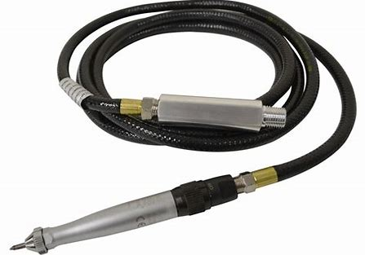
psalm
psyche
pseudo
tempt
prompt
attempt
7. receipt
8. pneumonia
9. pneumatic

Slide 12
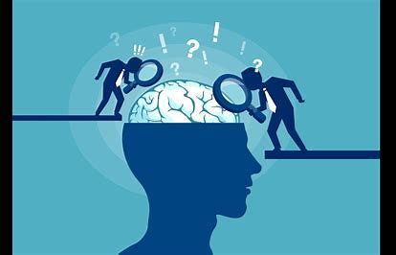
psalm
psyche
pseudo
tempt
prompt
attempt
7. receipt
8. pneumonia
9. pneumatic
10. psychiatry

Slide 13
psalm
psyche
pseudo
tempt
prompt
attempt
7. receipt
8. pneumonia
9. pneumatic
10. psychiatry
11. psychology

Slide 14
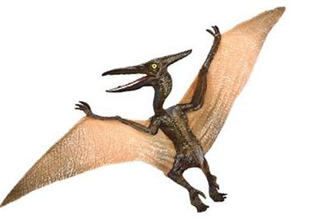
psalm
psyche
pseudo
tempt
prompt
attempt
7. receipt
8. pneumonia
9. pneumatic
10. psychiatry
11. psychology
12. pterodactyl

Slide 15
psalm
psyche
pseudo
tempt
prompt
attempt
7. receipt
8. pneumonia
9. pneumatic
10. psychiatry
11. psychology
12. pterodactyl
13. psychiatrist

Slide 16
psalm
psyche
pseudo
tempt
prompt
attempt
7. receipt
8. pneumonia
9. pneumatic
10. psychiatry
11. psychology
12. pterodactyl
13. psychiatrist
14. pseudonym

Slide 17
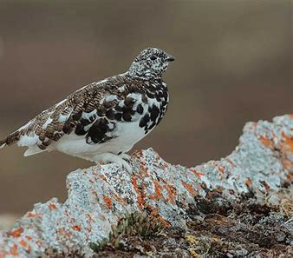
psalm
psyche
pseudo
tempt
prompt
attempt
7. receipt
8. pneumonia
9. pneumatic
10. psychiatry
11. psychology
12. pterodactyl
13. psychiatrist
14. pseudonym
15. ptarmigan

Slide 18
psalm
psyche
pseudo
tempt
prompt
attempt
7. receipt
8. pneumonia
9. pneumatic
10. psychiatry
11. psychology
12. pterodactyl
13. psychiatrist
14. pseudonym
15. ptarmigan
16. psoriasis

Slide 19
psalm
psyche
pseudo
tempt
prompt
attempt
7. receipt
8. pneumonia
9. pneumatic
10. psychiatry
11. psychology
12. pterodactyl
13. psychiatrist
14. pseudonym
15. ptarmigan
16. psoriasis
17. psi

Slide 20
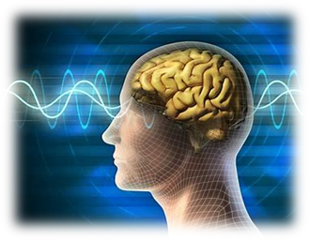
psalm
psyche
pseudo
tempt
prompt
attempt
7. receipt
8. pneumonia
9. pneumatic
10. psychiatry
11. psychology
12. pterodactyl
13. psychiatrist
14. pseudonym
15. ptarmigan
16. psoriasis
17. psi
18. psychological

Slide 21
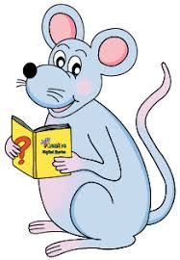
Let’s revise
Review Sentences.

Slide 22
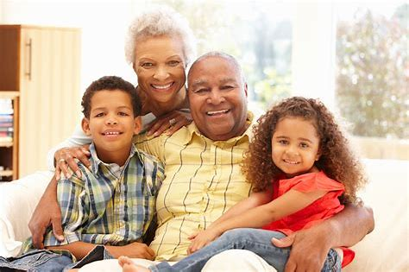
Granny and Grandpa sent their eldest
grandchildren cards and presents.

Slide 23
Granny and Grandpa sent their eldest
grandchildren cards and presents.

Slide 24
Granny and Grandpa sent their eldest
grandchildren cards and presents.

Slide 25
Granny and Grandpa sent their eldest
grandchildren cards and presents.

Slide 26
Granny and Grandpa sent their eldest
grandchildren cards and presents.

Slide 27
The cars were stolen
by the thieves last night.

Slide 28
The cars were stolen
by the thieves last night.

Slide 29
The cars were stolen
(by the thieves) last night.

Slide 30
The cars were stolen .

Slide 31
The cars were stolen
by the thieves last night.

Slide 32
Passive voice
The cars were stolen
by the thieves last night.

Slide 33
Passive voice
The cars were stolen
by the thieves last night.
The thieves stole
the cars last night.

Slide 34
Passive voice
The cars were stolen
by the thieves last night.
Active voice
The thieves stole
the cars last night.

Slide 35
Passive voice
The thieves have been arrested.
Our bikes were kept in the garage.
The cake was baked by Sue yesterday.
The fence will be painted today.

Slide 36
The thieves have been arrested.
Our bikes were kept in the garage.
The cake was baked by Sue yesterday.
The fence will be painted today.

Slide 37
The thieves have been arrested.
Our bikes were kept in the garage.
The cake was baked by Sue yesterday.
The fence will be painted today.

Slide 38
The thieves have been arrested.
Our bikes were kept in the garage.
The cake was baked by Sue yesterday.
The fence will be painted today.

Slide 39
The thieves have been arrested.
Our bikes were kept in the garage.
The cake was baked by Sue yesterday.
The fence will be painted today.

Slide 40
The thieves have been arrested.
Our bikes were kept in the garage.
The cake was baked by Sue yesterday.
The fence will be painted today.

Slide 41
The thieves have been arrested.
Our bikes were kept in the garage.
The cake was baked by Sue yesterday.
The fence will be painted today.

Slide 42
The thieves have been arrested.
Our bikes were kept in the garage.
The cake was baked by Sue yesterday.
The fence will be painted today.

Slide 43
The thieves have been arrested.
Our bikes were kept in the garage.
The cake was baked by Sue yesterday.
The fence will be painted today.

Slide 44
The thieves have been arrested.
Our bikes were kept in the garage.
The cake was baked by Sue yesterday.
The fence will be painted today.

Slide 45
The thieves have been arrested.
Our bikes were kept in the garage.
The cake was baked by Sue yesterday.
→Sue baked the cake yesterday. (active voice)
The fence will be painted today.

Slide 46
The Active and Passive Voice

Slide 47
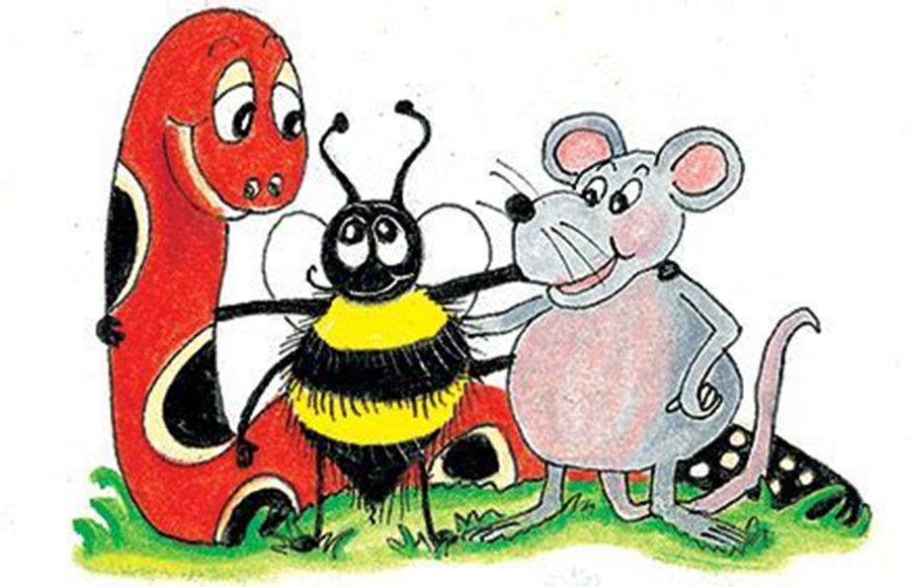

Slide 48
Are these sentences active or passive? Also, identify the verb and subject in each sentence.

Slide 50
See you
next time!

