Slide 1
Jolly Grammar
6b-5

Slide 2
climb
awesome
hymnbook
become
solemnly
crumb
overcome
comb

Slide 3
Activity Page:
/p/ Spellings

Slide 4
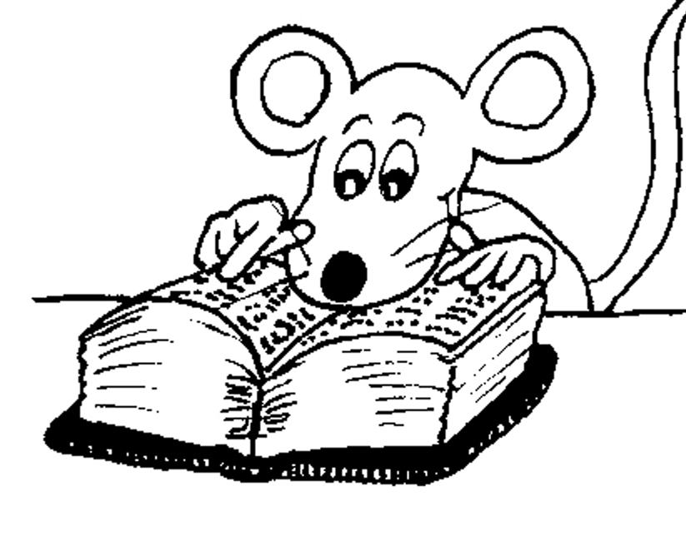
Spelling List

Slide 5
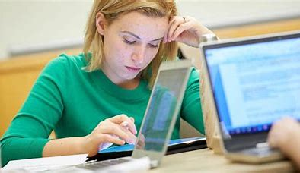
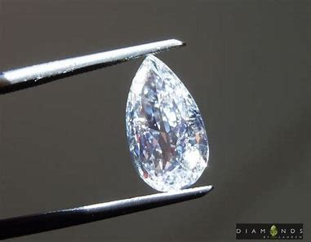
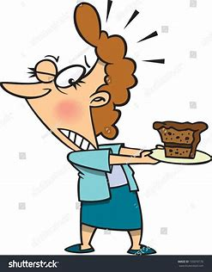
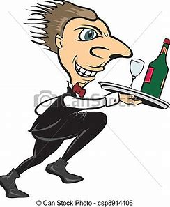
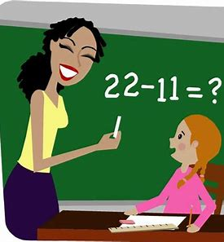
psalm psyche pseudo
tempt prompt attempt

Slide 6
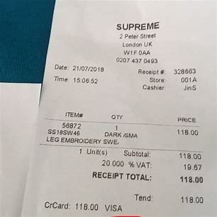
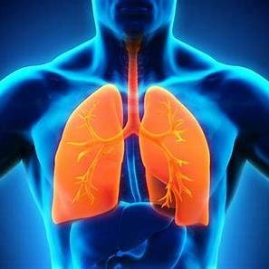
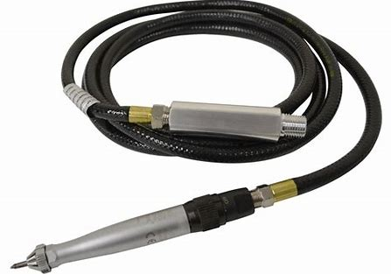
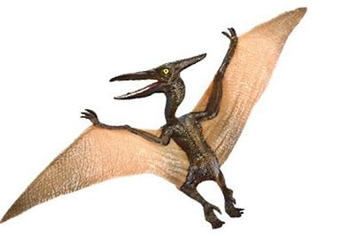
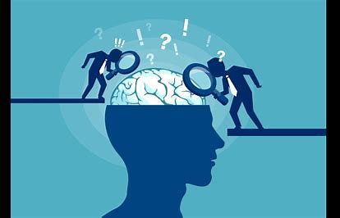
receipt pneumonia pneumatic
psychiatry psychology pterodactyl

Slide 7
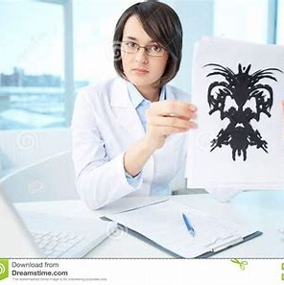
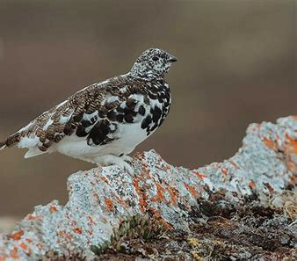
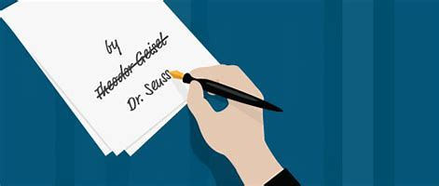
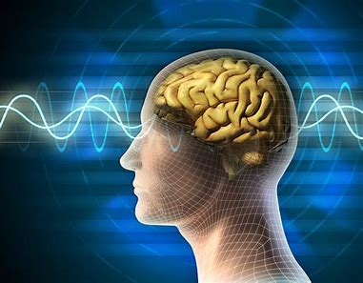
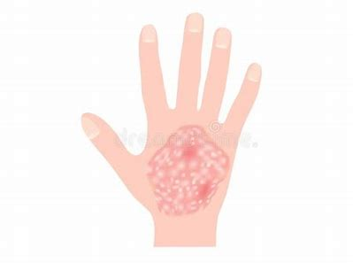
psychiatrist pseudonym ptarmigan
psoriasis psi psychological

Slide 9
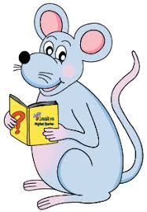
Put the words in alphabetical order.

Slide 10
How many words can you make?

Slide 11
psychological
logic physical
Laos local
pigs hog
chilly igloo
chill Lilo
school
caps
soy
solo
lip lips

Slide 12
Parsing and completing the wall.

Slide 13
The psoriasis (on the patient’s arm) looked rather sore.
Subject
psoriasis
The
Verb
looked/sore(rather)
on the patient’s arm
Object
(linking)

Slide 14
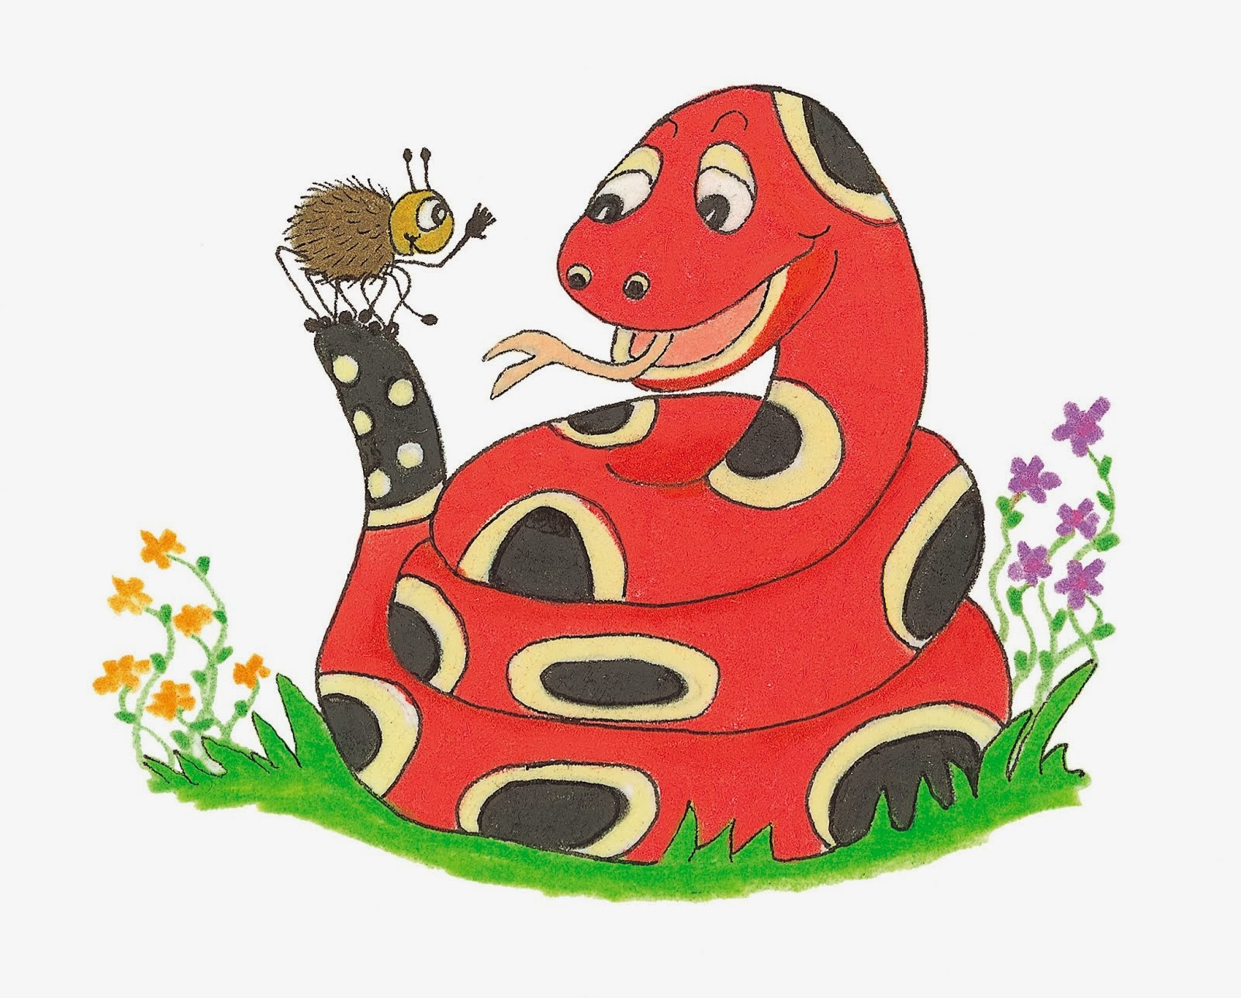
Dictation

Slide 15
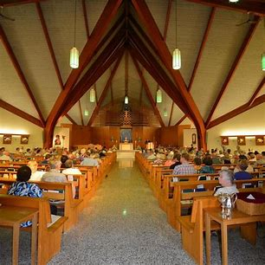
“A psalm is a hymn of praise,” explained Miss Beech.

Slide 17
The psychiatrist will attempt some psychological tests.

Slide 18
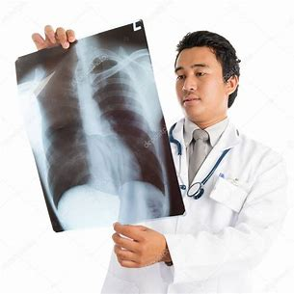

Slide 19
The doctor had some doubts that the man had pneumonia.

Slide 20
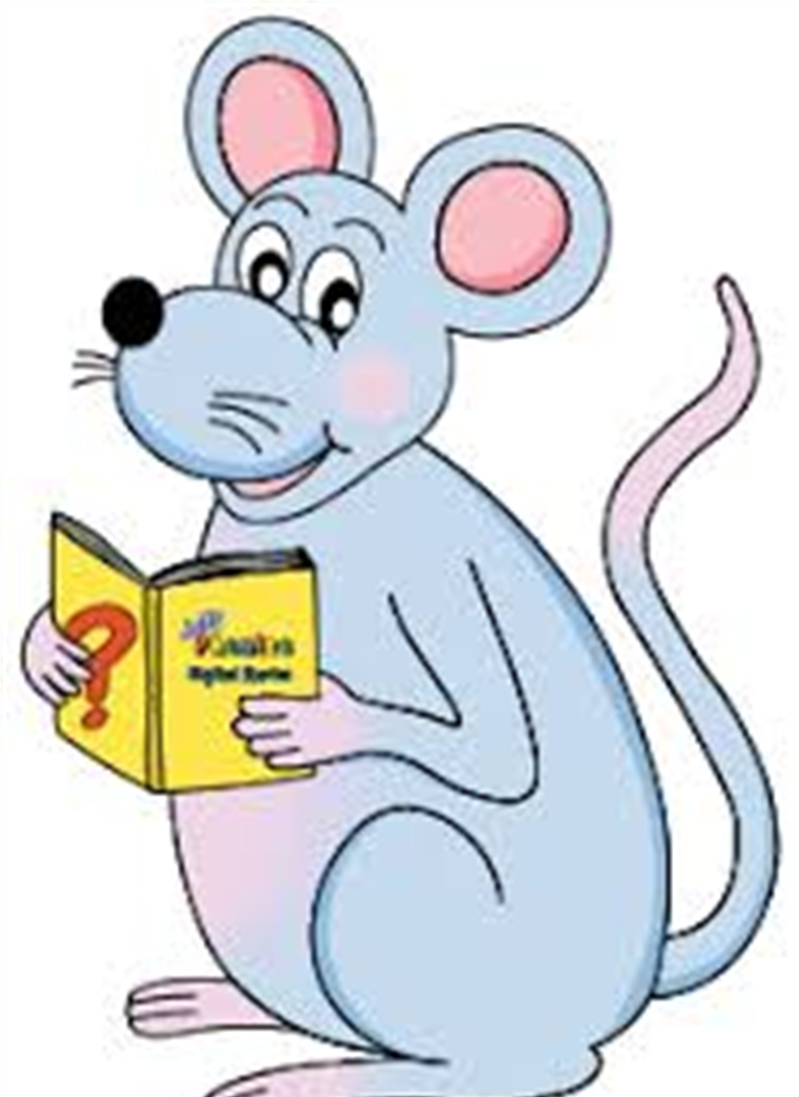
Assignment
Learn Words in the List

Slide 21
See you
next time!

