Slide 1
Jolly Grammar
6b-4

Slide 2
Spelling Test 20

Slide 3
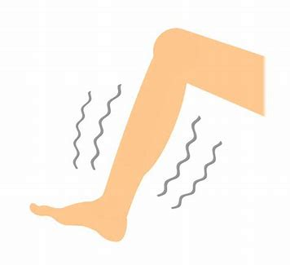
numb

Slide 4
numb
bomb

Slide 5
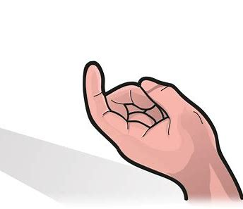
numb
bomb
come

Slide 6
numb
bomb
come
some

Slide 7
numb
bomb
come
some
hymn

Slide 8
numb
bomb
come
some
hymn
autumn

Slide 9
numb
bomb
come
some
hymn
autumn
7. welcome

Slide 10
numb
bomb
come
some
hymn
autumn
7. welcome
8. column

Slide 11
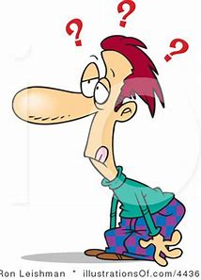
numb
bomb
come
some
hymn
autumn
7. welcome
8. column
9. dumb

Slide 12
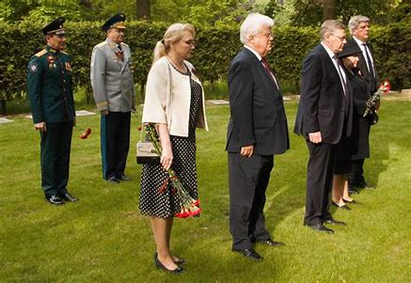
numb
bomb
come
some
hymn
autumn
7. welcome
8. column
9. dumb
10. solemn

Slide 13
numb
bomb
come
some
hymn
autumn
7. welcome
8. column
9. dumb
10. solemn
11. condemn

Slide 14
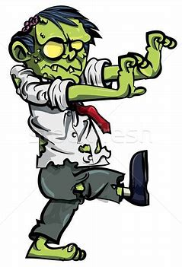
numb
bomb
come
some
hymn
autumn
7. welcome
8. column
9. dumb
10. solemn
11. condemn
12. gruesome

Slide 15
numb
bomb
come
some
hymn
autumn
7. welcome
8. column
9. dumb
10. solemn
11. condemn
12. gruesome
13. income

Slide 16
numb
bomb
come
some
hymn
autumn
7. welcome
8. column
9. dumb
10. solemn
11. condemn
12. gruesome
13. income
14. outcome

Slide 17
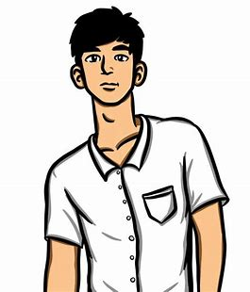
numb
bomb
come
some
hymn
autumn
7. welcome
8. column
9. dumb
10. solemn
11. condemn
12. gruesome
13. income
14. outcome
15. handsome

Slide 18
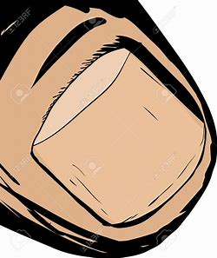
numb
bomb
come
some
hymn
autumn
7. welcome
8. column
9. dumb
10. solemn
11. condemn
12. gruesome
13. income
14. outcome
15. handsome
16. thumbnail

Slide 19
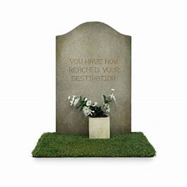
numb
bomb
come
some
hymn
autumn
7. welcome
8. column
9. dumb
10. solemn
11. condemn
12. gruesome
13. income
14. outcome
15. handsome
16. thumbnail
17. tombstone

Slide 20
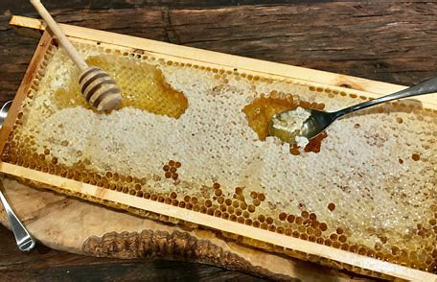
numb
bomb
come
some
hymn
autumn
7. welcome
8. column
9. dumb
10. solemn
11. condemn
12. gruesome
13. income
14. outcome
15. handsome
16. thumbnail
17. tombstone
18. honeycomb

Slide 21
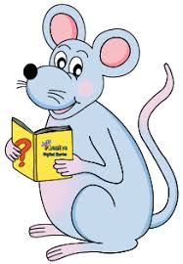
Let’s revise
Present participles
And
Past participles.

Slide 22
Present participle
Past participle
climb
paste
slip
play
hurry
fry
boil
ring
fall
break
freeze
tear
steal

Slide 23
Present participle
climbing
pasting
slipping
playing
hurrying
frying
boiling
ringing
falling
breaking
freezing
tearing
stealing
climb
paste
slip
play
hurry
fry
boil
ring
fall
break
freeze
tear
steal

Slide 24
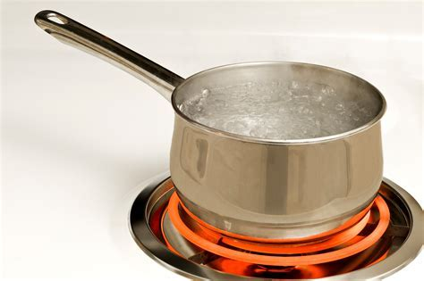
Present participle
climbing
pasting
slipping
playing
hurrying
frying
boiling
ringing
falling
breaking
freezing
tearing
stealing
climb
paste
slip
play
hurry
fry
boil
ring
fall
break
freeze
tear
steal
boiling water
falling leaves
freezing temperature

Slide 25
Past participle
climbed
pasted
slipped
played
hurried
fried
boiled
rung
fallen
broken
frozen
torn
stolen
climb
paste
slip
play
hurry
fry
boil
ring
fall
break
freeze
tear
steal

Slide 26
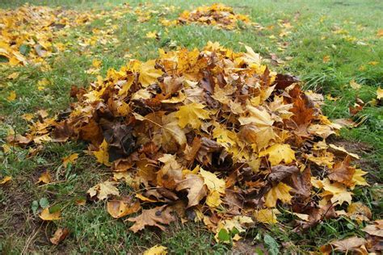
Past participle
climbed
pasted
slipped
played
hurried
fried
boiled
rung
fallen
broken
frozen
torn
stolen
climb
paste
slip
play
hurry
fry
boil
ring
fall
break
freeze
tear
steal
piles of fallen leaves
two sliced onions
stolen cars

Slide 27
Present participle
climbing
pasting
slipping
playing
hurrying
frying
boiling
ringing
falling
breaking
freezing
tearing
stealing
Past participle
climbed
pasted
slipped
played
hurried
fried
boiled
rung
fallen
broken
frozen
torn
stolen
climb
paste
slip
play
hurry
fry
boil
ring
fall
break
freeze
tear
steal

Slide 28
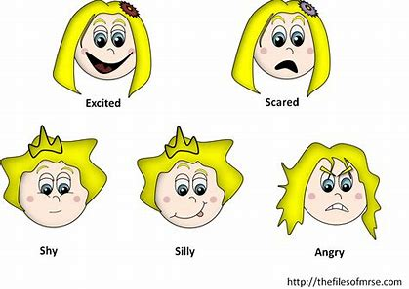
Present participle
boring
interesting
frightening
Past participle
bored
interested
frightened
bore
Interest
frighten
feelings

Slide 29
Past Participles as Adjectives

Slide 30
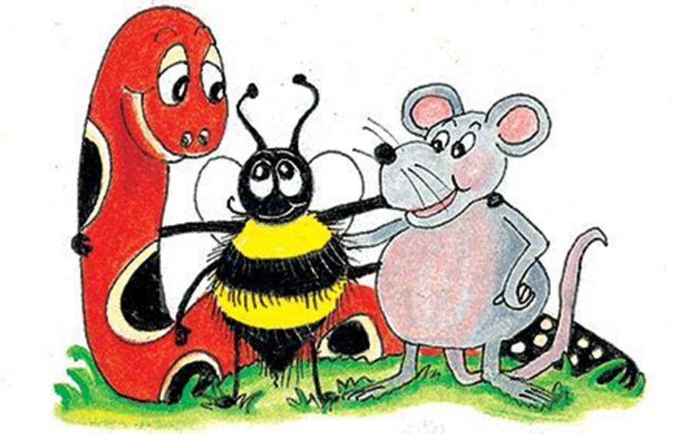
to break to fry to freeze to tear to boil to steal

Slide 31
to break to fry to freeze to tear to boil to steal
broken

Slide 32
to break to fry to freeze to tear to boil to steal
broken fried

Slide 33
to break to fry to freeze to tear to boil to steal
broken fried frozen

Slide 34
to break to fry to freeze to tear to boil to steal
broken fried frozen torn

Slide 35
to break to fry to freeze to tear to boil to steal
broken fried frozen torn boiled

Slide 36
to break to fry to freeze to tear to boil to steal
broken fried frozen torn boiled stolen

Slide 37
Complete the sentences and
underline adjectives in blue.

Slide 38
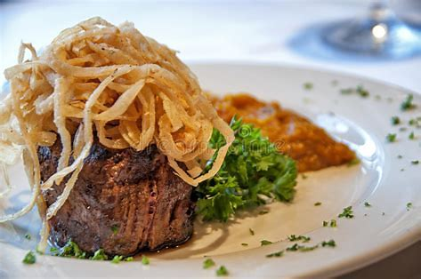
He likes onions with his steak.

Slide 39
He likes fried onions with his steak.

Slide 40
One of my mother’s shoes has
a heel.

Slide 41
One of my mother’s shoes has
a broken heel.

Slide 42
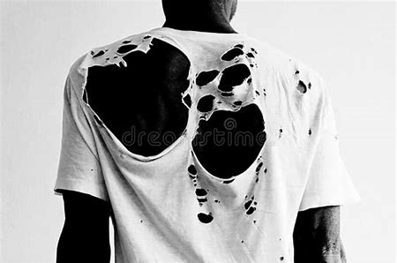
Could you mend my shirt
right away?

Slide 43
Could you mend my torn shirt
right away?

Slide 44
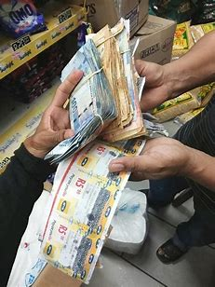
There is not doubt that
the thieves hid the money.

Slide 45
There is not doubt that
the thieves hid the stolen money.

Slide 46
There is not doubt that
the thieves hid the stolen money.

Slide 47
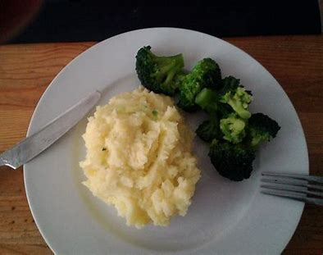
Dad mashed the potatoes
and cooked some broccoli.

Slide 48
Dad mashed the boiled potatoes
and cooked some broccoli.

Slide 49
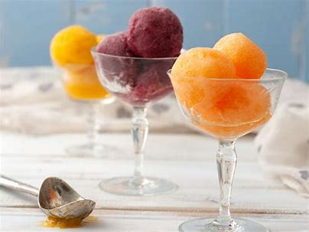
Sorbet is a dessert made from fruit juice, sugar and water.

Slide 50
Sorbet is a frozen dessert made from fruit juice, sugar and water.

Slide 51
What nouns could these past participles be describing?

Slide 52
the closed
an abandoned
a knitted
the chopped
the melted
the cracked
the wrinkled
the folded

Slide 53
the closed window
an abandoned
a knitted
the chopped
the melted
the cracked
the wrinkled
the folded

Slide 54
the closed window
an abandoned shoes
a knitted
the chopped
the melted
the cracked
the wrinkled
the folded

Slide 55
the closed window
an abandoned shoes
a knitted dress
the chopped
the melted
the cracked
the wrinkled
the folded

Slide 56
the closed window
an abandoned shoes
a knitted dress
the chopped pork
the melted
the cracked
the wrinkled
the folded

Slide 57
the closed window
an abandoned shoes
a knitted dress
the chopped pork
the melted ice
the cracked
the wrinkled
the folded

Slide 58
the closed window
an abandoned shoes
a knitted dress
the chopped pork
the melted ice
the cracked ceiling
the wrinkled
the folded

Slide 59
the closed window
an abandoned shoes
a knitted dress
the chopped pork
the melted ice
the cracked ceiling
the wrinkled shirt
the folded

Slide 60
the closed window
an abandoned shoes
a knitted dress
the chopped pork
the melted ice
the cracked ceiling
the wrinkled shirt
the folded blanket

Slide 61
The closed store will never open again.
The wrinkled dolphin dove into water.
Fried chicken is our favorite food.
I ate chopped bananas quietly.

Slide 62
See you
next time!

