Slide 1
Jolly Grammar
6b-3

Slide 2
doubt
yacht
paste
subtle
palette
suite
brunette
thyme

Slide 3
Activity Page:
/m/ Spellings

Slide 4
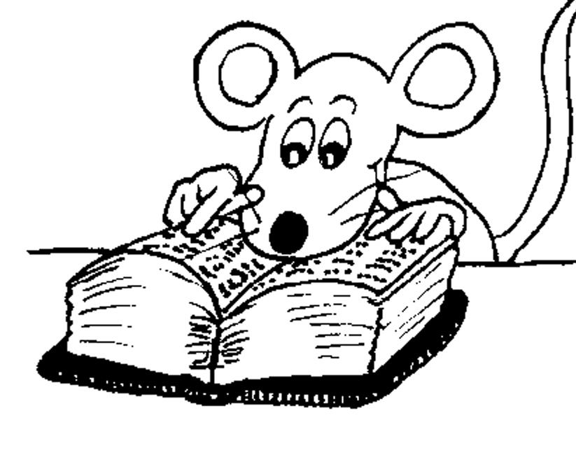
Spelling List

Slide 5
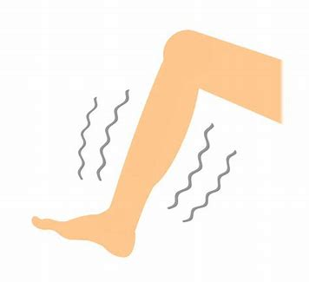
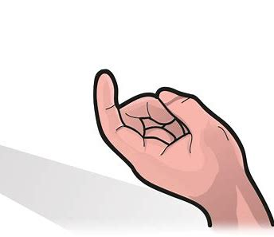
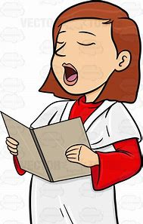
numb bomb come
some hymn autumn

Slide 6
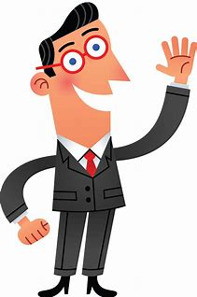
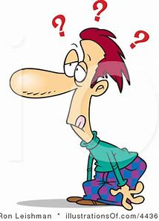
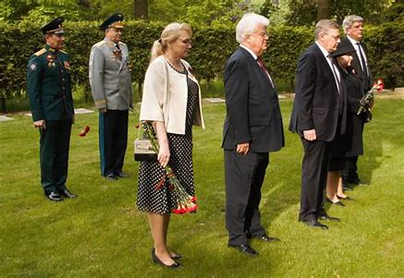
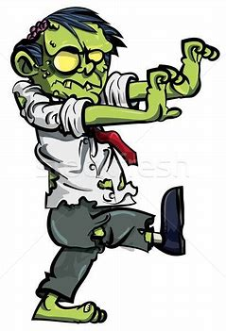
welcome column dumb
solemn condemn gruesome

Slide 7
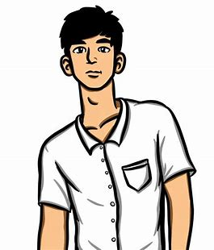
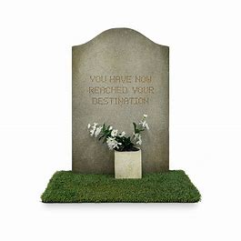
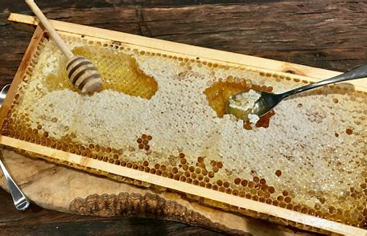
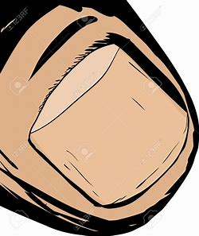
income outcome handsome
thumbnail tombstone honeycomb

Slide 9
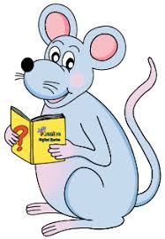
Find the compound words.

Slide 11
in
come
out
come
thumb
nail
tomb
stone
honey
comb

Slide 12
Think of an antonym and a synonym for each word.

Slide 13
antonym synonym
gruesome
doubt
great
welcome
come
accurate
solemn
handsome
: pleasant
:
:
:
:
:
:
:
: hideous
:
:
:
:
:
:
:

Slide 14
antonym synonym
gruesome
doubt
great
welcome
come
accurate
solemn
handsome
: pleasant
: trust
:
:
:
:
:
:
: hideous
: suspect
:
:
:
:
:
:

Slide 15
antonym synonym
gruesome
doubt
great
welcome
come
accurate
solemn
handsome
: pleasant
: trust
: tiny
:
:
:
:
:
: hideous
: suspect
: enormous
:
:
:
:
:

Slide 16
antonym synonym
gruesome
doubt
great
welcome
come
accurate
solemn
handsome
: pleasant
: trust
: tiny
: unpopular
:
:
:
:
: hideous
: suspect
: enormous
: encouraging
:
:
:
:

Slide 17
antonym synonym
gruesome
doubt
great
welcome
come
accurate
solemn
handsome
: pleasant
: trust
: tiny
: unpopular
: leave
:
:
:
: hideous
: suspect
: enormous
: encouraging
: reach
:
:
:

Slide 18
antonym synonym
gruesome
doubt
great
welcome
come
accurate
solemn
handsome
: pleasant
: trust
: tiny
: unpopular
: leave
: wrong
:
:
: hideous
: suspect
: enormous
: encouraging
: reach
: correct
:
:

Slide 19
antonym synonym
gruesome
doubt
great
welcome
come
accurate
solemn
handsome
: pleasant
: trust
: tiny
: unpopular
: leave
: wrong
: lively
:
: hideous
: suspect
: enormous
: encouraging
: reach
: correct
: serious
:

Slide 20
antonym synonym
gruesome
doubt
great
welcome
come
accurate
solemn
handsome
: pleasant
: trust
: tiny
: unpopular
: leave
: wrong
: lively
: ugly
: hideous
: suspect
: enormous
: encouraging
: reach
: correct
: serious
: attractive

Slide 21
Parsing and completing the wall.

Slide 22
The committee gave the musicians a courteous welcome.
Subject
committee
The
Verb
gave
Object
welcome
a courteous
musicians (the)
(action)

Slide 23
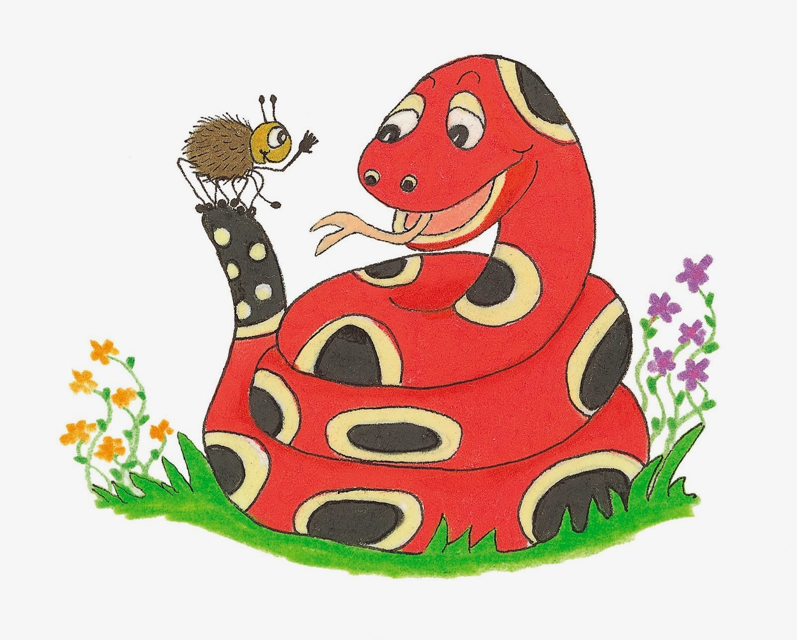
Dictation

Slide 24
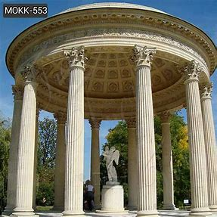

Slide 25
The Roman temple had handsome marble columns.

Slide 26
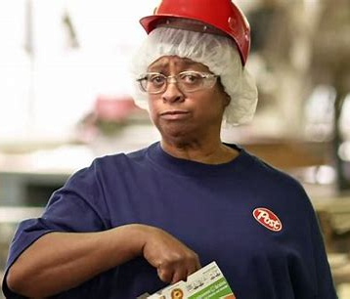
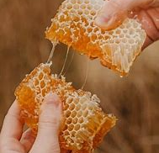

Slide 27
“Come and try some lovely honeycomb,” called the lady.

Slide 28
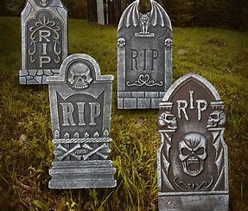
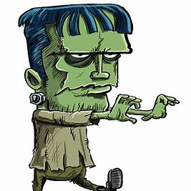
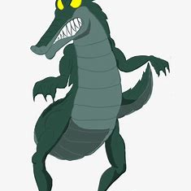
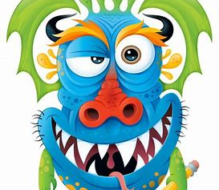

Slide 29
The gruesome monsters appeared among the tombstones.

Slide 30
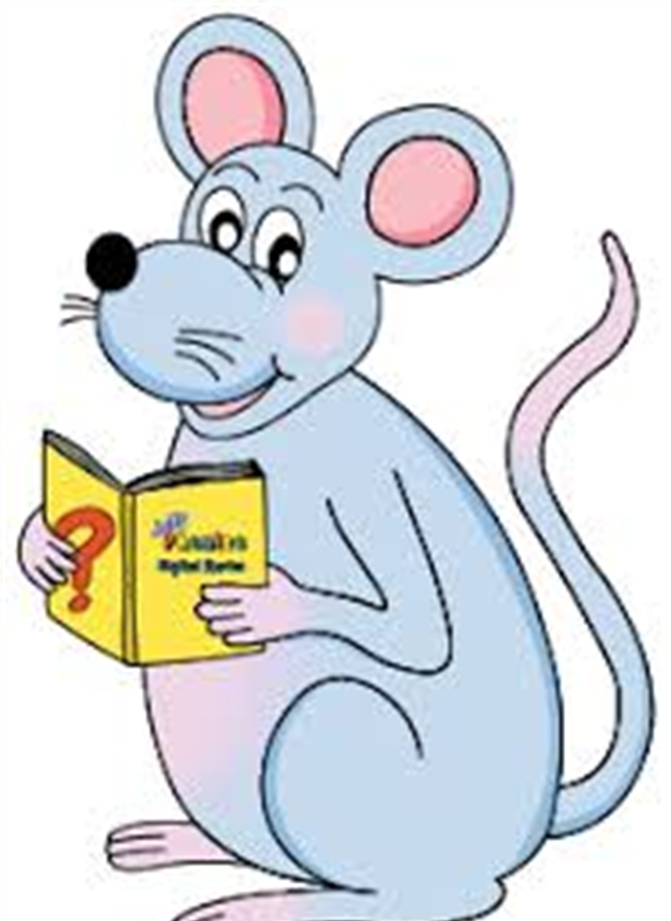
Assignment
Learn Words in the List

Slide 31
See you
next time!

