Slide 2
Spelling Test 19

Slide 3
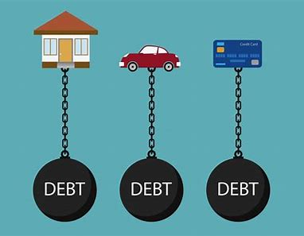
debt

Slide 4
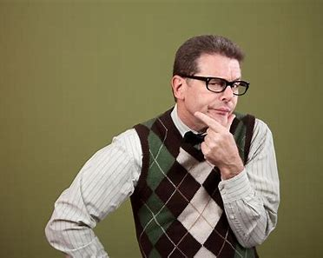
debt
doubt

Slide 5
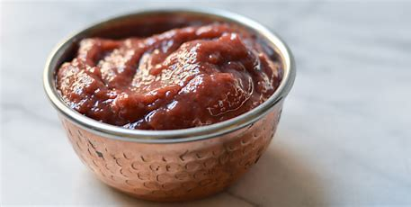
debt
doubt
paste

Slide 6
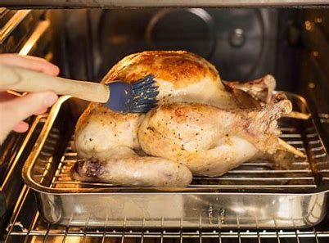
debt
doubt
paste
baste

Slide 7
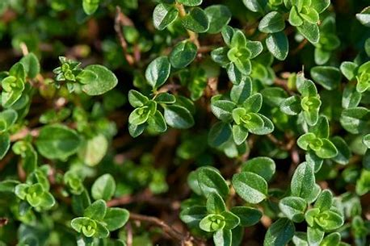
debt
doubt
paste
baste
thyme

Slide 8
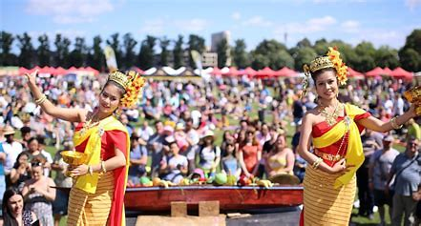
debt
doubt
paste
baste
thyme
Thailand

Slide 9
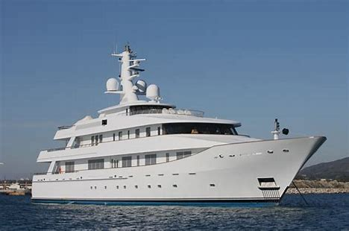
debt
doubt
paste
baste
thyme
Thailand
7. yacht

Slide 10
debt
doubt
paste
baste
thyme
Thailand
7. yacht
8. subtle

Slide 11
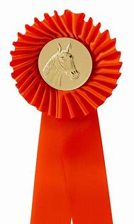
debt
doubt
paste
baste
thyme
Thailand
7. yacht
8. subtle
9. rosette

Slide 12
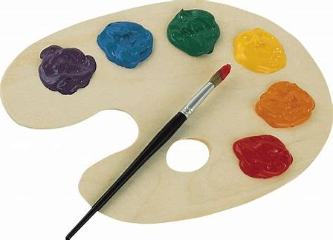
debt
doubt
paste
baste
thyme
Thailand
7. yacht
8. subtle
9. rosette
10. palette

Slide 13
debt
doubt
paste
baste
thyme
Thailand
7. yacht
8. subtle
9. rosette
10. palette
11. definite

Slide 14
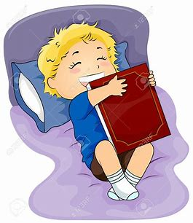
debt
doubt
paste
baste
thyme
Thailand
7. yacht
8. subtle
9. rosette
10. palette
11. definite
12. favourite

Slide 15
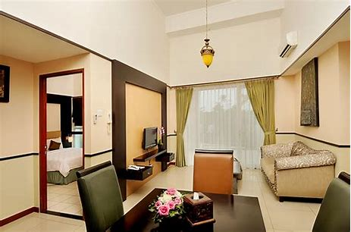
debt
doubt
paste
baste
thyme
Thailand
7. yacht
8. subtle
9. rosette
10. palette
11. definite
12. favourite
13. suite

Slide 16
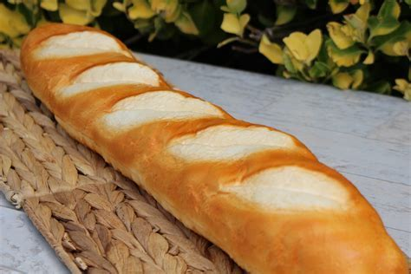
debt
doubt
paste
baste
thyme
Thailand
7. yacht
8. subtle
9. rosette
10. palette
11. definite
12. favourite
13. suite
14. baguette

Slide 17
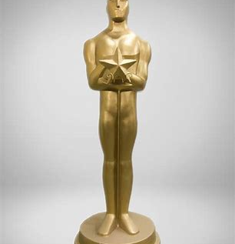
debt
doubt
paste
baste
thyme
Thailand
7. yacht
8. subtle
9. rosette
10. palette
11. definite
12. favourite
13. suite
14. baguette
15. statuette

Slide 18
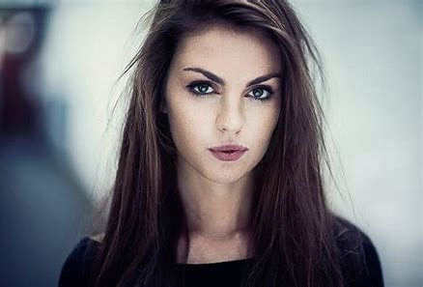
debt
doubt
paste
baste
thyme
Thailand
7. yacht
8. subtle
9. rosette
10. palette
11. definite
12. favourite
13. suite
14. baguette
15. statuette
16. brunette

Slide 19
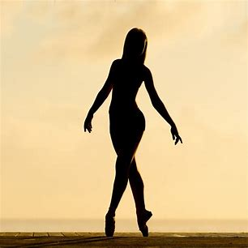
debt
doubt
paste
baste
thyme
Thailand
7. yacht
8. subtle
9. rosette
10. palette
11. definite
12. favourite
13. suite
14. baguette
15. statuette
16. brunette
17. silhouette

Slide 20
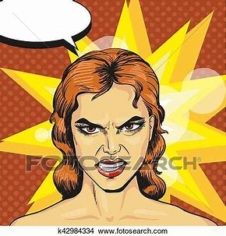
debt
doubt
paste
baste
thyme
Thailand
7. yacht
8. subtle
9. rosette
10. palette
11. definite
12. favourite
13. suite
14. baguette
15. statuette
16. brunette
17. silhouette
18. redoubtable

Slide 21
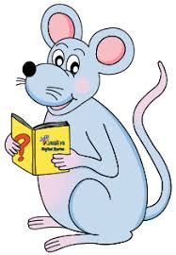
Let’s revise
adverbs.

Slide 22
loudly, here, today, sometimes

Slide 23
loudly, here, today, sometimes
definite article / noun / verb / adverb

Slide 24
loudly, here, today, sometimes
definite article / noun / verb / adverb
The baby is crying loudly.

Slide 25
loudly, here, today, sometimes
definite article / noun / verb / adverb
The family moved here.

Slide 26
loudly, here, today, sometimes
definite article / noun / verb / adverb
The sale ends today.

Slide 27
loudly, here, today, sometimes
definite article / noun / verb / adverb
The boys argue sometimes.

Slide 28
loudly, here, today, sometimes
definite article / noun / verb / adverb
The baby is crying loudly.
The family moved here.
The sale ends today.
The boys argue sometimes.

Slide 29
loudly, here, today, sometimes
definite article / noun / verb / adverb
The baby is crying loudly. how
The family moved here.
The sale ends today.
The boys argue sometimes.

Slide 30
loudly, here, today, sometimes
definite article / noun / verb / adverb
The baby is crying loudly. how
The family moved here. where
The sale ends today.
The boys argue sometimes.

Slide 31
loudly, here, today, sometimes
definite article / noun / verb / adverb
The baby is crying loudly. how
The family moved here. where
The sale ends today. when
The boys argue sometimes.

Slide 32
loudly, here, today, sometimes
definite article / noun / verb / adverb
The baby is crying loudly. how
The family moved here. where
The sale ends today. when
The boys argue sometimes. how often

Slide 33
loudly, here, today, sometimes
definite article / noun / verb / adverb
The baby is crying loudly. how
The family moved here. where
The sale ends today. when
The boys argue sometimes. how often
The plan had almost worked. how much

Slide 34
loudly, here, today, sometimes
definite article / noun / verb / adverb
The baby is crying loudly. how
The family moved here. where
The sale ends today. when
The boys argue sometimes. how often
The plan had almost worked. how much
really, very, too describes adverbs and adjectives

Slide 35
The family moved here.

Slide 36
The family moved here.

Slide 37
The family moved here.

Slide 38
The family moved here.

Slide 39
The family moved here.
in a hurry.

Slide 40
The family moved here.
in a hurry.
because the house
was too small.

Slide 41
The family moved here.
in a hurry.
because the house
was too small.
adverbials

Slide 42
The family moved here.
in a hurry.
because the house
was too small.
adverbials
Fronted adverbials
Because the house was too small, the family moved here.

Slide 43
Adverbials

Slide 44
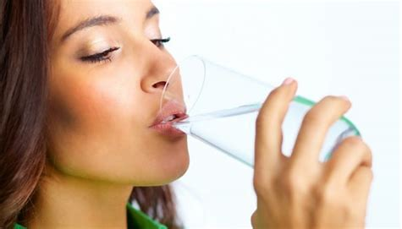
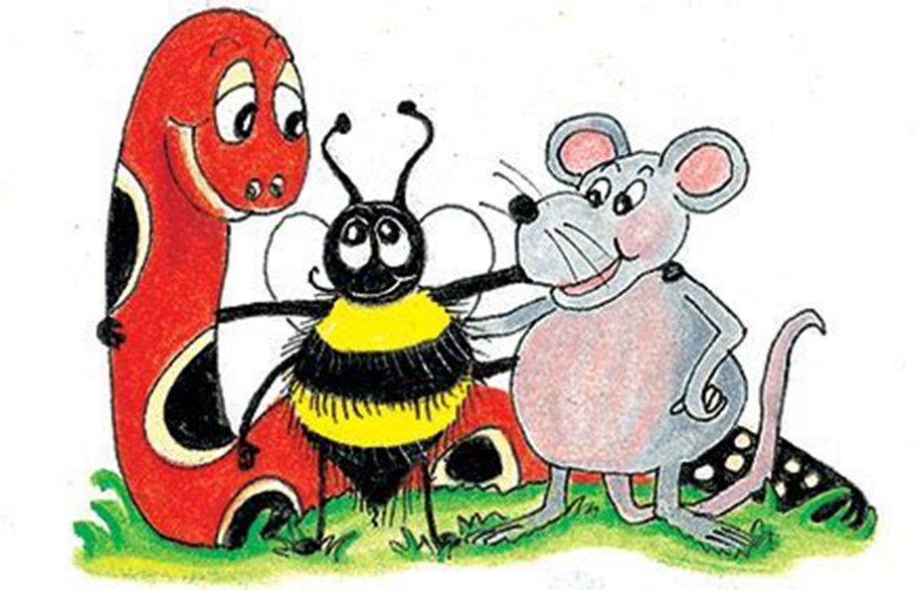
I drank water because I had hiccups.

Slide 45
I drank water because I had hiccups.
Why?

Slide 46
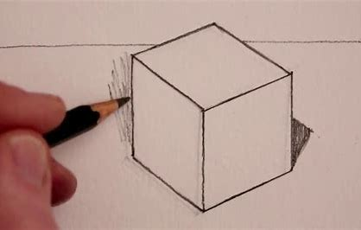
Tom carefully drew a square and a rhombus.

Slide 47
Tom carefully drew a square and a rhombus.
How?

Slide 48
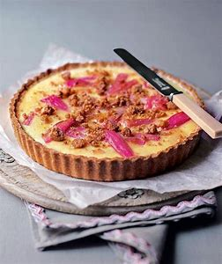
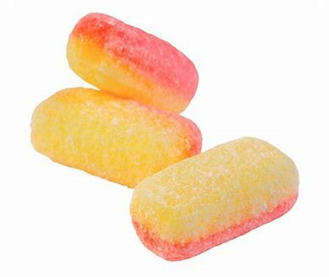
They had rhubarb and custard on Tuesday.

Slide 49
They had rhubarb and custard on Tuesday.
When?

Slide 50
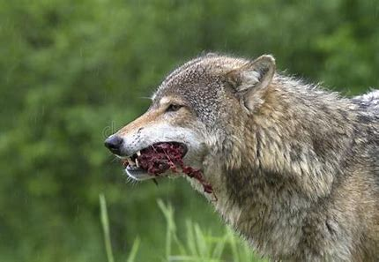
The hungry wolf hunted its prey in silence.

Slide 51
The hungry wolf hunted its prey in silence.
How?

Slide 52
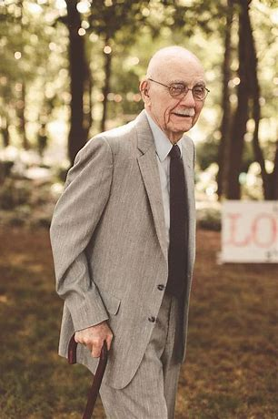
Grandpa wears his suit wherever he goes.

Slide 53
Grandpa wears his suit wherever he goes.
Where?

Slide 54
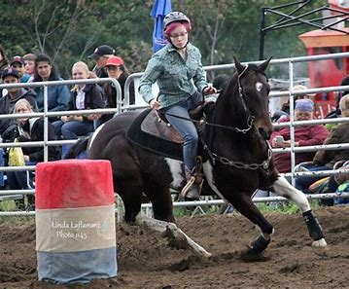
There will be a gymkhana next month.

Slide 55
There will be a gymkhana next month.
When?

Slide 56
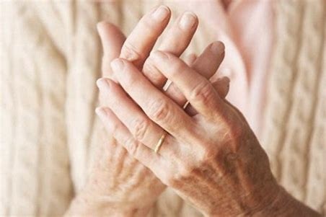
Grandma has rheumatism in her hands.

Slide 57
Grandma has rheumatism in her hands.
Where?

Slide 58
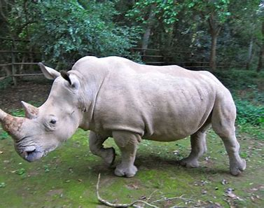
The zoo received a white rhino last year.

Slide 59
The zoo received a white rhino last year.
When?

Slide 60
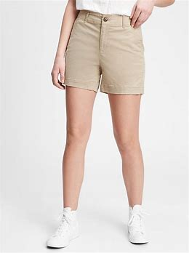
Anna wore her khaki shorts at the beach.

Slide 61
Anna wore her khaki shorts at the beach.
Where?

Slide 62
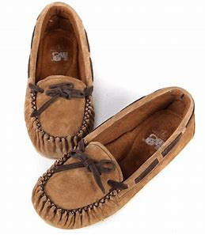
I got some new moccasins for my birthday.

Slide 63
I got some new moccasins for my birthday.
Why?

Slide 64
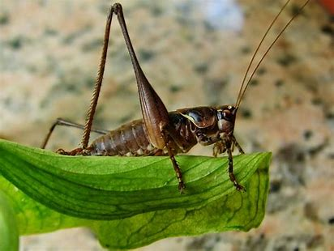
The little brown crickets chirped rhythmically.

Slide 65
The little brown crickets chirped rhythmically.
How?

Slide 66
We loved nursery rhymes when we were young.

Slide 67
We loved nursery rhymes when we were young.
When?

Slide 69
See you
next time!

