Slide 1
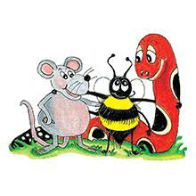
Jolly Grammar 3a-36

Slide 2
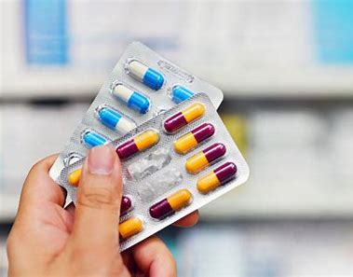
avoidable

Slide 3
avoidable
profitable

Slide 4
avoidable
profitable
available

Slide 5
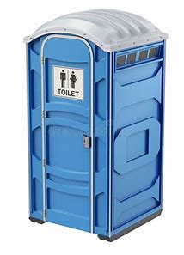
avoidable
profitable
available
portable

Slide 6
avoidable
profitable
available
portable
adaptable

Slide 7
avoidable
profitable
available
portable
adaptable
dependable

Slide 8
avoidable
profitable
available
portable
adaptable
dependable
7. breakable

Slide 9
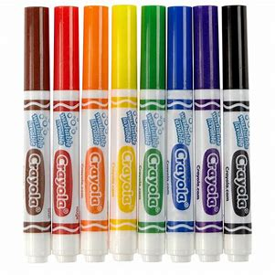
avoidable
profitable
available
portable
adaptable
dependable
7. breakable
8. usable

Slide 10
avoidable
profitable
available
portable
adaptable
dependable
7. breakable
8. usable
9. lovable

Slide 11
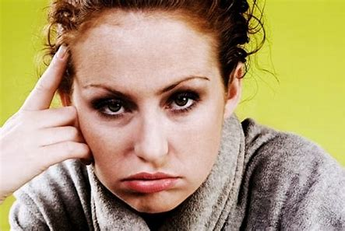
avoidable
profitable
available
portable
adaptable
dependable
7. breakable
8. usable
9. lovable
10. irritable

Slide 12
avoidable
profitable
available
portable
adaptable
dependable
7. breakable
8. usable
9. lovable
10. irritable
11. enjoyable

Slide 13
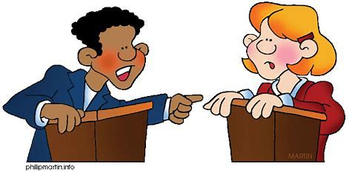
avoidable
profitable
available
portable
adaptable
dependable
7. breakable
8. usable
9. lovable
10. irritable
11. enjoyable
12. debatable

Slide 14
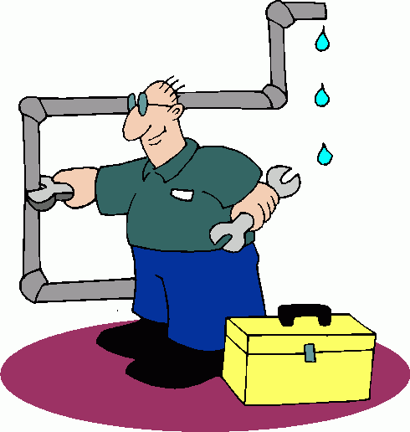
avoidable
profitable
available
portable
adaptable
dependable
7. breakable
8. usable
9. lovable
10. irritable
11. enjoyable
12. debatable
13. changeable

Slide 15
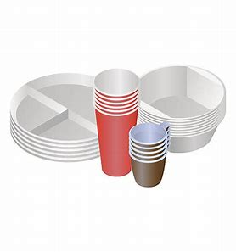
avoidable
profitable
available
portable
adaptable
dependable
7. breakable
8. usable
9. lovable
10. irritable
11. enjoyable
12. debatable
13. changeable
14. disposable

Slide 16
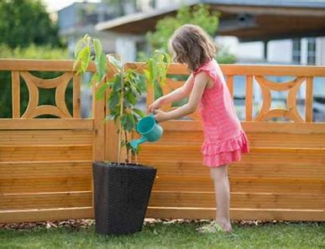
avoidable
profitable
available
portable
adaptable
dependable
7. breakable
8. usable
9. lovable
10. irritable
11. enjoyable
12. debatable
13. changeable
14. disposable
15. desirable

Slide 17
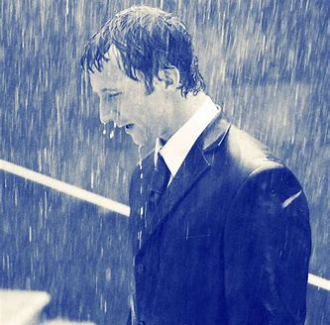
avoidable
profitable
available
portable
adaptable
dependable
7. breakable
8. usable
9. lovable
10. irritable
11. enjoyable
12. debatable
13. changeable
14. disposable
15. desirable
16. miserable

Slide 18
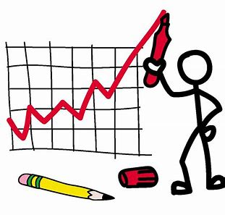
avoidable
profitable
available
portable
adaptable
dependable
7. breakable
8. usable
9. lovable
10. irritable
11. enjoyable
12. debatable
13. changeable
14. disposable
15. desirable
16. miserable
17. variable

Slide 19
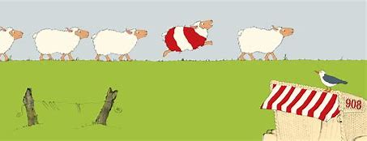
avoidable
profitable
available
portable
adaptable
dependable
7. breakable
8. usable
9. lovable
10. irritable
11. enjoyable
12. debatable
13. changeable
14. disposable
15. desirable
16. miserable
17. variable
18. noticeable

Slide 20
Activity Page:
The <-less> and <-ful> suffixes

Slide 21
pain

Slide 22
painful

Slide 23
painful
painless

Slide 24
1. powerful
powerless
2. harmful
harmless
3. hopeful
hopeless
4. careful
careless
5. useful
useless
6. painful
painless

Slide 25
Mr. Keito is powerful.
Shizu is powerless.
2. King Cobra is harmful.
Elephants are harmless.
3. My future is hopeful.
No one’s future is hopeless.
4. Soshiro is careful.
Keito is careless.
5. Masato has a lot of useful pens.
There are a few useless markers.
6. Playing badminton is painful.
Playing the piano is painless.

Slide 26
Spelling List
Spelling
The <-less> and <-full> Suffix

Slide 27
Thank you!

