Slide 1
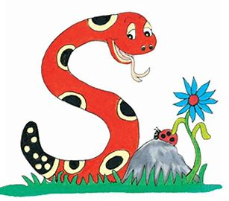
Jolly Grammar
4a-21

Slide 2
Let’s review Possessive Nouns

Slide 3
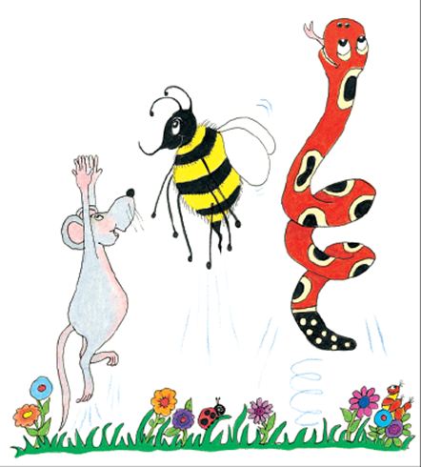
Everyone applauded the model’s outfit.
A genius’s ideas are usually brilliant.
The crowd’s cheers were very loud.

Slide 4
Everyone applauded the model’s outfit.
A genius’s ideas are usually brilliant.
The crowd’s cheers were very loud.

Slide 5
Everyone applauded the model’s outfit.
A genius’s ideas are usually brilliant.
The crowd’s cheers were very loud.

Slide 6
Everyone applauded the model’s outfit.
A genius’s ideas are usually brilliant.
The crowd’s cheers were very loud.

Slide 7
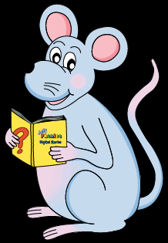
Schwa <or>

Slide 8
How many syllables are there?
actor

Slide 9
How many syllables are there?
actor

Slide 10
Which syllable is stressed?
actor

Slide 11
Which syllable is stressed?
actor
stressed
unstressed

Slide 12
Which syllable is stressed?
actor
< >
stressed
unstressed

Slide 13
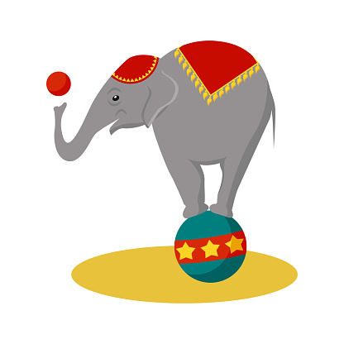
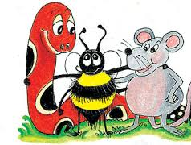
Activity Page: Schwa <or>

Slide 14
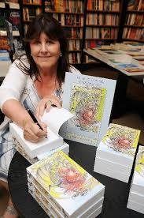
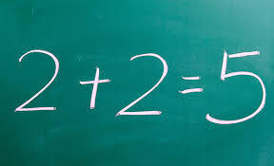
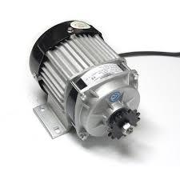
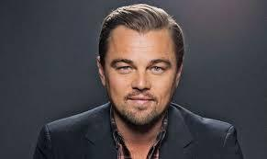
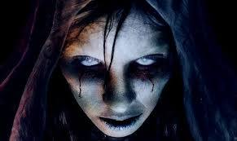
author error doctor
motor actor terror

Slide 15
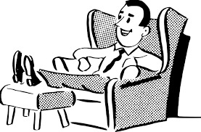
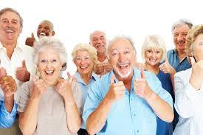
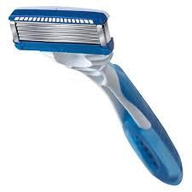
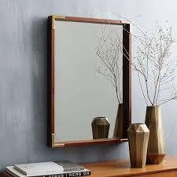
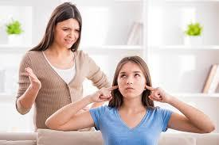
comfort senior razor
mirror memory stubborn

Slide 16
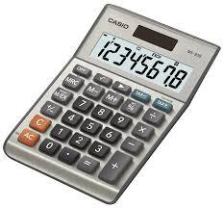
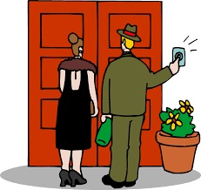
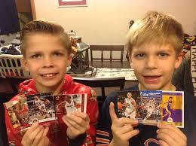
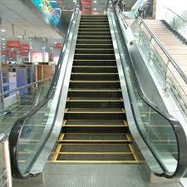
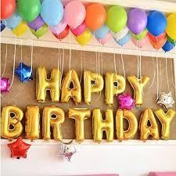
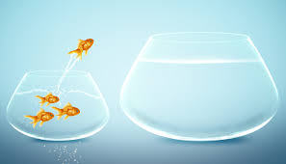
calculator visitor collector
escalator decoration opportunity

Slide 19
I went to the doctor because I was sick.
I put decoration in my room for my sister’s birthday.
I bought a new mirror.
My teacher made an error in my math class.
My sister is stubborn.
I used my calculator for math.
Jackson is a good actor.
I lost my memory about my math.
There was a visitor in my house.

Slide 20
I used the escalator because I don’t like stairs.
I am a hocky card collector.
My dad uses a razor.

Slide 21
Write the Comparative and Superlative

Slide 22
stubborn
adjective
comparative
superlative

Slide 23
stubborner
comparative
stubborn
adjective
superlative

Slide 24
stubborner
comparative
stubbornest
superlative
stubborn
adjective

Slide 25
Write the Comparative and Superlative

Slide 26
Adjective | Comparatives | Superlatives
big
heavy
huge
broad

Slide 27
Adjective | Comparatives | Superlatives
big | bigger | biggest
heavy
huge
broad

Slide 28
Adjective | Comparatives | Superlatives
big | bigger | biggest
heavy | heavier | heaviest
huge
broad

Slide 29
Adjective | Comparatives | Superlatives
big | bigger | biggest
heavy | heavier | heaviest
huge | huger | hugest
broad

Slide 30
Adjective | Comparatives | Superlatives
big | bigger | biggest
heavy | heavier | heaviest
huge | huger | hugest
broad | broader | broadest

Slide 31
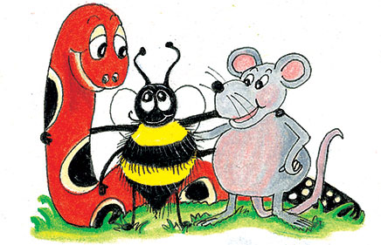
parsing

Slide 32
The senior doctor was making a correct diagnosis.

Slide 33
The senior doctor was making a correct diagnosis.

Slide 34
The senior doctor was making a correct diagnosis.

Slide 35
The senior doctor was making a correct diagnosis.

Slide 36
The senior doctor was making a correct diagnosis.

Slide 37
The senior doctor was making a correct diagnosis.

Slide 38
The senior doctor was making a correct diagnosis.
→Past Continuous

Slide 39
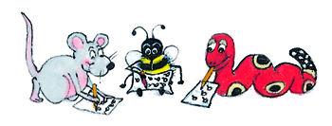
Dictation

Slide 40
Dictation
1.
2.
3.

Slide 41
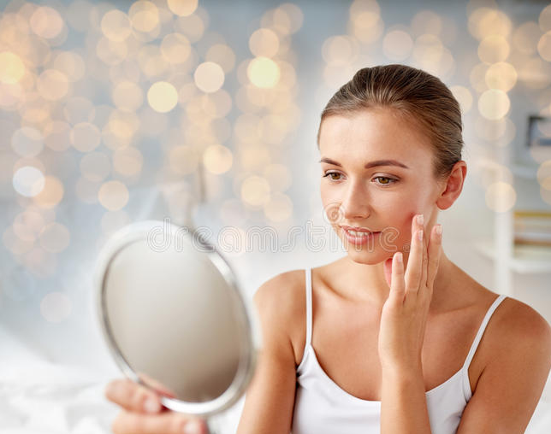

Slide 42
The beautiful woman looked in the mirror.

Slide 43
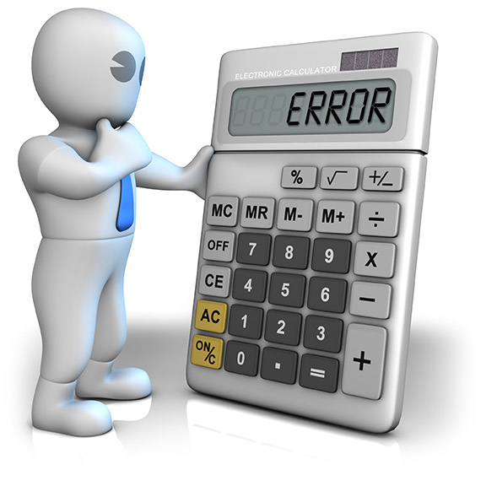

Slide 44
He made an error when he used the calculator.

Slide 45
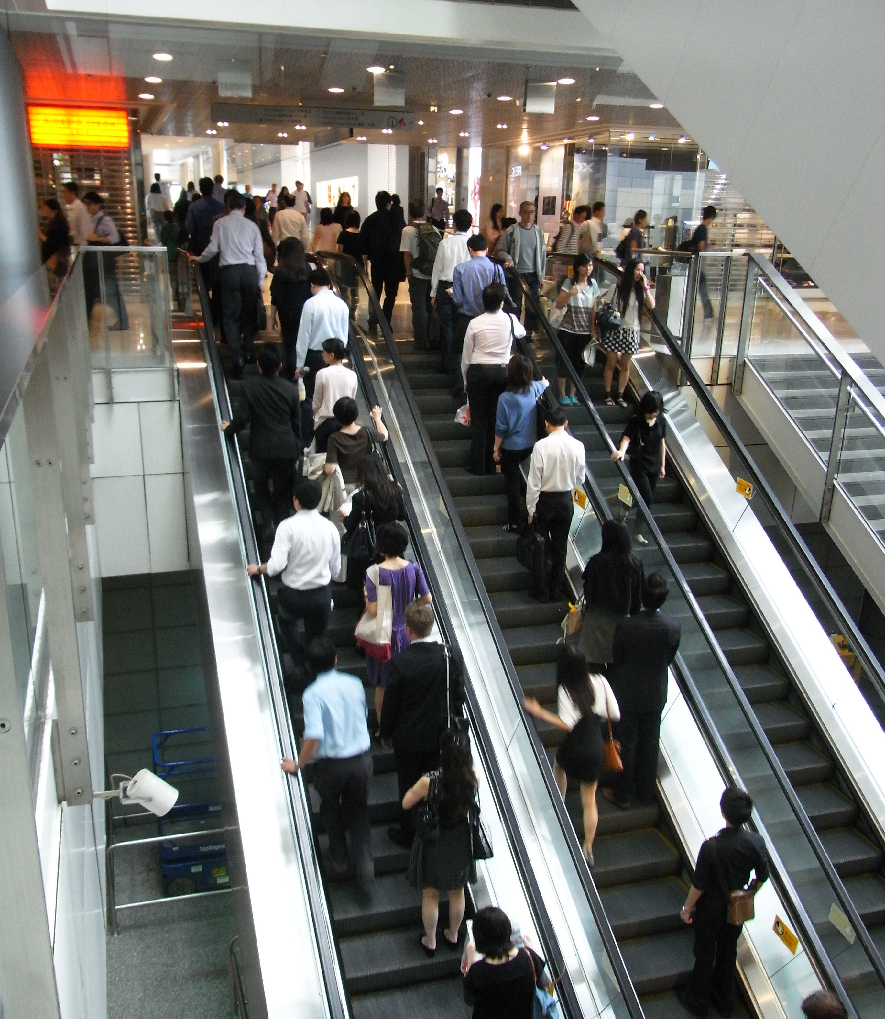

Slide 46
The visitors took the escalator to the next floor.

Slide 47
Thank you.
See you
next time!

