Slide 1
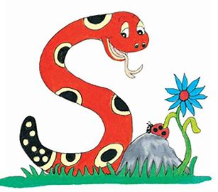
Jolly Grammar
4a-19

Slide 2
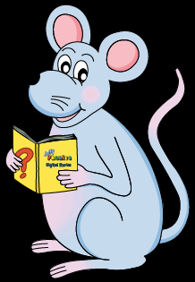
Let’s revise Abstract Nouns

Slide 3
Proper Nouns | Concrete Nouns | Abstract Nouns
 |  | idea

Slide 4
Proper Nouns | Concrete Nouns | Abstract Nouns
Carlos |  | idea
Africa
London
Wednesday
October
Canada

Slide 5
Proper Nouns | Concrete Nouns | Abstract Nouns
Carlos | table | idea
Africa | flute
London | carrot
Wednesday | rabbit
October | shoes
Canada | train

Slide 6
Proper Nouns | Concrete Nouns | Abstract Nouns
Carlos | table | idea
Africa | flute | knowledge
London | carrot | intelligence
Wednesday | rabbit | fear
October | shoes | hope
Canada | train | sadness

Slide 7
Schwa <ar>

Slide 8
How many syllables are there?
dollar

Slide 9
How many syllables are there?
dollar

Slide 10
Which syllable is stressed?
dollar

Slide 11
Which syllable is stressed?
dollar
stressed
unstressed

Slide 12
Which syllable is stressed?
dollar
< >
stressed
unstressed

Slide 13
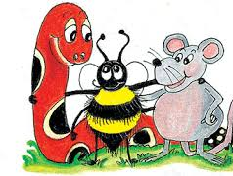
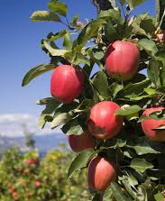
Activity Page: Schwa <ar>

Slide 14
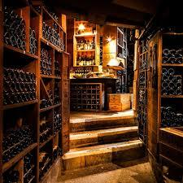
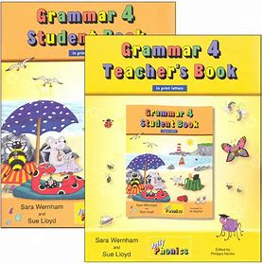
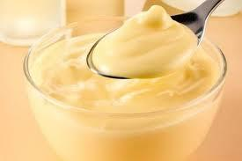
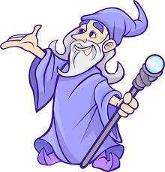
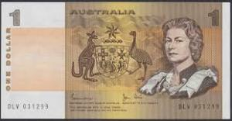
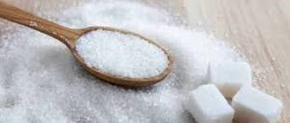
grammar custard cellar
sugar wizard dollar

Slide 15
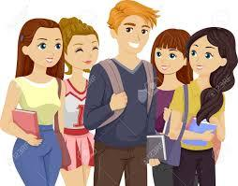
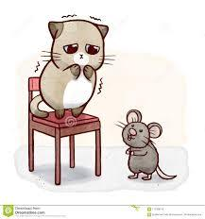
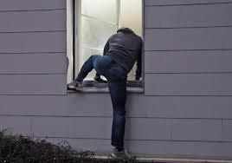
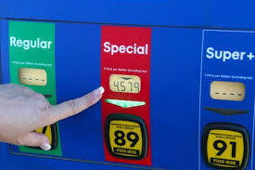
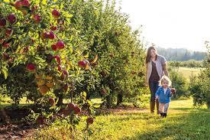
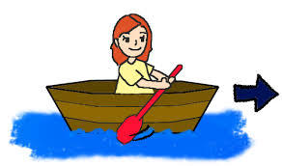
popular coward burglar
regular orchard forward

Slide 16
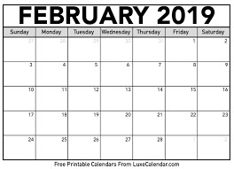
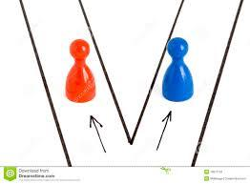
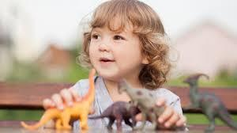
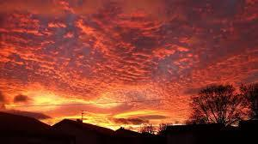
standard separate calendar
familiar particular spectacular

Slide 19
Correct each word
Using a different colour

Slide 21
leaf

Slide 22
leaf

Slide 23
leaves
leaf

Slide 24
leaves
leaf
singular

Slide 25
leaves
leaf
plural
singular

Slide 26
Write the singular nouns for each of the plurals

Slide 27
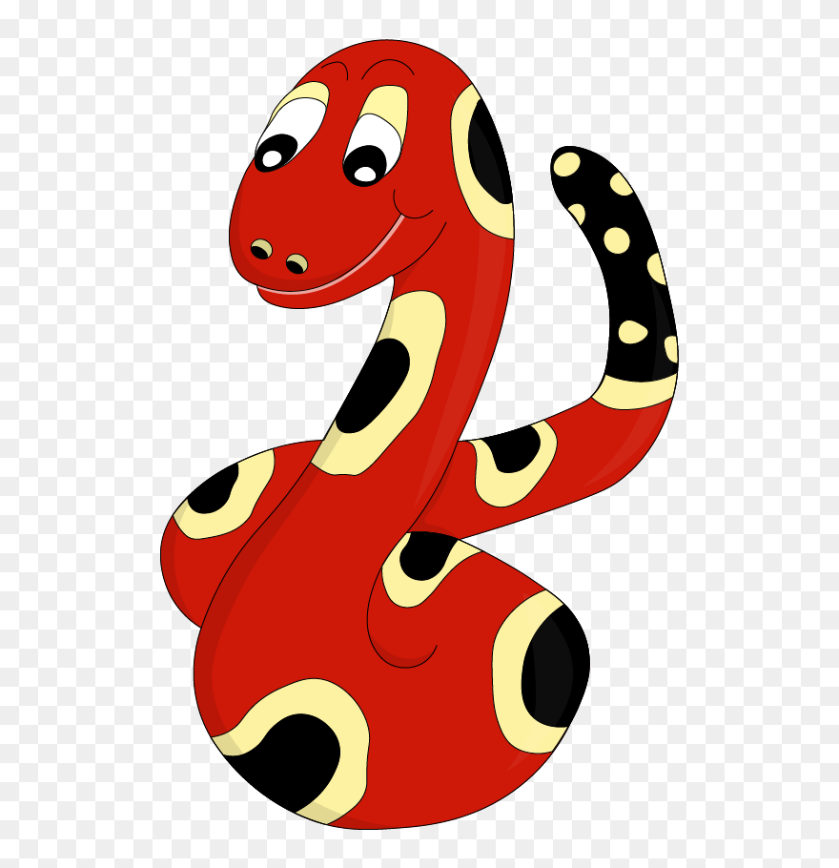
parent
spider
fox
pirate
piano
baby
dollar
anchovy
deer
virus
mouse
apology
leaf
scarf
goose
thief

Slide 28
parsing

Slide 29
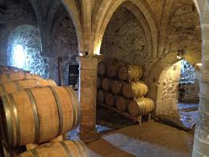
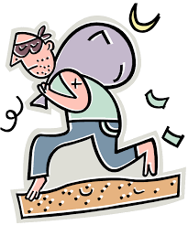
The cowardly burglar is hiding in the castle’s cellar.

Slide 30
The cowardly burglar is hiding in the castle’s cellar.

Slide 31
The cowardly burglar is hiding in the castle’s cellar.

Slide 32
The cowardly burglar is hiding in the castle’s cellar.

Slide 33
The cowardly burglar is hiding in the castle’s cellar.

Slide 34
The cowardly burglar is hiding in the castle’s cellar.

Slide 35
The cowardly burglar is hiding in the castle’s cellar.

Slide 36
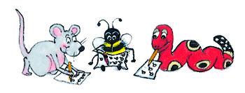
Dictation

Slide 37
Dictation
1.
2.
3.

Slide 38
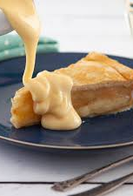

Slide 39
Apple pie and custard is a popular dish.

Slide 41
It was an ordinary Saturday afternoon.

Slide 42
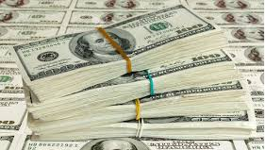
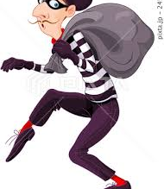

Slide 43
The burglar stole two thousand American dollars.

Slide 44
Thank you.
See you
next time!

