Slide 1
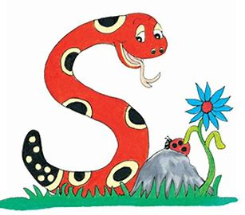
Jolly Grammar
4a-17

Slide 2
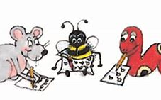
Let’s review concrete nouns

Slide 3
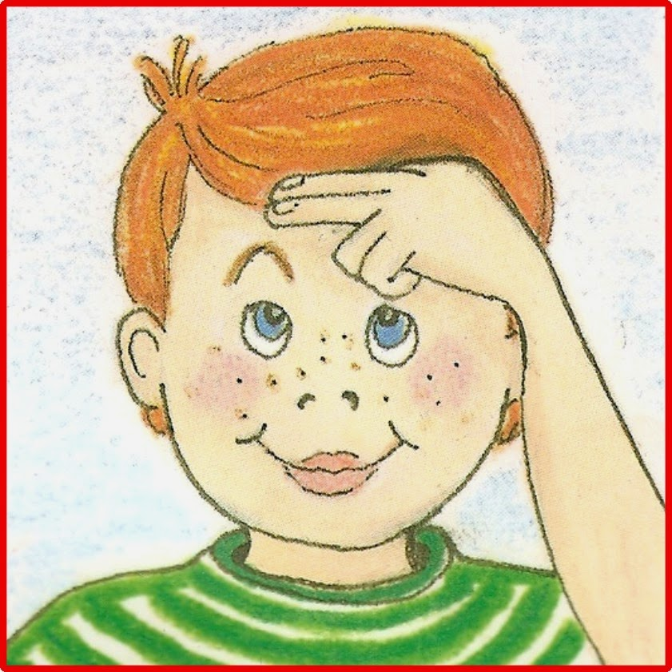
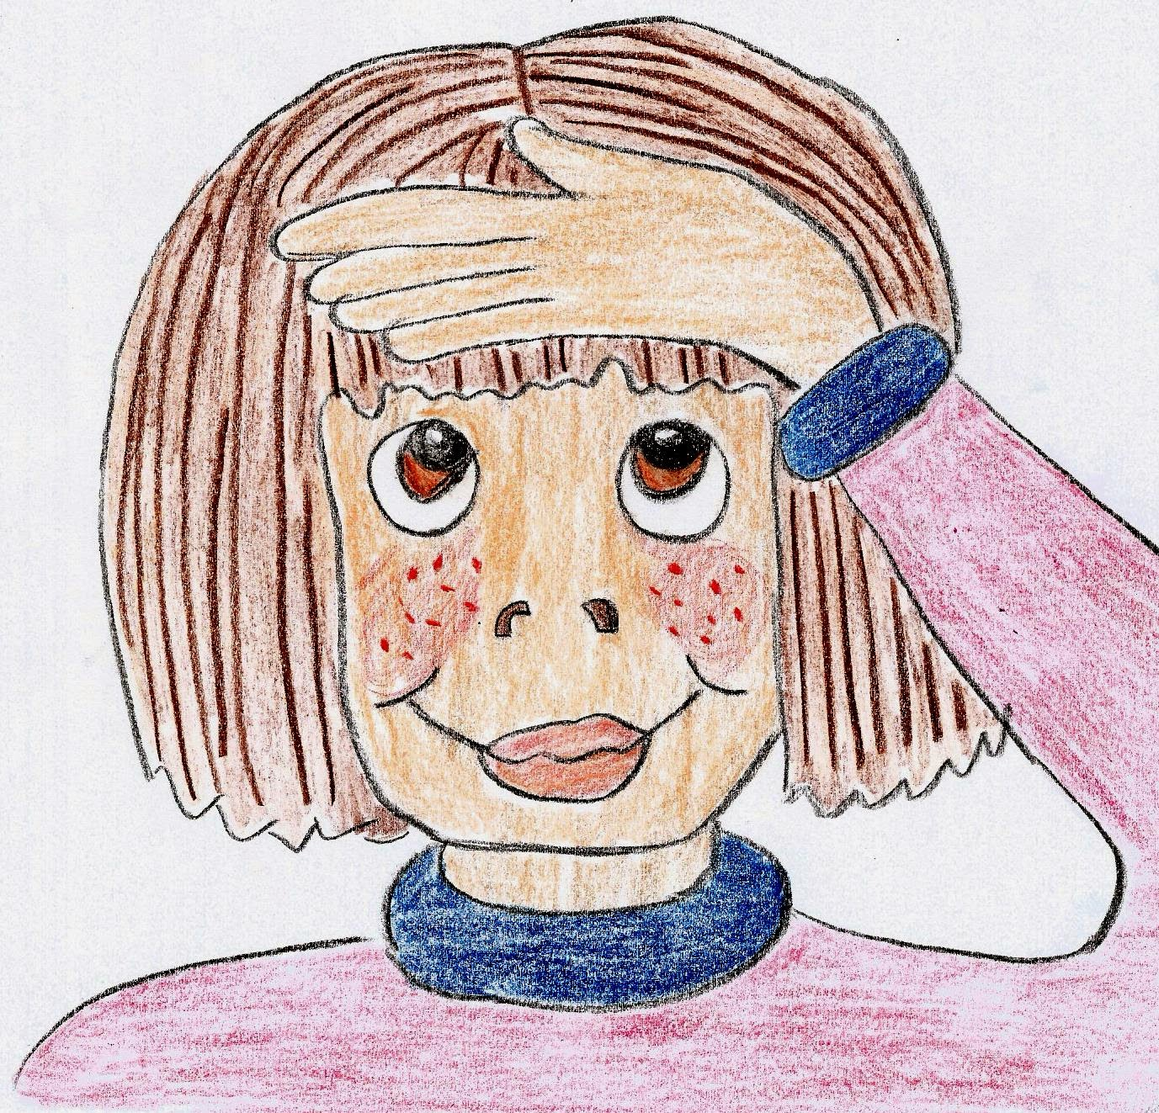
Nouns
Proper Nouns
Common Nouns
Monday
Jane
Tokyo
egg
classes
rain

Slide 4
Common Nouns
①concrete: photo, drum, flowers, ice
②collective: a class of children
a herd of cows
③abstract: love, trouble, friendship

Slide 5
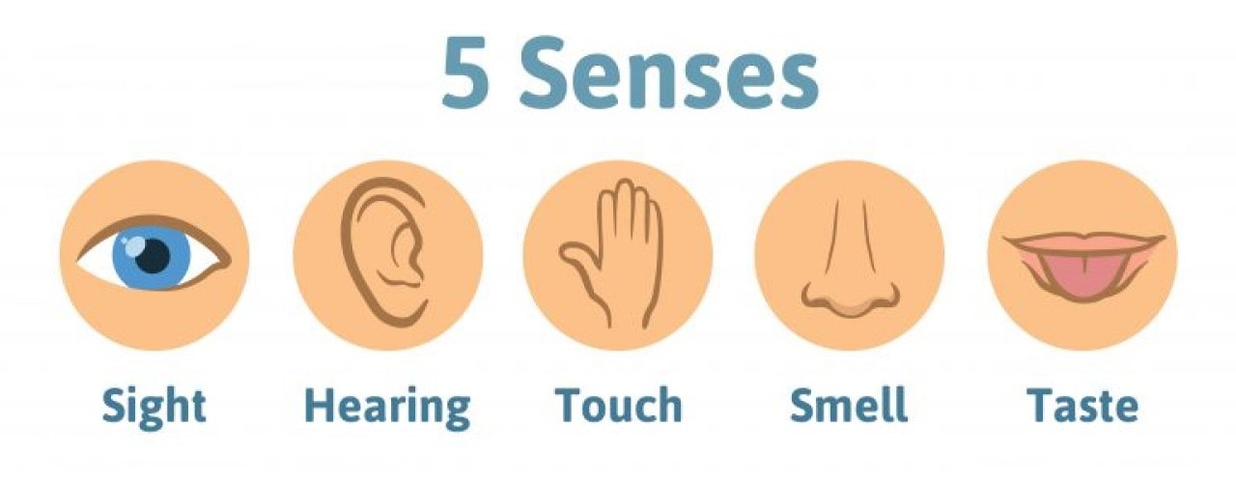
Concrete Nouns

Slide 6
Concrete Nouns
tree
floor
chair
shoe
bed
bell
telephone
radio
bird
frog
silk
water
wool
ice
sand
smoke
perfume
rose
coffee
paint
sugar
vinegar
milk
mint
salt

Slide 7
Concrete Nouns

Slide 8
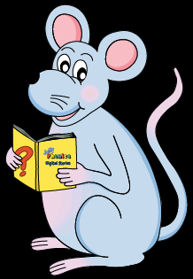
Schwa <u>

Slide 9
How many syllables are there?
cactus

Slide 10
How many syllables are there?
cactus

Slide 11
Which syllable is stressed?
cactus

Slide 12
Which syllable is stressed?
cactus
< >
stressed
unstressed

Slide 13
Which syllable is stressed?
cactus
stressed
unstressed

Slide 14
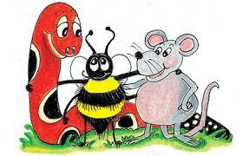
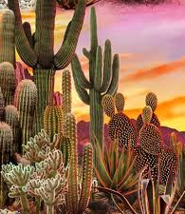
Activity Page: Schwa <u>

Slide 15
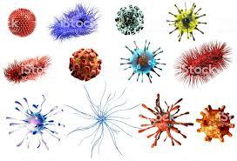
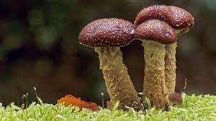
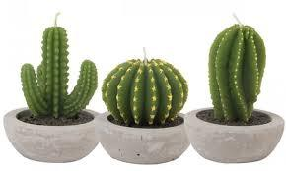
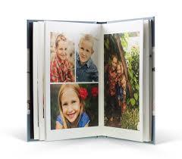
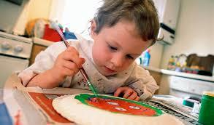
fungus cactus virus
focus minus album

Slide 16
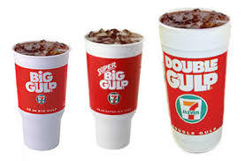
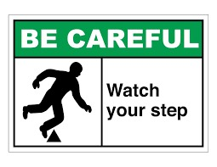
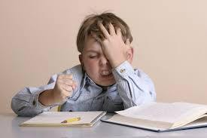
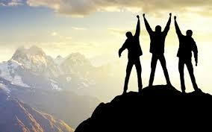
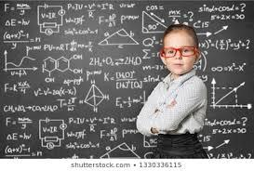
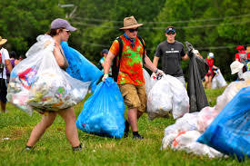
medium careful difficult
success genius volunteer

Slide 17
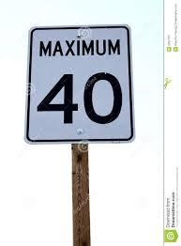
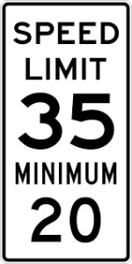
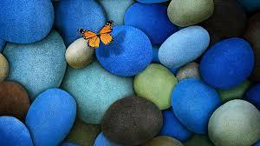
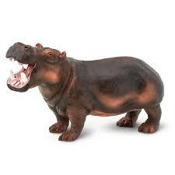
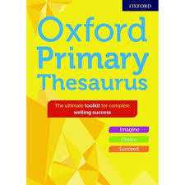
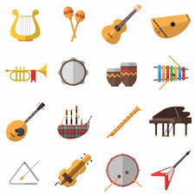
maximum minimum beautiful
thesaurus instrument hippopotamus

Slide 20
Let a thesaurus help you

Slide 21
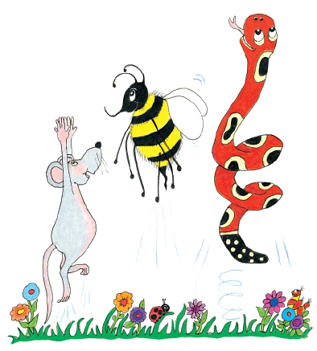
beautiful

Slide 22
charming superb
gorgeous pretty
appealing divine
elegant excellent
cute lovely

Slide 23
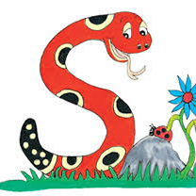
bad

Slide 24
awful horrible
dreadful wicked
annoying beastly
infamous unworthy
repulsive repellent

Slide 25
minimum

Slide 26
minimal least
smallest lowest
limit littlest

Slide 27
difficult

Slide 29
good

Slide 31
parsing

Slide 32
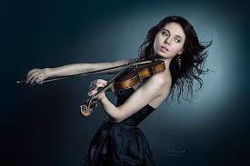
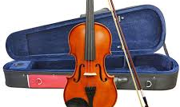
The musician carefully places her beautiful instrument inside its case.

Slide 33
The musician carefully places her beautiful instrument inside its case.

Slide 34
The musician carefully places her beautiful instrument inside its case.

Slide 35
The musician carefully places her beautiful instrument inside its case.

Slide 36
The musician carefully places her beautiful instrument inside its case.

Slide 37
The musician carefully places her beautiful instrument inside its case.

Slide 38
The musician carefully places her beautiful instrument inside its case.

Slide 39
The musician carefully places her beautiful instrument inside its case.

Slide 40
The musician carefully places her beautiful instrument inside its case.

Slide 41
The musician carefully places her beautiful instrument inside its case.

Slide 42
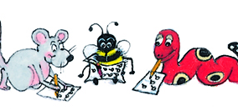
Dictation

Slide 43
Dictation
1.
2.
3.

Slide 44
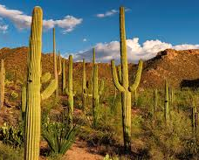

Slide 45
A cactus is a plant that grows in the dessert.

Slide 46
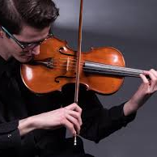

Slide 47
Is the violin a difficult instrument to play?

Slide 48
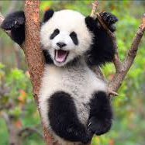
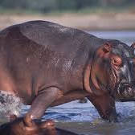

Slide 49
I saw a crocodile, a panda and a hippopotamus.

Slide 50
Thank you.
See you
next time!

