Slide 1
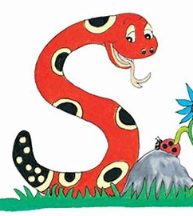
Jolly Grammar
4a-15

Slide 2
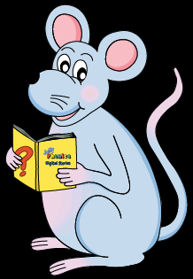
Let’s review synonyms.

Slide 3
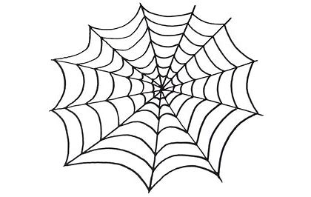
big

Slide 4
large
huge
great
giant
gigantic
enormous
massive
mighty
heavy
immense
mammoth
colossal
vast
tall
high
lofty
important
sturdy
big

Slide 5
Schwa <o>

Slide 6
How many syllables are there?
lemon

Slide 7
How many syllables are there?
lemon

Slide 8
Which syllable is stressed?
lemon

Slide 9
Which syllable is stressed?
lemon
stressed
unstressed

Slide 10
Which syllable is stressed?
lemon
< >
stressed
unstressed

Slide 11
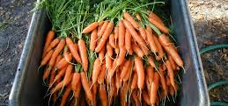
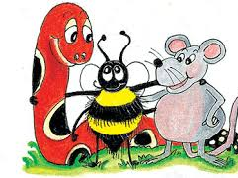
Activity Page: Schwa <o>

Slide 12
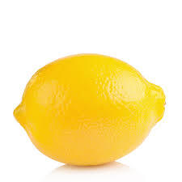
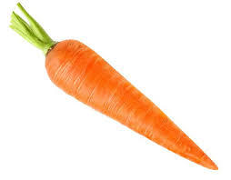
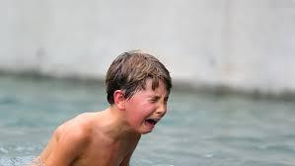
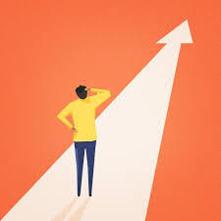
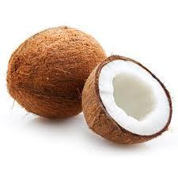
lemon carrot agony
coconut second purpose

Slide 13
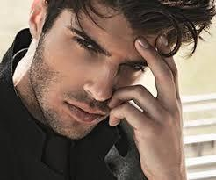
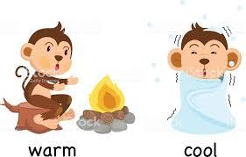
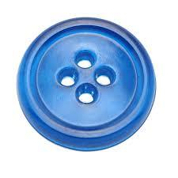
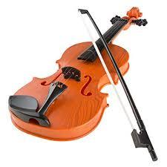
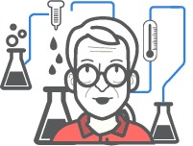
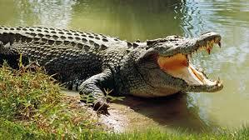
handsome opposite button
violin method crocodile

Slide 14
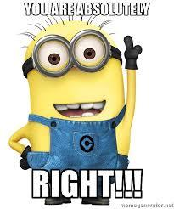
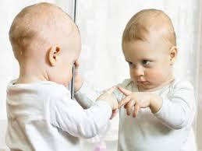
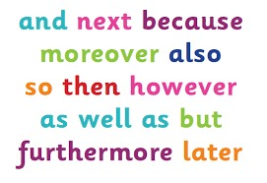
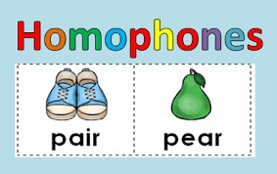
absolutely apostrophe recognise
apology conjunction homophone

Slide 17
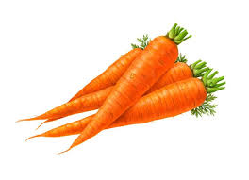
carrot purpose coconut agony
lemon second handsome method
button crocodile method violin opposite
homophone apology conjunction
recognise apostrophe absolutely

Slide 18
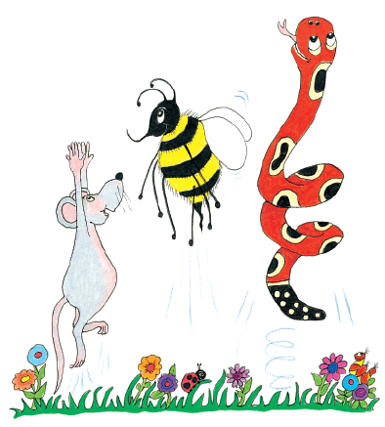
Your or you’re ?

Slide 19
You’re having your class photo taken today.
Your apology shows that you’re sorry.
You’re right to be careful with your pet crocodile.

Slide 20
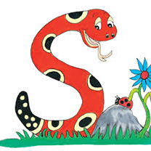
To, two or too ?

Slide 21
I am going to the zoo today.
Do you want to come too?
They have two new pandas.

Slide 22
There, their
or they’re ?

Slide 23
Over there is their new house.
They’re moving in next week.

Slide 24
parsing

Slide 25
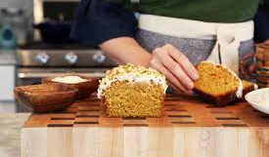
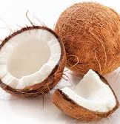
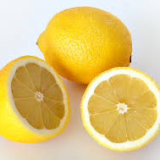
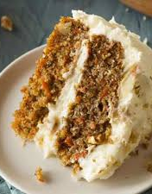
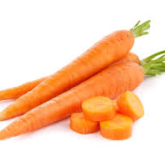
She will be using
a new method for
the lemon, coconut,
and carrot cakes.

Slide 26
She will be using
a new method for
the lemon, coconut,
and carrot cakes.

Slide 27
She will be using
a new method for
the lemon, coconut,
and carrot cakes.

Slide 28
She will be using
a new method for
the lemon, coconut,
and carrot cakes.

Slide 29
She will be using
a new method for
the lemon, coconut,
and carrot cakes.

Slide 30
She will be using
a new method for
the lemon, coconut,
and carrot cakes.

Slide 31
She will be using
a new method for
the lemon, coconut,
and carrot cakes.

Slide 32
She will be using
a new method for
the lemon, coconut,
and carrot cakes.

Slide 33
She will be using
a new method for
the lemon, coconut,
and carrot cakes.

Slide 34
She will be using
a new method for
the lemon, coconut,
and carrot cakes.

Slide 35
She will be using
a new method for
the lemon, coconut,
and carrot cakes.

Slide 36
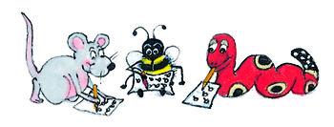
Dictation

Slide 37
Dictation
1.
2.
3.

Slide 38
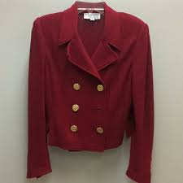

Slide 39
The second button on his coat was missing.

Slide 40
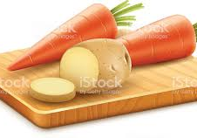
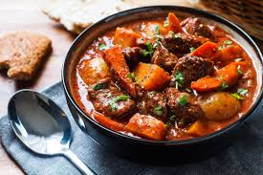

Slide 41
We chopped carrots and potatoes for the stew.

Slide 42
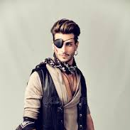
I’m sorry.

Slide 43
I’m sorry.
The handsome pirate apologized for his awful deed.

Slide 44
Thank you.
See you
next time!

