Slide 1
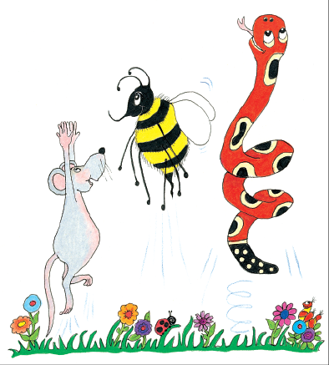
Jolly Grammar
4a-12

Slide 2
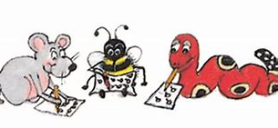
Spelling Test 6

Slide 3
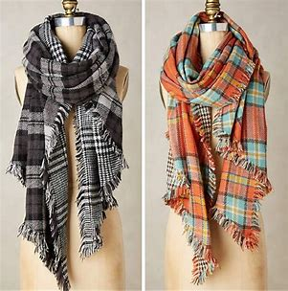
scarves

Slide 4
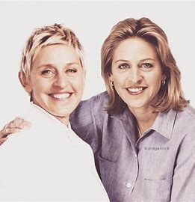
scarves
selves

Slide 5
scarves
selves
wives

Slide 6
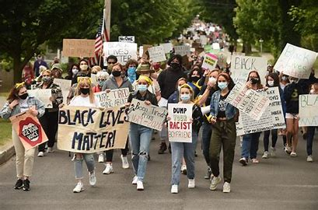
scarves
selves
wives
lives

Slide 7
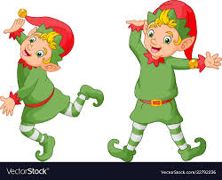
scarves
selves
wives
lives
elves

Slide 8
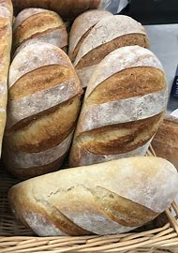
scarves
selves
wives
lives
elves
loaves

Slide 9
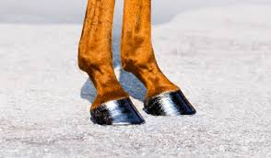
scarves
selves
wives
lives
elves
loaves
7.hooves

Slide 10
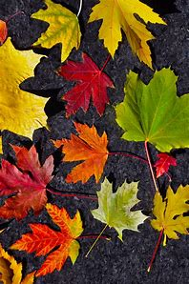
scarves
selves
wives
lives
elves
loaves
7.hooves
8.leaves

Slide 11
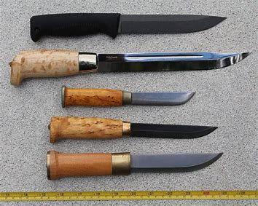
scarves
selves
wives
lives
elves
loaves
7.hooves
8.leaves
9.knives

Slide 12
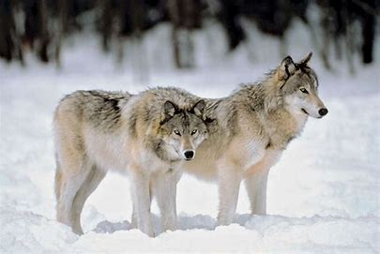
scarves
selves
wives
lives
elves
loaves
7.hooves
8.leaves
9.knives
10.wolves

Slide 13
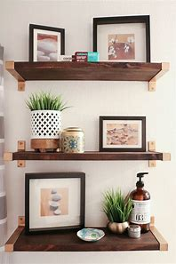
scarves
selves
wives
lives
elves
loaves
7.hooves
8.leaves
9.knives
10.wolves
11.shelves

Slide 14
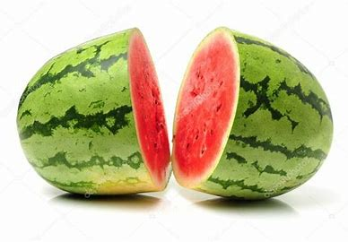
scarves
selves
wives
lives
elves
loaves
7.hooves
8.leaves
9.knives
10.wolves
11.shelves
12.halves

Slide 15
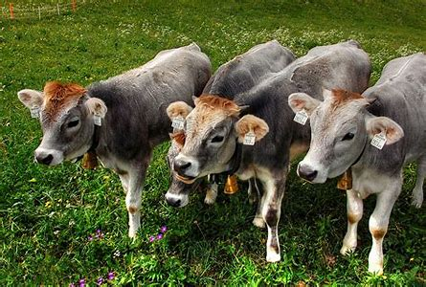
scarves
selves
wives
lives
elves
loaves
7.hooves
8.leaves
9.knives
10.wolves
11.shelves
12.halves
13.calves

Slide 16
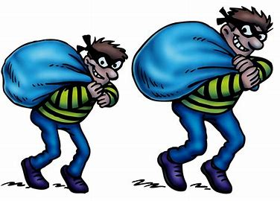
scarves
selves
wives
lives
elves
loaves
7.hooves
8.leaves
9.knives
10.wolves
11.shelves
12.halves
13.calves
14.thieves

Slide 17
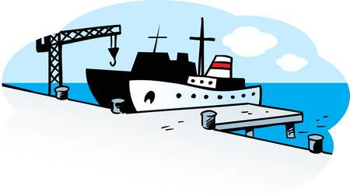
scarves
selves
wives
lives
elves
loaves
7.hooves
8.leaves
9.knives
10.wolves
11.shelves
12.halves
13.calves
14.thieves
15.wharves

Slide 18
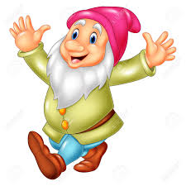
scarves
selves
wives
lives
elves
loaves
7.hooves
8.leaves
9.knives
10.wolves
11.shelves
12.halves
13.calves
14.thieves
15.wharves
16.dwarves

Slide 19
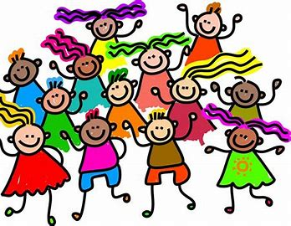
scarves
selves
wives
lives
elves
loaves
7.hooves
8.leaves
9.knives
10.wolves
11.shelves
12.halves
13.calves
14.thieves
15.wharves
16.dwarves
17.ourselves

Slide 20
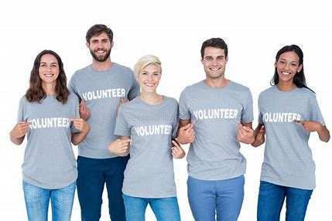
scarves
selves
wives
lives
elves
loaves
7.hooves
8.leaves
9.knives
10.wolves
11.shelves
12.halves
13.calves
14.thieves
15.wharves
16.dwarves
17.ourselves
18.themselves

Slide 21
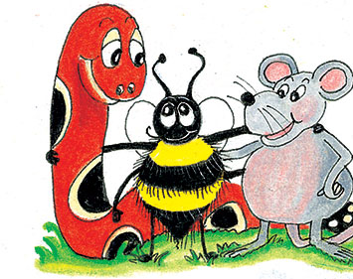
Plurals

Slide 22
・dogs, houses, cars
plurals

Slide 23
・dogs, houses, cars
・watches, bushes, glasses
plurals

Slide 24
・dogs, houses, cars
・watches, bushes, glasses
・tomatoes, potatoes, tornadoes
plurals

Slide 25
・dogs, houses, cars
・watches, bushes, glasses
・tomatoes, potatoes, tornadoes
・pianos, kilos, studios
plurals

Slide 26
・dogs, houses, cars
・watches, bushes, glasses
・tomatoes, potatoes, tornadoes
・pianos, kilos, studios
・cherries, flies
plurals

Slide 27
・dogs, houses, cars
・watches, bushes, glasses
・tomatoes, potatoes, tornadoes
・pianos, kilos, studios
・cherries, flies
・boys, days, keys
plurals

Slide 28
・dogs, houses, cars
・watches, bushes, glasses
・tomatoes, potatoes, tornadoes
・pianos, kilos, studios
・cherries, flies
・boys, days, keys
・sheep, fish, deer
plurals

Slide 29
・dogs, houses, cars
・watches, bushes, glasses
・tomatoes, potatoes, tornadoes
・pianos, kilos, studios
・cherries, flies
・boys, days, keys
・sheep, fish, deer
・feet, children, people
plurals

Slide 30
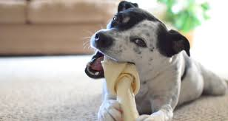
The dog chews the bone.

Slide 31
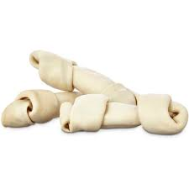
The dog chews the bones.

Slide 32
The dog chews a bones.

Slide 33
The dog chews some bones.

Slide 34
The dog chews lots of bones.

Slide 35
The dog chews the bone.

Slide 36
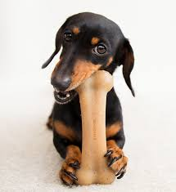
The dogs chews the bone.

Slide 37
The dogs chew the bone.

Slide 38
Activity Page:
Plural Nouns in Sentences

Slide 39
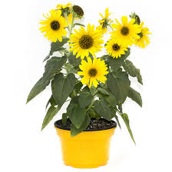
I grew some sunflowers in a big pot.

Slide 40
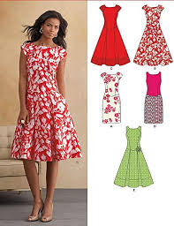
Beth tried on the new dresses.

Slide 41
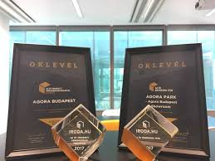
Jenny won two prizes
in the competition.

Slide 42
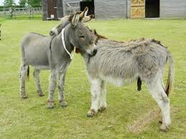
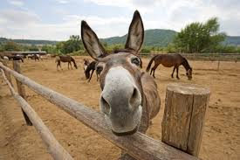
He keeps donkeys in the fields.

Slide 43
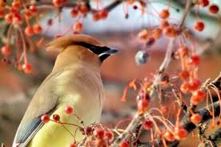
The bird ate lots of berries from the bushes.

Slide 44
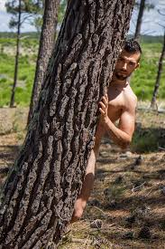
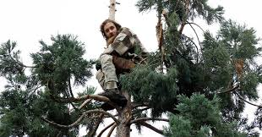
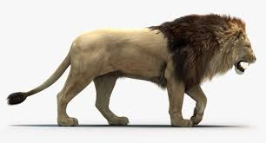
The lion chased the men up trees.

Slide 45
Thank you!

