Slide 1
Jolly Grammar
4a-14

Slide 2
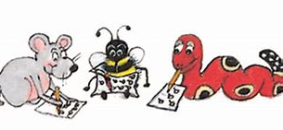
Spelling Test 7

Slide 3
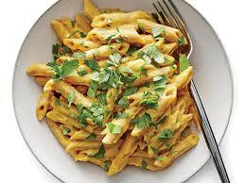
pasta

Slide 4
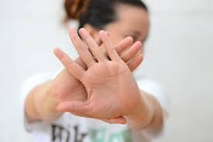
pasta
avoid

Slide 5
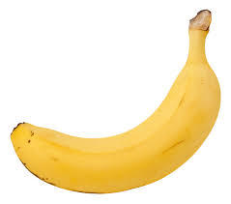
pasta
avoid
banana

Slide 6
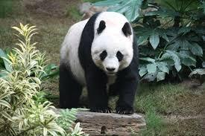
pasta
avoid
banana
panda

Slide 7
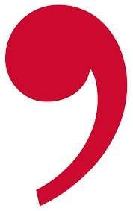
pasta
avoid
banana
panda
comma

Slide 8
pasta
avoid
banana
panda
comma
hexagon

Slide 9
pasta
avoid
banana
panda
comma
hexagon
7.anagram

Slide 10
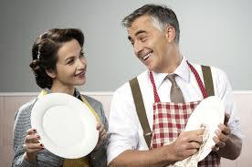
pasta
avoid
banana
panda
comma
hexagon
7.anagram
8.husband

Slide 11
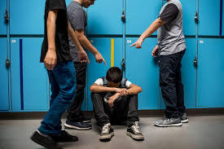
pasta
avoid
banana
panda
comma
hexagon
7.anagram
8.husband
9.harass

Slide 12
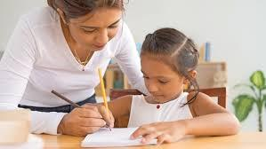
pasta
avoid
banana
panda
comma
hexagon
7.anagram
8.husband
9.harass
10.private

Slide 13
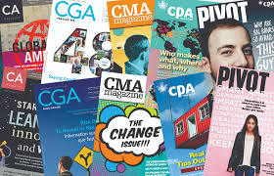
pasta
avoid
banana
panda
comma
hexagon
7.anagram
8.husband
9.harass
10.private
11.magazine

Slide 14
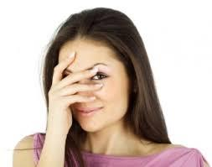
pasta
avoid
banana
panda
comma
hexagon
7.anagram
8.husband
9.harass
10.private
11.magazine
12.embarrass

Slide 15
pasta
avoid
banana
panda
comma
hexagon
7.anagram
8.husband
9.harass
10.private
11.magazine
12.embarrass
13.exclamation

Slide 16
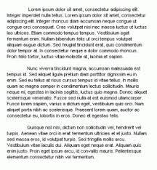
pasta
avoid
banana
panda
comma
hexagon
7.anagram
8.husband
9.harass
10.private
11.magazine
12.embarrass
13.exclamation
14.paragraph

Slide 17
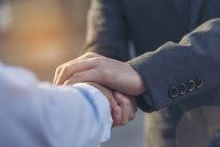
pasta
avoid
banana
panda
comma
hexagon
7.anagram
8.husband
9.harass
10.private
11.magazine
12.embarrass
13.exclamation
14.paragraph
15.guarantee

Slide 18
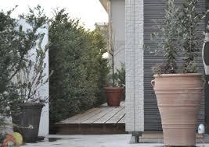
pasta
avoid
banana
panda
comma
hexagon
7.anagram
8.husband
9.harass
10.private
11.magazine
12.embarrass
13.exclamation
14.paragraph
15.guarantee
16.entrance

Slide 19
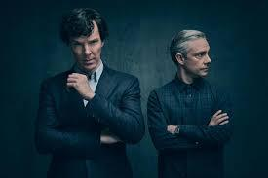
pasta
avoid
banana
panda
comma
hexagon
7.anagram
8.husband
9.harass
10.private
11.magazine
12.embarrass
13.exclamation
14.paragraph
15.guarantee
16.entrance
17.abominable

Slide 20
pasta
avoid
banana
panda
comma
hexagon
7.anagram
8.husband
9.harass
10.private
11.magazine
12.embarrass
13.exclamation
14.paragraph
15.guarantee
16.entrance
17.abominable
18.announcement

Slide 21
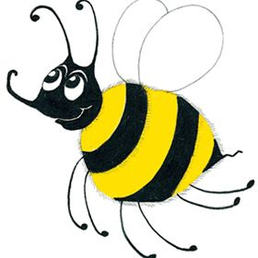
Antonyms

Slide 22
true ⇔

Slide 23
true ⇔ false

Slide 24
true ⇔ false
black ⇔

Slide 25
true ⇔ false
black ⇔ white

Slide 26
true ⇔ false
black ⇔ white
tall ⇔

Slide 27
true ⇔ false
black ⇔ white
tall ⇔ short

Slide 28
true ⇔ false
black ⇔ white
tall ⇔ short
shallow ⇔

Slide 29
true ⇔ false
black ⇔ white
tall ⇔ short
shallow ⇔ deep

Slide 30
true ⇔ false
black ⇔ white
tall ⇔ short
shallow ⇔ deep
last ⇔

Slide 31
true ⇔ false
black ⇔ white
tall ⇔ short
shallow ⇔ deep
last ⇔ first

Slide 32
true ⇔ false
black ⇔ white
tall ⇔ short
shallow ⇔ deep
last ⇔ first
empty ⇔

Slide 33
true ⇔ false
black ⇔ white
tall ⇔ short
shallow ⇔ deep
last ⇔ first
empty ⇔ full

Slide 34
true ⇔ false
black ⇔ white
tall ⇔ short
shallow ⇔ deep
last ⇔ first
empty ⇔ full
end ⇔

Slide 35
true ⇔ false
black ⇔ white
tall ⇔ short
shallow ⇔ deep
last ⇔ first
empty ⇔ full
end ⇔ beginning

Slide 36
true ⇔ false
black ⇔ white
tall ⇔ short
shallow ⇔ deep
last ⇔ first
empty ⇔ full
end ⇔ beginning
new ⇔

Slide 37
true ⇔ false
black ⇔ white
tall ⇔ short
shallow ⇔ deep
last ⇔ first
empty ⇔ full
end ⇔ beginning
new ⇔ old

Slide 38
true ⇔ false
black ⇔ white
tall ⇔ short
shallow ⇔ deep
last ⇔ first
empty ⇔ full
end ⇔ beginning
new ⇔ old
impossible ⇔

Slide 39
true ⇔ false
black ⇔ white
tall ⇔ short
shallow ⇔ deep
last ⇔ first
empty ⇔ full
end ⇔ beginning
new ⇔ old
impossible ⇔ possible

Slide 40
true ⇔ false
black ⇔ white
tall ⇔ short
shallow ⇔ deep
last ⇔ first
empty ⇔ full
end ⇔ beginning
new ⇔ old
impossible ⇔ possible
careless ⇔

Slide 41
true ⇔ false
black ⇔ white
tall ⇔ short
shallow ⇔ deep
last ⇔ first
empty ⇔ full
end ⇔ beginning
new ⇔ old
impossible ⇔ possible
careless ⇔ careful

Slide 42
true ⇔ false
black ⇔ white
tall ⇔ short
shallow ⇔ deep
last ⇔ first
empty ⇔ full
end ⇔ beginning
new ⇔ old
impossible ⇔ possible
careless ⇔ careful
untie ⇔

Slide 43
true ⇔ false
black ⇔ white
tall ⇔ short
shallow ⇔ deep
last ⇔ first
empty ⇔ full
end ⇔ beginning
new ⇔ old
impossible ⇔ possible
careless ⇔ careful
untie ⇔ tie

Slide 44
happy ⇔

Slide 45
happy ⇔ unhappy
sad
glum
gloomy

Slide 46
right ⇔

Slide 47
right ⇔ left
wrong

Slide 48
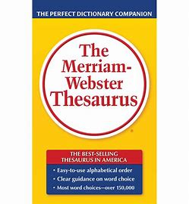
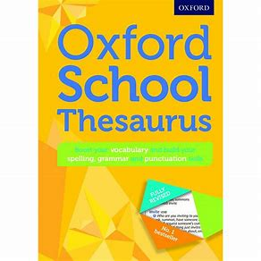
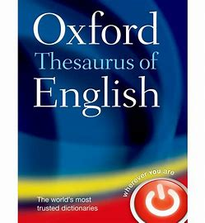
Thesaurus

Slide 49
What is opposite of the word opposite?

Slide 50
What is opposite of the word opposite?
opposite ⇔

Slide 51
What is opposite of the word opposite?
opposite ⇔ same

Slide 52
What is opposite of the word opposite?
opposite ⇔ same
antonym ⇔

Slide 53
What is opposite of the word opposite?
opposite ⇔ same
antonym ⇔ synonym

Slide 54
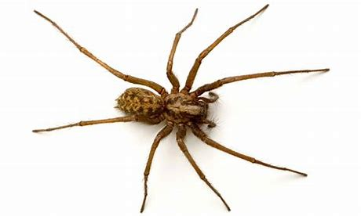
I saw a big spider.

Slide 55
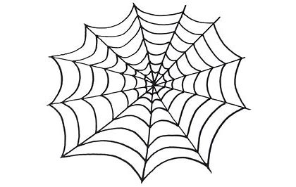
big

Slide 56
large
huge
great
giant
gigantic
enormous
massive
mighty
heavy
immense
mammoth
colossal
vast
tall
high
lofty
important
sturdy
big

Slide 57
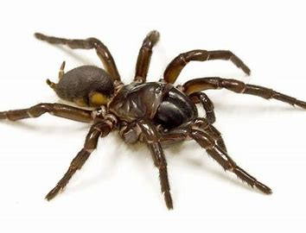
I saw a big spider.

Slide 58
I saw a big spider.
I saw a large spider.

Slide 59
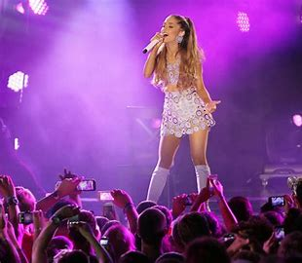
The concert was a big success.

Slide 60
The concert was a big success.
The concert was a huge success.

Slide 61
They have a big problem to solve.

Slide 62
They have a big problem to solve.
They have an important problem to solve .

Slide 63
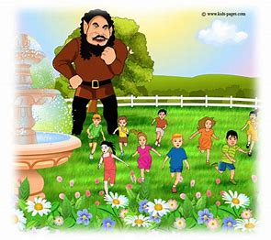
She told them a story about a big giant.

Slide 64
She told them a story about a big giant.
She told them a story about a heavy giant.

Slide 65
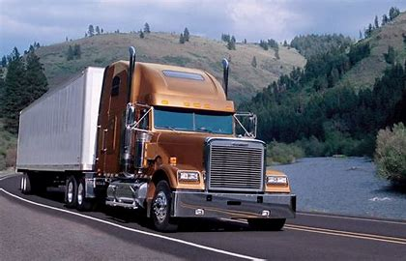
The driver had a big truck.

Slide 66
The driver had a big truck.
The driver had a massive truck.

Slide 67
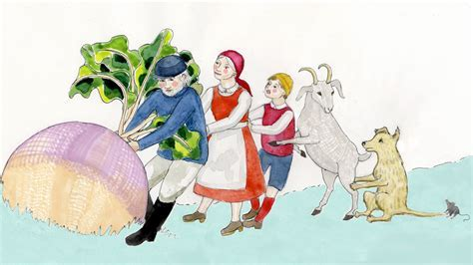
They pulled a big turnip
out of the ground.

Slide 68
They pulled a big turnip
out of the ground.
They pulled an enormous turnip
out of the ground.

Slide 69
The days of the week are Sunday,
Monday, Tuesday, Wednesday, Thursday, Friday and Saturday.
My friends’ names are Kosuke, Yuto, Yuka, Kokona, Matthew and Manon.

Slide 70
Thank you!

