Slide 1
Jolly Grammar
4a-11

Slide 2
Let’s review antonyms

Slide 3
day
hot
quiet
up
hard
asleep
right

Slide 4
day
hot
quiet
up
hard
asleep
right
night

Slide 5
day
hot
quiet
up
hard
asleep
right
night
cold

Slide 6
day
hot
quiet
up
hard
asleep
right
night
cold
noisy

Slide 7
day
hot
quiet
up
hard
asleep
right
night
cold
noisy
down

Slide 8
day
hot
quiet
up
hard
asleep
right
night
cold
noisy
down
soft

Slide 9
day
hot
quiet
up
hard
asleep
right
night
cold
noisy
down
soft
awake

Slide 10
day
hot
quiet
up
hard
asleep
right
night
cold
noisy
down
soft
awake
left

Slide 11
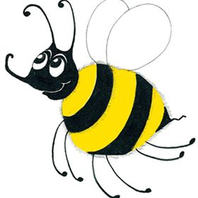

Slide 12
leaf

Slide 13
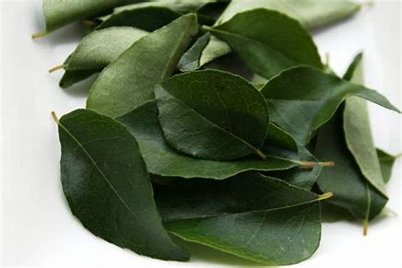
leaf

Slide 14
leaf
leaves

Slide 15
Spelling
Plurals
<ves>

Slide 16
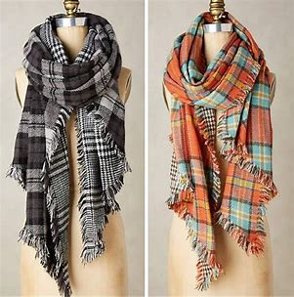
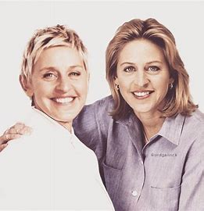
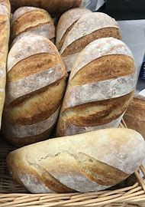
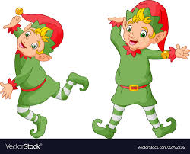
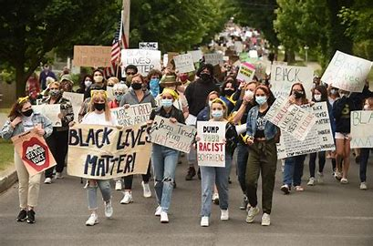
scarves selves wives
lives elves loaves

Slide 17
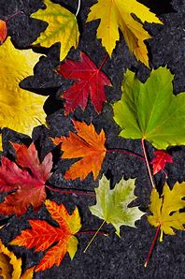
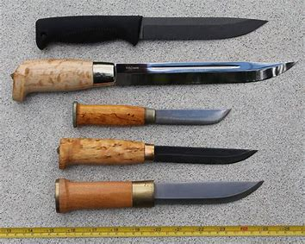
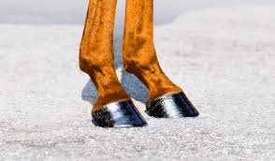
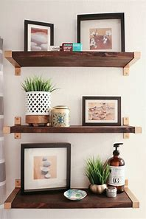
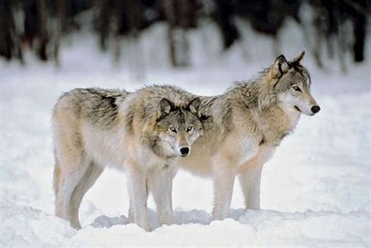
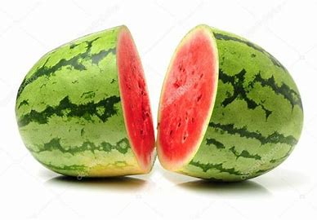
hooves leaves knives
wolves shelves halves

Slide 18
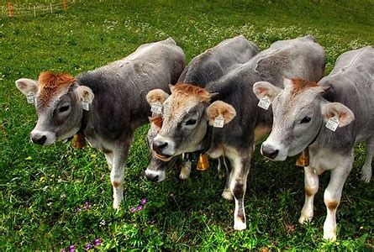
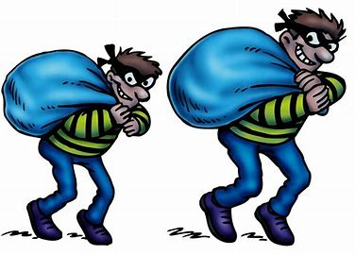
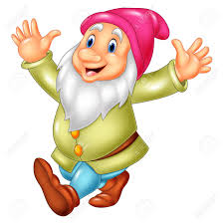
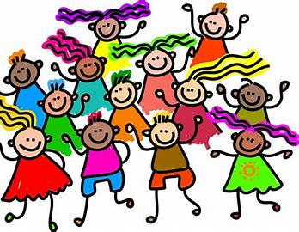
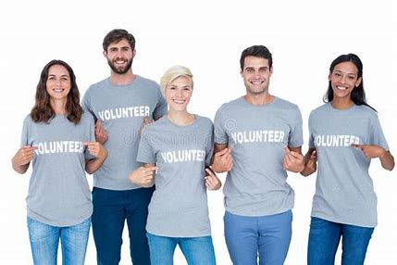
calves thieves wharves
dwarves ourselves themselves

Slide 20
Make these plural words into singular nouns.

Slide 21
selves
scarves
wives
elves
lives
loaves
hooves
leaves
self
scarf
wife
elf
life
loaf
hoof
leaf
knives
wolves
shelves
halves
calves
thieves
wharves
dwarves
knife
wolf
shelf
half
calf
thief
wharf
dwarf

Slide 22
Make the plural of each noun and draw some more examples

Slide 23
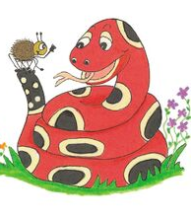
monkeys

Slide 24
monkeys
geese

Slide 25
monkeys
geese
cherries

Slide 26
monkeys
geese
cherries
tomatoes

Slide 27
monkeys
geese
cherries
tomatoes
bushes

Slide 28
monkeys
geese
cherries
tomatoes
bushes
radios

Slide 29
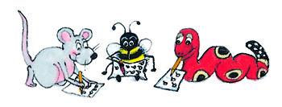
Parsing

Slide 30
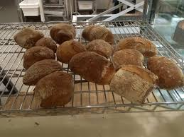
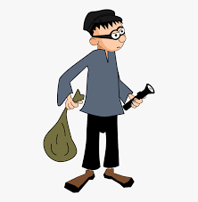
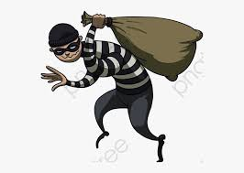
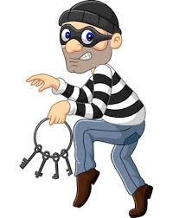
The greedy thieves are stealing the warm loaves from
the bakery shelves.

Slide 31
The greedy thieves are stealing the warm loaves from
the bakery shelves.

Slide 32
The greedy thieves are stealing the warm loaves from
the bakery shelves.

Slide 33
The greedy thieves are stealing the warm loaves from
the bakery shelves.

Slide 34
The greedy thieves are stealing the warm loaves from
the bakery shelves.

Slide 35
The greedy thieves are stealing the warm loaves from
the bakery shelves.

Slide 36
The greedy thieves are stealing the warm loaves from
the bakery shelves.

Slide 37
The greedy thieves are stealing the warm loaves from
the bakery shelves.

Slide 38
The greedy thieves are stealing the warm loaves from
the bakery shelves.

Slide 39
Dictation

Slide 40
Dictation
1.
2.
3.

Slide 41
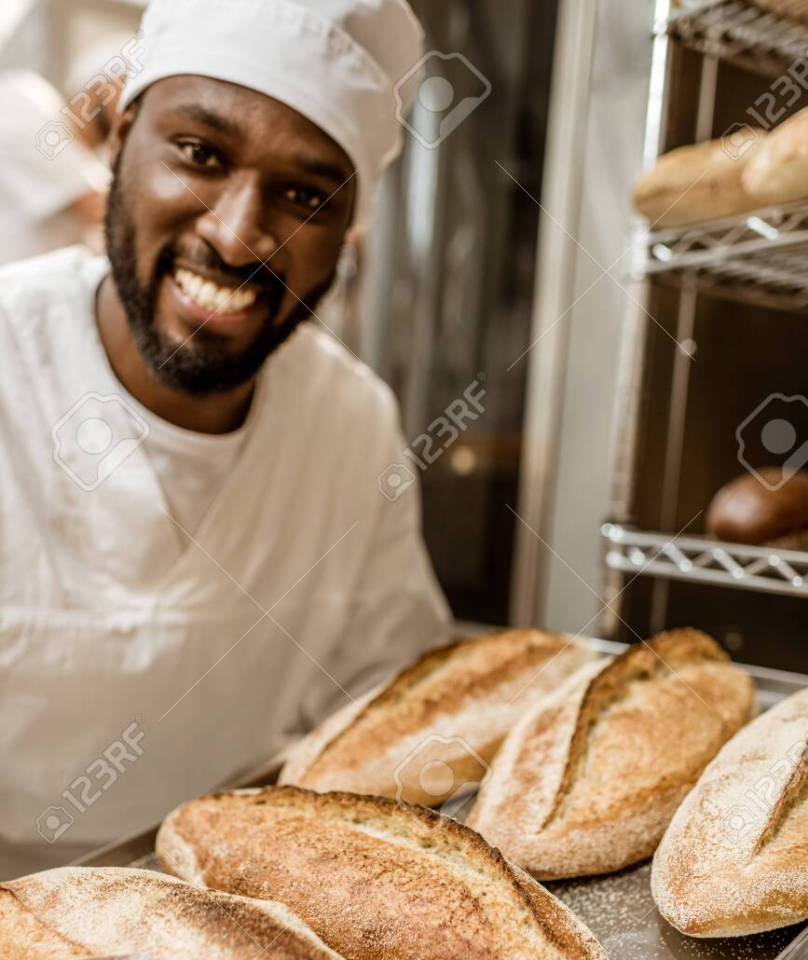

Slide 42
The baker put the loaves on the shelves.

Slide 43
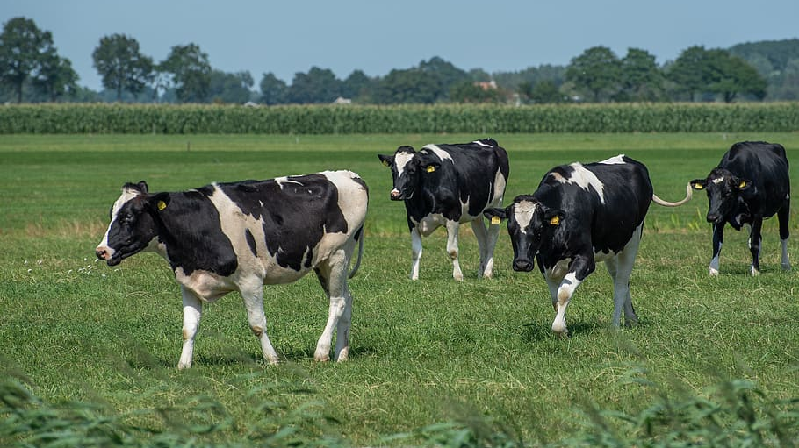

Slide 44
The cows and their calves grazed in the field.

Slide 45
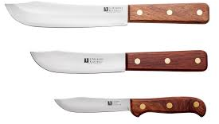
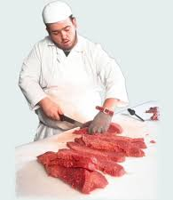

Slide 46
“Are the knives sharp?” asked
the butcher.

Slide 47
Thank you!

