Slide 1
Jolly Grammar
4a-1

Slide 2
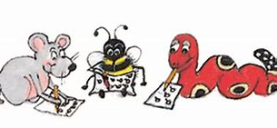
Spelling Test 36
(Grammar 3)

Slide 3
exit

Slide 4
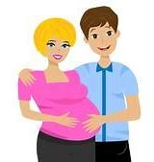
exit
expect

Slide 5
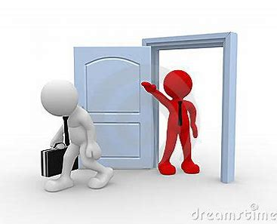
exit
expect
expel

Slide 6
exit
expect
expel
expert

Slide 7
exit
expect
expel
expert
extra

Slide 8
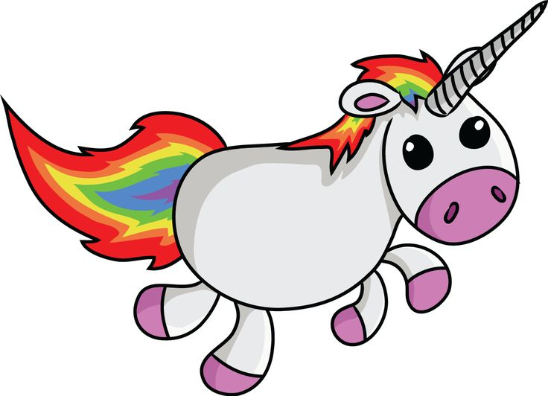
exit
expect
expel
expert
extra
exist

Slide 9
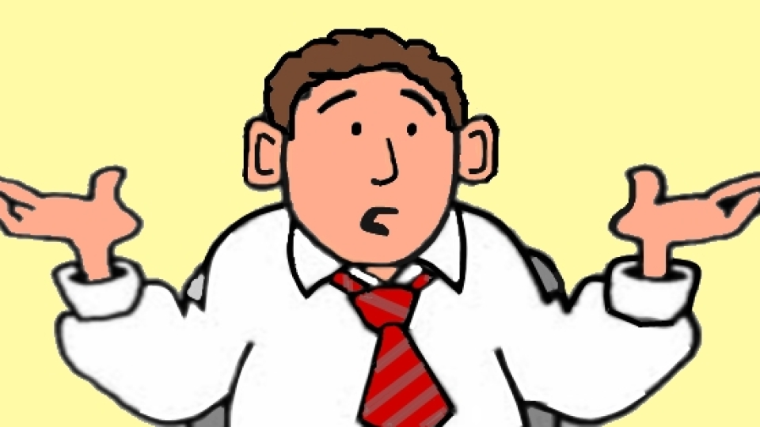
exit
expect
expel
expert
extra
exist
7.excuse

Slide 10
exit
expect
expel
expert
extra
exist
7.excuse
8.except

Slide 11
exit
expect
expel
expert
extra
exist
7.excuse
8.except
9.explain

Slide 12
exit
expect
expel
expert
extra
exist
7.excuse
8.except
9.explain
10.explore

Slide 13
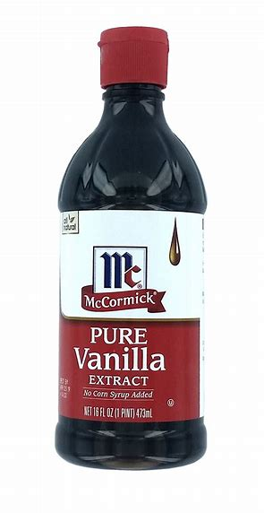
exit
expect
expel
expert
extra
exist
7.excuse
8.except
9.explain
10.explore
11.extract

Slide 14
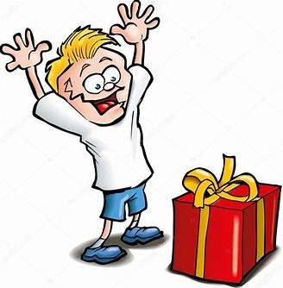
exit
expect
expel
expert
extra
exist
7.excuse
8.except
9.explain
10.explore
11.extract
12.excite

Slide 15
exit
expect
expel
expert
extra
exist
7.excuse
8.except
9.explain
10.explore
11.extract
12.excite
13.excellent

Slide 16
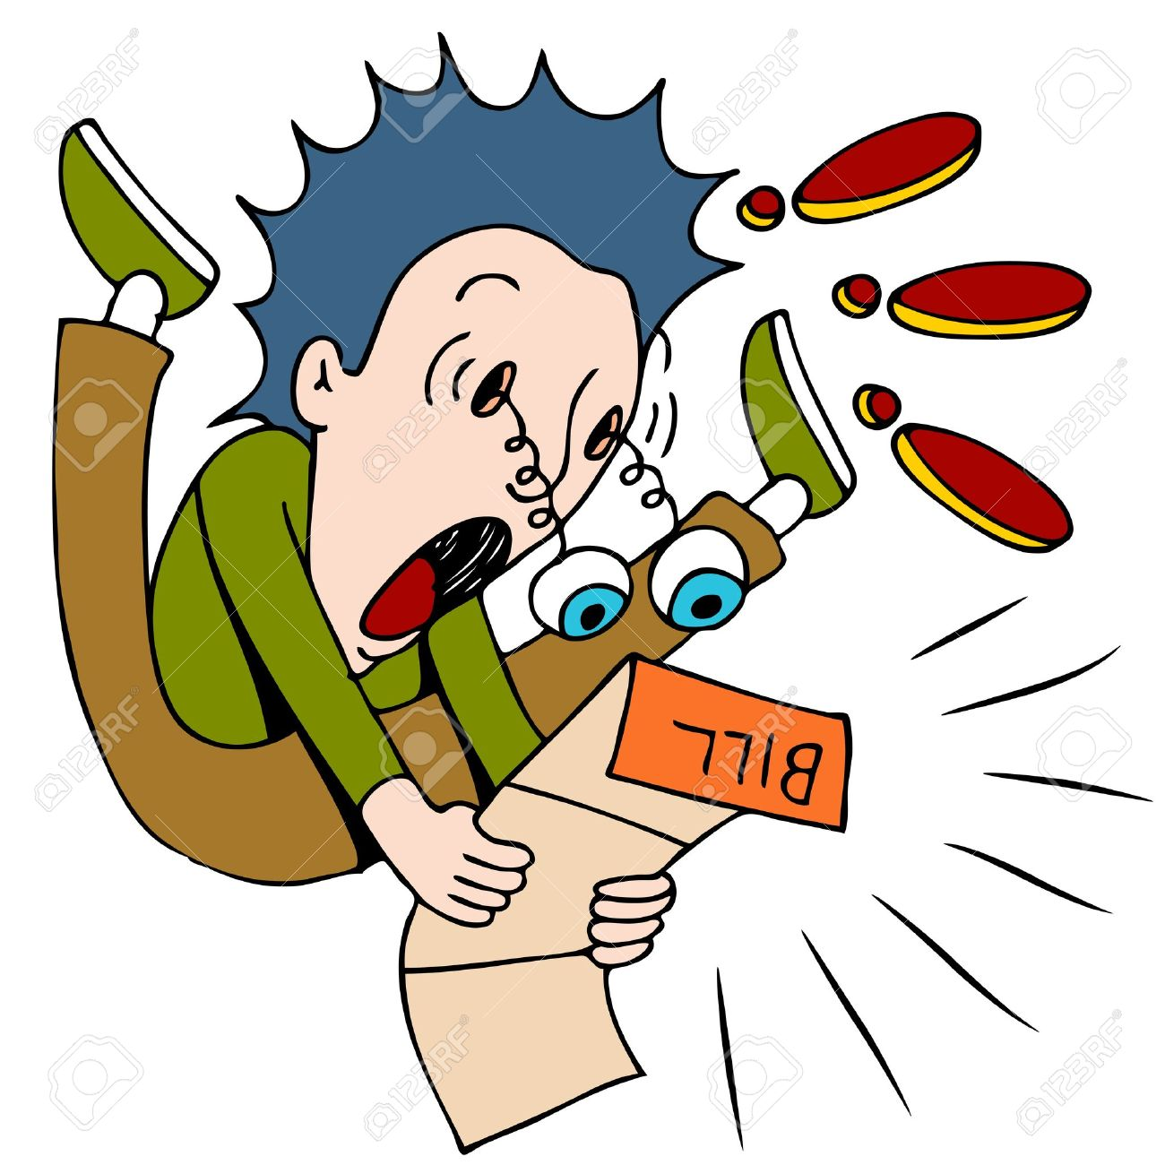
exit
expect
expel
expert
extra
exist
7.excuse
8.except
9.explain
10.explore
11.extract
12.excite
13.excellent
14.expensive

Slide 17
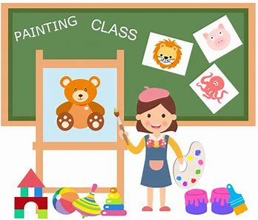
exit
expect
expel
expert
extra
exist
7.excuse
8.except
9.explain
10.explore
11.extract
12.excite
13.excellent
14.expensive
15.example

Slide 18
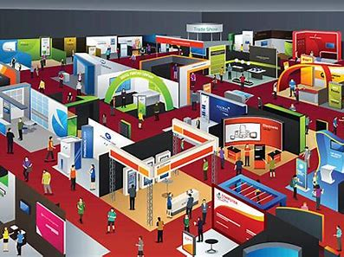
exit
expect
expel
expert
extra
exist
7.excuse
8.except
9.explain
10.explore
11.extract
12.excite
13.excellent
14.expensive
15.example
16.exhibition

Slide 19
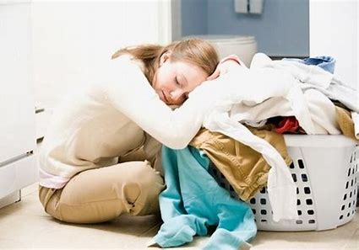
exit
expect
expel
expert
extra
exist
7.excuse
8.except
9.explain
10.explore
11.extract
12.excite
13.excellent
14.expensive
15.example
16.exhibition
17.exhausted

Slide 20
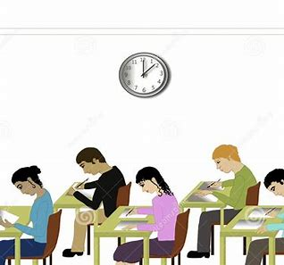
exit
expect
expel
expert
extra
exist
7.excuse
8.except
9.explain
10.explore
11.extract
12.excite
13.excellent
14.expensive
15.example
16.exhibition
17.exhausted
18.examination

Slide 21
Spelling
<ch><sh>
and<th>

Slide 22
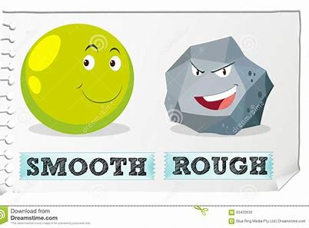
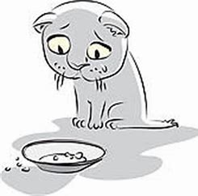
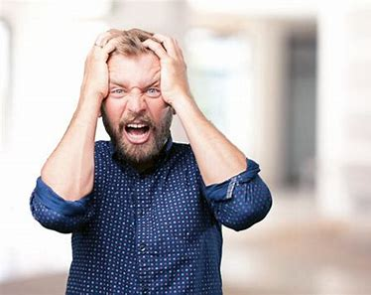
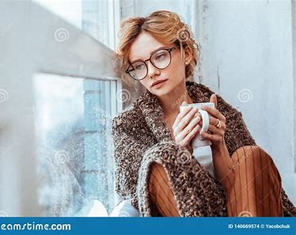
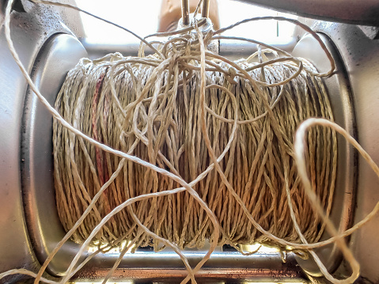
smooth famish thorny
loathing backlash cheerless

Slide 23
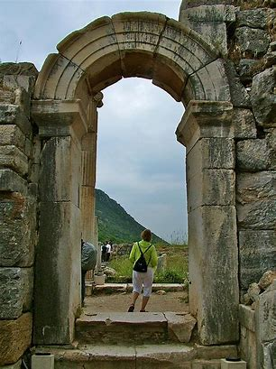
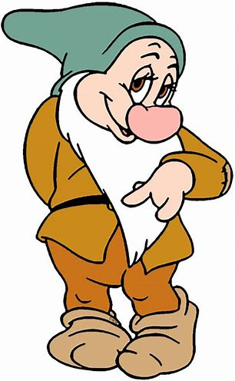
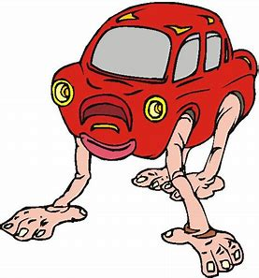
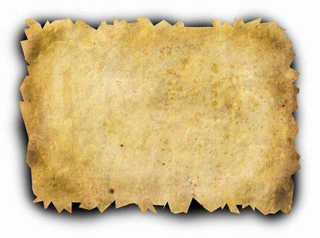
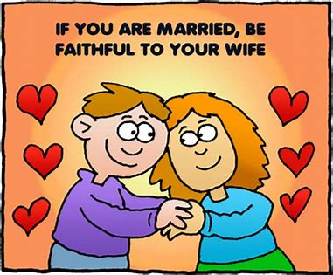
benchmark archway bashful
faithful outlandish parchment

Slide 24
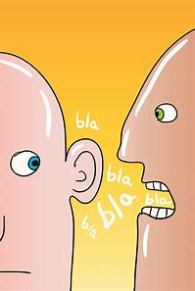
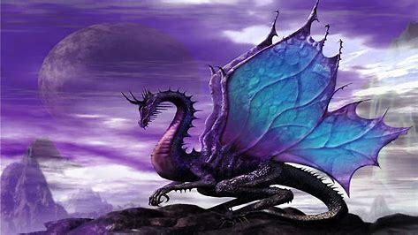
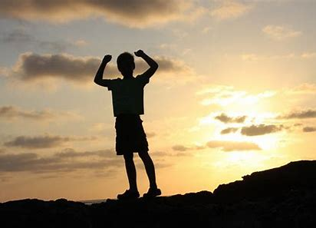
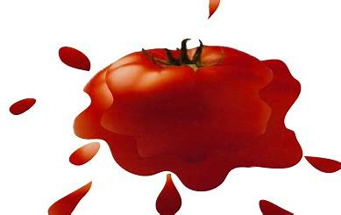
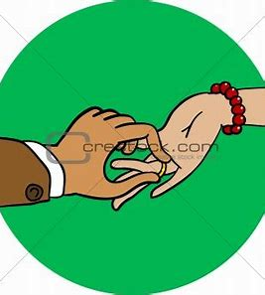
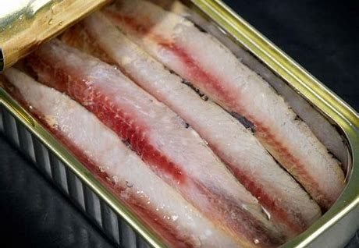
gibberish mythical achieve
anchovy squashed betrothed

Slide 26
Complete the words.

Slide 27
ch
sh
th

Slide 28
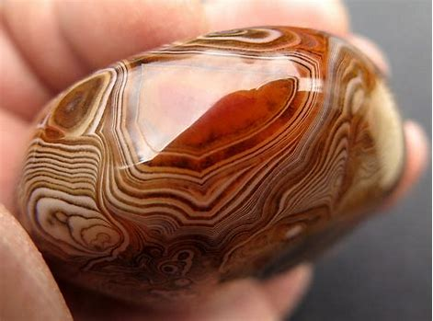
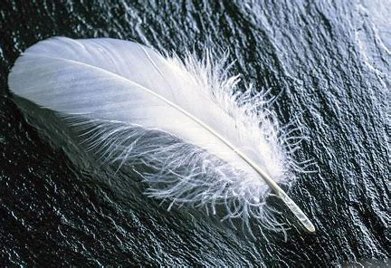
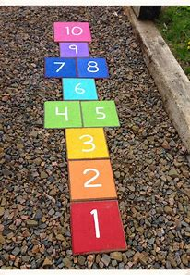
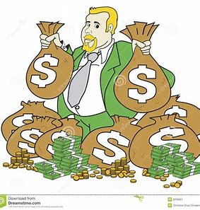
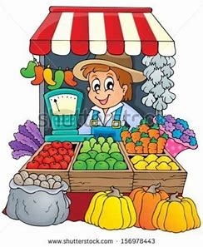
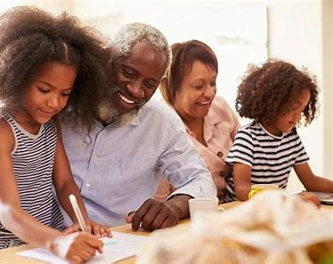
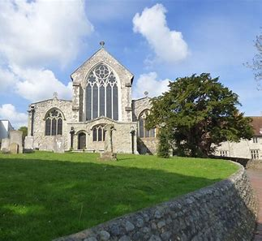
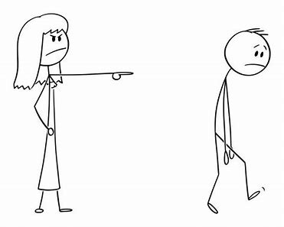
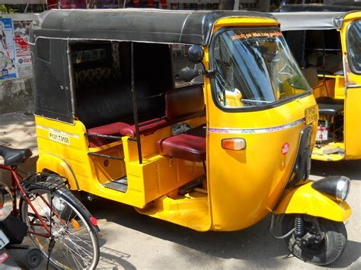
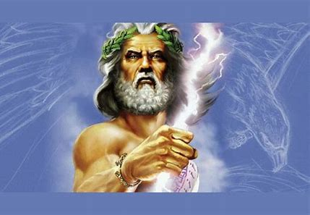

Slide 29
Let’s review
syllables.

Slide 30
outlandish cheerless gibberish
famish bashful thorny

Slide 31
outlandish cheerless gibberish
famish bashful thorny

Slide 32
outlandish cheerless gibberish
famish bashful thorny

Slide 33
outlandish cheerless gibberish
famish bashful thorny

Slide 34
outlandish cheerless gibberish
famish bashful thorny

Slide 35
outlandish cheerless gibberish
famish bashful thorny

Slide 36
outlandish cheerless gibberish
famish bashful thorny

Slide 37
parsing

Slide 38
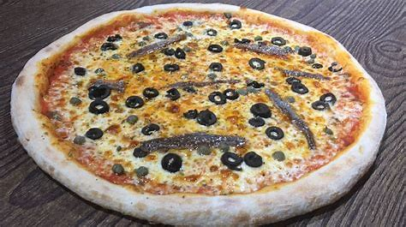
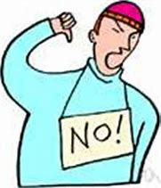
I loathe fishy anchovy on my pizza.

Slide 39
I loathe fishy anchovy on my pizza.

Slide 40
I loathe fishy anchovy on my pizza.

Slide 41
I loathe fishy anchovy on my pizza.

Slide 42
I loathe fishy anchovy on my pizza.

Slide 43
I loathe fishy anchovy on my pizza.

Slide 44
I loathe fishy anchovy on my pizza.

Slide 45
I loathe fishy anchovy on my pizza.

Slide 46
s
I loathe fishy anchovy on my pizza.

Slide 47
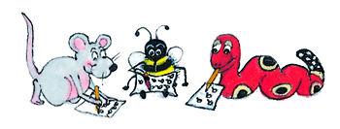
Dictation

Slide 48
Dictation
1.
2.
3.

Slide 49
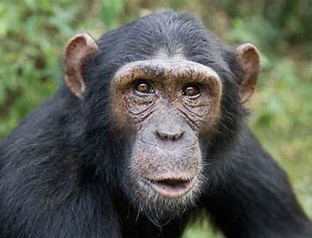

Slide 50
The chimpanzee was talking a lot of gibberish.

Slide 51
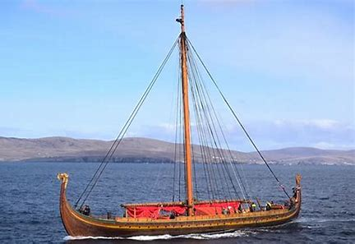
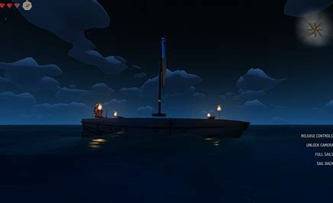

Slide 52
The Viking longship was vanishing into the distance.

Slide 53
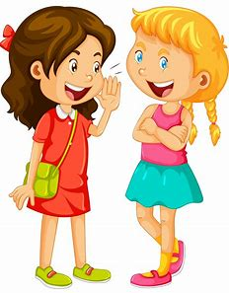

Slide 54
Both of the girls wished for good weather.

