Slide 1
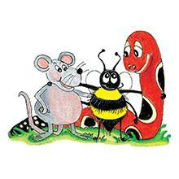
Jolly Grammar 3a-24

Slide 2
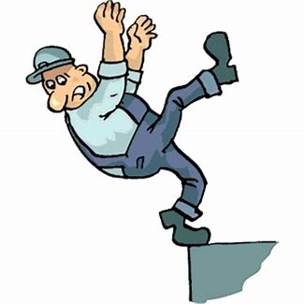
edge

Slide 3
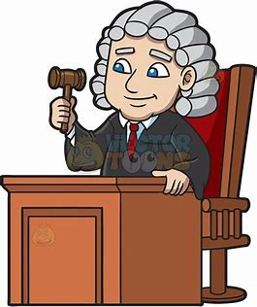
edge
judge

Slide 4
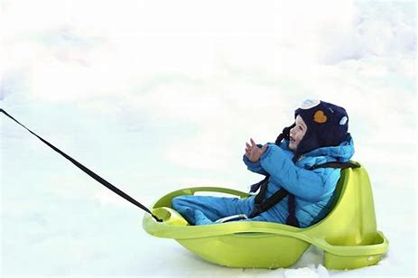
edge
judge
sledge

Slide 5
edge
judge
sledge
badge

Slide 6
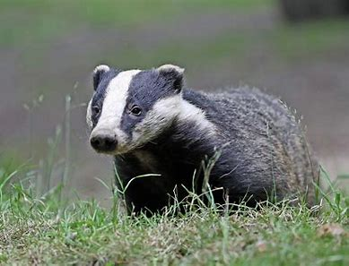
edge
judge
sledge
badge
badger

Slide 7
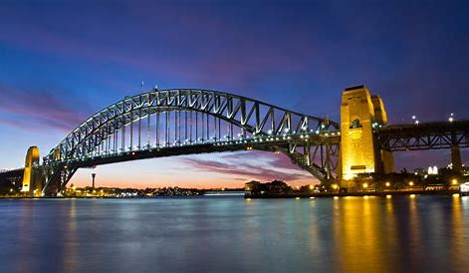
edge
judge
sledge
badge
badger
bridge

Slide 8
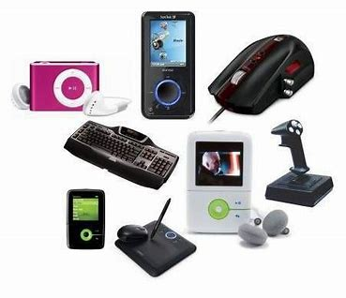
edge
judge
sledge
badge
badger
bridge
7. gadget

Slide 9
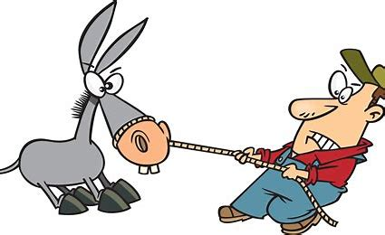
edge
judge
sledge
badge
badger
bridge
7. gadget
8. budge

Slide 10
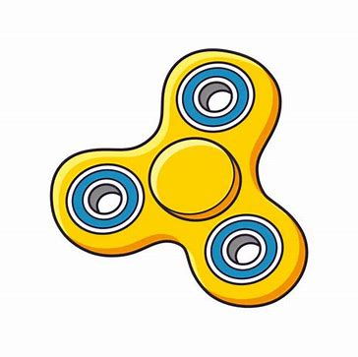
edge
judge
sledge
badge
badger
bridge
7. gadget
8. budge
9. fidget

Slide 11
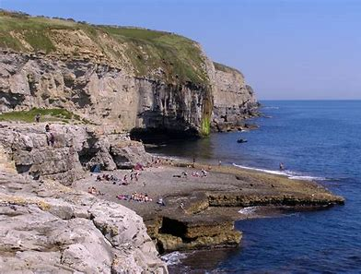
edge
judge
sledge
badge
badger
bridge
7. gadget
8. budge
9. fidget
10. ledge

Slide 12
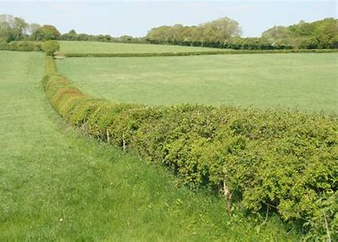
edge
judge
sledge
badge
badger
bridge
7. gadget
8. budge
9. fidget
10. ledge
11. hedgerow

Slide 13
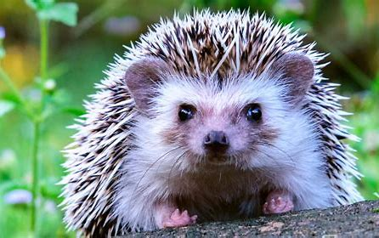
edge
judge
sledge
badge
badger
bridge
7. gadget
8. budge
9. fidget
10. ledge
11. hedgerow
12. hedgehog

Slide 14
edge
judge
sledge
badge
badger
bridge
7. gadget
8. budge
9. fidget
10. ledge
11. hedgerow
12. hedgehog
13. knowledge

Slide 15
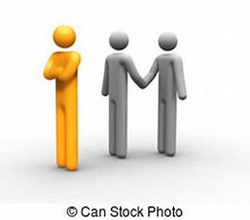
edge
judge
sledge
badge
badger
bridge
7. gadget
8. budge
9. fidget
10. ledge
11. hedgerow
12. hedgehog
13. knowledge
14. begrudge

Slide 16
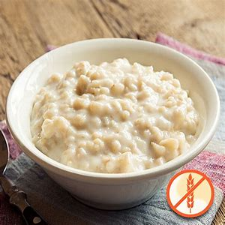
edge
judge
sledge
badge
badger
bridge
7. gadget
8. budge
9. fidget
10. ledge
11. hedgerow
12. hedgehog
13. knowledge
14. begrudge
15. porridge

Slide 17
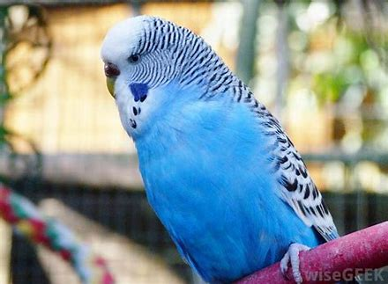
edge
judge
sledge
badge
badger
bridge
7. gadget
8. budge
9. fidget
10. ledge
11. hedgerow
12. hedgehog
13. knowledge
14. begrudge
15. porridge
16. budgerigar

Slide 18
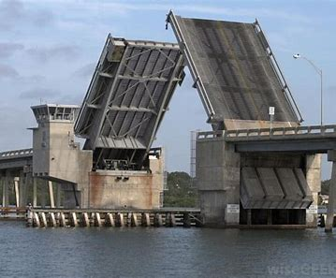
edge
judge
sledge
badge
badger
bridge
7. gadget
8. budge
9. fidget
10. ledge
11. hedgerow
12. hedgehog
13. knowledge
14. begrudge
15. porridge
16. budgerigar
17. drawbridge

Slide 19
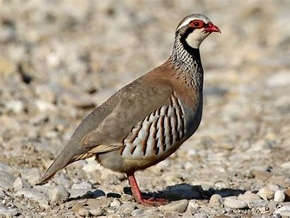
edge
judge
sledge
badge
badger
bridge
7. gadget
8. budge
9. fidget
10. ledge
11. hedgerow
12. hedgehog
13. knowledge
14. begrudge
15. porridge
16. budgerigar
17. drawbridge
18. partridge

Slide 20
Let’s review
syllables.

Slide 21
・Words are made up of units of sound called syllables
・Each syllable has one vowel sound
request
hedgehog
germ
bluebell
princess

Slide 22
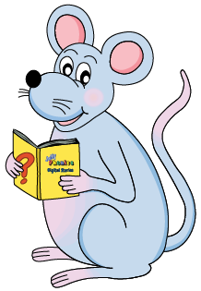
・Double consonants
puppet happen bitten rotten humming

Slide 23
・Double consonants
puppet happen bitten rotten humming
・<ck> words
cracker rocket chicken cricket

Slide 24
Activity Page:
More Syllables

Slide 25
ladder kitten cracker
jogging cricket pepper
bramble ankle jungle
simple uncle thimble
pebble pickle dazzle
assemble unsaddle unbuckle

Slide 26
ladder kitten cracker
jogging cricket pepper
bramble ankle jungle
simple uncle thimble
pebble pickle dazzle
assemble unsaddle unbuckle

Slide 27
・Double consonants
puppet happen bitten rotten humming
・<ck> words
cracker rocket chicken cricket

Slide 28
・Double consonants
puppet happen bitten rotten humming
・<ck> words
cracker rocket chicken cricket
・＜le＞words
candle saddle ramble ankle temple
pickle cackle buckle

Slide 29
ladder kitten cracker
jogging cricket pepper
bramble ankle jungle
simple uncle thimble
pebble pickle dazzle
assemble unsaddle unbuckle

Slide 30
ladder kitten cracker
jogging cricket pepper
bramble ankle jungle
simple uncle thimble
pebble pickle dazzle
assemble unsaddle unbuckle

Slide 31
ladder kitten cracker
jogging cricket pepper
bramble ankle jungle
simple uncle thimble
pebble pickle dazzle
assemble unsaddle unbuckle

Slide 32
Thank you!

