Slide 1
Jolly Grammar 3a-21

Slide 2
Let’s revise
Places as
Proper Nouns

Slide 3
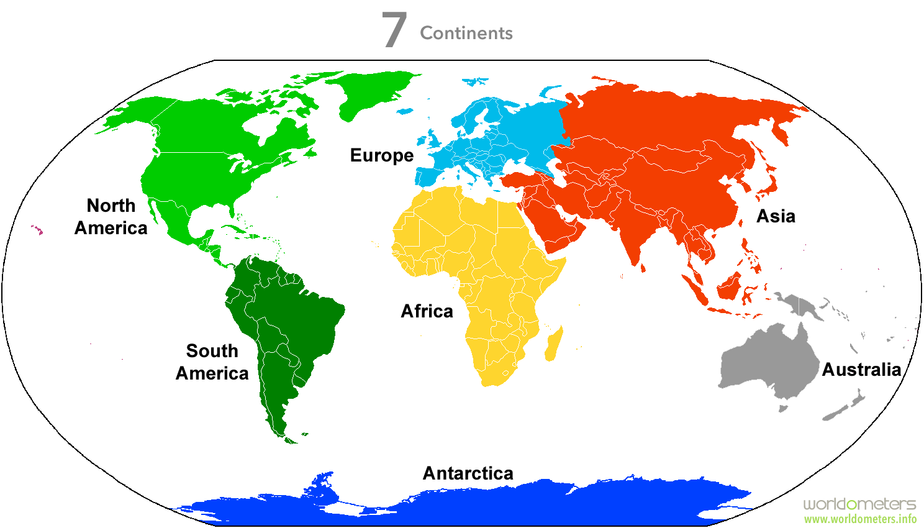

Slide 4
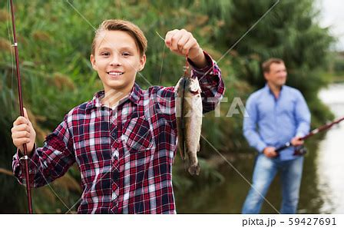
catch
/ch/

Slide 5
Spelling List
The <tch> Spelling of the /ch/ Sound

Slide 6
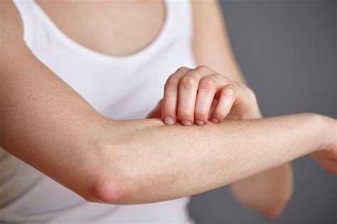
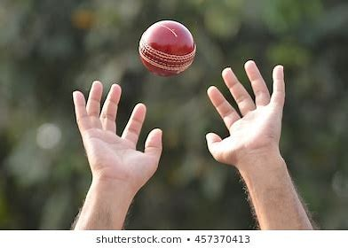
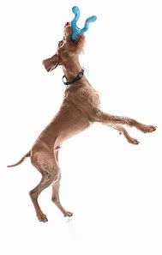
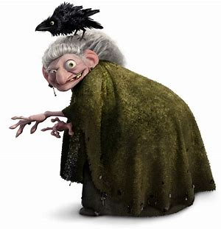
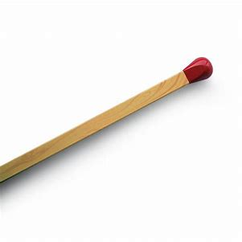
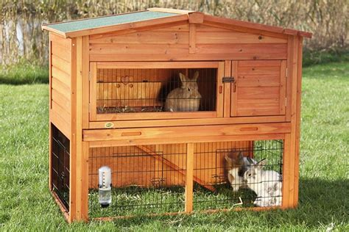
itch catch fetch
witch match hutch

Slide 7
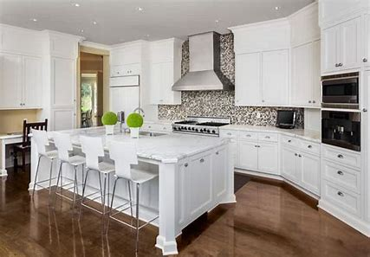
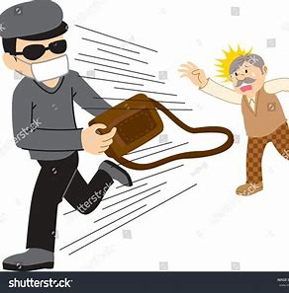
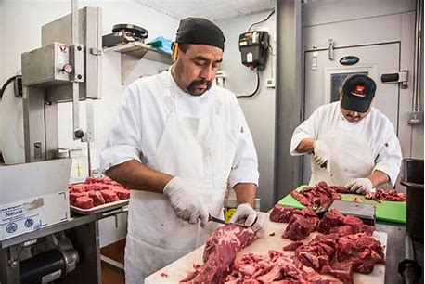
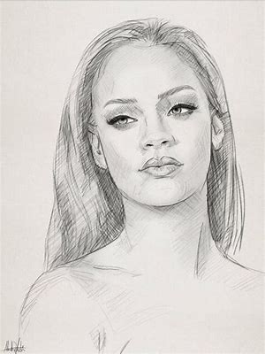
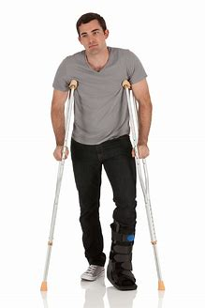
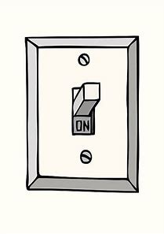
kitchen snatch butcher
switch sketch crutches

Slide 8
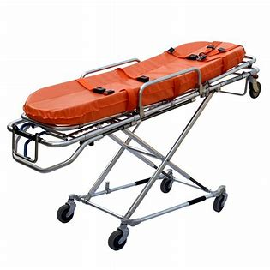
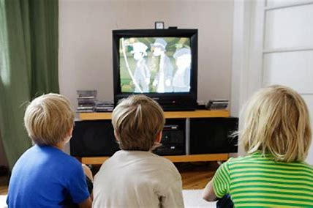
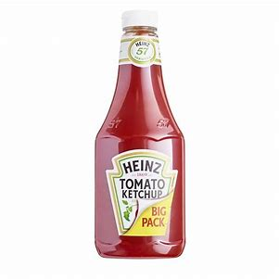
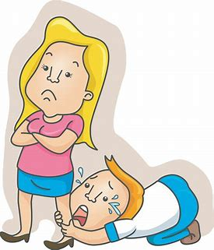
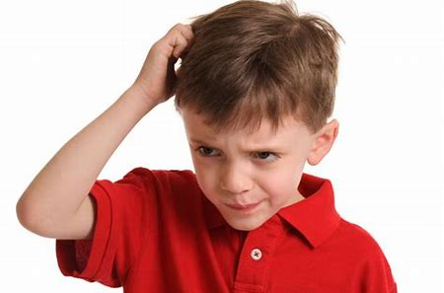
watching stretcher ketchup
wretched scratching stretching

Slide 9
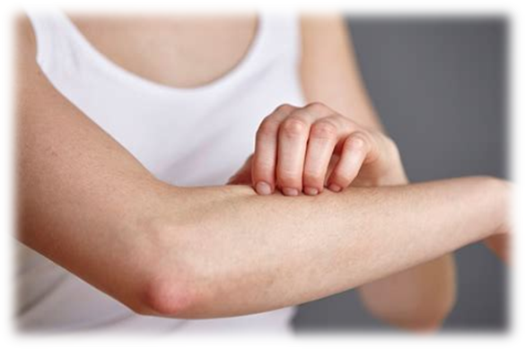
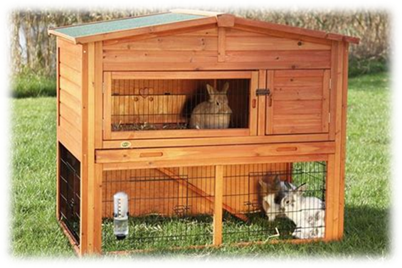
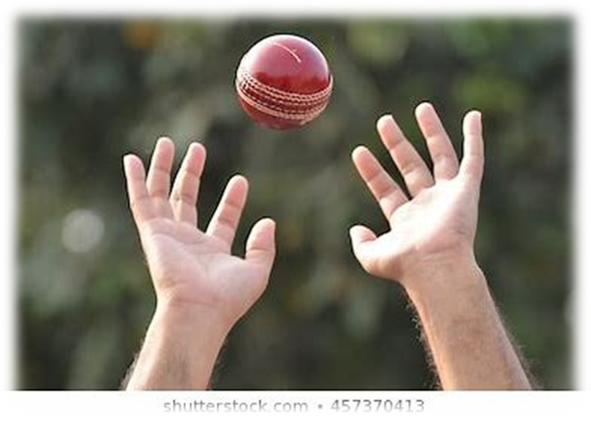
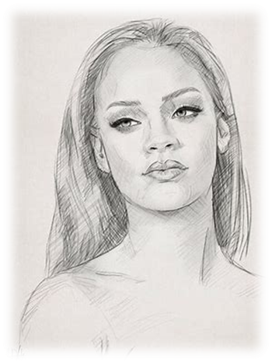
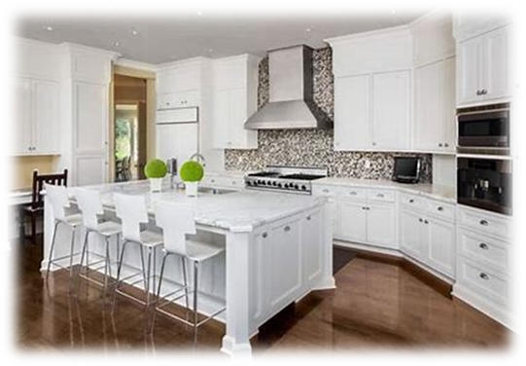
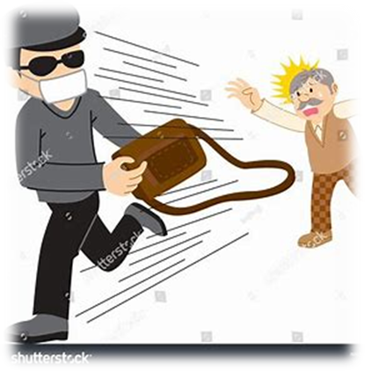
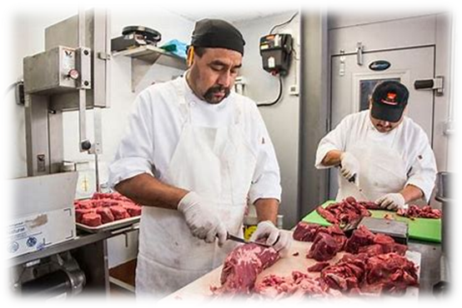
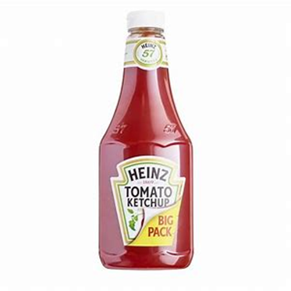
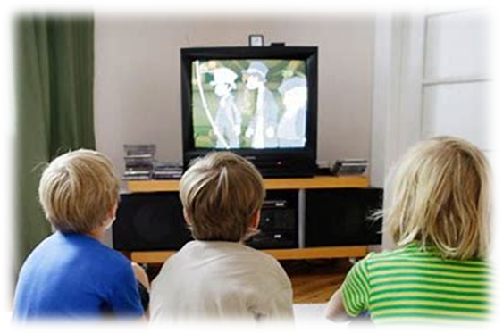
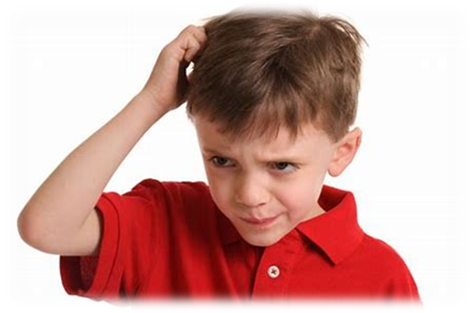

Slide 10
Which words in the spelling list match these descriptions?

Slide 11
Let’s parse
sentences.

Slide 12
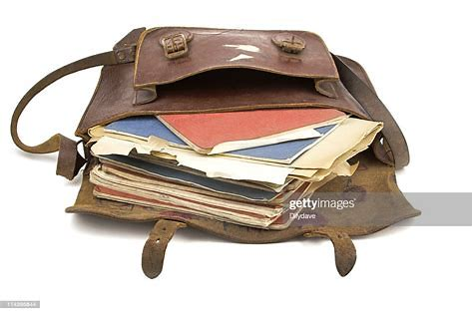
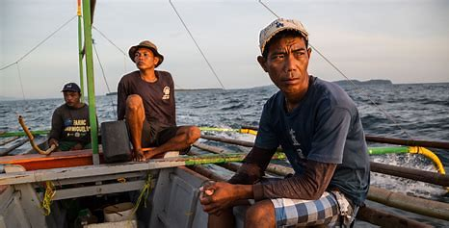
Parse these sentences.
The small boy quickly
put his books in his satchel.
I watched the quiet fisherman
on the riverbank.

Slide 13
Parse these sentences.
The small boy quickly
put his books in his satchel.
I watched the quiet fisherman
on the riverbank.

Slide 14
Parse these sentences.
The small boy quickly
put his books in his satchel.
I watched the quiet fisherman
on the riverbank.

Slide 15
Parse these sentences.
The small boy quickly
put his books in his satchel.
I watched the quiet fisherman
on the riverbank.

Slide 16
Parse these sentences.
The small boy quickly
put his books in his satchel.
I watched the quiet fisherman
on the riverbank.

Slide 17
Parse these sentences.
The small boy quickly
put his books in his satchel.
I watched the quiet fisherman
on the riverbank.

Slide 18
Parse these sentences.
The small boy quickly
put his books in his satchel.
I watched the quiet fisherman
on the riverbank.

Slide 19
Parse these sentences.
The small boy quickly
put his books in his satchel.
I watched the quiet fisherman
on the riverbank.

Slide 20
Parse these sentences.
The small boy quickly
put his books in his satchel.
I watched the quiet fisherman
on the riverbank.

Slide 21
Parse these sentences.
The small boy quickly
put his books in his satchel.
I watched the quiet fisherman
on the riverbank.

Slide 22
Parse these sentences.
The small boy quickly
put his books in his satchel.
I watched the quiet fisherman
on the riverbank.

Slide 23
Parse these sentences.
The small boy quickly
put his books in his satchel.
I watched the quiet fisherman
on the riverbank.

Slide 24
Parse these sentences.
The small boy quickly
put his books in his satchel.
I watched the quiet fisherman
on the riverbank.

Slide 25
Parse these sentences.
The small boy quickly
put his books in his satchel.
I watched the quiet fisherman
on the riverbank.

Slide 26
Parse these sentences.
The small boy quickly
put his books in his satchel.
I watched the quiet fisherman
on the riverbank.

Slide 27
Parse these sentences.
The small boy quickly
put his books in his satchel.
I watched the quiet fisherman
on the riverbank.

Slide 28
Dictation

Slide 29
Dictation
1.
2.
3.

Slide 30
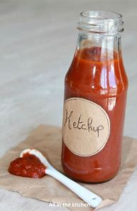

Slide 31
I went to the kitchen to fetch the ketchup.

Slide 32
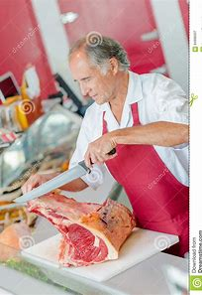

Slide 33
We watched the butcher cut up the meat.

Slide 34
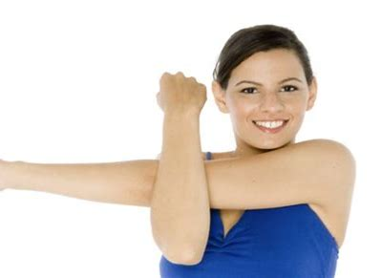

Slide 35
He stretched his arms and legs when he stood up.

Slide 36
Thank you!

