Slide 1
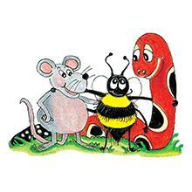
Jolly Grammar 3a-5

Slide 2
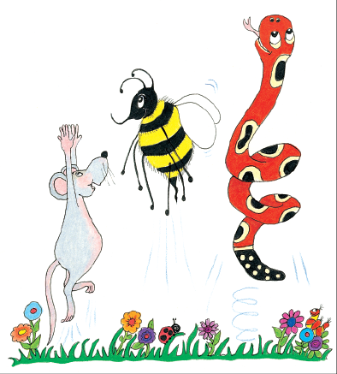
Let’s review
Parts of Speech.

Slide 3
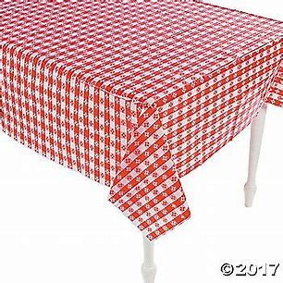
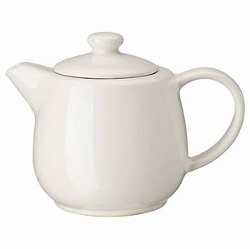
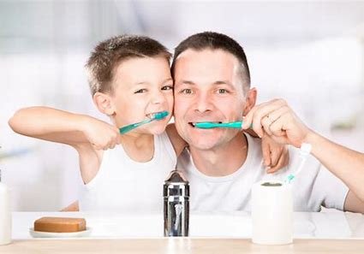
Parse these sentences.
The old teapot fell off the little table.
They quickly washed and brushed their teeth.
A tall beanstalk grew rapidly outside
the cottage.

Slide 4
Parse these sentences.
The old teapot fell off the little table.
They quickly washed and brushed their teeth.
A tall beanstalk grew rapidly outside
the cottage.

Slide 5
Parse these sentences.
The old teapot fell off the little table.
They quickly washed and brushed their teeth.
A tall beanstalk grew rapidly outside
the cottage.

Slide 6
Parse these sentences.
The old teapot fell off the little table.
They quickly washed and brushed their teeth.
A tall beanstalk grew rapidly outside
the cottage.

Slide 7
Parse these sentences.
The old teapot fell off the little table.
They quickly washed and brushed their teeth.
A tall beanstalk grew rapidly outside
the cottage.

Slide 8
Parse these sentences.
The old teapot fell off the little table.
They quickly washed and brushed their teeth.
A tall beanstalk grew rapidly outside
the cottage.

Slide 9
Parse these sentences.
The old teapot fell off the little table.
They quickly washed and brushed their teeth.
A tall beanstalk grew rapidly outside
the cottage.

Slide 10
Parse these sentences.
The old teapot fell off the little table.
They quickly washed and brushed their teeth.
A tall beanstalk grew rapidly outside
the cottage.

Slide 11
Parse these sentences.
The old teapot fell off the little table.
They quickly washed and brushed their teeth.
A tall beanstalk grew rapidly outside
the cottage.

Slide 12
Parse these sentences.
The old teapot fell off the little table.
They quickly washed and brushed their teeth.
A tall beanstalk grew rapidly outside
the cottage.

Slide 13
Parse these sentences.
The old teapot fell off the little table.
They quickly washed and brushed their teeth.
A tall beanstalk grew rapidly outside
the cottage.

Slide 14
Parse these sentences.
The old teapot fell off the little table.
They quickly washed and brushed their teeth.
A tall beanstalk grew rapidly outside
the cottage.

Slide 15
Parse these sentences.
The old teapot fell off the little table.
They quickly washed and brushed their teeth.
A tall beanstalk grew rapidly outside
the cottage.

Slide 16
Parse these sentences.
The old teapot fell off the little table.
They quickly washed and brushed their teeth.
A tall beanstalk grew rapidly outside
the cottage.

Slide 17
Parse these sentences.
The old teapot fell off the little table.
They quickly washed and brushed their teeth.
A tall beanstalk grew rapidly outside
the cottage.

Slide 18
Parse these sentences.
The old teapot fell off the little table.
They quickly washed and brushed their teeth.
A tall beanstalk grew rapidly outside
the cottage.

Slide 19
Parse these sentences.
The old teapot fell off the little table.
They quickly washed and brushed their teeth.
A tall beanstalk grew rapidly outside
the cottage.

Slide 20
Parse these sentences.
The old teapot fell off the little table.
They quickly washed and brushed their teeth.
A tall beanstalk grew rapidly outside
the cottage.

Slide 21
Parse these sentences.
The old teapot fell off the little table.
They quickly washed and brushed their teeth.
A tall beanstalk grew rapidly outside
the cottage.

Slide 22
Parse these sentences.
The old teapot fell off the little table.
They quickly washed and brushed their teeth.
A tall beanstalk grew rapidly outside
the cottage.

Slide 23
Spelling List <ee><ea><e-e>

Slide 24
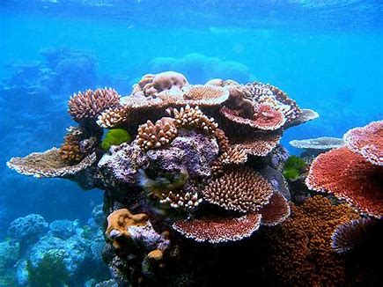
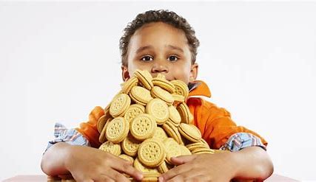
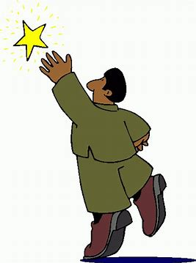
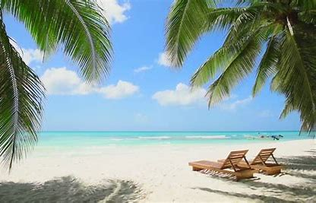
reef greed neat
reach eve beach

Slide 25
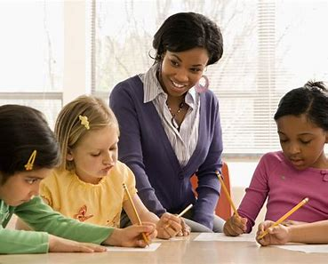
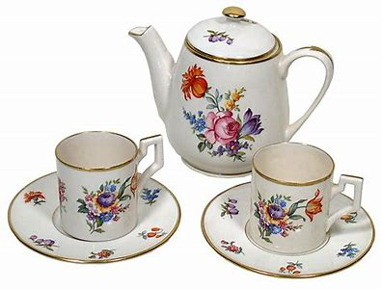
teacher theme coffee
teapot thirteen evening

Slide 26
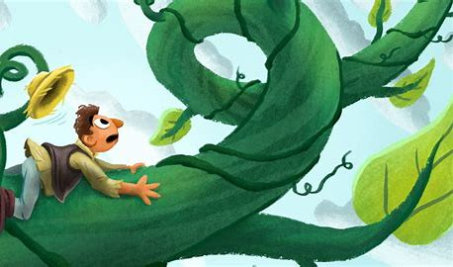
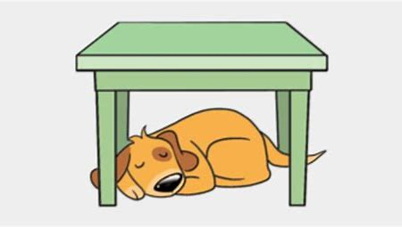
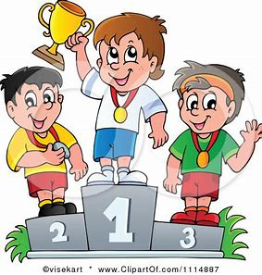
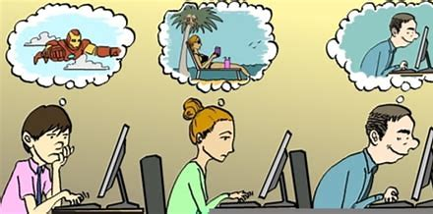
beanstalk underneath agreement
seaweed compete daydream

Slide 27
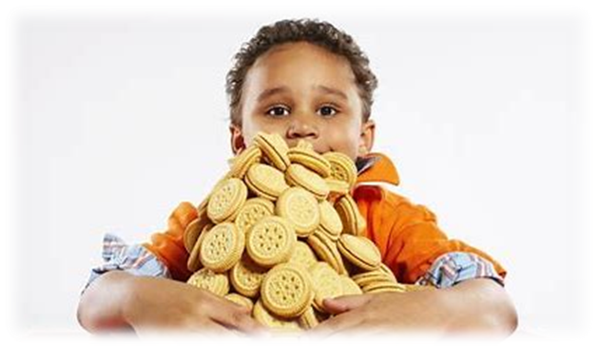
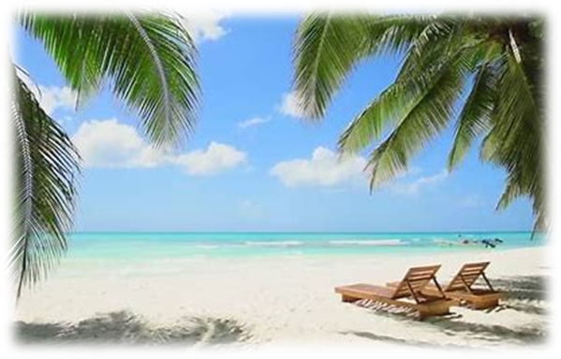
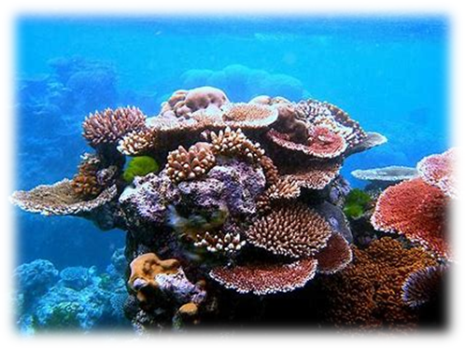
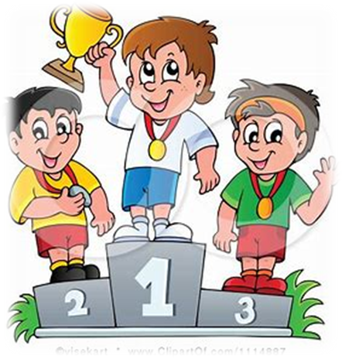
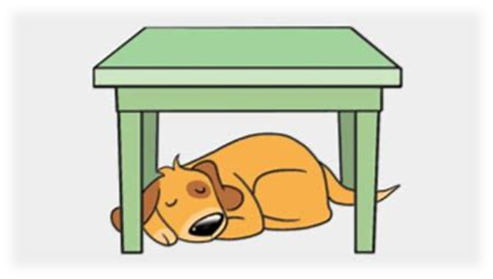
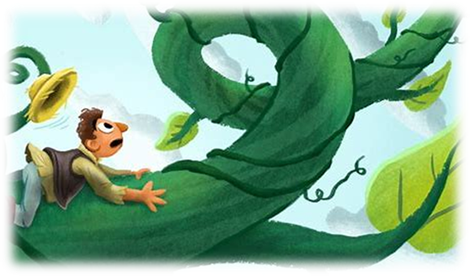
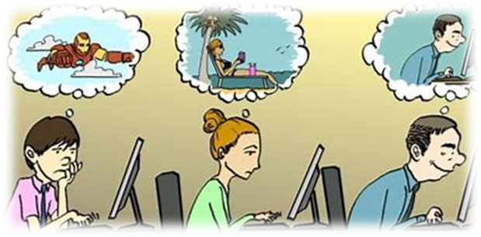

Slide 28
Spelling List
Fill in the mission letters

Slide 29
coffee
greed
agreement
thirteen
underneath

Slide 30
Dictation

Slide 31
Dictation
1.
2.
3.

Slide 32
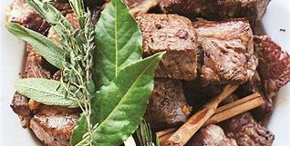
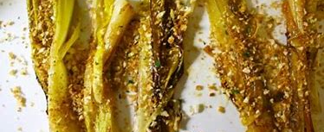

Slide 33
This evening I had meat and leeks for dinner.

Slide 34
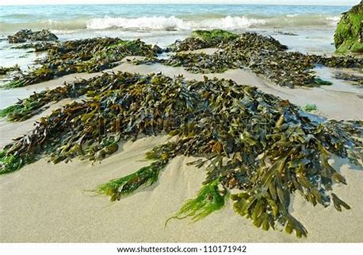

Slide 35
We found green seaweed on the beach.

Slide 36
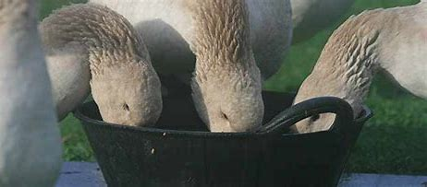
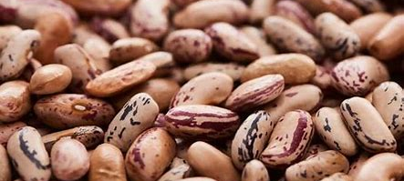

Slide 37
I had a dream about three geese eating beans.

