Slide 1
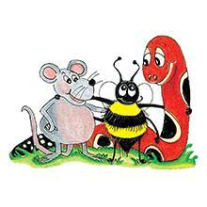
Jolly Grammar 3a-4

Slide 2
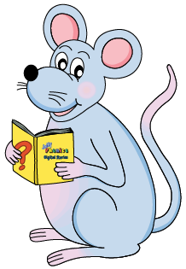
Mini Test 2

Slide 3
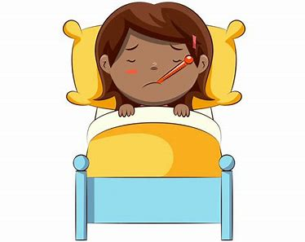
stay

Slide 4
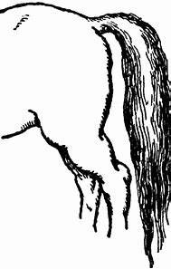
stay
tail

Slide 5
stay
tail
mail

Slide 6
stay
tail
mail
male

Slide 7
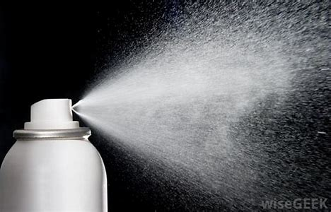
stay
tail
mail
male
spray

Slide 8
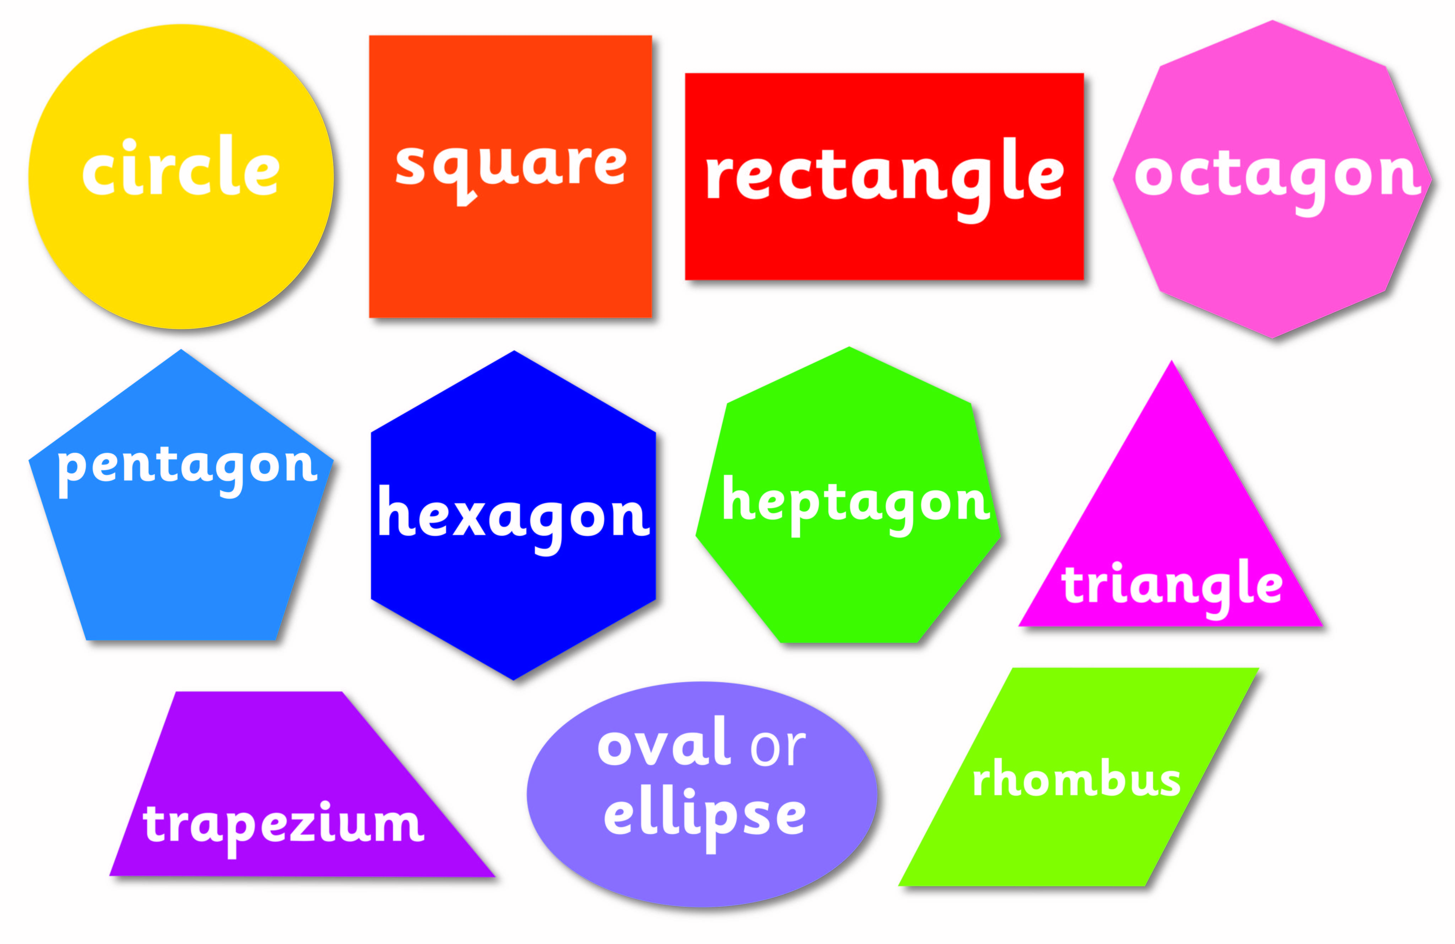
stay
tail
mail
male
spray
shape

Slide 9
stay
tail
mail
male
spray
shape
7.crayon

Slide 10
stay
tail
mail
male
spray
shape
7.crayon
8.praying

Slide 11
stay
tail
mail
male
spray
shape
7.crayon
8.praying
9.mainly

Slide 12
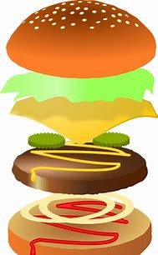
stay
tail
mail
male
spray
shape
7.crayon
8.praying
9.mainly
10.layer

Slide 13
stay
tail
mail
male
spray
shape
7.crayon
8.praying
9.mainly
10.layer
11.escape

Slide 14
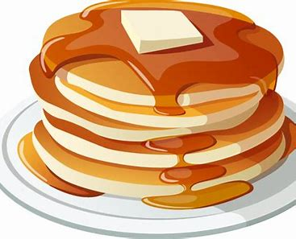
stay
tail
mail
male
spray
shape
7.crayon
8.praying
9.mainly
10.layer
11.escape
12.pancake

Slide 15
stay
tail
mail
male
spray
shape
7.crayon
8.praying
9.mainly
10.layer
11.escape
12.pancake
13.birthday

Slide 16
stay
tail
mail
male
spray
shape
7.crayon
8.praying
9.mainly
10.layer
11.escape
12.pancake
13.birthday
14.yesterday

Slide 17
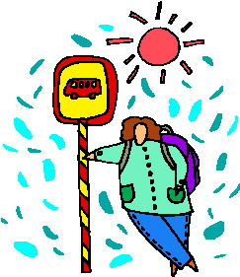
stay
tail
mail
male
spray
shape
7.crayon
8.praying
9.mainly
10.layer
11.escape
12.pancake
13.birthday
14.yesterday
15.waiting

Slide 18
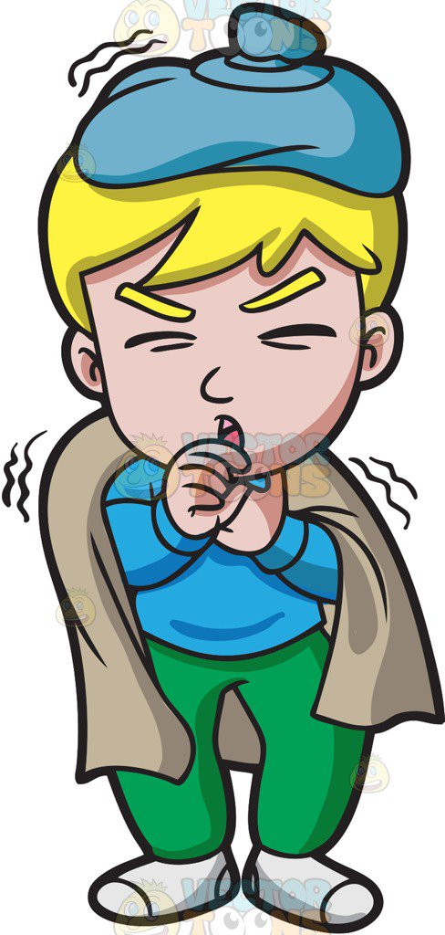
stay
tail
mail
male
spray
shape
7.crayon
8.praying
9.mainly
10.layer
11.escape
12.pancake
13.birthday
14.yesterday
15.waiting
16.ailing

Slide 19
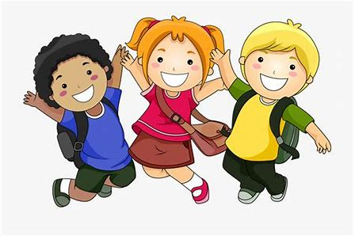
stay
tail
mail
male
spray
shape
7.crayon
8.praying
9.mainly
10.layer
11.escape
12.pancake
13.birthday
14.yesterday
15.waiting
16.ailing
17.animate

Slide 20
stay
tail
mail
male
spray
shape
7.crayon
8.praying
9.mainly
10.layer
11.escape
12.pancake
13.birthday
14.yesterday
15.waiting
16.ailing
17.animate
18.decade

Slide 21
Let’s revise parts of speech!

Slide 22
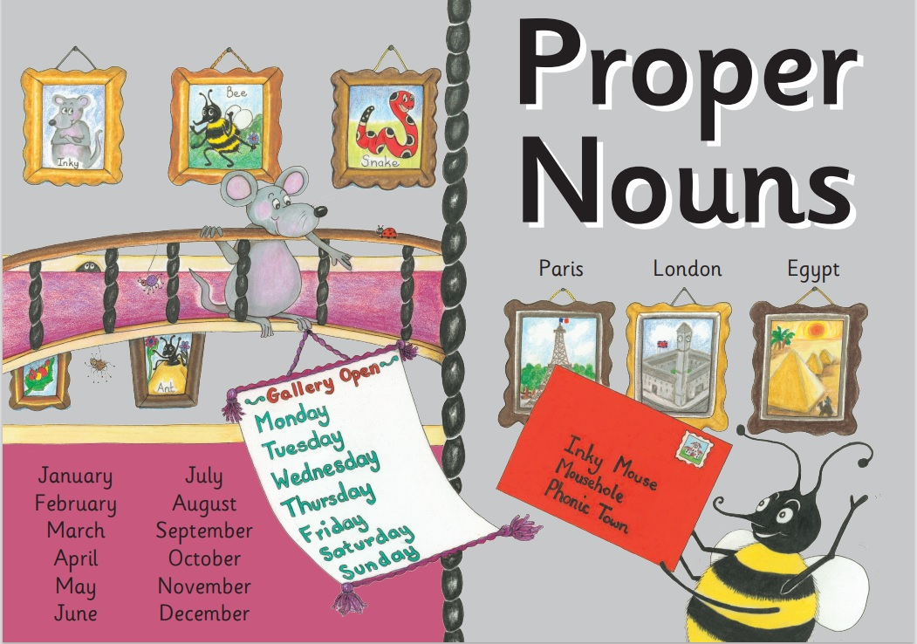

Slide 24
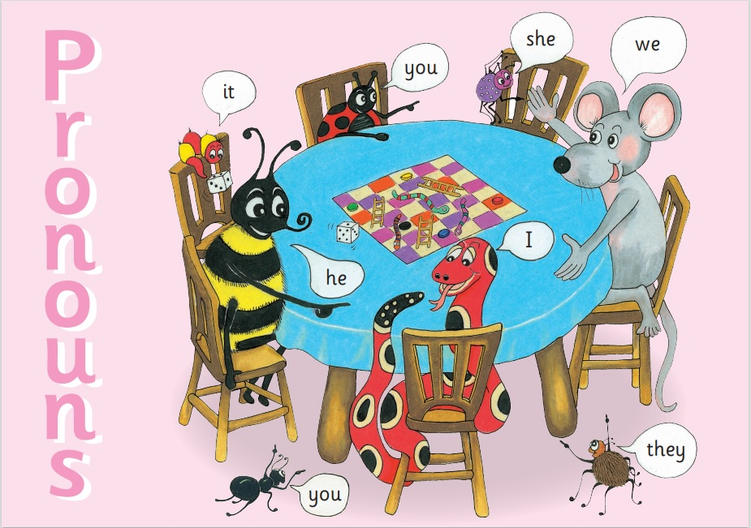

Slide 25
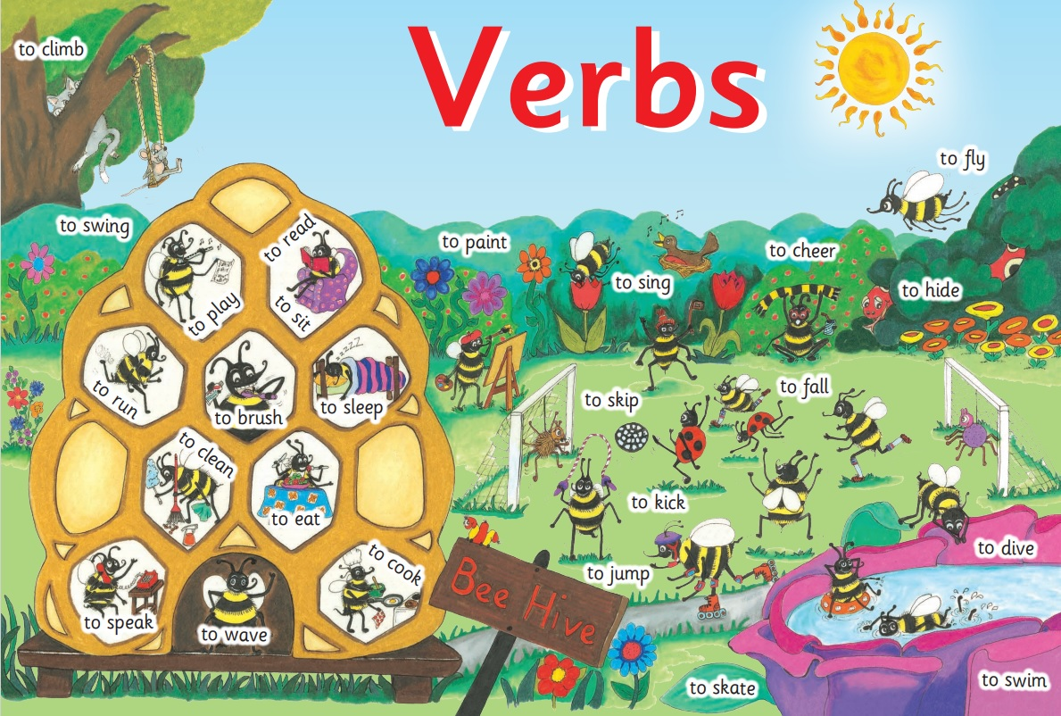

Slide 26
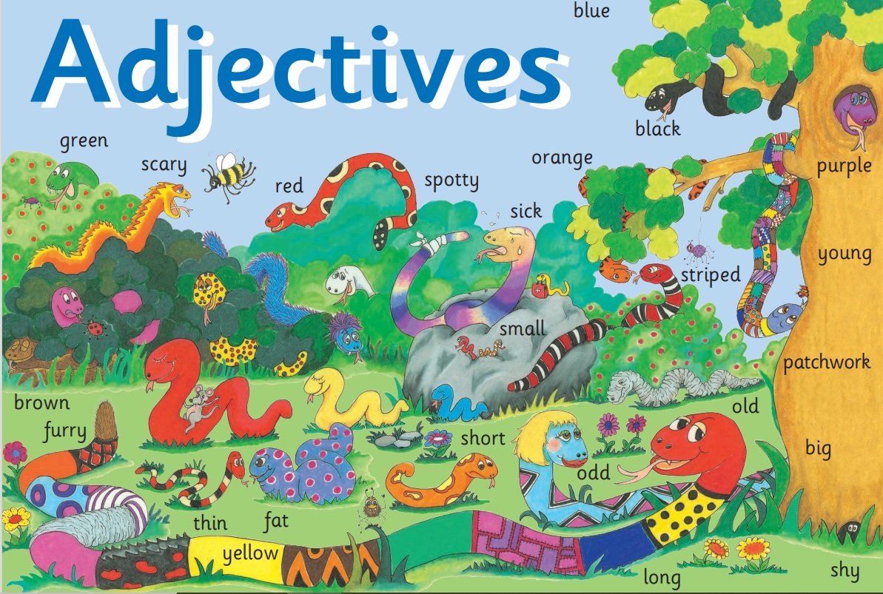

Slide 27
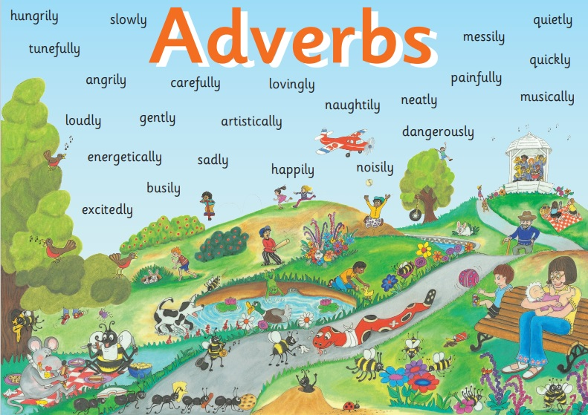

Slide 28
Preposition
Conjunction
with Big Book

Slide 29
Activity Page:
Identify as many of the different parts of speech as you can.

Slide 30
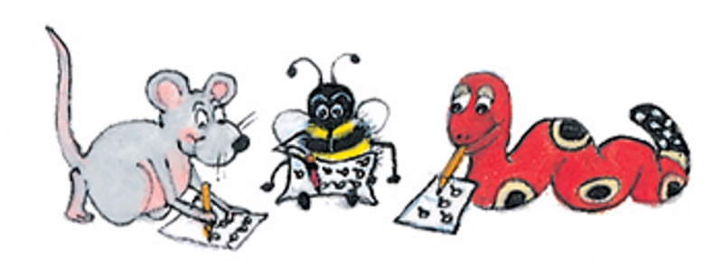
Snake’s Surprise
Inky skipped happily down the dusty road and over a low bridge. She
saw her friend Bee in the big meadow. Bee buzzed busily while she flew
from flower to flower. Inky called. “Bee,” loudly and waved, so her friend
zoomed quickly across the meadow.

Slide 31
Snake’s Surprise
Inky skipped happily down the dusty road and over a low bridge. She
saw her friend Bee in the big meadow. Bee buzzed busily while she flew
from flower to flower. Inky called. “Bee,” loudly and waved, so her friend
zoomed quickly across the meadow.

Slide 32
Snake’s Surprise
Inky skipped happily down the dusty road and over a low bridge. She
saw her friend Bee in the big meadow. Bee buzzed busily while she flew
from flower to flower. Inky called. “Bee,” loudly and waved, so her friend
zoomed quickly across the meadow.

Slide 33
Snake’s Surprise
Inky skipped happily down the dusty road and over a low bridge. She
saw her friend Bee in the big meadow. Bee buzzed busily while she flew
from flower to flower. Inky called. “Bee,” loudly and waved, so her friend
zoomed quickly across the meadow.

Slide 34
Snake’s Surprise
Inky skipped happily down the dusty road and over a low bridge. She
saw her friend Bee in the big meadow. Bee buzzed busily while she flew
from flower to flower. Inky called. “Bee,” loudly and waved, so her friend
zoomed quickly across the meadow.

Slide 35
Snake’s Surprise
Inky skipped happily down the dusty road and over a low bridge. She
saw her friend Bee in the big meadow. Bee buzzed busily while she flew
from flower to flower. Inky called. “Bee,” loudly and waved, so her friend
zoomed quickly across the meadow.

Slide 36
Snake’s Surprise
Inky skipped happily down the dusty road and over a low bridge. She
saw her friend Bee in the big meadow. Bee buzzed busily while she flew
from flower to flower. Inky called. “Bee,” loudly and waved, so her friend
zoomed quickly across the meadow.

Slide 37
Snake’s Surprise
Inky skipped happily down the dusty road and over a low bridge. She
saw her friend Bee in the big meadow. Bee buzzed busily while she flew
from flower to flower. Inky called. “Bee,” loudly and waved, so her friend
zoomed quickly across the meadow.

Slide 38
Snake’s Surprise
Inky skipped happily down the dusty road and over a low bridge. She
saw her friend Bee in the big meadow. Bee buzzed busily while she flew
from flower to flower. Inky called. “Bee,” loudly and waved, so her friend
zoomed quickly across the meadow.

Slide 39
Snake’s Surprise
Inky skipped happily down the dusty road and over a low bridge. She
saw her friend Bee in the big meadow. Bee buzzed busily while she flew
from flower to flower. Inky called. “Bee,” loudly and waved, so her friend
zoomed quickly across the meadow.

Slide 40
Snake’s Surprise
Inky skipped happily down the dusty road and over a low bridge. She
saw her friend Bee in the big meadow. Bee buzzed busily while she flew
from flower to flower. Inky called. “Bee,” loudly and waved, so her friend
zoomed quickly across the meadow.

Slide 41
Snake’s Surprise
Inky skipped happily down the dusty road and over a low bridge. She
saw her friend Bee in the big meadow. Bee buzzed busily while she flew
from flower to flower. Inky called. “Bee,” loudly and waved, so her friend
zoomed quickly across the meadow.

Slide 42
Snake’s Surprise
Inky skipped happily down the dusty road and over a low bridge. She
saw her friend Bee in the big meadow. Bee buzzed busily while she flew
from flower to flower. Inky called. “Bee,” loudly and waved, so her friend
zoomed quickly across the meadow.

Slide 43
Snake’s Surprise
Inky skipped happily down the dusty road and over a low bridge. She
saw her friend Bee in the big meadow. Bee buzzed busily while she flew
from flower to flower. Inky called. “Bee,” loudly and waved, so her friend
zoomed quickly across the meadow.

Slide 44
Snake’s Surprise
Inky skipped happily down the dusty road and over a low bridge. She
saw her friend Bee in the big meadow. Bee buzzed busily while she flew
from flower to flower. Inky called. “Bee,” loudly and waved, so her friend
zoomed quickly across the meadow.

Slide 45
Snake’s Surprise
Inky skipped happily down the dusty road and over a low bridge. She
saw her friend Bee in the big meadow. Bee buzzed busily while she flew
from flower to flower. Inky called. “Bee,” loudly and waved, so her friend
zoomed quickly across the meadow.

Slide 46
Snake’s Surprise
Inky skipped happily down the dusty road and over a low bridge. She
saw her friend Bee in the big meadow. Bee buzzed busily while she flew
from flower to flower. Inky called. “Bee,” loudly and waved, so her friend
zoomed quickly across the meadow.

Slide 47
Snake’s Surprise
Inky skipped happily down the dusty road and over a low bridge. She
saw her friend Bee in the big meadow. Bee buzzed busily while she flew
from flower to flower. Inky called. “Bee,” loudly and waved, so her friend
zoomed quickly across the meadow.

Slide 48
Snake’s Surprise
Inky skipped happily down the dusty road and over a low bridge. She
saw her friend Bee in the big meadow. Bee buzzed busily while she flew
from flower to flower. Inky called. “Bee,” loudly and waved, so her friend
zoomed quickly across the meadow.

Slide 49
Article
the
: definite article is used to refer to a particular thing
the table in my hall
a, an
: indefinite article is used to refer to something in general
a table has four legs

Slide 50
Snake’s Surprise
Inky skipped happily down the dusty road and over a low bridge. She
saw her friend Bee in the big meadow. Bee buzzed busily while she flew
from flower to flower. Inky called. “Bee,” loudly and waved, so her friend
zoomed quickly across the meadow.

