Slide 1
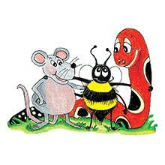
Jolly Grammar 2-25

Slide 2
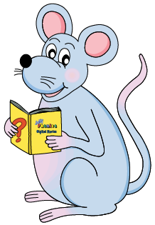
Mini Test 24

Slide 3
grip

Slide 4
grip
milk

Slide 5
grip
milk
ear

Slide 6
grip
milk
ear
dear

Slide 7
grip
milk
ear
dear
year

Slide 8
grip
milk
ear
dear
year
6. tear

Slide 9
grip
milk
ear
dear
year
6. tear
7. spear

Slide 10
grip
milk
ear
dear
year
6. tear
7. spear
8. earrings

Slide 11
grip
milk
ear
dear
year
6. tear
7. spear
8. earrings
9. zero

Slide 12
grip
milk
ear
dear
year
6. tear
7. spear
8. earrings
9. zero
10. equals

Slide 13
Let’s revise
Plural form

Slide 14
star
pony
toy
fairy

Slide 15
star
pony
toy
fairy
stars

Slide 16
star
pony
toy
fairy
stars
ponies

Slide 17
star
pony
toy
fairy
stars
ponies
toys

Slide 18
star
pony
toy
fairy
stars
ponies
toys
fairies

Slide 19
dictionary.

Slide 20
“It is my birthday,” said Hannah.

Slide 21
“It is my birthday,” said Hannah.
( )

Slide 22
“It is my birthday,” said Hannah.
(say)
talk
speak
tell
answer
whisper
shout

Slide 23
Activity page1

Slide 24
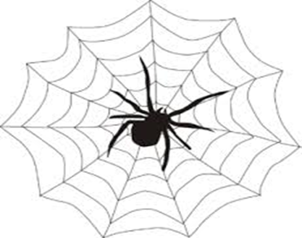
angry
quick
pretty

Slide 25
angry
mad
wild
cross
infuriated
furious
quick
pretty

Slide 26
angry
mad
wild
cross
infuriated
furious
quick
fast
hurried
rapid
speedy
brisk
pretty

Slide 27
angry
mad
wild
cross
infuriated
furious
quick
fast
hurried
rapid
speedy
brisk
pretty
cute
beautiful

Slide 28
Measurement Words
centimetre cm
metre m
gram g
kilogram kg
millilitre ml
litre l
weight
volume
minute
second
fraction
estimate

Slide 29
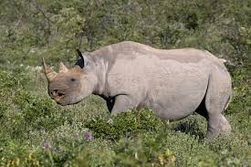
rhinoceros
silent <h>

Slide 30
Activity page2

Slide 31
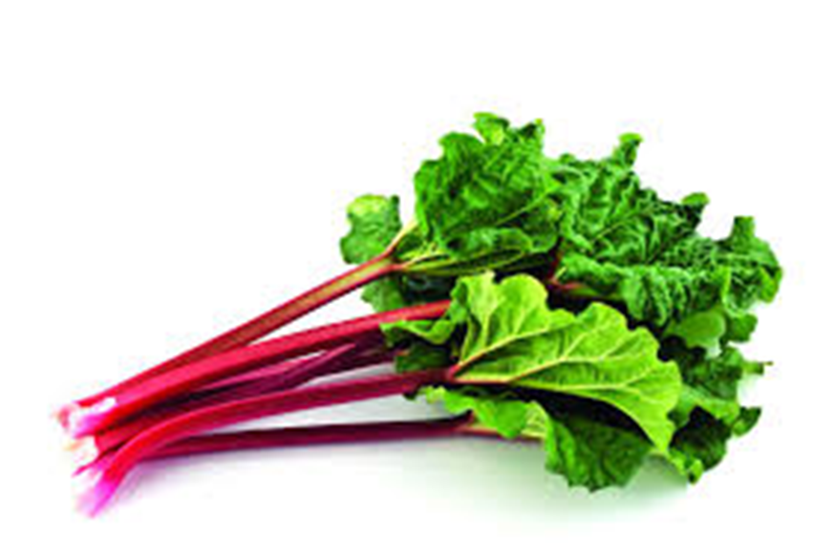
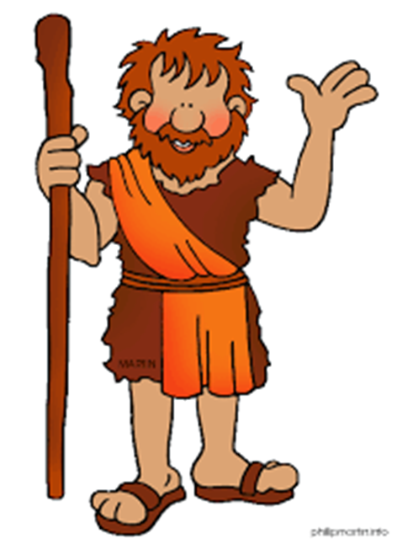
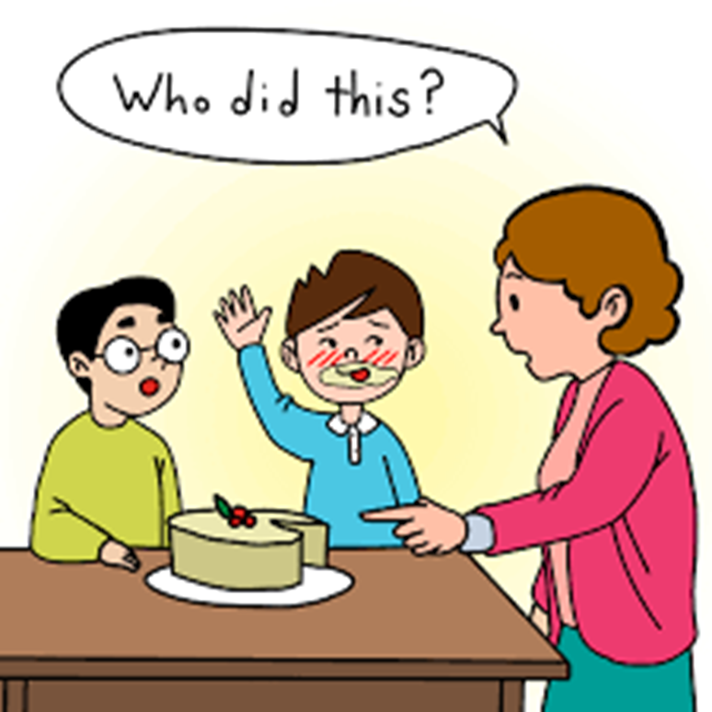
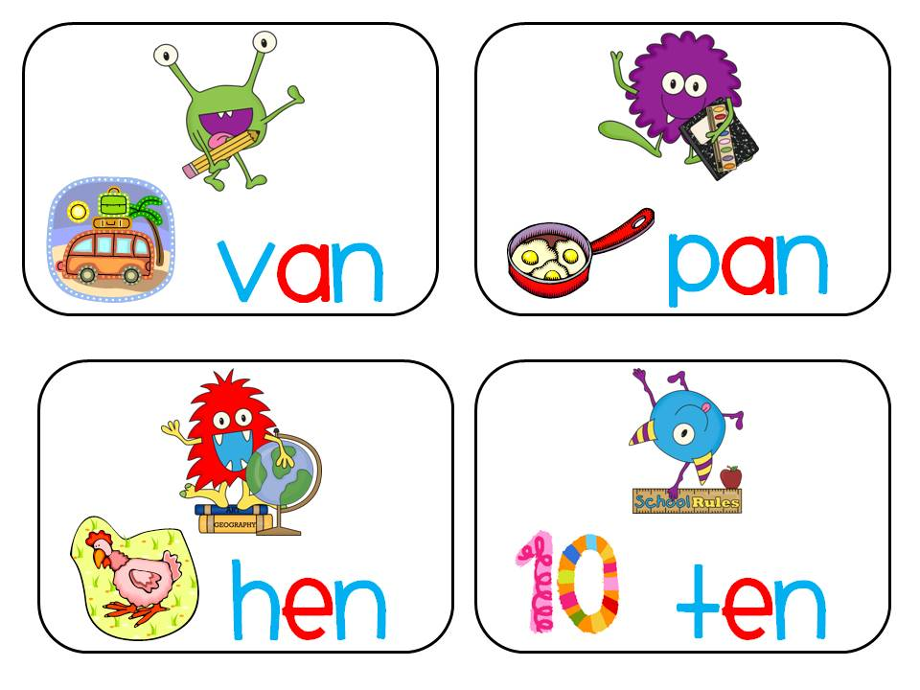
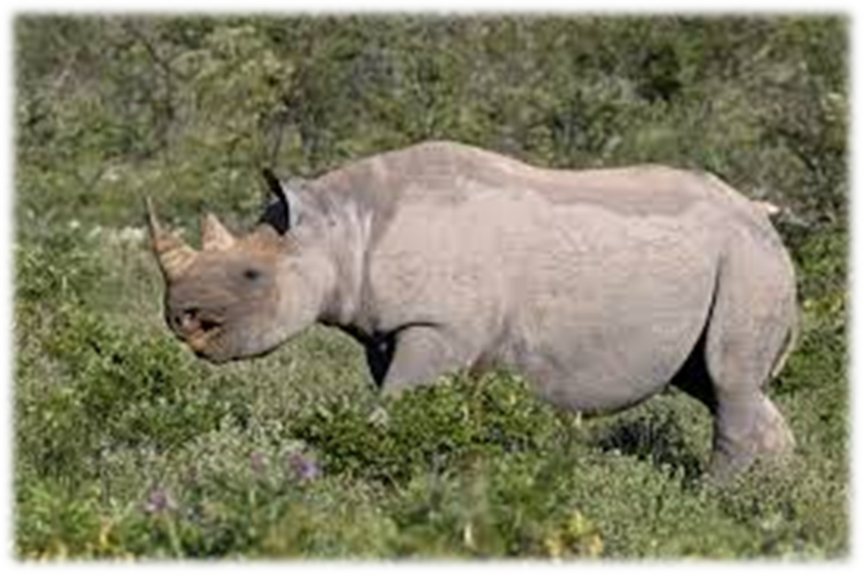
hour
rhythm
rhubarb
rhombus
belt
farm
hour
ghost
rhyme
rhythm
honest
rhinoceros
centimetre
metre
John
ghost
honest
ghastly
rhyme
rhinoceros
hourglass

Slide 32
Dictation

Slide 33
Name:
1. 2. 3.
4. 5. 6.
7.
8.
9.

Slide 34
John

Slide 35
John 2. rhubarb

Slide 36
John 2. rhubarb 3. hour

Slide 37
John 2. rhubarb 3. hour
4. ghastly

Slide 38
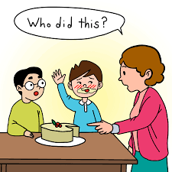
John 2. rhubarb 3. hour
4. ghastly 5. honest

Slide 39
John 2. rhubarb 3. hour
4. ghastly 5. honest 6. rhombus

Slide 40
John 2. rhubarb 3. hour
4. ghastly 5. honest 6. rhombus
7. The keys are by the hourglass.

Slide 41
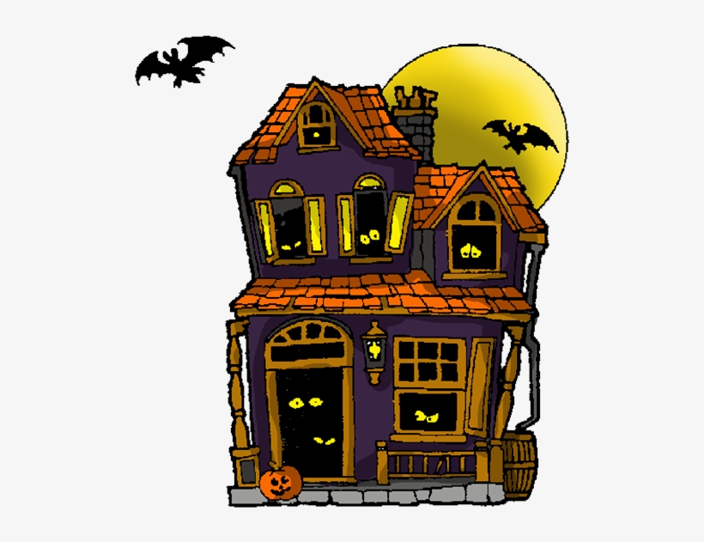
John 2. rhubarb 3. hour
4. ghastly 5. honest 6. rhombus
7. The keys are by the hourglass.
8. That house is haunted
by a ghost.

Slide 42
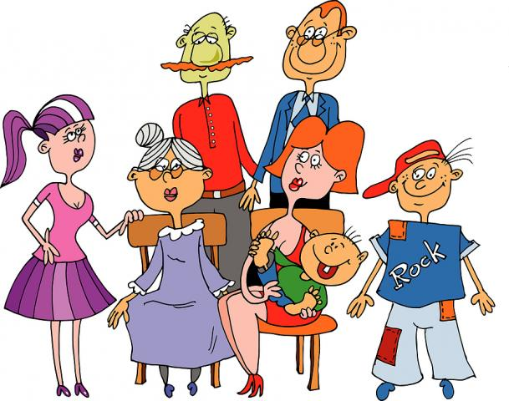
John 2. rhubarb 3. hour
4. ghastly 5. honest 6. rhombus
7. The keys are by the hourglass.
8. That house is haunted
by a ghost.
9. My family likes poems
with rhythm and rhyme.

Slide 43
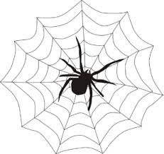
In the spaces in each word web, write some words that could be used instead of the word in the middle.
cold
sad
happy

Slide 44
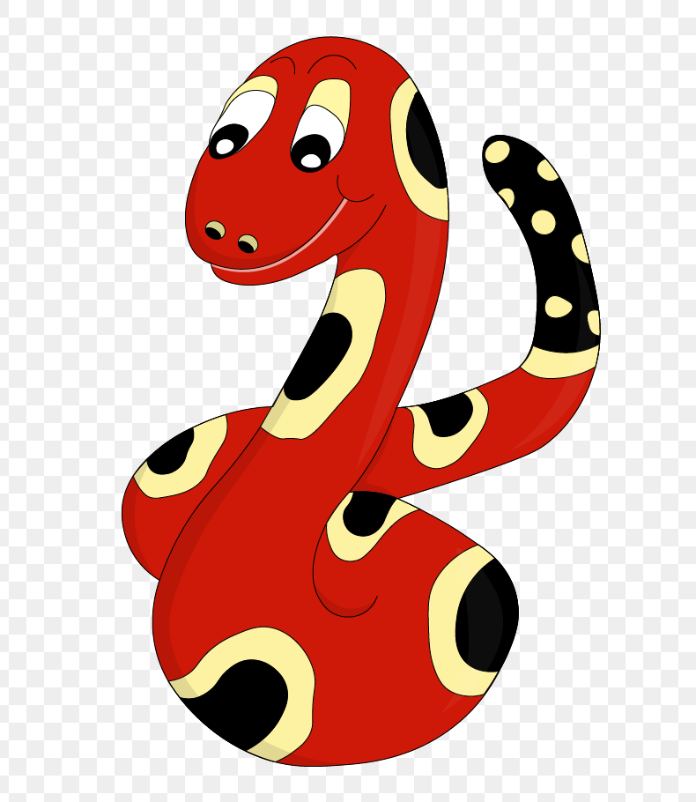
Thank you!
See you
next lesson.

