Slide 1
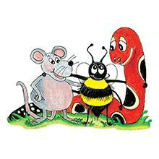
Jolly Grammar 2-12

Slide 2
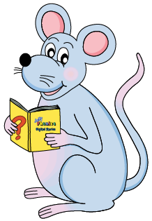
Mini Test 11

Slide 3
cliff

Slide 4
cliff
off

Slide 5
cliff
off
air

Slide 6
cliff
off
air
hair

Slide 7
cliff
off
air
hair
pair

Slide 8
cliff
off
air
hair
pair
6. stair

Slide 9
cliff
off
air
hair
pair
6. stair
7. chair

Slide 10
cliff
off
air
hair
pair
6. stair
7. chair
8. hairbrush

Slide 11
cliff
off
air
hair
pair
6. stair
7. chair
8. hairbrush
9. September

Slide 12
cliff
off
air
hair
pair
6. stair
7. chair
8. hairbrush
9. September
10. October

Slide 13
Let’s Revise
Possessive
Adjectives.

Slide 15
my

Slide 16
my
your

Slide 17
my
your
his

Slide 18
my
your
his
her

Slide 19
my
your
his
her
its

Slide 20
my
your
his
her
its
our

Slide 21
my
your
his
her
its
our
your

Slide 22
my
your
his
her
its
our
your
their

Slide 23
The children took out pencil cases.

Slide 24
The children took out their pencil cases.

Slide 25
The children took out their pencil cases.
The boy read his book.

Slide 26
The children took out their pencil cases.
The boy read his book.
My sister played her recorder.

Slide 27
The children took out their pencil cases.
The boy read his book.
My sister played her recorder.
We sang our favorite song.

Slide 28
Homophones

Slide 29
Homophones
Homophones are words that sound similar to one another despite having different meanings and spellings.

Slide 30
there
their

Slide 31
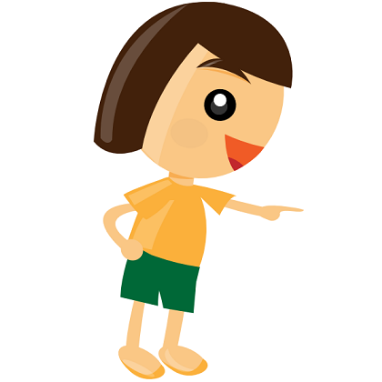
there → place
their

Slide 32
there → place
their → possessive adjective

Slide 33
there → place
Leave the package over there.
their → possessive adjective

Slide 34
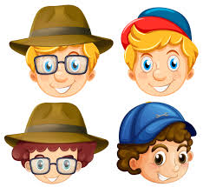
there → place
Leave the package over there.
their → possessive adjective
They put on their hats.

Slide 35
are
our

Slide 36
are → to be (verb)
our

Slide 37
are → to be
our → possessive adjective

Slide 38
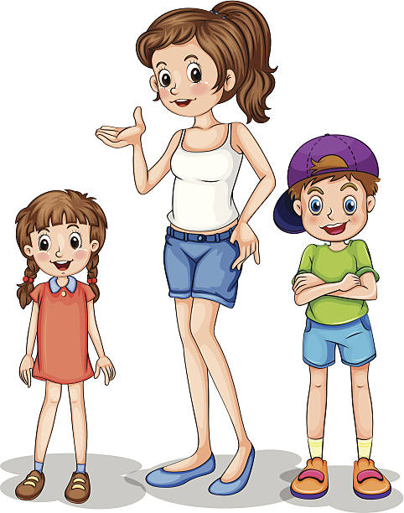
are → to be
You are very tall.
our → possessive adjective

Slide 39
are → to be
You are very tall.
our → possessive adjective
Our house has a red door.

Slide 40
Activity page

Slide 41
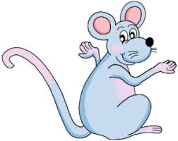
there
or
their?

Slide 42
there → place
their → possessive adjective

Slide 43
They put on hats.

Slide 44
They put on their hats.

Slide 45
They put on their hats.
Leave the package over there.

Slide 46
They put on their hats.
Leave the package over there.
There he is, behind the tree.

Slide 47
They put on their hats.
Leave the package over there.
There he is, behind the tree.
The children rode their bikes.

Slide 48
They put on their hats.
Leave the package over there.
There he is, behind the tree.
The children rode their bikes.
There is no-one at home.

Slide 49
are
or
our?

Slide 50
are → to be
our → possessive adjective

Slide 51
You are very tall.

Slide 52
You are very tall.
Our house has a red door.

Slide 53
You are very tall.
Our house has a red door.
They are all going to a party.

Slide 54
You are very tall.
Our house has a red door.
They are all going to a party.
We put on our boots to go outside.

Slide 55
You are very tall.
Our house has a red door.
They are all going to a party.
We put on our boots to go outside.
He likes our cats.

Slide 56
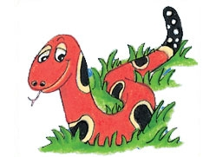
Months of the Year
January
February
March
April
May
June
July
August
September
October
November
December

Slide 57
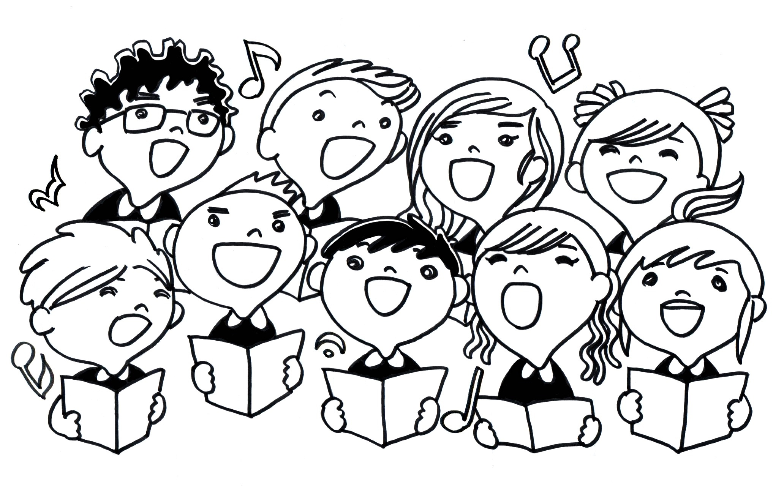
choir
/k/

Slide 58
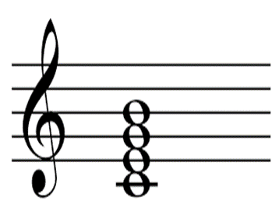
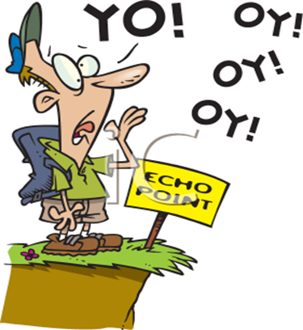
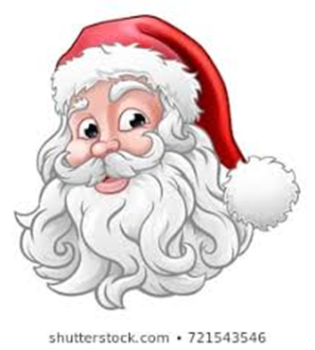
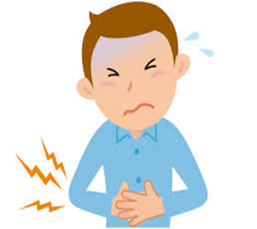
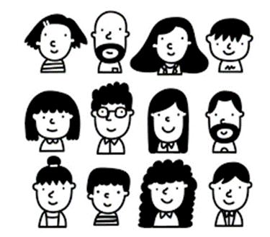
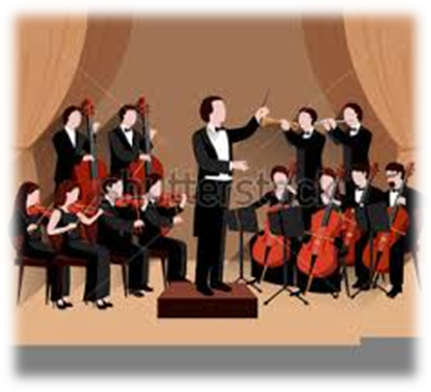
echo
stomach
chord
chorus
buzz
fizz
echo
choir
ache
stomach
Christmas
character
November
December
choir
Christmas
chemist
ache
character
orchestra

Slide 59
Dictation

Slide 60
Name:
1. 2. 3.
4. 5. 6.
7.
8.
9.

Slide 61
chord

Slide 62
chord 2. chemist

Slide 63
chord 2. chemist 3. chorus

Slide 64
chord 2. chemist 3. chorus
4. orchestra

Slide 65
chord 2. chemist 3. chorus
4. orchestra 5. echo

Slide 66
chord 2. chemist 3. chorus
4. orchestra 5. echo 6. character

Slide 67
chord 2. chemist 3. chorus
4. orchestra 5. echo 6. character
7. The orchestra played chords.

Slide 68
chord 2. chemist 3. chorus
4. orchestra 5. echo 6. character
7. The orchestra played chords.
8. Our cousin is a
mechanic.

Slide 69
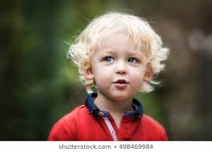
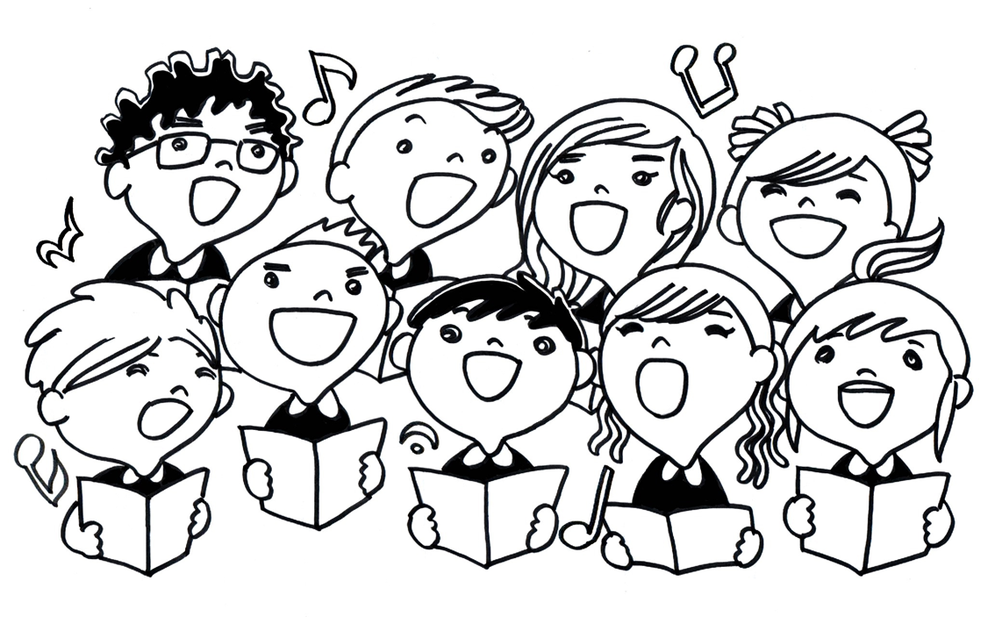
chord 2. chemist 3. chorus
4. orchestra 5. echo 6. character
7. The orchestra played chords.
8. Our cousin is a
mechanic.
9. The choirboy had
fair hair.

Slide 70
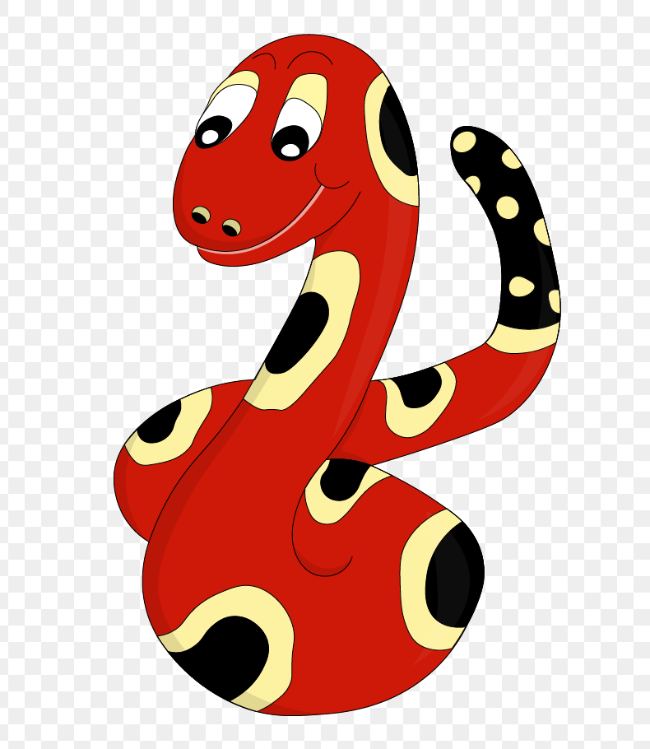
Thank you!
See you
next lesson.

