Slide 1
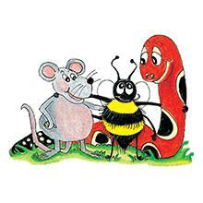
Jolly Grammar 2-7

Slide 2
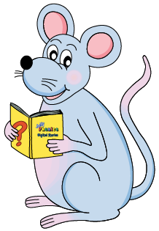
Mini Test 6

Slide 3
glad

Slide 4
glad
plum

Slide 5
glad
plum
read

Slide 6
glad
plum
read
head

Slide 7
glad
plum
read
head
bread

Slide 8
glad
plum
read
head
bread
6. weather

Slide 9
glad
plum
read
head
bread
6. weather
7. treasure

Slide 10
glad
plum
read
head
bread
6. weather
7. treasure
8. breakfast

Slide 11
glad
plum
read
head
bread
6. weather
7. treasure
8. breakfast
9. cousin

Slide 12
glad
plum
read
head
bread
6. weather
7. treasure
8. breakfast
9. cousin
10.friend

Slide 13
Alphabetical Order

Slide 14
A B C D E
F G H I J K L M
N O P Q R S T U V W X Y Z

Slide 15
Put these words into alphabetical order.
sheep horse dog cow

Slide 16
sheep horse dog cow
cow

Slide 17
sheep horse dog cow
cow dog

Slide 18
sheep horse dog cow
cow dog horse

Slide 19
sheep horse dog cow
cow dog horse sheep

Slide 20
swing bat bike toy
Remember
If more than one word starts with the same letter, look at the next letter in each word.

Slide 21
swing bat bike toy
bat bike swing toy

Slide 22
Throne Sid Ted Billy Tom

Slide 23
Tyrone Sid Ted Billy Tom
Billy Sid Ted Tom Tyrone

Slide 24
Tyrone Sam Ted Billy Tom
Billy Sam Ted Tom Tyrone

Slide 25
avocado peach
cherry orange plum

Slide 26
avocado peach
cherry orange plum
avocado cherry orange peach plum

Slide 27
chin clap cake
cut coat crayon

Slide 28
chin clap cake
cut coat crayon
cake chin clap coat crayon cut

Slide 29
stop scar skin
second sack shell

Slide 30
stop scar skin
second sack shell
sack scar second shell skin stop

Slide 31
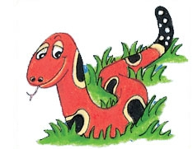
Months of the Year
January
February
March
April
May
June
July
August
September
October
November
December

Slide 32
circus

Slide 33
soft c
ce
ci
cy

Slide 34
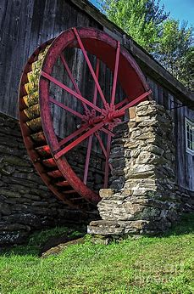
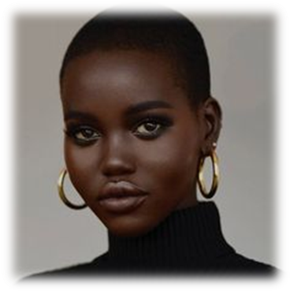
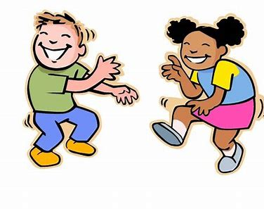
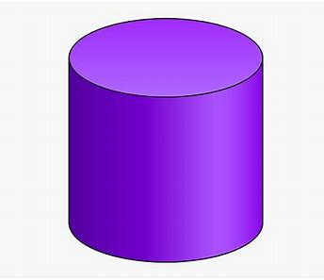
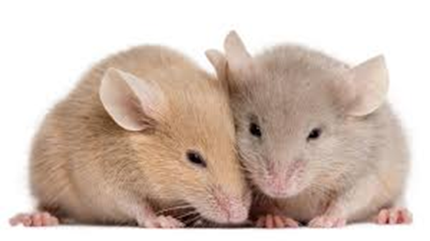
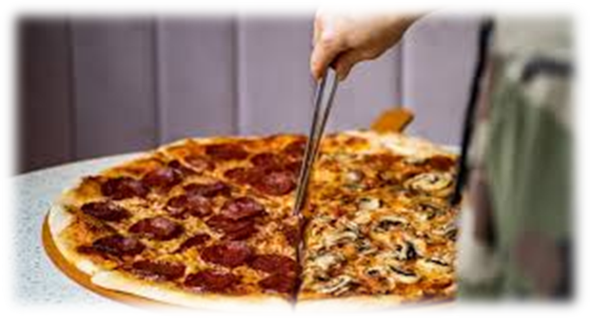
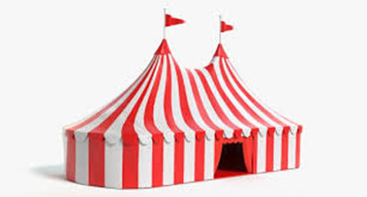
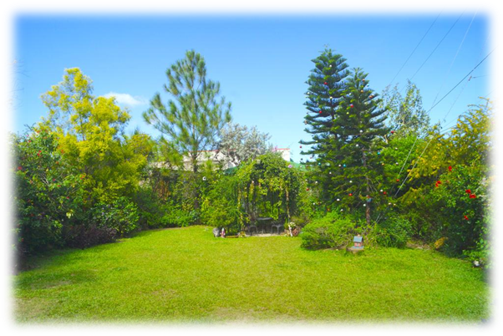
ice
face
police
mill
tell
ice
dance
city
circle
police
cylinder
January
February
dance
cylinder
twice
mice
slice
circus
city
circle
place
pencil

Slide 35
Activity page:
Soft <c>

Slide 36
A cylinder is a shape like a tube.
I ate some vanilla ice cream.
The police arrested the robber.
We dance to the music.

Slide 37
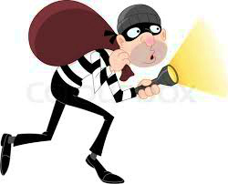
“Stop thief!” shouted the man. “Call the police!”
The police arrived quickly. “What has been taken?”
asked the policeman.
“The thief stole two rings, a watch, a pair of earrings and
a necklace,” the man explained.

Slide 38
Dictation

Slide 39
Name:
1. 2. 3.
4. 5. 6.
7.
8.
9.

Slide 40
mice

Slide 41
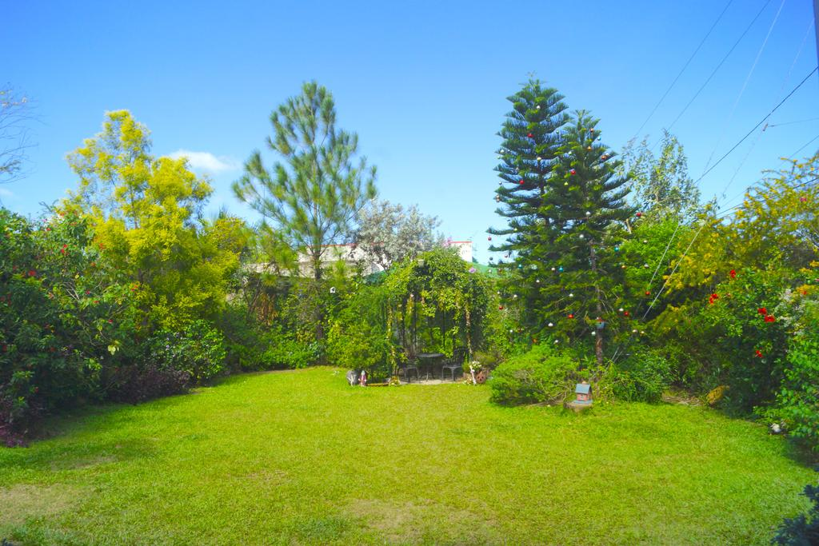
mice 2. place

Slide 42
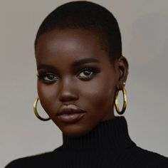
mice 2. place 3. face

Slide 43
mice 2. place 3. face
4. twice

Slide 44
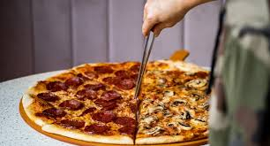
mice 2. place 3. face
4. twice 5. slice

Slide 45
mice 2. place 3. face
4. twice 5. slice 6. pencil

Slide 46
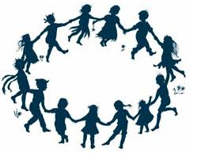
mice 2. place 3. face
4. twice 5. slice 6. pencil
7. They danced in a circle.

Slide 47
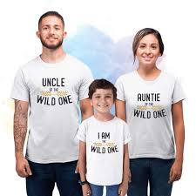
mice 2. place 3. face
4. twice 5. slice 6. pencil
7. They danced in a circle.
8. My aunt and uncle took me
to the circus.

Slide 48
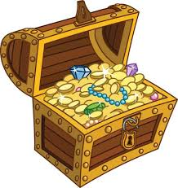
mice 2. place 3. face
4. twice 5. slice 6. pencil
7. They danced in a circle.
8. My aunt and uncle took me
to the circus.
9. The police found the stolen
treasure.

