Slide 1
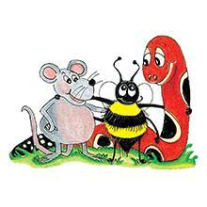
Jolly Grammar 2-6

Slide 2
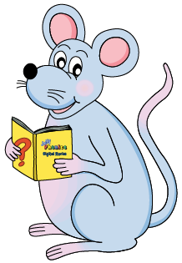
Mini Test 5

Slide 3
1. club

Slide 4
1. club
2. flag

Slide 5
1. club
2. flag
3. phone

Slide 6
1. club
2. flag
3. phone
4. photo

Slide 7
1. club
2. flag
3. phone
4. photo
5. dolphin

Slide 8
1. club
2. flag
3. phone
4. photo
5. dolphin
6. elephant

Slide 9
1. club
2. flag
3. phone
4. photo
5. dolphin
6. elephant
7. sphere

Slide 10
1. club
2. flag
3. phone
4. photo
5. dolphin
6. elephant
7. sphere
8. alphabet

Slide 11
1. club
2. flag
3. phone
4. photo
5. dolphin
6. elephant
7. sphere
8. alphabet
9. nephew

Slide 12
1. club
2. flag
3. phone
4. photo
5. dolphin
6. elephant
7. sphere
8. alphabet
9. nephew
10. niece

Slide 13
Let’s revise
commas.

Slide 14
They went out to buy milk butter cheese and bread.

Slide 15
They went out to buy milk, butter cheese and bread.

Slide 16
They went out to buy milk, butter, cheese and bread.

Slide 17
In my garden I grow carrots potatoes tomatoes beans
and peas.

Slide 18
In my garden I grow carrots, potatoes tomatoes beans
and peas.

Slide 19
In my garden I grow carrots, potatoes, tomatoes beans
and peas.

Slide 20
In my garden I grow carrots, potatoes, tomatoes, beans
and peas.

Slide 21
Squares circles triangles ovals and rectangles are all shapes.

Slide 22
Squares, circles triangles ovals and rectangles are all shapes.

Slide 23
Squares, circles, triangles ovals and rectangles are all shapes.

Slide 24
Squares, circles, triangles, ovals and rectangles are all shapes.

Slide 25
Let’s revise
punctuation.

Slide 26
do you need red blue or green paint asked dad
Activity page:
Commas in Lists

Slide 27
Do you need red blue or green paint asked dad
Activity page:
Commas in Lists

Slide 28
Do you need red, blue or green paint asked dad
Activity page:
Commas in Lists

Slide 29
Do you need red, blue or green paint? asked dad
Activity page:
Commas in Lists

Slide 30
Do you need red, blue or green paint? asked dad.
Activity page:
Commas in Lists

Slide 31
“Do you need red, blue or green paint?” asked dad.
Activity page:
Commas in Lists

Slide 32
! Exclamation Marks !

Slide 33
Activity page:
Exclamation Marks

Slide 34
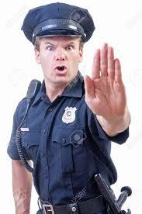
Stop shouted the policeman

Slide 35
“Stop!” shouted the policeman.

Slide 36
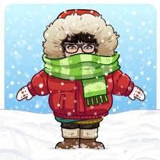
Tina went outside
Brr It is freezing she said

Slide 37
Tina went outside.
“Brr! It is freezing!” she said.

Slide 38
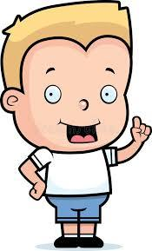
Brilliant
That is just what I wanted
exclaimed Seth

Slide 39
“Brilliant!
That is just what I wanted!”
exclaimed Seth.

Slide 40
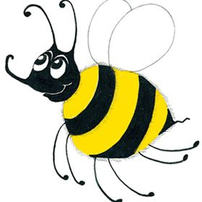
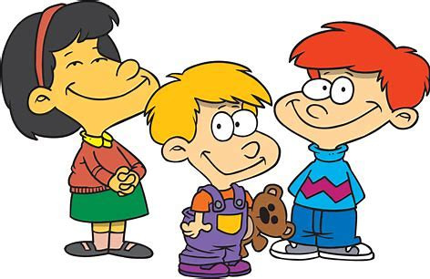
Family and Friends
mother
father
sister
brother
grandma
grandpa
aunt
uncle
nephew
niece
cousin
friend

Slide 41
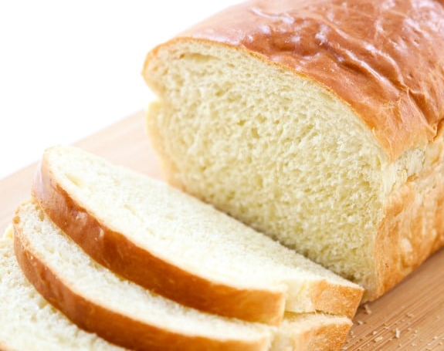
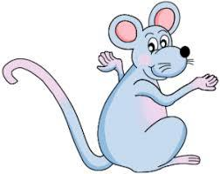
bread
/e/

Slide 42
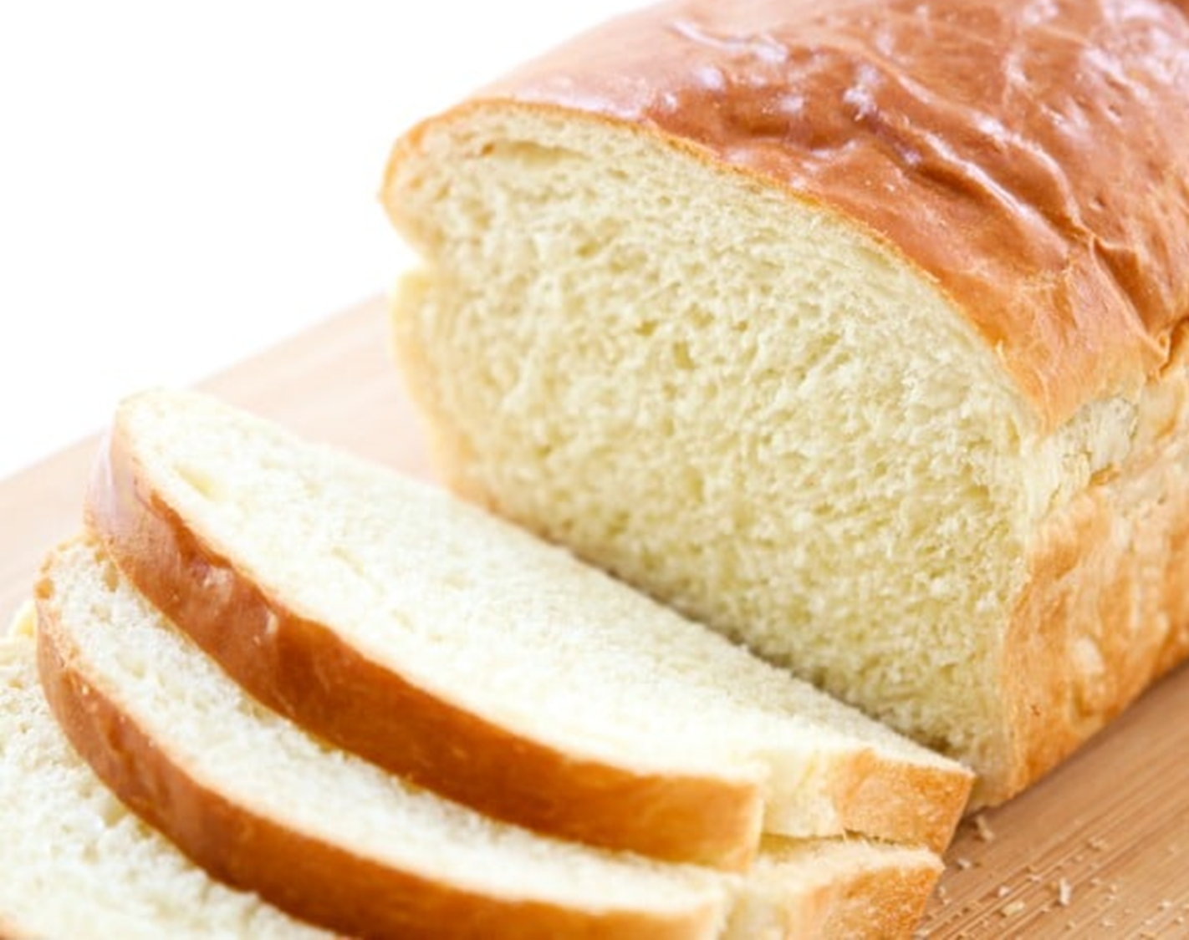
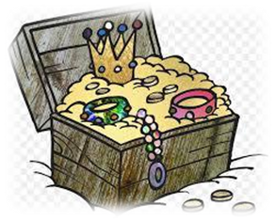
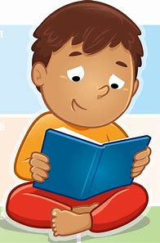
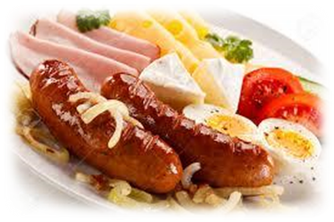
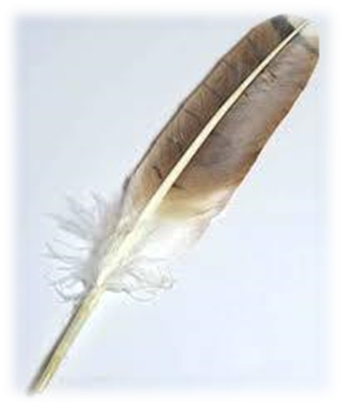
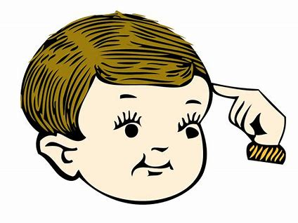
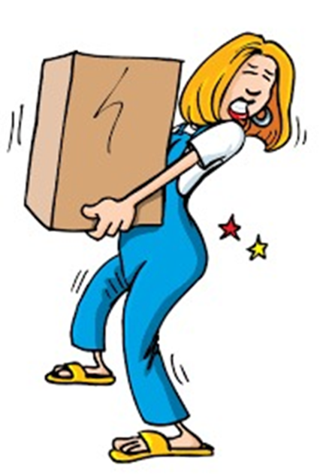
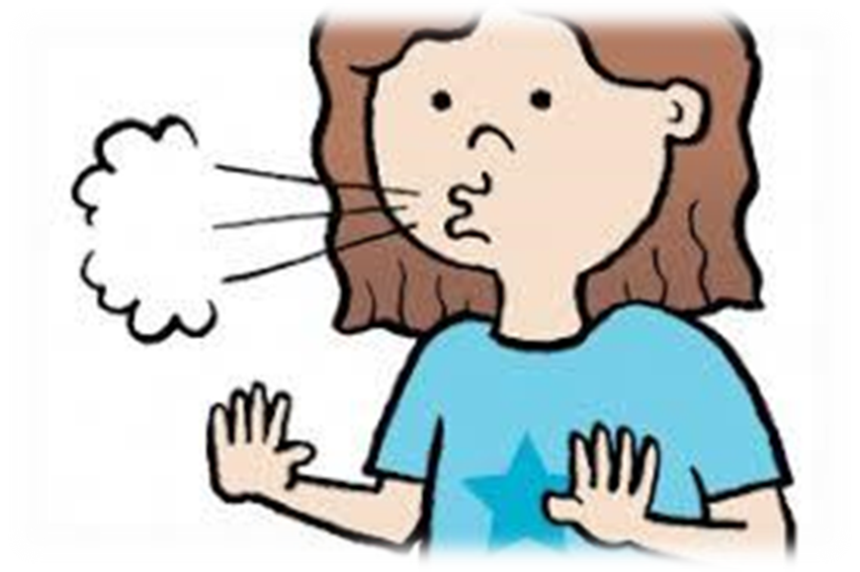
bread
treasure
dead
glad
plum
read
head
bread
weather
treasure
breakfast
cousin
friend
read
breakfast
feather
head
deaf
heavy
weather
breath
leather

Slide 43
Activity page:
The <ea> spelling of the /e/ Sound

Slide 44
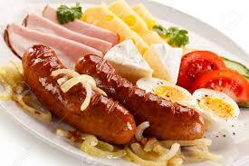
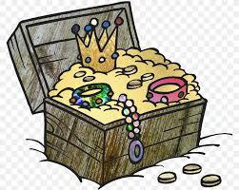
The is sunny today.
Dad cooks in the morning.
She found some buried .
I have that book already.

Slide 45
The weather is sunny today.
Dad cooks in the morning.
She found some buried .
I have that book already.

Slide 46
The weather is sunny today.
Dad cooks breakfast in the morning.
She found some buried .
I have that book already.

Slide 47
The weather is sunny today.
Dad cooks breakfast in the morning.
She found some buried treasure.
I have that book already.

Slide 48
The weather is sunny today.
Dad cooks breakfast in the morning.
She found some buried treasure.
I have read that book already.

Slide 49
Dictation

Slide 50
Name:
1. 2. 3.
4. 5. 6.
7.
8.
9.

Slide 51
1. deaf

Slide 52
1. deaf 2. breath

Slide 53
1. deaf 2. breath 3.dead

Slide 54
1. deaf 2. breath 3.dead
4. feather

Slide 55
1. deaf 2. breath 3.dead
4. feather 5. heavy

Slide 56
1. deaf 2. breath 3.dead
4. feather 5. heavy 6.leather

Slide 57
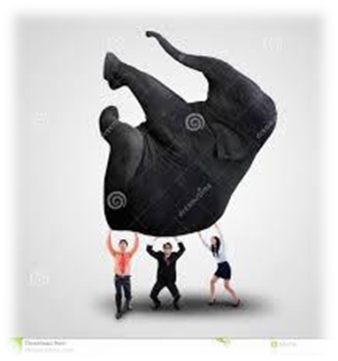
1. deaf 2. breath 3.dead
4. feather 5. heavy 6.leather
7. An elephant is heavy.

Slide 58
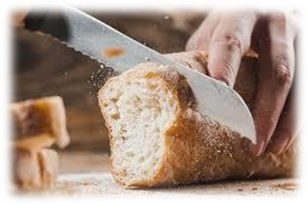
1. deaf 2. breath 3.dead
4. feather 5. heavy 6.leather
7. An elephant is heavy.
8. I cut bread with my knife.

Slide 59
1. deaf 2. breath 3.dead
4. feather 5. heavy 6.leather
7. An elephant is heavy.
8. I cut bread with my knife.
9. He read the book in one
night.

