Slide 1
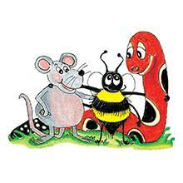
Jolly Grammar 2-4

Slide 2
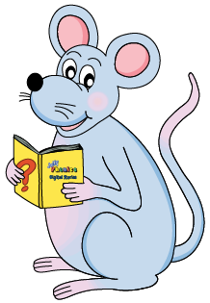
Mini Test 3

Slide 3
1. song

Slide 4
1. song
2. trunk

Slide 5
1. song
2. trunk
3. knee

Slide 6
1. song
2. trunk
3. knee
4. knit

Slide 7
1. song
2. trunk
3. knee
4. knit
5. know

Slide 8
1. song
2. trunk
3. knee
4. knit
5. know
6. knock

Slide 9
1. song
2. trunk
3. knee
4. knit
5. know
6. knock
7. knight

Slide 10
1. song
2. trunk
3. knee
4. knit
5. know
6. knock
7. knight
8. penknife

Slide 11
1. song
2. trunk
3. knee
4. knit
5. know
6. knock
7. knight
8. penknife
9. grandma

Slide 12
1. song
2. trunk
3. knee
4. knit
5. know
6. knock
7. knight
8. penknife
9. grandma
10. grandpa

Slide 13
Let’s revise Speech Marks.

Slide 14
The boy said, I rode my bike.
We like to go swimming, said the children.
Be careful, warned the policeman.
The librarian whispered, Please be quiet.

Slide 15
The boy said, “I rode my bike.”
We like to go swimming, said the children.
Be careful, warned the policeman.
The librarian whispered, Please be quiet.

Slide 16
The boy said, “I rode my bike.”
“We like to go swimming,” said the children.
Be careful, warned the policeman.
The librarian whispered, Please be quiet.

Slide 17
The boy said, “I rode my bike.”
“We like to go swimming,” said the children.
“Be careful,” warned the policeman.
The librarian whispered, Please be quiet.

Slide 18
The boy said, “I rode my bike.”
“We like to go swimming,” said the children.
“Be careful,” warned the policeman.
The librarian whispered, “Please be quiet.”

Slide 19
Let’s revise question words.

Slide 20
What? Why? When? Where?
Who? Whose? Which? How?

Slide 21
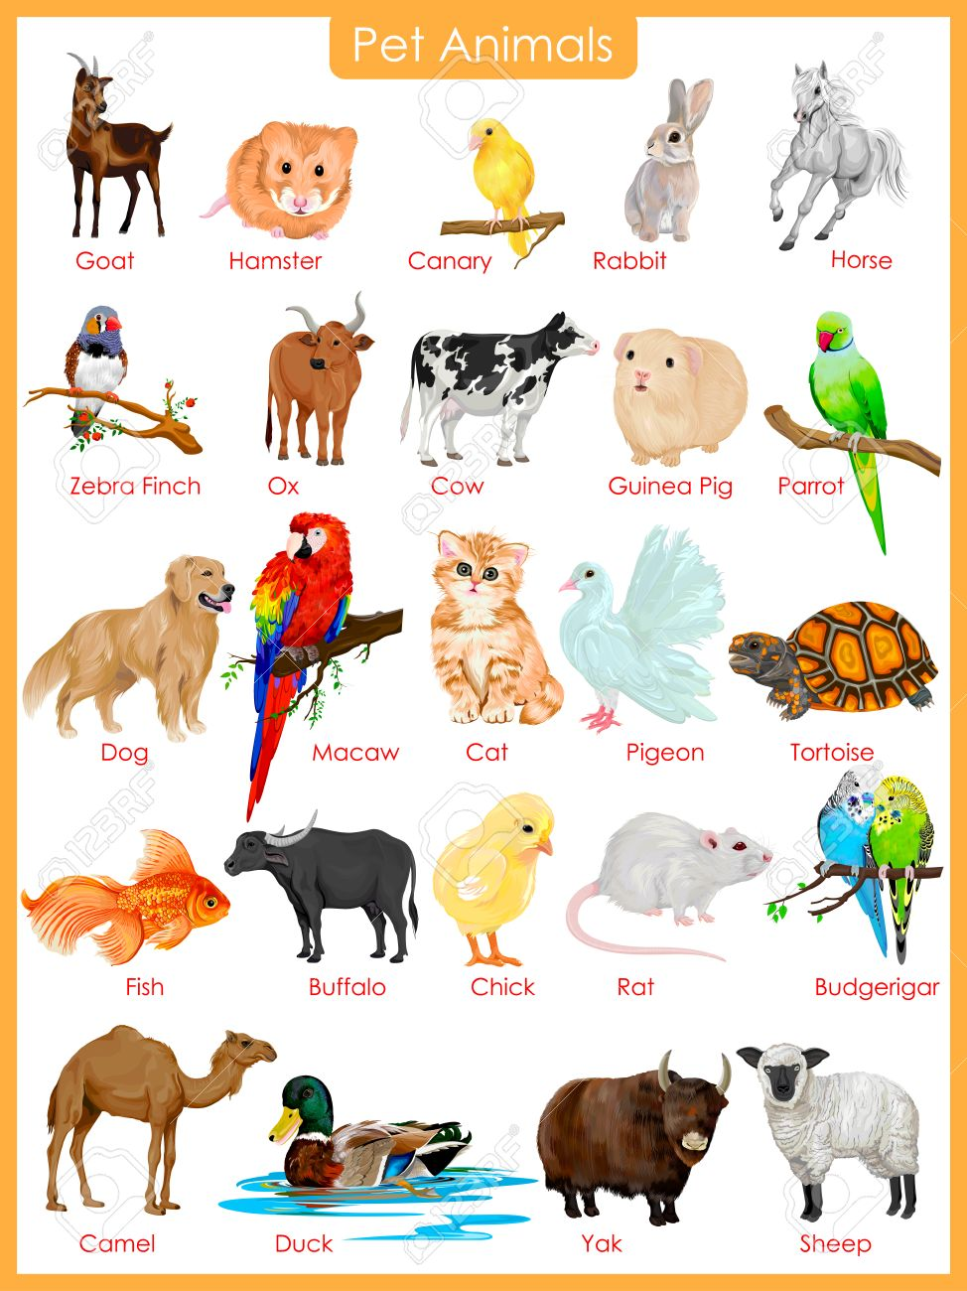
What kind of animal would you like to have as a pet?
Why?

Slide 22
Where does it live?

Slide 23
Where does it live?
What does it eat?

Slide 24
Where does it live?
What does it eat?
What colour is it?

Slide 25
Where does it live?
What does it eat?
What colour is it?
How big is it?

Slide 26
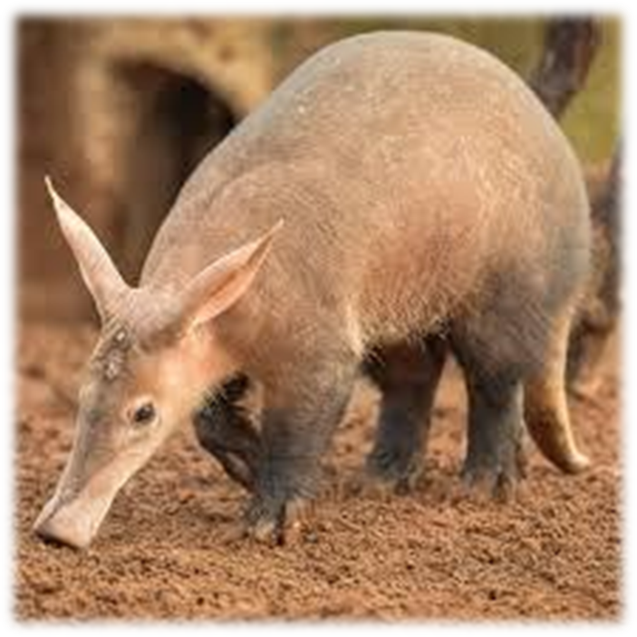
Where does it live?
What does it eat?
What colour is it?
How big is it?
aardvark

Slide 27
Activity page:
Questions

Slide 28
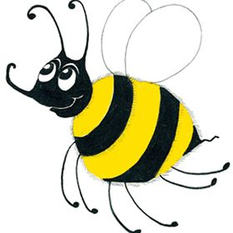
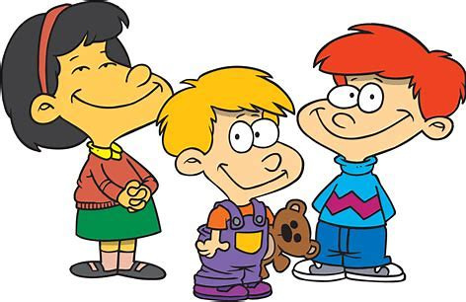
Family and Friends
mother
father
sister
brother
grandma
grandpa
aunt
uncle
nephew
niece
cousin
friend

Slide 29
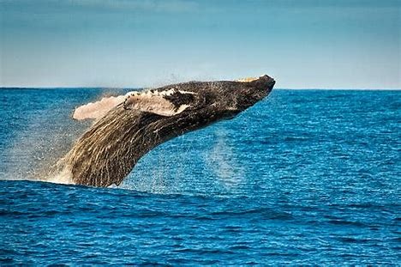
whale
(Silent wh)

Slide 30
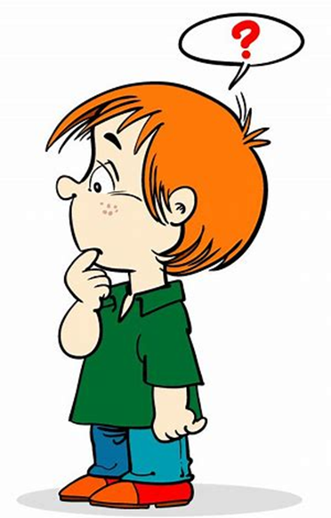
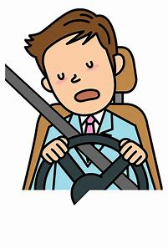
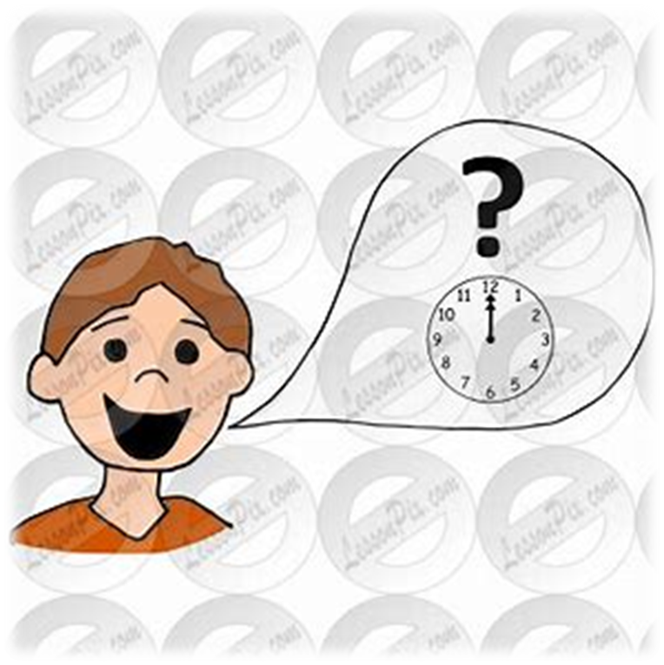
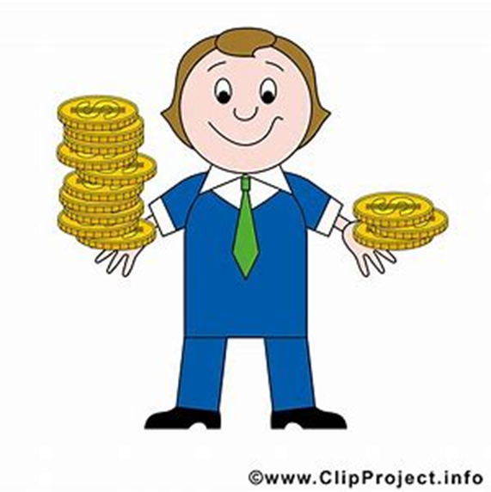
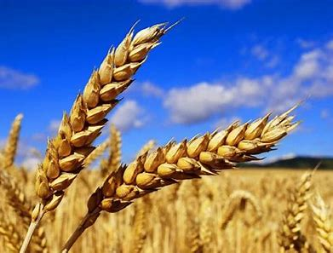
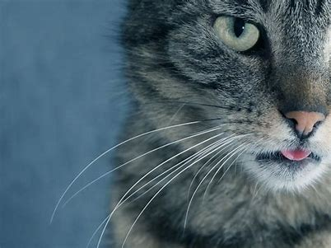
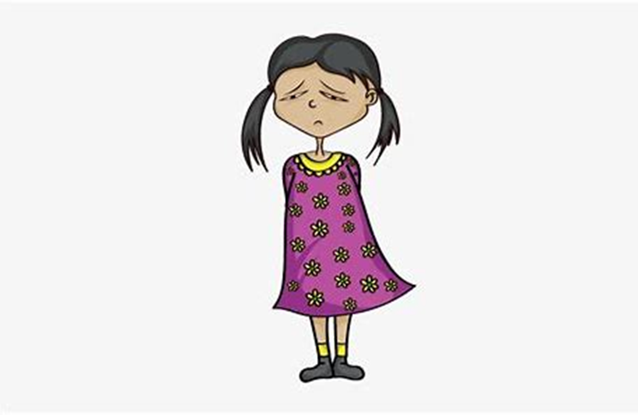
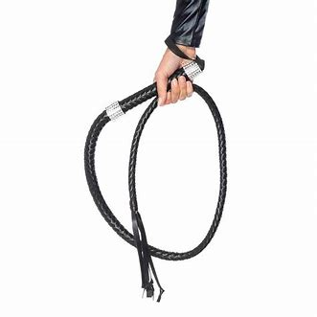
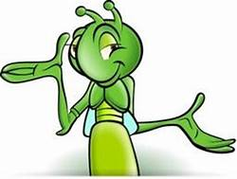
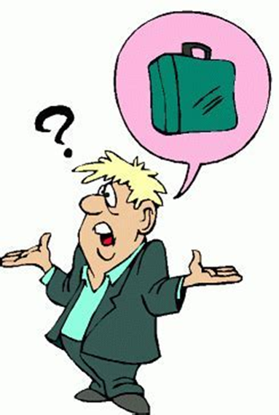
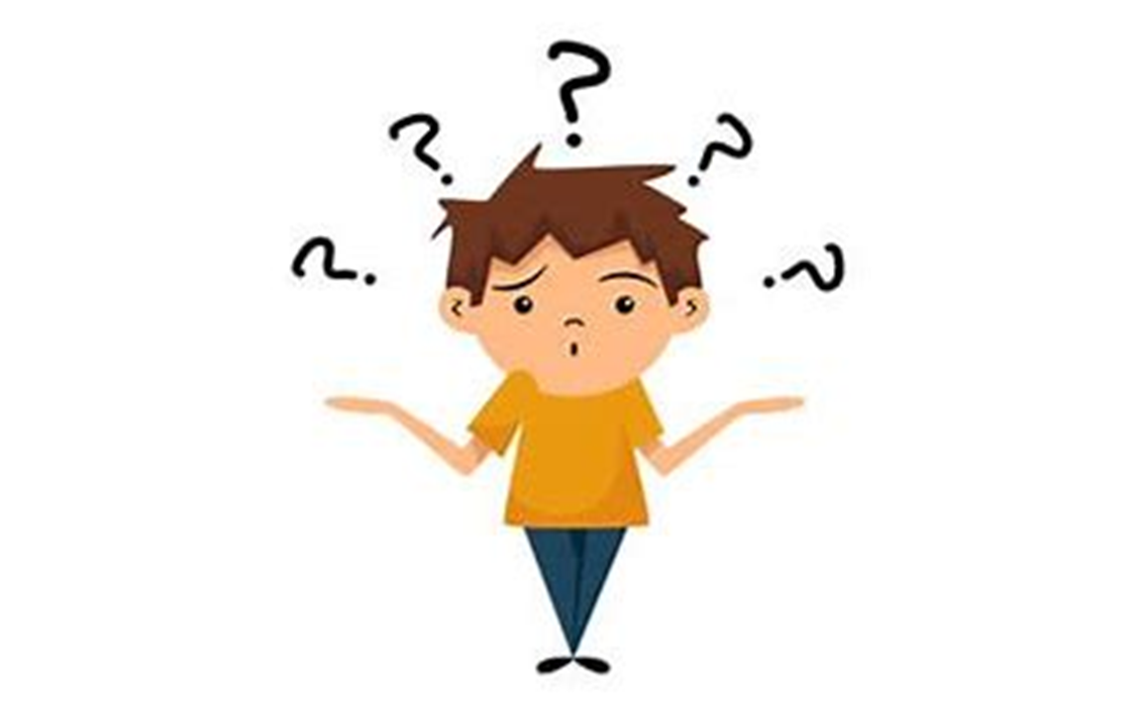
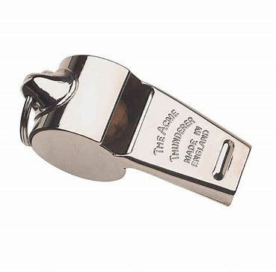
while
when
which
what
this
that
while
wheat
whip
whistle
whiskers
whatever
aunt
uncle
wheat
whiskers
whenever
whip
whatever
where
whistle
who
why

Slide 31
Activity page:
The <wh> spelling of the /w/ Sound

Slide 32
Dictation

Slide 33
Name:
1. 2. 3.
4. 5. 6.
7.
8.
9.

Slide 34
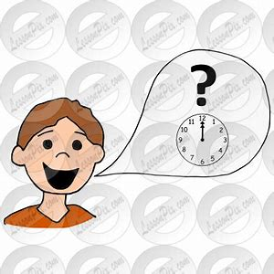
when

Slide 35
when 2. which

Slide 36
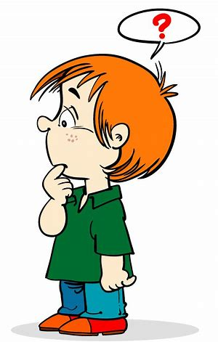
when 2. which 3. what

Slide 37
when 2. which 3. what
4. why

Slide 38
when 2. which 3. what
4. why 5. where

Slide 39
when 2. which 3. what
4. why 5. where 6. whenever

Slide 40
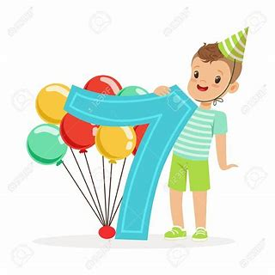
when 2. which 3. what
4. why 5. where 6. whenever
7. “When will I be seven?” asked Ben.

Slide 41
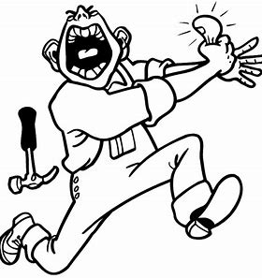
when 2. which 3. what
4. why 5. where 6. whenever
7. “When will I be seven?” asked Ben.
8. “Which thumb did you knock?”
I whispered.

Slide 42
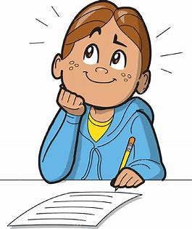
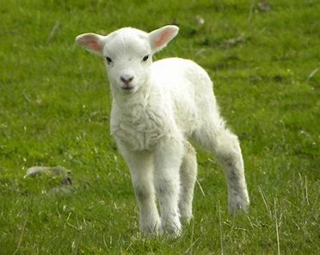
when 2. which 3. what
4. why 5. where 6. whenever
7. “When will I be seven?” asked Ben.
8. “Which thumb did you knock?”
I whispered.
9. “Who wrote about
the white lamb?” asked Jill.

Slide 43
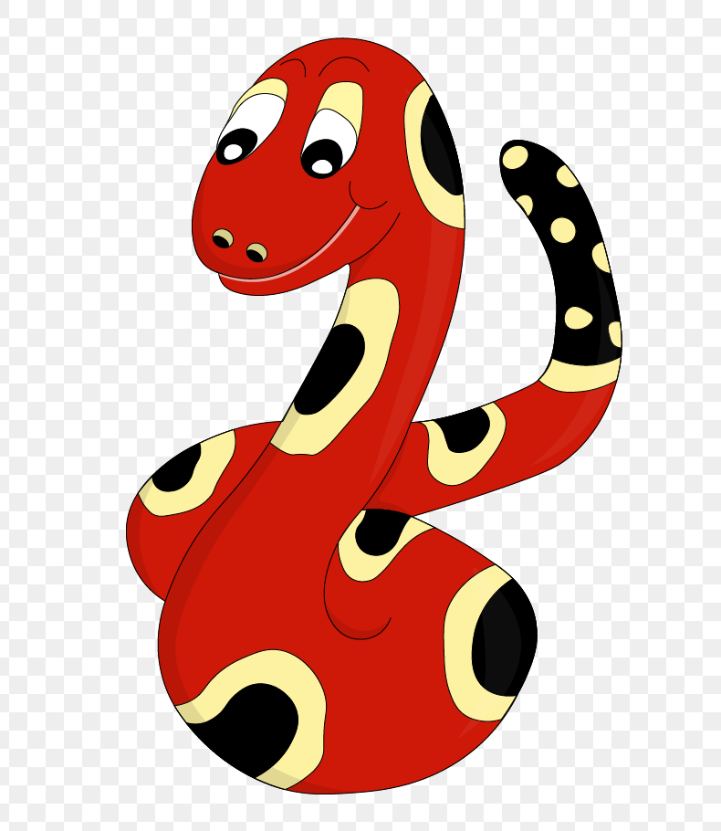
Thank you!

