Slide 1
Jolly Grammar 1-27

Slide 2
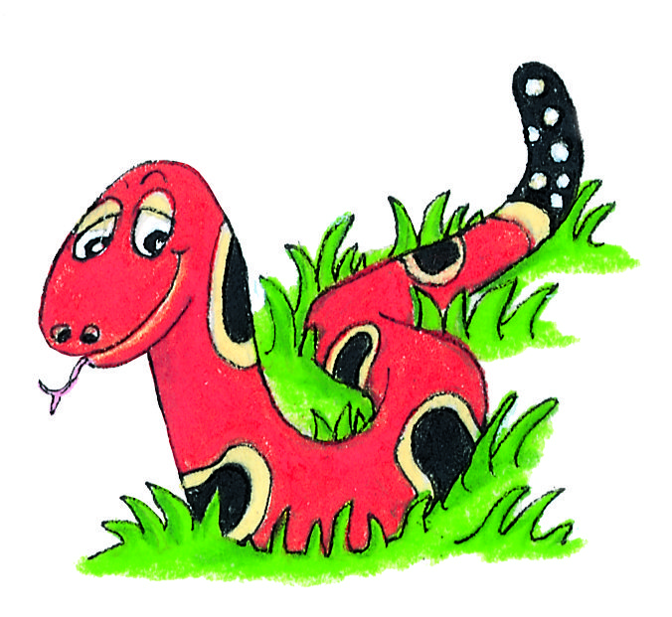
Spelling Test 26

Slide 3
big

Slide 4
big
fox

Slide 5
big
fox
milk

Slide 6
big
fox
milk
how

Slide 7
big
fox
milk
how
owl

Slide 8
big
fox
milk
how
owl
6. brown

Slide 9
big
fox
milk
how
owl
6. brown
7. town

Slide 10
big
fox
milk
how
owl
6. brown
7. town
8. could

Slide 11
big
fox
milk
how
owl
6. brown
7. town
8. could
9. should

Slide 12
big
fox
milk
how
owl
6. brown
7. town
8. could
9. should
10.flowerpot

Slide 13
Let’s review
Verbs

Slide 14
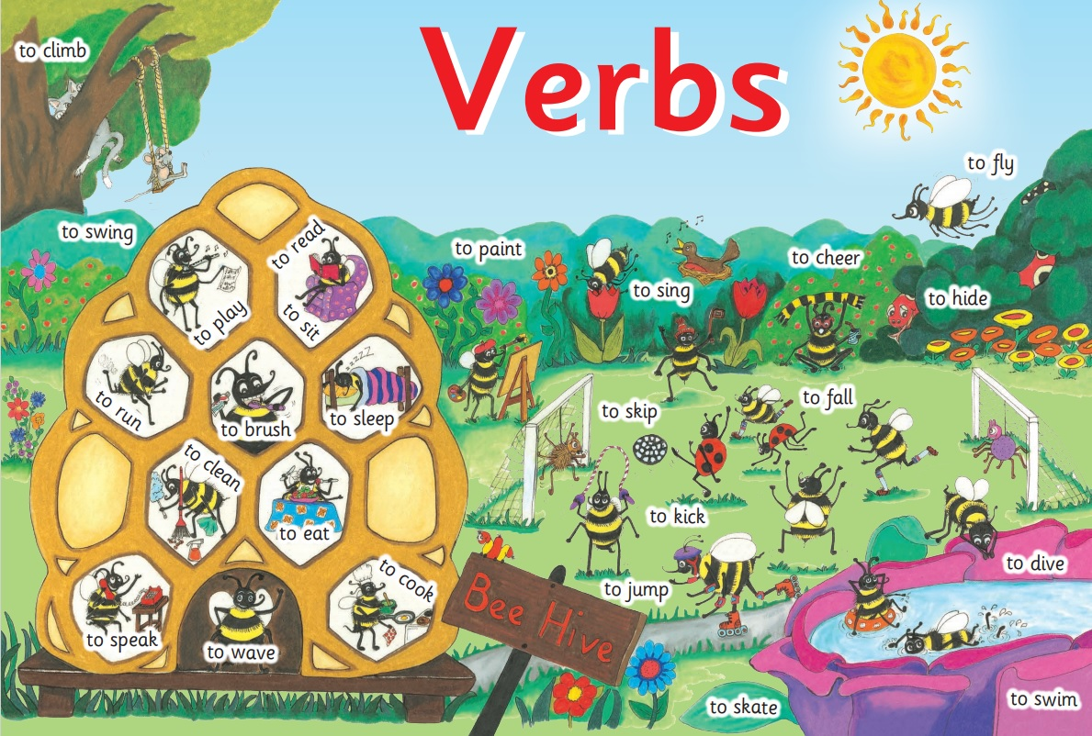

Slide 15
Let’s learn
Adverbs

Slide 16
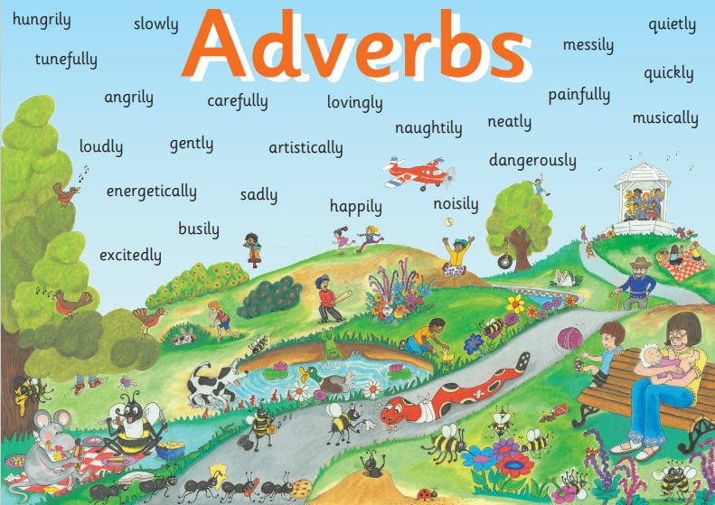

Slide 17
Activity Page:

Slide 18
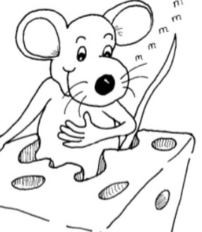
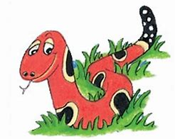
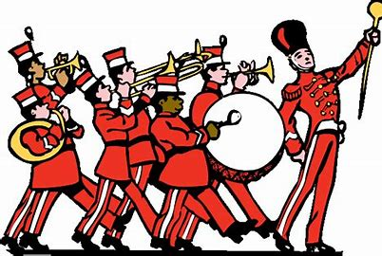
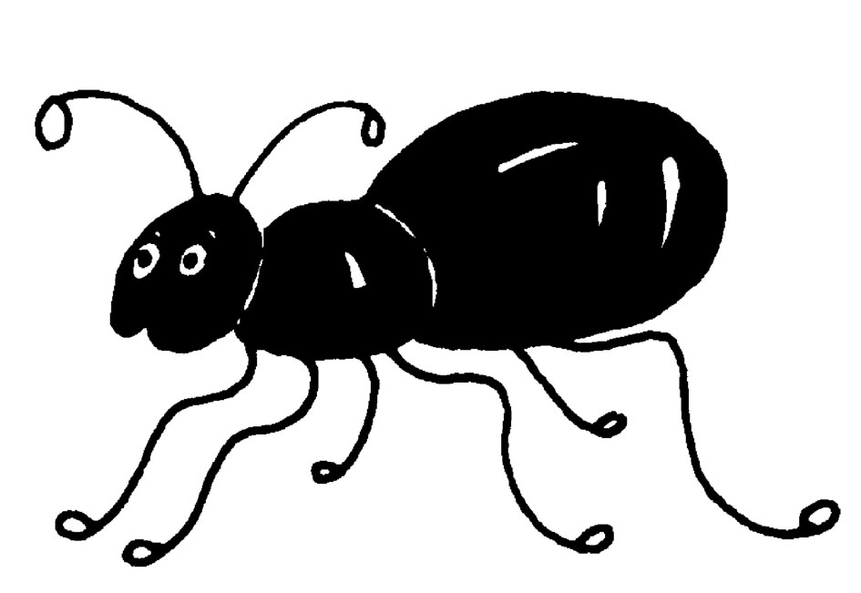
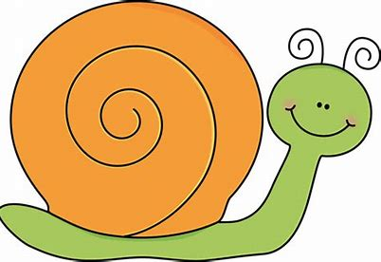
quickly hungrily slowly
secretly happily loudly
Inky eats
Snake slithers
Bee buzzes
The ants whispers
The snail goes
The band played

Slide 19
quickly slowly
secretly happily loudly
Inky eats
hungrily
Snake slithers
Bee buzzes
The ants whispers
The snail goes
The band played

Slide 20
quickly
secretly happily loudly
Inky eats
hungrily
Snake slithers
Bee buzzes
The ants whispers
The snail goes
slowly
The band played

Slide 21
quickly
secretly happily loudly
Inky eats
hungrily
Snake slithers
Bee buzzes
The ants whispers
The snail goes
slowly
The band played

Slide 22
quickly
secretly happily
Inky eats
hungrily
Snake slithers
Bee buzzes
The ants whispers
The snail goes
slowly
The band played
loudly

Slide 23
quickly
happily
Inky eats
hungrily
Snake slithers
Bee buzzes
The ants whispers
secretly
The snail goes
slowly
The band played
loudly

Slide 24
happily
Inky eats
hungrily
Snake slithers
quickly
Bee buzzes
The ants whispers
secretly
The snail goes
slowly
The band played
loudly

Slide 25
Bee buzzes
happily
Inky eats
hungrily
Snake slithers
quickly
The ants whispers
secretly
The snail goes
slowly
The band played
loudly

Slide 26
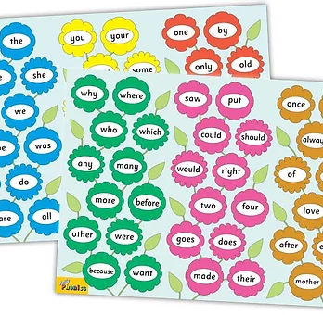
Tricky Words
^{5th} set

Slide 27
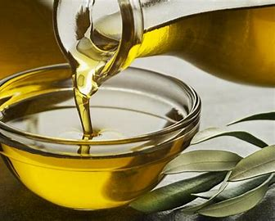
oil
/oi/

Slide 28
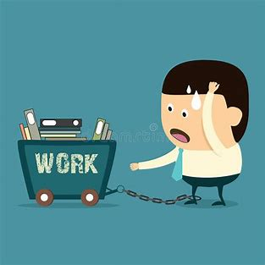
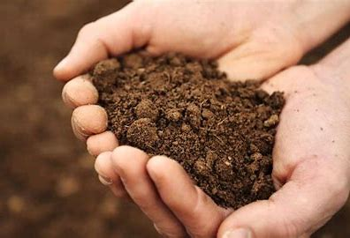
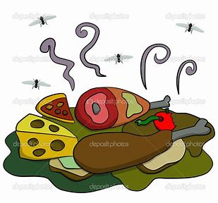
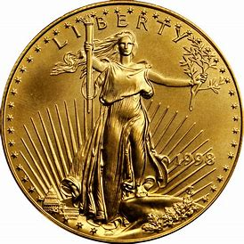
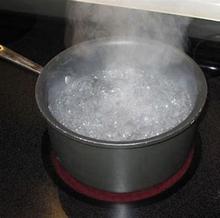
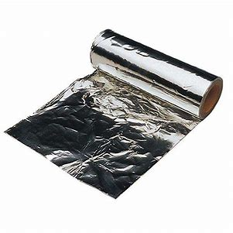
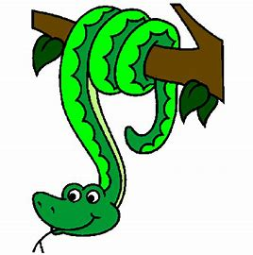
oil
toil
soil
spoil
bug
had
film
oil
coin
noisy
toil
would
right
boiling
coin
boil
joint
point
noisy
join
foil
coil

Slide 29
Activity page

Slide 30
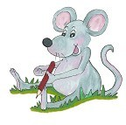
Dictation

Slide 31
boil

Slide 32
boil 2. join

Slide 33
boil 2. join 3. soil

Slide 34
boil 2. join 3. soil
4. joint

Slide 35
boil 2. join 3. soil
4. joint 5.foil

Slide 36
boil 2. join 3. soil
4. joint 5.foil 6. spoil

Slide 37
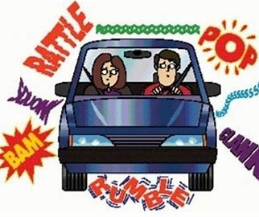
boil 2. join 3. soil
4. joint 5.foil 6. spoil
7. It was a noisy car.

Slide 38
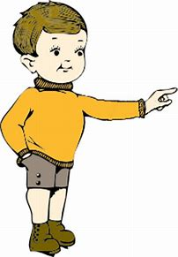
boil 2. join 3. soil
4. joint 5.foil 6. spoil
7. It was a noisy car.
8. They are pointing at me.

Slide 39
boil 2. join 3. soil
4. joint 5.foil 6. spoil
7. It was a noisy car.
8. They are pointing at me.
9. The snake coils
around the tree.

Slide 40
Thank you! See you next time.

