Slide 1
Jolly Grammar 1-25

Slide 2
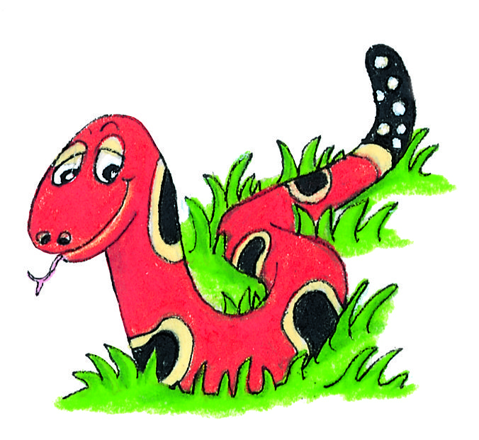
Spelling Test 24

Slide 3
bud

Slide 4
bud
sun

Slide 5
bud
sun
held

Slide 6
bud
sun
held
few

Slide 7
bud
sun
held
few
flew

Slide 8
bud
sun
held
few
flew
6. grew

Slide 9
bud
sun
held
few
flew
6. grew
7. chew

Slide 10
bud
sun
held
few
flew
6. grew
7. chew
8. because

Slide 11
bud
sun
held
few
flew
6. grew
7. chew
8. because
9. want

Slide 12
bud
sun
held
few
flew
6. grew
7. chew
8. because
9. want
10.newspaper

Slide 13
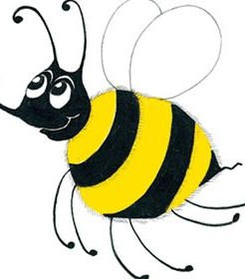
Let’s review alphabetical order.

Slide 14
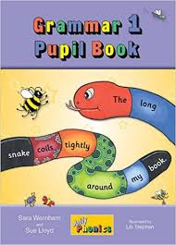
Activity Page:

Slide 15
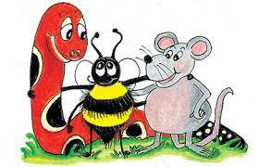
car lorry tractor

Slide 16
car lorry tractor
bus car truck

Slide 17
car lorry tractor
bus car truck
2. cat hamster rabbit

Slide 18
car lorry tractor
bus car truck
2. cat hamster rabbit
3. apple banana lemon

Slide 19
car lorry tractor
bus car truck
2. cat hamster rabbit
3. apple banana lemon
4. Alex Gilbert Ravi Sam
Greg Mark Rasheed Sam

Slide 20
car lorry tractor
bus car truck
2. cat hamster rabbit
3. apple banana lemon
4. Alex Gilbert Ravi Sam
Greg Mark Rasheed Sam
5. Davinda Emily Jill Pat Sue
Donna Emily Jennifer Jill Sue

Slide 21
crab swan television

Slide 22
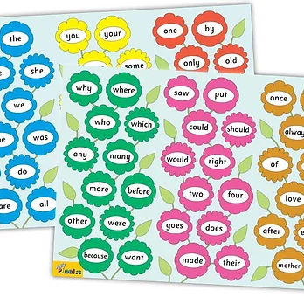
Tricky Words
^{5th} set

Slide 23
house
/ou/

Slide 24
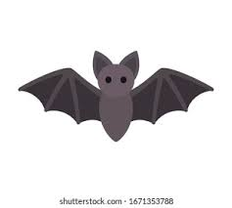
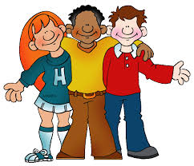
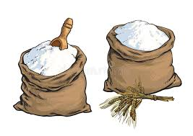
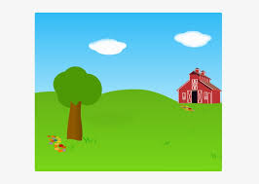
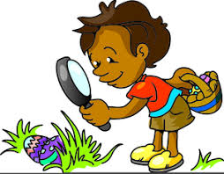
out
mouth
south
bat
pet
self
out
our
round
mouth
saw
put
outside
our
outside
flour
round
loud
found

Slide 25
Activity page

Slide 26
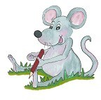
Dictation

Slide 27
our

Slide 28
our 2. loud

Slide 29
our 2. loud 3. south

Slide 30
our 2. loud 3. south
4. flour

Slide 31
our 2. loud 3. south
4. flour 5. found

Slide 32
our 2. loud 3. south
4. flour 5. found 6. round

Slide 33
our 2. loud 3. south
4. flour 5. found 6. round
7. The hoop is round.

Slide 34
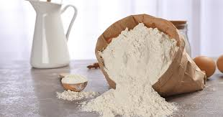
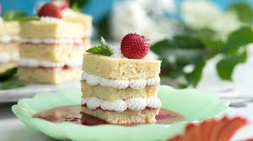
our 2. loud 3. south
4. flour 5. found 6. round
7. The hoop is round.
8. Dad needs some flour
to make a cake.

Slide 35
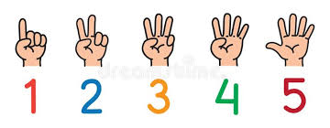
our 2. loud 3. south
4. flour 5. found 6. round
7. The hoop is round.
8. Dad needs some flour
to make a cake.
9. He counted to fifty.

Slide 36
Thank you! See you next time.

