Slide 1
Jolly Grammar 1-24

Slide 2
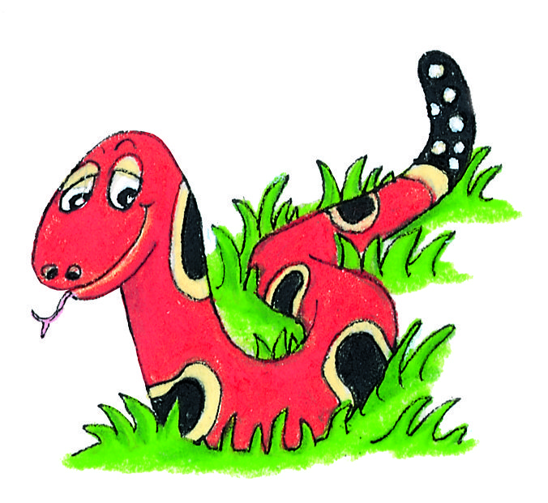
Spelling Test 23

Slide 3
box

Slide 4
box
job

Slide 5
box
job
bulb

Slide 6
box
job
bulb
own

Slide 7
box
job
bulb
own
grow

Slide 8
box
job
bulb
own
grow
6. elbow

Slide 9
box
job
bulb
own
grow
6. elbow
7. yellow

Slide 10
box
job
bulb
own
grow
6. elbow
7. yellow
8. other

Slide 11
box
job
bulb
own
grow
6. elbow
7. yellow
8. other
9. were

Slide 12
box
job
bulb
own
grow
6. elbow
7. yellow
8. other
9. were
10.snowman

Slide 13
Let’s learn
Compound Words.

Slide 14
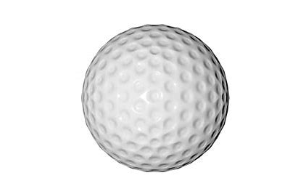
foot ＋ ball ＝

Slide 15
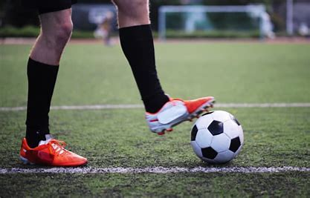
foot ＋ ball ＝ football

Slide 16
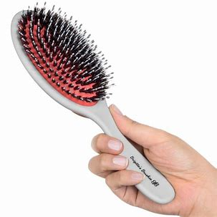
tooth ＋ brush ＝

Slide 17
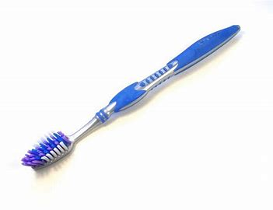
tooth ＋ brush ＝ toothbrush

Slide 18
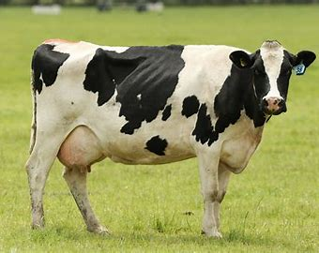
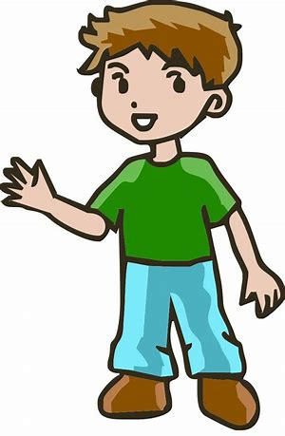
cow ＋ boy ＝

Slide 19
cow ＋ boy ＝ cowboy

Slide 20
sun ＋ flower ＝

Slide 21
sun ＋ flower ＝ sunflower

Slide 22
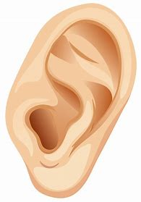
ear ＋ ring ＝

Slide 23
ear ＋ ring ＝ earring

Slide 24
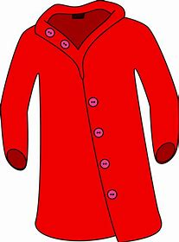
rain ＋ coat ＝

Slide 25
rain ＋ coat ＝ raincoat

Slide 26
Activity Page:

Slide 27
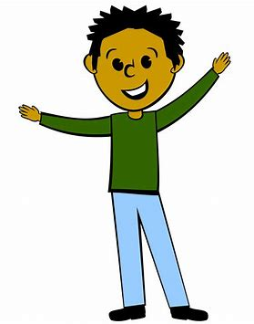
post ＋ man ＝

Slide 28
post ＋ man ＝ postman

Slide 29
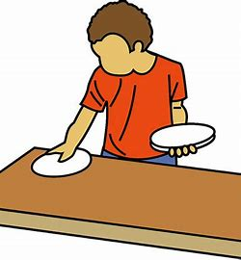
post ＋ man ＝ postman
sun ＋ set ＝ sunset

Slide 30
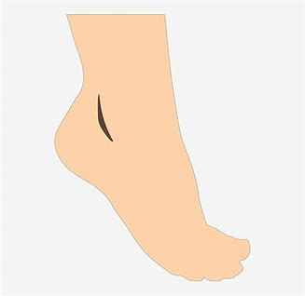
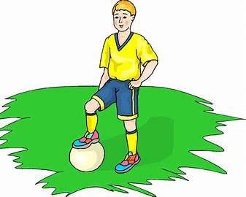
post ＋ man ＝ postman
sun ＋ set ＝ sunset
foot ＋ ball ＝ football

Slide 31
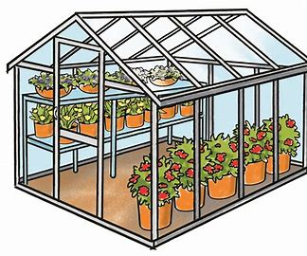
post ＋ man ＝ postman
sun ＋ set ＝ sunset
foot ＋ ball ＝ football
green ＋ house ＝ greenhouse

Slide 32
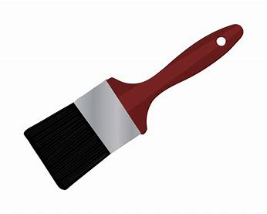
post ＋ man ＝ postman
sun ＋ set ＝ sunset
foot ＋ ball ＝ football
green ＋ house ＝ greenhouse
tooth ＋ brush ＝ toothbrush

Slide 33
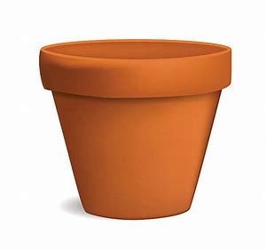
post ＋ man ＝ postman
sun ＋ set ＝ sunset
foot ＋ ball ＝ football
green ＋ house ＝ greenhouse
tooth ＋ brush ＝ toothbrush
tea ＋ pot ＝ teapot

Slide 34
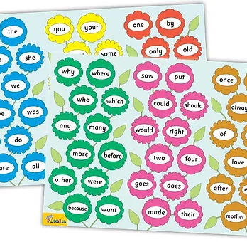
Tricky Words
^{4th} set

Slide 35
jewel
/ue/

Slide 36
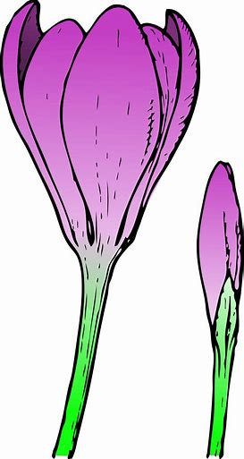
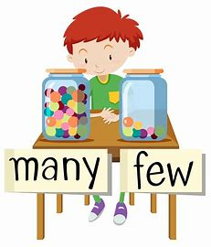
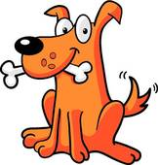
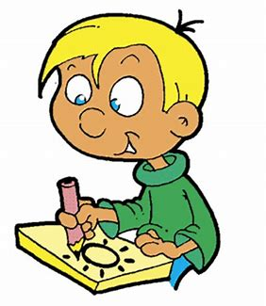
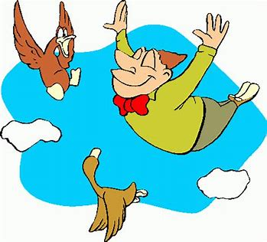
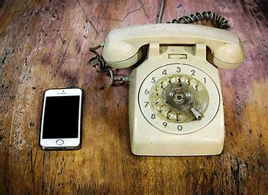
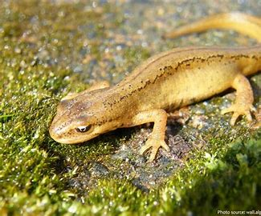
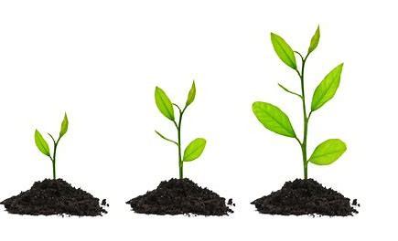
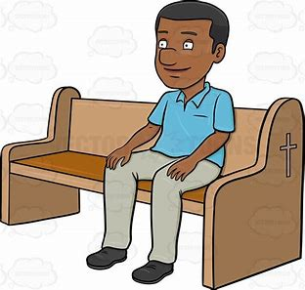
few
chew
drew
bud
sun
held
few
flew
grew
chew
because
want
newspaper
flew
new
newspaper
grew
pew
newt

Slide 37
Activity page

Slide 38
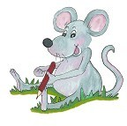
Dictation

Slide 39
few

Slide 40
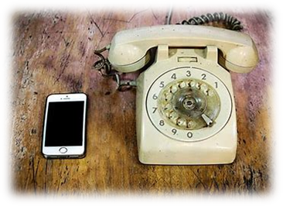
few 2. new

Slide 41
few 2. new 3. pew

Slide 42
few 2. new 3. pew
4. grew

Slide 43
few 2. new 3. pew
4. grew 5. chew

Slide 44
few 2. new 3. pew
4. grew 5. chew 6. drew

Slide 45
few 2. new 3. pew
4. grew 5. chew 6. drew
7. A few more can go.

Slide 46
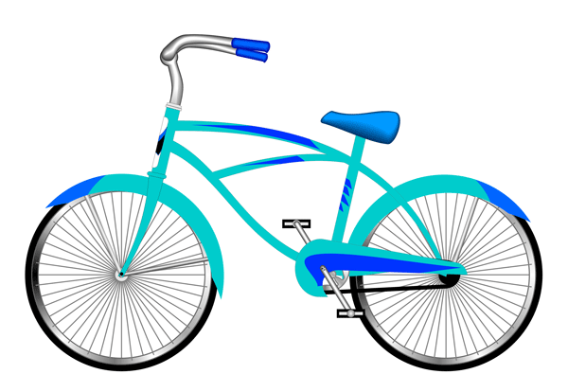
few 2. new 3. pew
4. grew 5. chew 6. drew
7. A few more can go.
8. There is my new bike.

Slide 47
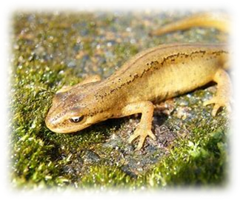
few 2. new 3. pew
4. grew 5. chew 6. drew
7. A few more can go.
8. There is my new bike.
9. He drew a newt.

Slide 48
Thank you! See you next time.

