Slide 1
Jolly Grammar 1-16

Slide 2
Spelling Test 15

Slide 3
six

Slide 4
six
pad

Slide 5
six
pad
smell

Slide 6
six
pad
smell
bike

Slide 7
six
pad
smell
bike
time

Slide 8
six
pad
smell
bike
time
6. smile

Slide 9
six
pad
smell
bike
time
6. smile
7. prize

Slide 10
six
pad
smell
bike
time
6. smile
7. prize
8. like

Slide 11
six
pad
smell
bike
time
6. smile
7. prize
8. like
9. have

Slide 12
six
pad
smell
bike
time
6. smile
7. prize
8. like
9. have
10. bridesmaid

Slide 13
Let’s revise
Nouns & Verbs.

Slide 14
She races up the hill.
She runs in the race.

Slide 15
She races up the hill.
She runs in the race.

Slide 16
She races up the hill.
She runs in the race.

Slide 17
Today I wish.

Slide 18
Today I wish.
Yesterday, I wished.

Slide 19
Today I wish.
Yesterday, I wished.
present tense
past tense

Slide 20
Today, I talk.
Today, I smile.

Slide 21
Today, I talk.
Today, I smile.

Slide 22
Today, I talk.
Yesterday, I talked.
Today, I smile.

Slide 23
Today, I talk.
Yesterday, I talked.
Today, I smile.
Yesterday, I smileed?

Slide 24
Today, I talk.
Yesterday, I talked.
Today, I smile.
Yesterday, I smiled.

Slide 25
Activity page

Slide 26
jump
paint
like
shout
rest
hope
play
wave
skate
twist

Slide 27
jumped
painted
liked
shouted
rested
hoped
played
waved
skated
twisted

Slide 28
She brushed her hair. past/present
They look out of the window. past/present
I cooked dinner. past/present
The race started in the park. past/present

Slide 29
She brushed her hair. past/present
They look out of the window. past/present
I cooked dinner. past/present
The race started in the park. past/present

Slide 30
She brushed her hair. past/present
They look out of the window. past/present
I cooked dinner. past/present
The race started in the park. past/present

Slide 31
She brushed her hair. past/present
They look out of the window. past/present
I cooked dinner. past/present
The race started in the park. past/present

Slide 32
She brushed her hair. past/present
They look out of the window. past/present
I cooked dinner. past/present
The race started in the park. past/present

Slide 33
She brushed her hair. past/present
They look out of the window. past/present
I cooked dinner. past/present
The race started in the park. past/present

Slide 34
She brushed her hair. past/present
They look out of the window. past/present
I cooked dinner. past/present
The race started in the park. past/present

Slide 35
She brushed her hair. past/present
They look out of the window. past/present
I cooked dinner. past/present
The race started in the park. past/present

Slide 36
She brushed her hair. past/present
They look out of the window. past/present
I cooked dinner. past/present
The race started in the park. past/present

Slide 37
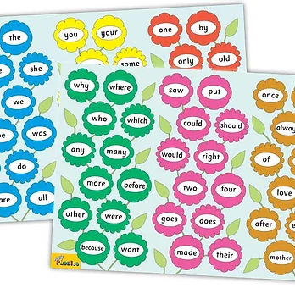
Tricky Words
3rd set

Slide 38
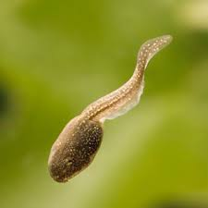
tadpole
/oa/

Slide 39
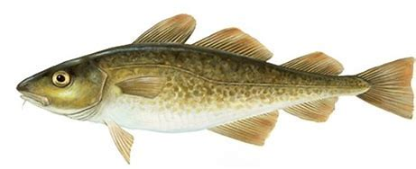
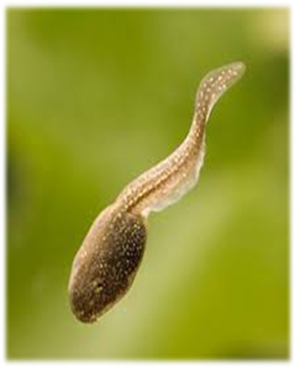
bone
globe
hope
mole
cod
lot
snap
bone
nose
home
globe
live
give
tadpole
nose
tadpole
rose
home
rode
note
hole

Slide 40
Dictation

Slide 41
rode

Slide 42
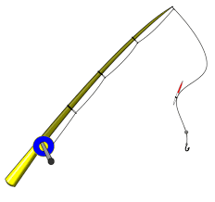
rode 2. rod

Slide 43
rode 2. rod 3. hope

Slide 44
rode 2. rod 3. hope
4. hop

Slide 45
rode 2. rod 3. hope
4. hop 5. note

Slide 46
rode 2. rod 3. hope
4. hop 5. note 6. not

Slide 47
rode 2. rod 3. hope
4. hop 5. note 6. not
7. It is time to go home.

Slide 48
rode 2. rod 3. hope
4. hop 5. note 6. not
7. It is time to go home.
8. Those roses are pink.

Slide 49
rode 2. rod 3. hope
4. hop 5. note 6. not
7. It is time to go home.
8. Those roses are pink.
9. The mole is in his hole.

Slide 50
Thank you! See you next time.

