Slide 1
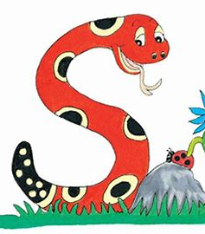
Jolly Grammar 1-7

Slide 2
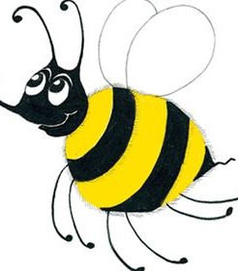
Spelling Test 6

Slide 3
at

Slide 4
at
2. yes

Slide 5
at
2. yes
3. slug

Slide 6
at
2. yes
3. slug
4. arm

Slide 7
at
2. yes
3. slug
4. arm
5. hard

Slide 8
at
2. yes
3. slug
4. arm
5. hard
6. scarf

Slide 9
at
2. yes
3. slug
4. arm
5. hard
6. scarf
7. card

Slide 10
at
2. yes
3. slug
4. arm
5. hard
6. scarf
7. card
8. are

Slide 11
at
2. yes
3. slug
4. arm
5. hard
6. scarf
7. card
8. are
9. all

Slide 12
at
2. yes
3. slug
4. arm
5. hard
6. scarf
7. card
8. are
9. all
10. farmyard

Slide 13
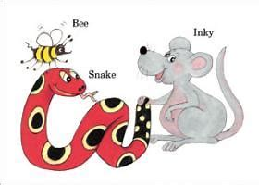
Alphabetical order

Slide 14
A B C D E
F G H I J K L M
N O P Q R S T U V W X Y Z

Slide 15
S
K

Slide 16
S
T
K
R

Slide 17
S
T
J
K
L
R

Slide 18
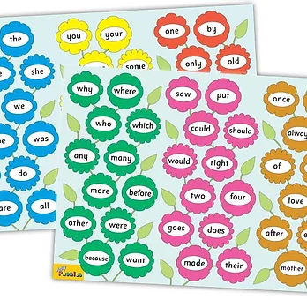
Tricky Words
^{2nd} set

Slide 19
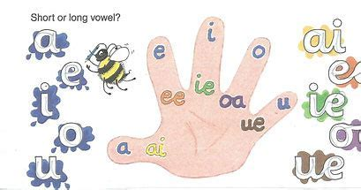
Short
vowels

Slide 20
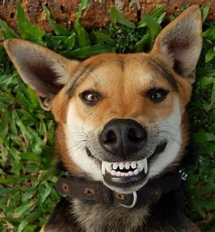
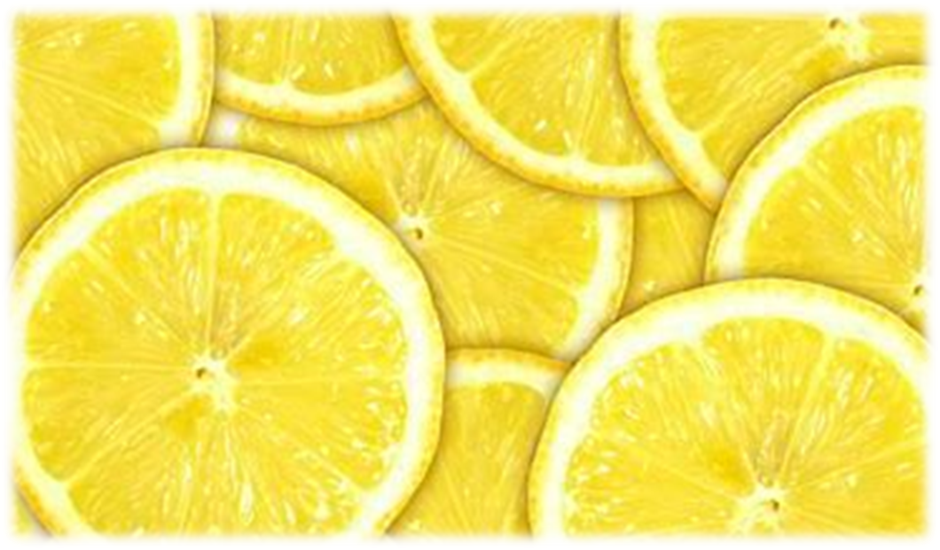
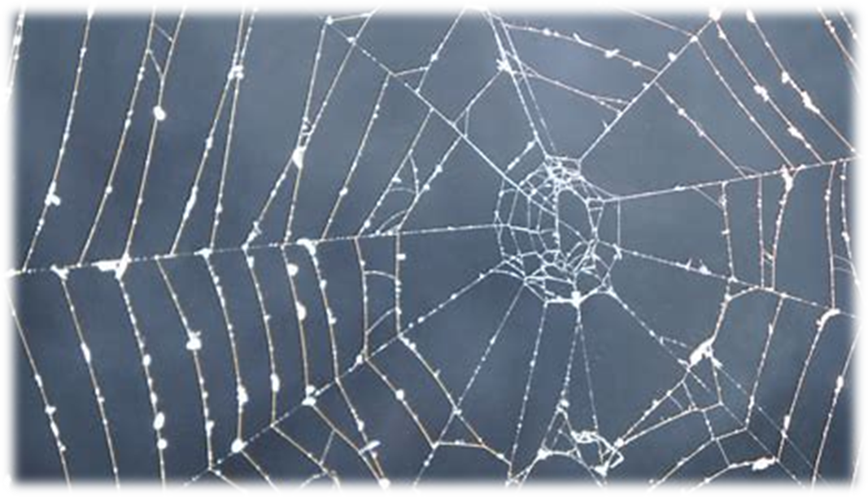
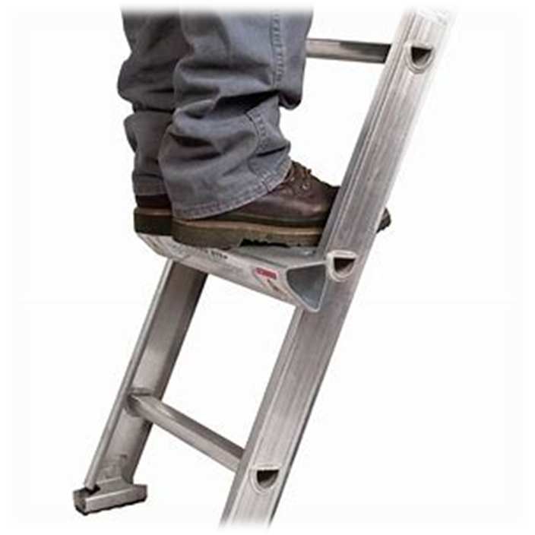
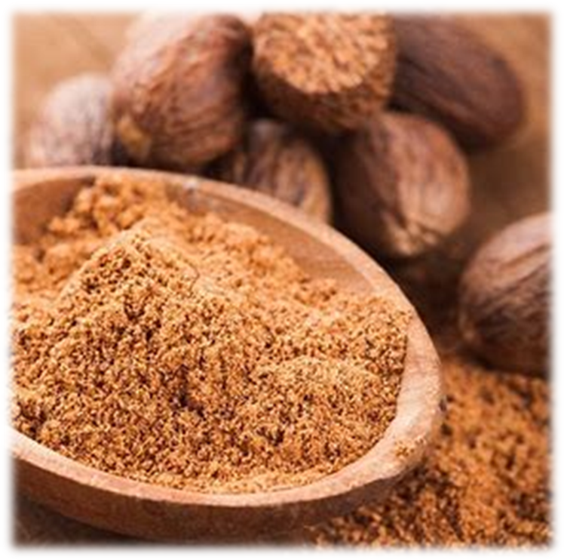
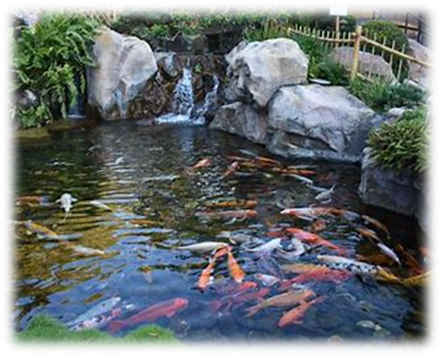
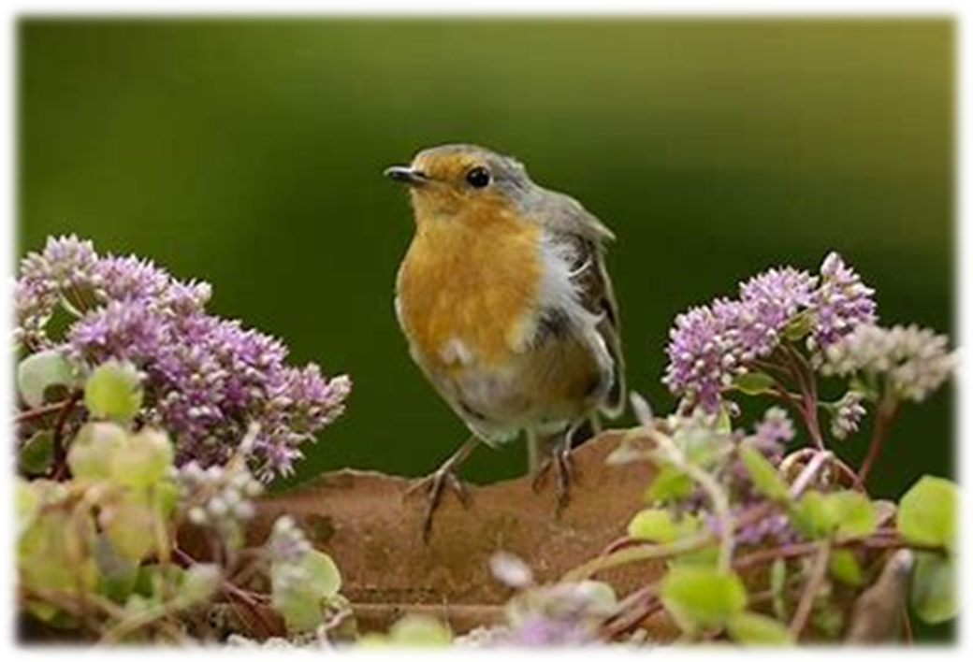
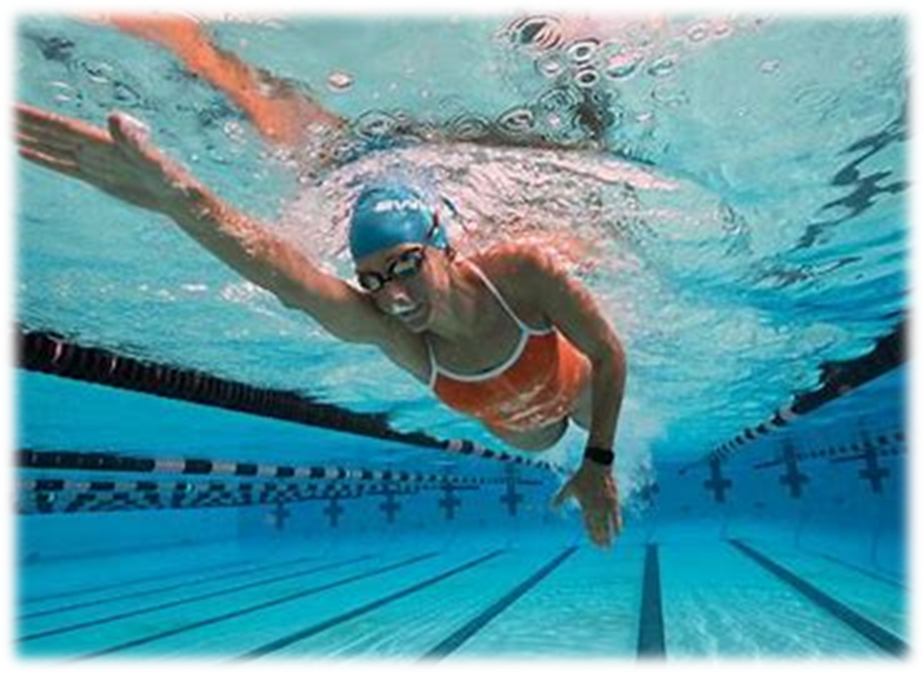
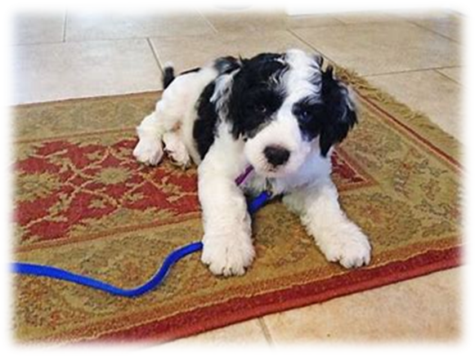
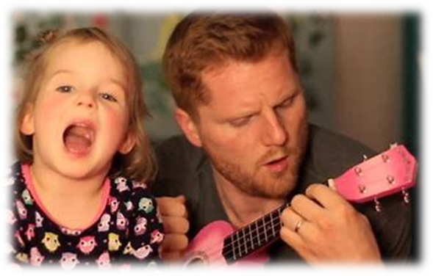
dog
lemon
cobweb
rung
dog
bran
Monday
Tuesday
Wednesday
Thursday
Friday
you
your
Saturday
bran
nutmeg
pond
robin
swam
rug
sing

Slide 21
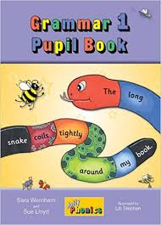
Activity page

Slide 22
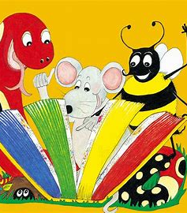
Dictation

Slide 23
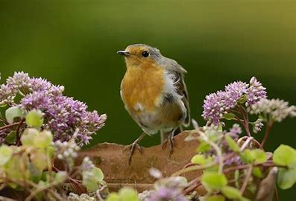
robin

Slide 24
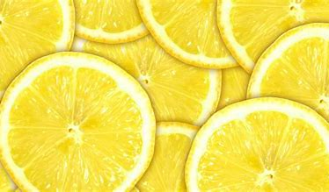
robin 2. lemon

Slide 25
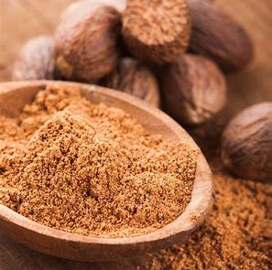
robin 2. lemon 3. nutmeg

Slide 26
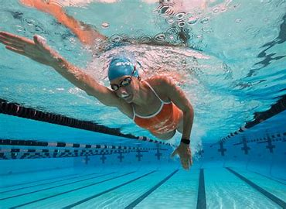
robin 2. lemon 3. nutmeg
4. swam

Slide 27
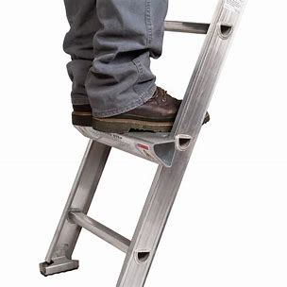
robin 2. lemon 3. nutmeg
4. swam 5. rung

Slide 28
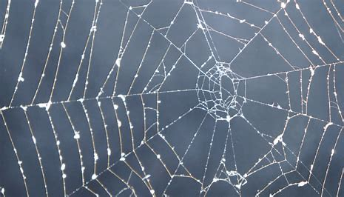
robin 2. lemon 3. nutmeg
4. swam 5. rung 6. cobweb

Slide 29
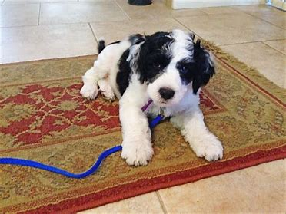
robin 2. lemon 3. nutmeg
4. swam 5. rung 6. cobweb
7. The dog sits on the rug.

Slide 30
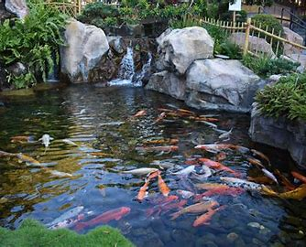
robin 2. lemon 3. nutmeg
4. swam 5. rung 6. cobweb
7. The dog sits on the rug.
8. The fish swims in the pond.

Slide 31
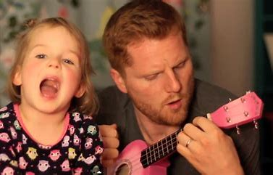
robin 2. lemon 3. nutmeg
4. swam 5. rung 6. cobweb
7. The dog sits on the rug.
8. The fish swims in the pond.
9. She sings a song for her dad.

