Slide 1
Grammar 1-5

Slide 2
Spelling Test 4

Slide 3
in

Slide 4
in
leg

Slide 5
in
leg
glad

Slide 6
in
leg
glad
ring

Slide 7
in
leg
glad
ring
sang

Slide 8
in
leg
glad
ring
sang
6. strong

Slide 9
in
leg
glad
ring
sang
6. strong
7. lung

Slide 10
in
leg
glad
ring
sang
6. strong
7. lung
8. be

Slide 11
in
leg
glad
ring
sang
6. strong
7. lung
8. be
9. was

Slide 12
in
leg
glad
ring
sang
6. strong
7. lung
8. be
9. was
10. length

Slide 13
Proper Nouns

Slide 14
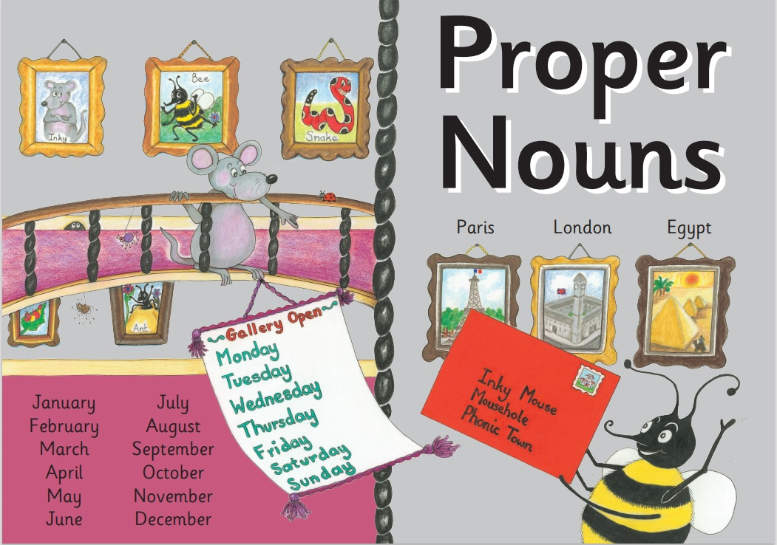

Slide 15
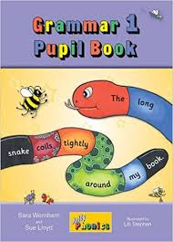
Activity Page:
Capital Letters

Slide 16
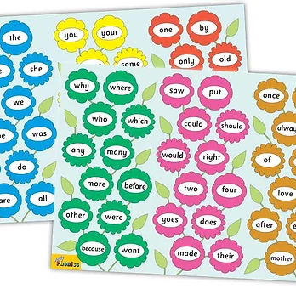
Tricky Words
^{1st} set

Slide 17
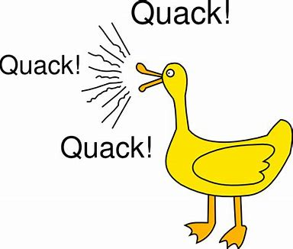
quack
/qu/

Slide 18
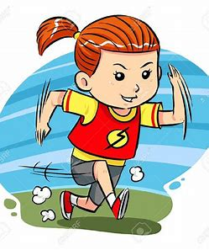
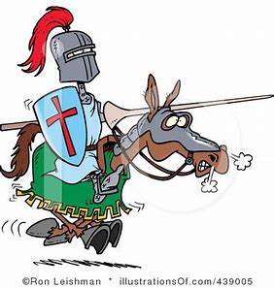
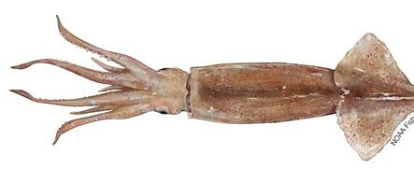
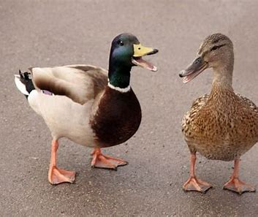
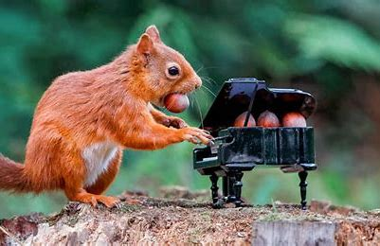
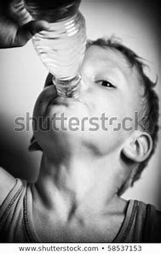
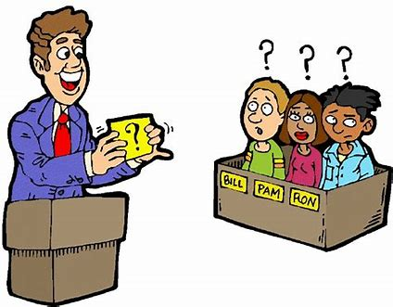
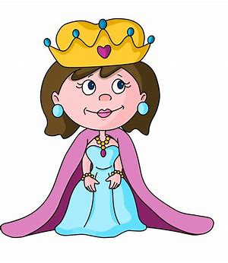
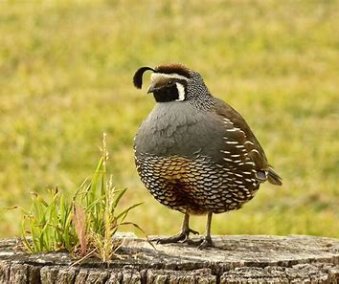
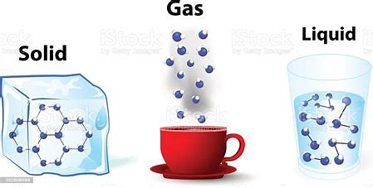
quick
squid
quest
on
but
plum
quick
quiz
queen
squid
to
do
squirrel
quiz
quack
squirrel
quench
queen
quit
quail
liquid

Slide 19
Activity page

Slide 20
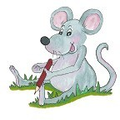
Dictation

Slide 21
quit

Slide 22
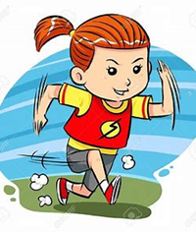
quit 2. quick

Slide 23
quit 2. quick 3. queen

Slide 24
quit 2. quick 3. queen
4. quail

Slide 25
quit 2. quick 3. queen
4. quail 5. quest

Slide 26
quit 2. quick 3. queen
4. quail 5. quest 6. liquid

Slide 27
quit 2. quick 3. queen
4. quail 5. quest 6. liquid
7. She is quick.

Slide 28
quit 2. quick 3. queen
4. quail 5. quest 6. liquid
7. She is quick.
8. The ducks quack.

Slide 29
quit 2. quick 3. queen
4. quail 5. quest 6. liquid
7. She is quick.
8. The ducks quack.
9. The quiz was hard.

Slide 30
Thank you! See you next time.

