Slide 1
Grammar 1-4

Slide 2
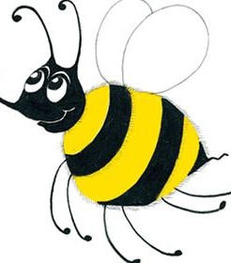
Spelling Test 3

Slide 3
in

Slide 4
in
leg

Slide 5
in
leg
glad

Slide 6
in
leg
glad
ring

Slide 7
in
leg
glad
ring
sang

Slide 8
in
leg
glad
ring
sang
6. strong

Slide 9
in
leg
glad
ring
sang
6. strong
7. lung

Slide 10
in
leg
glad
ring
sang
6. strong
7. lung
8. be

Slide 11
in
leg
glad
ring
sang
6. strong
7. lung
8. be
9. was

Slide 12
in
leg
glad
ring
sang
6. strong
7. lung
8. be
9. was
10. length

Slide 13
Capital Letters

Slide 14
Aa Bb Cc Dd Ee
Ff Gg Hh Ii Jj Kk Ll Mm
Nn Oo Pp Qq Rr Ss
Tt Uu Vv Ww Xx Yy Zz

Slide 15
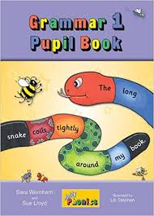
Activity Page:
Capital Letters

Slide 16
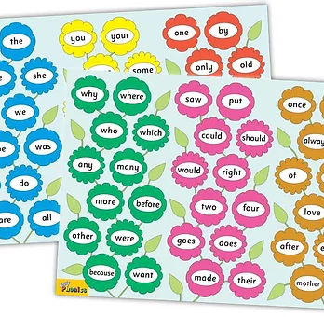
Tricky Words
^{1st} set

Slide 17
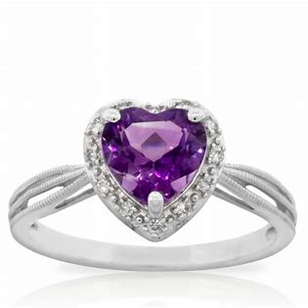
ring
/ng/

Slide 18
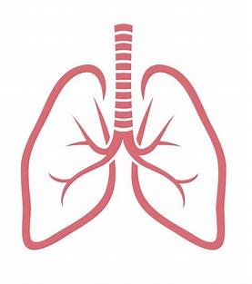
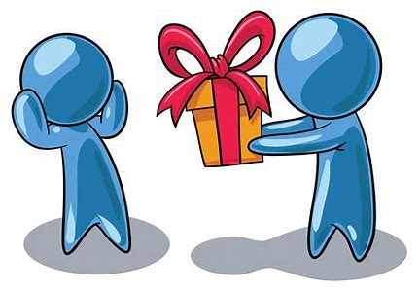
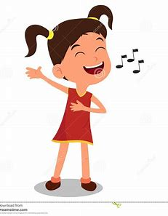
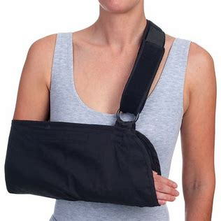
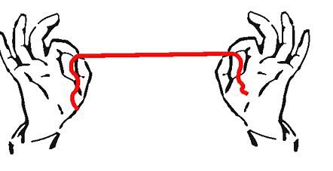
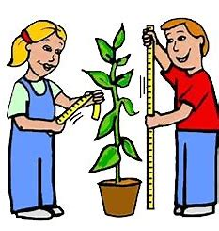
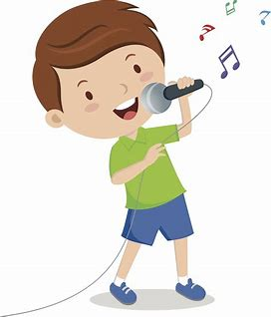
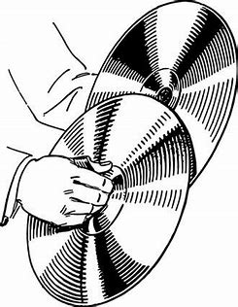
ring
lung
bring
sung
sling
in
leg
glad
ring
sang
strong
lung
be
was
length
sang
length
spring
string
strong
wing
song
clang

Slide 19
Activity page

Slide 20
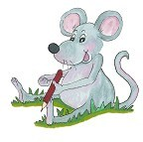
Dictation

Slide 21
wing

Slide 22
wing 2. song

Slide 23
wing 2. song 3. bring

Slide 24
wing 2. song 3. bring
4. spring

Slide 25
wing 2. song 3. bring
4. spring 5. sung

Slide 26
wing 2. song 3. bring
4. spring 5. sung 6. clang

Slide 27
wing 2. song 3. bring
4. spring 5. sung 6. clang
7. The string was long.

Slide 28
wing 2. song 3. bring
4. spring 5. sung 6. clang
7. The string was long.
8. She sang a song.

Slide 29
wing 2. song 3. bring
4. spring 5. sung 6. clang
7. The string was long.
8. She sang a song.
9. He had a sling on his arm.

Slide 30
Thank you! See you next time.

