Slide 1
Grammar 1-2

Slide 2
Spelling Test 1

Slide 3
am

Slide 4
am
get

Slide 5
am
get
clap

Slide 6
am
get
clap
shop

Slide 7
am
get
clap
shop
fish

Slide 8
am
get
clap
shop
fish
6. shut

Slide 9
am
get
clap
shop
fish
6. shut
7. wish

Slide 10
am
get
clap
shop
fish
6. shut
7. wish
8. I

Slide 11
am
get
clap
shop
fish
6. shut
7. wish
8. I
9. the

Slide 12
am
get
clap
shop
fish
6. shut
7. wish
8. I
9. the
10. shampoo

Slide 13
Sentences

Slide 14
we went to the park

Slide 15
we went to the park
We went to the park.

Slide 16
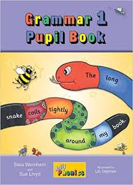
Activity Page:
Sentences

Slide 17
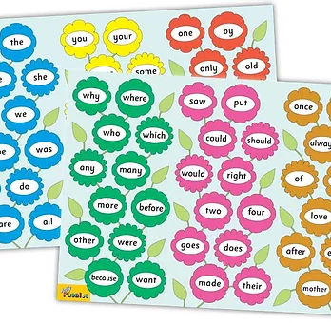
Tricky Words
^{1st} set

Slide 18
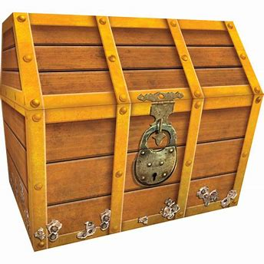
chest
/ch/

Slide 19
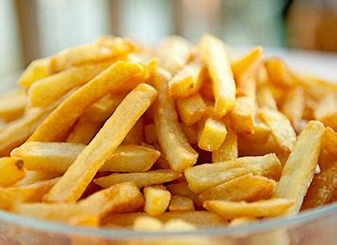
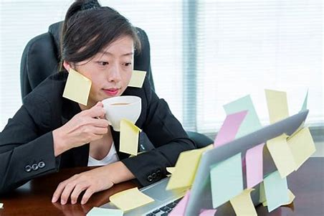
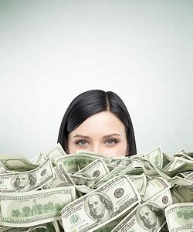
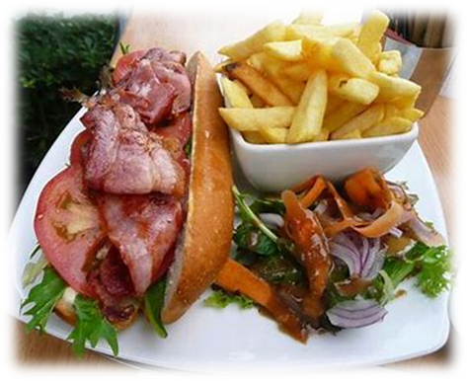
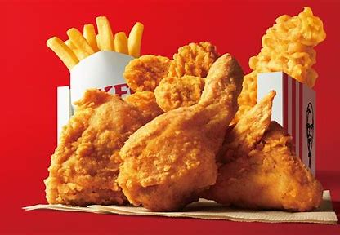
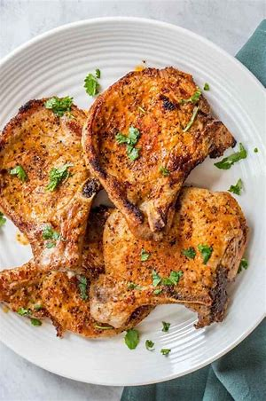
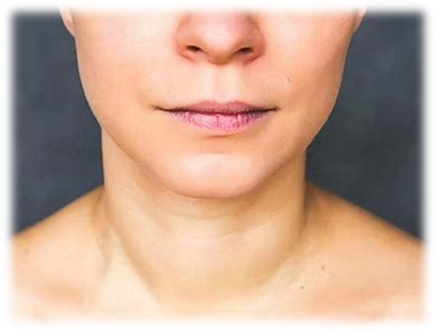
chips
much
such
rich
if
hot
blot
chips
lunch
chest
much
he
she
chicken
lunch
chicken
chop
chest
chin
bench

Slide 20
Activity page

Slide 21
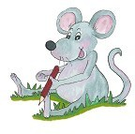
Dictation

Slide 22
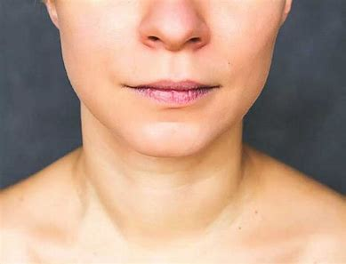
chin

Slide 23
chin 2. much

Slide 24
chin 2. much 3. chop

Slide 25
chin 2. much 3. chop
4. bench

Slide 26
chin 2. much 3. chop
4. bench 5. such

Slide 27
chin 2. much 3. chop
4. bench 5. such 6. lunch

Slide 28
chin 2. much 3. chop
4. bench 5. such 6. lunch
7. I am rich.

Slide 29
chin 2. much 3. chop
4. bench 5. such 6. lunch
7. I am rich.
8. She sat on the bench.

Slide 30
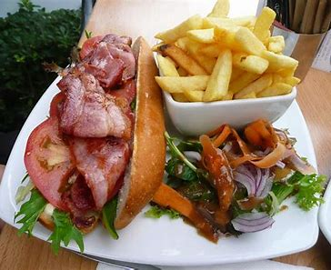
chin 2. much 3. chop
4. bench 5. such 6. lunch
7. I am rich.
8. She sat on the bench.
9. He had chips for lunch.

Slide 31
Thank you! See you next time.

