Slide 1
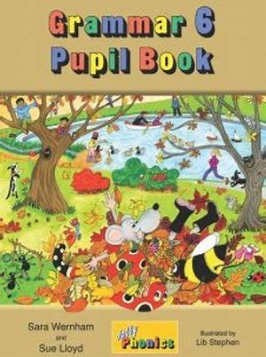
Jolly Grammar
6b-1

Slide 2
dinghy
sheikh
rhino
jodhpurs
wheel
rhombus
khaki
Buddhism

Slide 3
Activity Page:
/t/ Spellings

Slide 4
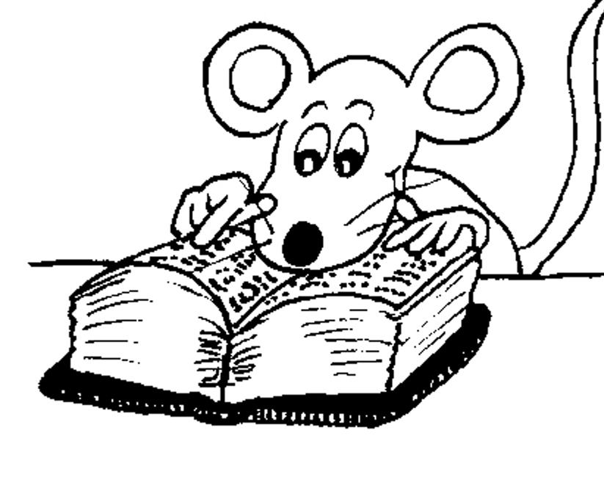
Spelling List

Slide 5
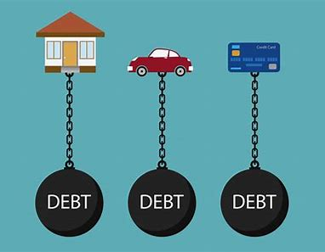
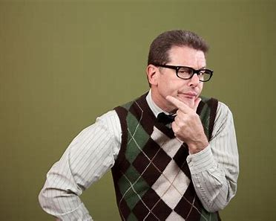
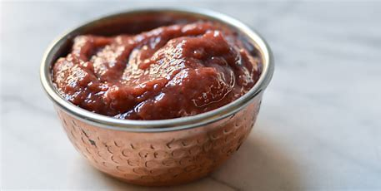
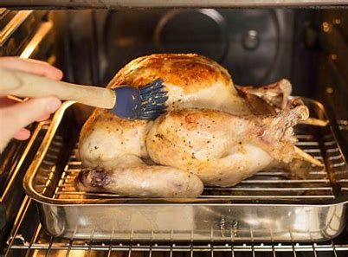
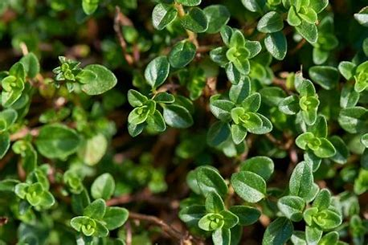
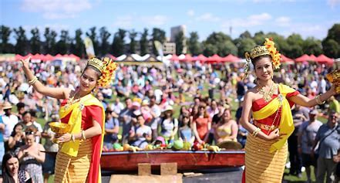
debt doubt paste
baste thyme Thailand

Slide 6
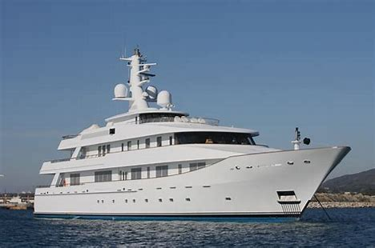
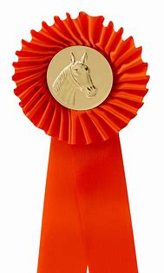
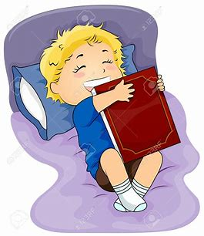
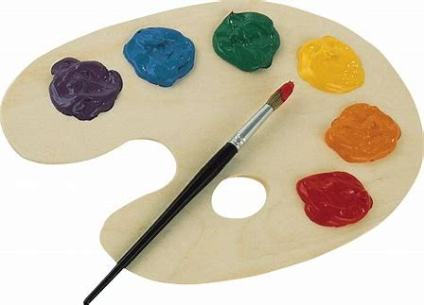
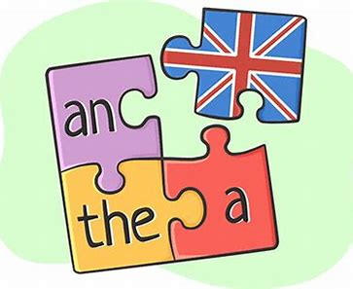
yacht subtle rosette
palette definite favourite

Slide 7
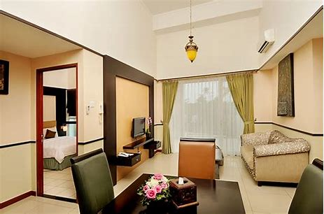
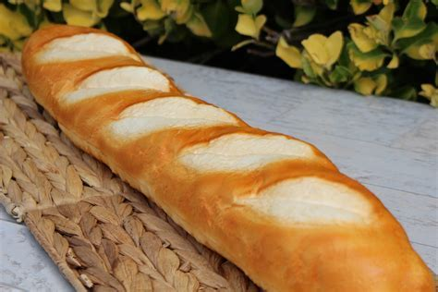
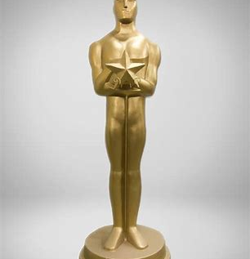
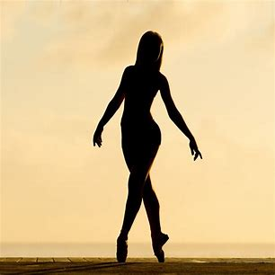
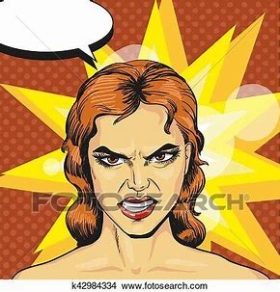
suite baguette statuette
brunette silhouette redoubtable

Slide 9
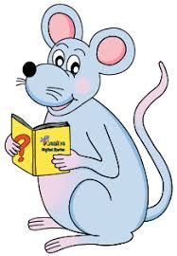
Draw a picture for each of the words shown under the four easels.

Slide 10
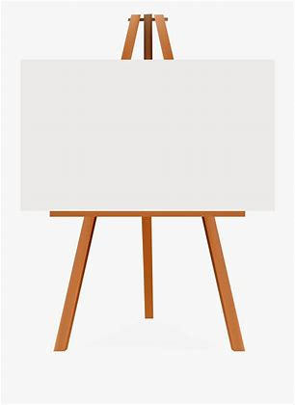
yacht
rosette
baguette
statuette

Slide 11
yacht
rosette
baguette
statuette

Slide 12
yacht
rosette
baguette
statuette

Slide 13
yacht
rosette
baguette
statuette

Slide 14
yacht
rosette
baguette
statuette

Slide 15
Think of a main clause to go with each subordinate clause and write it down.

Slide 16
after our trip to Thailand

Slide 17
although I had some doubts

Slide 18
unless you pay your debts

Slide 19
because your yacht was very fast

Slide 20
Parsing and completing the wall.

Slide 21
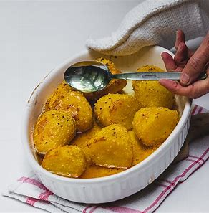
The chef had definitely basted the roast potatoes.
Subject
chef
The
Verb
had basted
definitely
Object
potatoes
the roast
(action)

Slide 22
Write the meanings for the spelling words shown.

Slide 23
debt
doubt
paste
thyme
Thailand
palette
brunette
silhouette
:
:
:
:
:
:
:
:

Slide 24
debt
doubt
paste
thyme
Thailand
palette
brunette
silhouette
:
:to not be sure of something
:to stick paper to something with glue
:
:
:
:
:

Slide 25
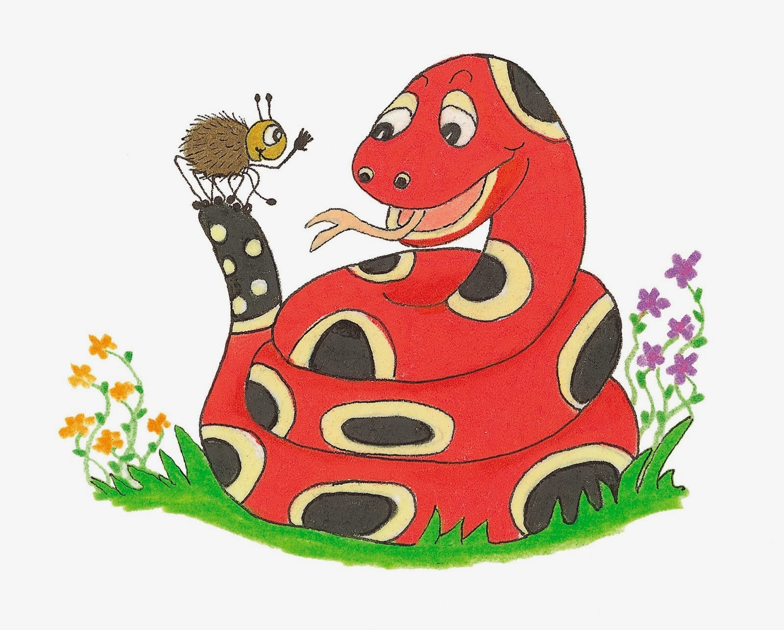
Dictation

Slide 26
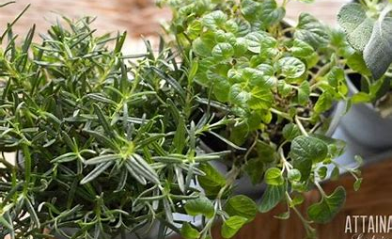

Slide 27
Granny grows mint and thyme in her herb garden.

Slide 28
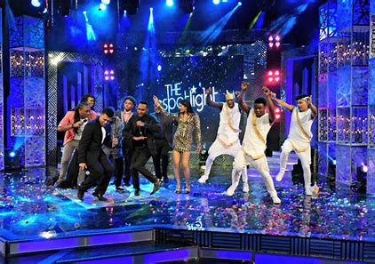

Slide 29
The winner of the talent show got a golden statuette.

Slide 30
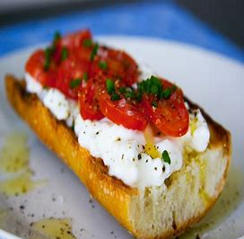

Slide 31
“Would you like a cheese and tomato baguette?” I asked.

Slide 32
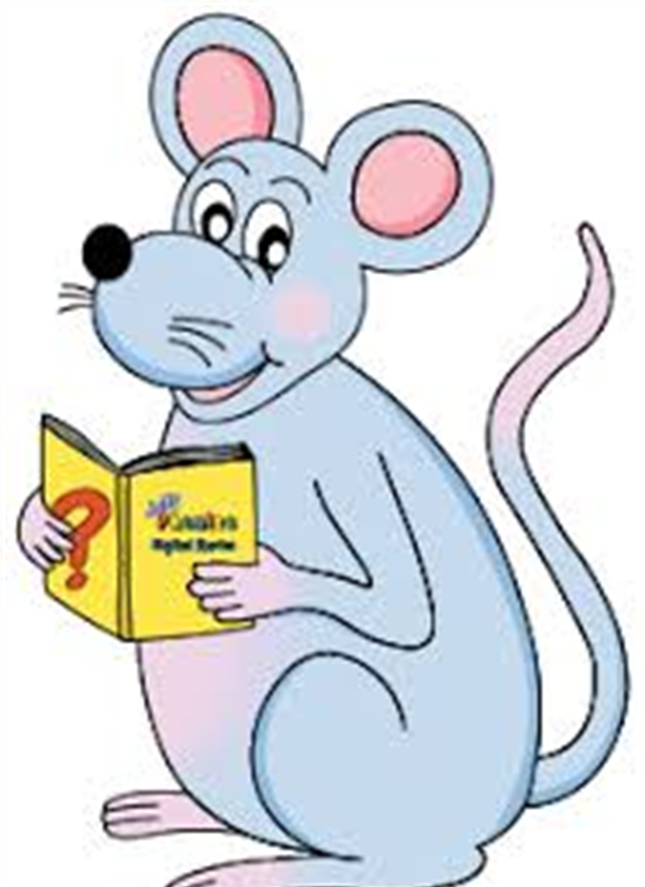
Assignment
Learn Words in the List

Slide 33
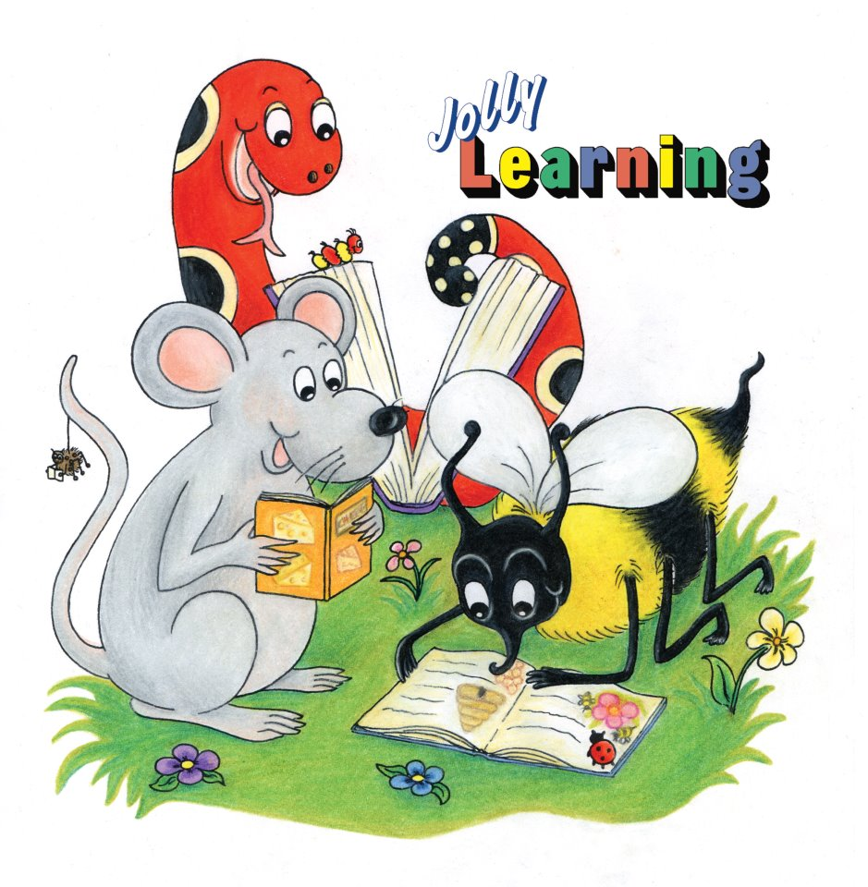
See you
next time!

