Slide 1
Jolly Grammar 3-34

Slide 2
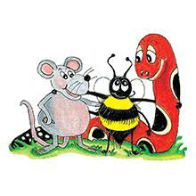
Spelling Test 33

Slide 3
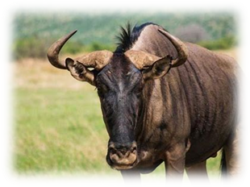
gnu

Slide 4
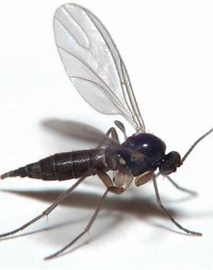
gnu
gnat

Slide 5
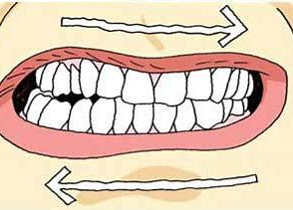
gnu
gnat
gnash

Slide 6
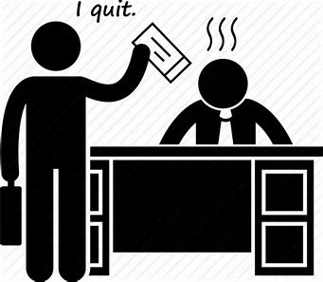
gnu
gnat
gnash
resign

Slide 7
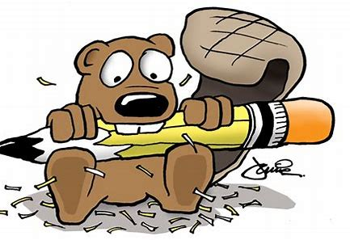
gnu
gnat
gnash
resign
gnaw

Slide 8
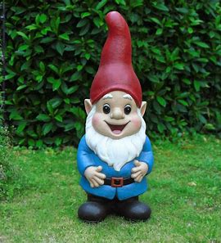
gnu
gnat
gnash
resign
gnaw
gnome

Slide 9
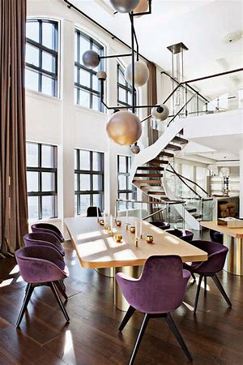
gnu
gnat
gnash
resign
gnaw
gnome
7. design

Slide 10
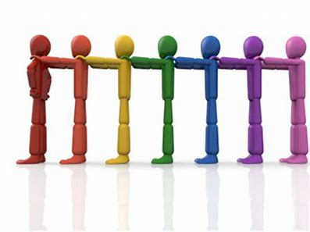
gnu
gnat
gnash
resign
gnaw
gnome
7. design
8. align

Slide 11
gnu
gnat
gnash
resign
gnaw
gnome
7. design
8. align
9. assign

Slide 12
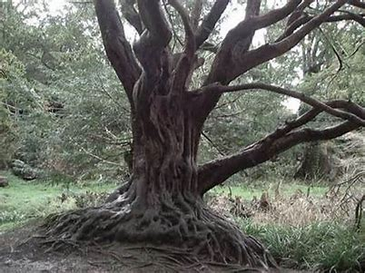
gnu
gnat
gnash
resign
gnaw
gnome
7. design
8. align
9. assign
10. gnarled

Slide 13
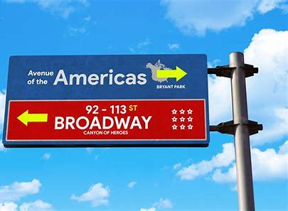
gnu
gnat
gnash
resign
gnaw
gnome
7. design
8. align
9. assign
10. gnarled
11. signpost

Slide 14
gnu
gnat
gnash
resign
gnaw
gnome
7. design
8. align
9. assign
10. gnarled
11. signpost
12. reign

Slide 15
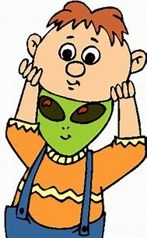
gnu
gnat
gnash
resign
gnaw
gnome
7. design
8. align
9. assign
10. gnarled
11. signpost
12. reign
13. feign

Slide 16
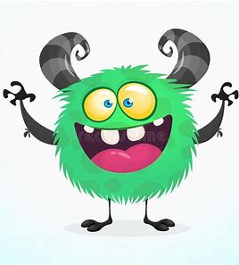
gnu
gnat
gnash
resign
gnaw
gnome
7. design
8. align
9. assign
10. gnarled
11. signpost
12. reign
13. feign
14. malign

Slide 17
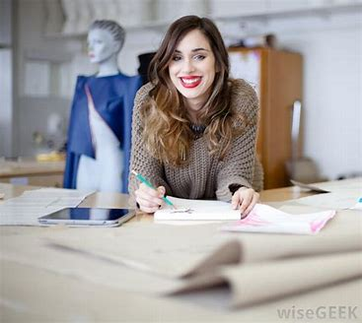
gnu
gnat
gnash
resign
gnaw
gnome
7. design
8. align
9. assign
10. gnarled
11. signpost
12. reign
13. feign
14. malign
15. designer

Slide 18
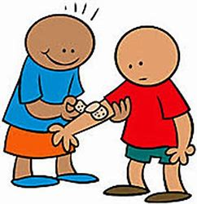
gnu
gnat
gnash
resign
gnaw
gnome
7. design
8. align
9. assign
10. gnarled
11. signpost
12. reign
13. feign
14. malign
15. designer
16. benign

Slide 19
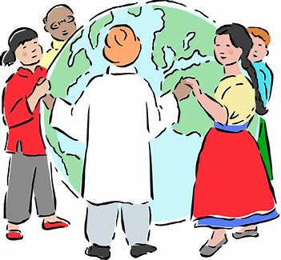
gnu
gnat
gnash
resign
gnaw
gnome
7. design
8. align
9. assign
10. gnarled
11. signpost
12. reign
13. feign
14. malign
15. designer
16. benign
17. foreigner

Slide 20
gnu
gnat
gnash
resign
gnaw
gnome
7. design
8. align
9. assign
10. gnarled
11. signpost
12. reign
13. feign
14. malign
15. designer
16. benign
17. foreigner
18. poignant

Slide 21
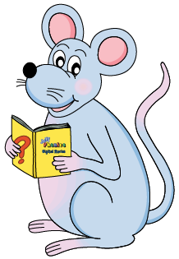
Let’s review
sentences.

Slide 22
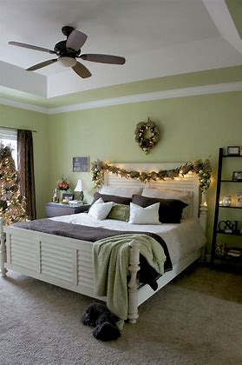
ben decorated bedroom

Slide 23
ben decorated bedroom
Ben decorated his bedroom.

Slide 24
ben decorated bedroom
Ben decorated his bedroom.

Slide 25
ben decorated bedroom
Ben decorated his bedroom.
s

Slide 26
ben decorated bedroom
Ben decorated his bedroom.
s
o

Slide 27
Phrases

Slide 28
Phrase
A treasure island.

Slide 29
Phrases
knives and forks
in the shed
today at school
at the local museum
the house next door
on the phone
out and about
a box of chocolate

Slide 30
Activity page
page.69

Slide 31
Use each phrase in a sentence, underline the phrase in pencil and the verb in red.

Slide 32
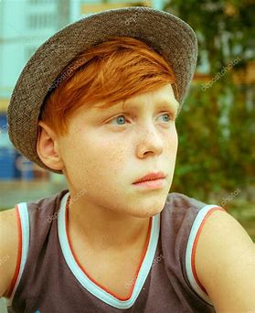
The red-haired boy

Slide 33
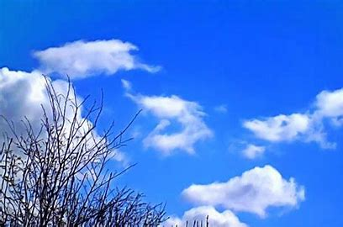
one sunny morning

Slide 34
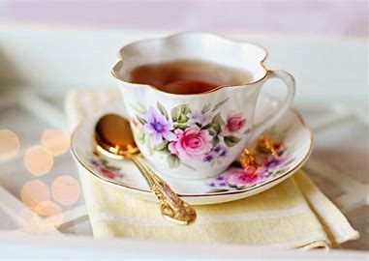
a cup of tea

Slide 35
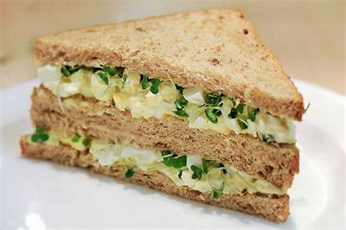
an egg and cress sandwich

Slide 36
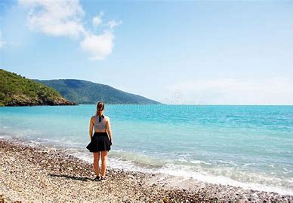
out at sea

Slide 37
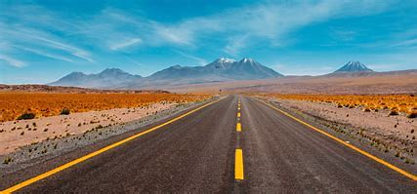
on the road

Slide 38
Revision

Slide 39
lawn
haunt
halt
deer
mere
dear
failure
gnome
design

Slide 40
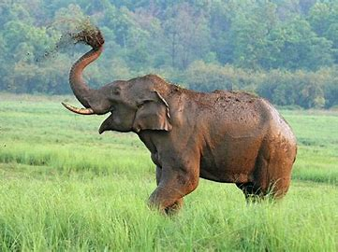
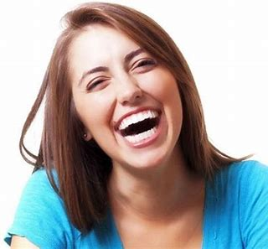
elephant
/f/
laugh
/f/

Slide 41
Spelling List

Slide 42
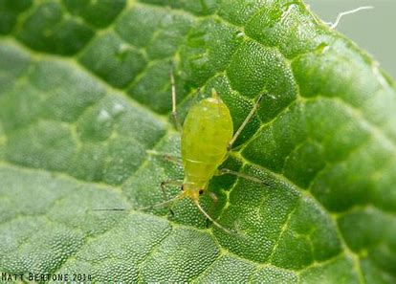
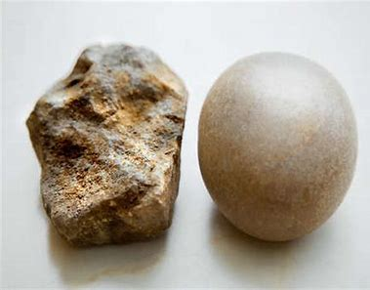
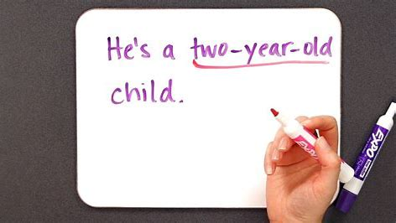
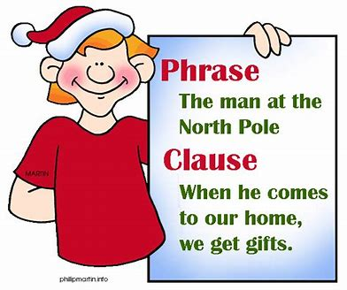
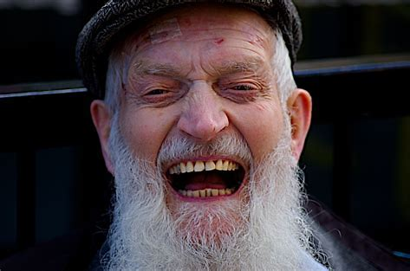
aphid rough hyphen
phrase graphic laugh

Slide 43
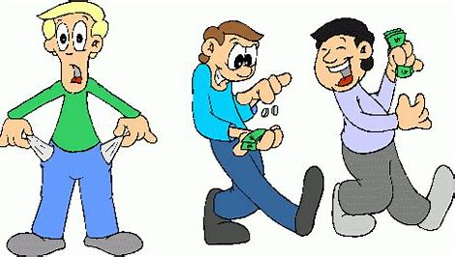
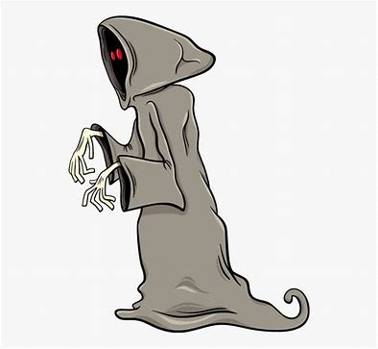
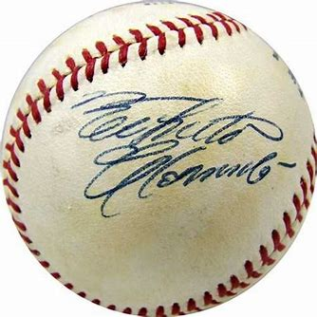
toughest decipher enough
phantom autograph apostrophe

Slide 44
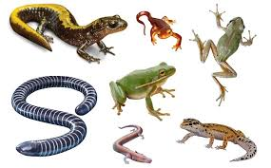
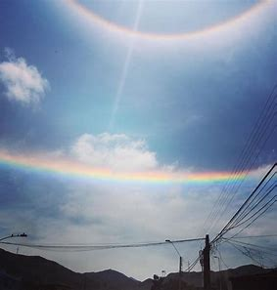
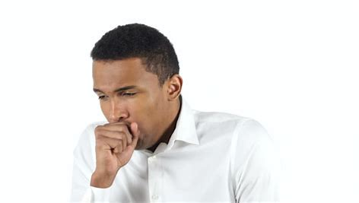
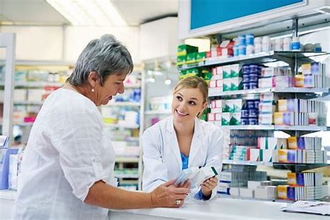
triumph amphibian laughter
coughing pharmacy phenomenon

Slide 46
Activity page
page.66

Slide 47
Let’s review
syllables.

Slide 48
aphid
roughly
coughing
decipher
phenomenon

Slide 49
Let’s parse
sentences.

Slide 50
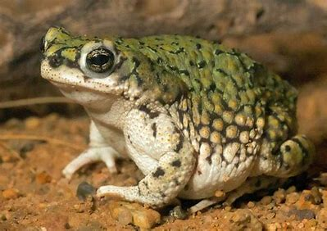
Parse these sentences.
The tough Indian elephant laughed triumphantly.
A toad is a warty amphibian.

Slide 51
Parse these sentences.
The tough Indian elephant laughed triumphantly.
A toad is a warty amphibian.

Slide 52
Parse these sentences.
The tough Indian elephant laughed triumphantly.
A toad is a warty amphibian.

Slide 53
Parse these sentences.
The tough Indian elephant laughed triumphantly.
A toad is a warty amphibian.

Slide 54
Parse these sentences.
The tough Indian elephant laughed triumphantly.
A toad is a warty amphibian.

Slide 55
Parse these sentences.
The tough Indian elephant laughed triumphantly.
A toad is a warty amphibian.

Slide 56
Parse these sentences.
The tough Indian elephant laughed triumphantly.
A toad is a warty amphibian.

Slide 57
Parse these sentences.
The tough Indian elephant laughed triumphantly.
A toad is a warty amphibian.

Slide 58
Parse these sentences.
The tough Indian elephant laughed triumphantly.
A toad is a warty amphibian.

Slide 59
Parse these sentences.
The tough Indian elephant laughed triumphantly.
A toad is a warty amphibian.

Slide 60
Complete each word and draw a picture.

Slide 61
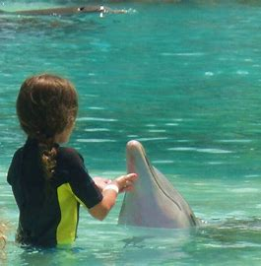
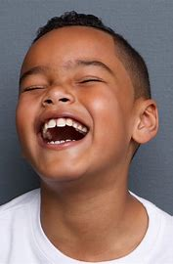
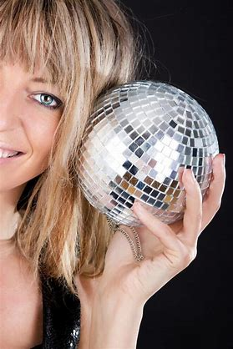
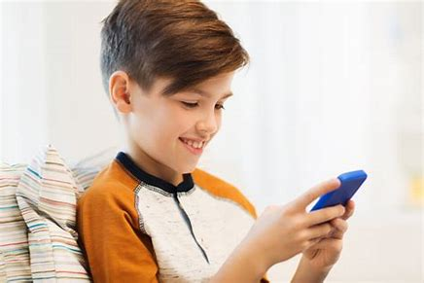
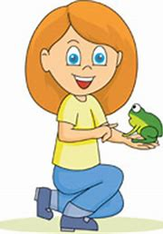
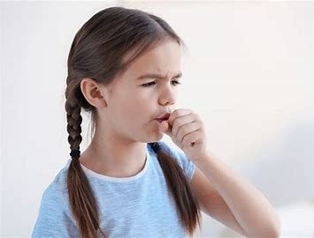
Dan’s dolphin
Lenny’s laugh
Sam’s sphere
Fred’s phone
Anna’s amphibian
Cara’s cough

Slide 62
Dictation

Slide 63
Dictation
1.
2.
3.

Slide 64
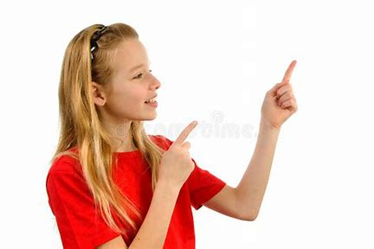
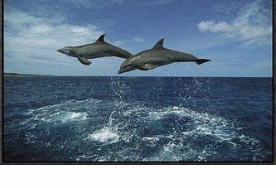

Slide 65
“The photos of the leaping dolphins are over there,” said Pam.

Slide 66
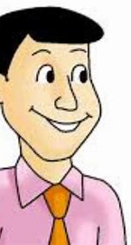

Slide 67
“Our little nephew can say he alphabet,” said Steve proudly.

Slide 68
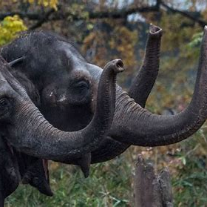

Slide 69
The elephants waved their trunks and walked off.

Slide 70
Homework

