Slide 1
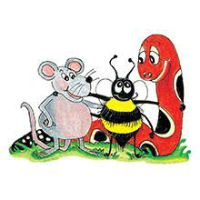
Jolly Grammar 2-34

Slide 2
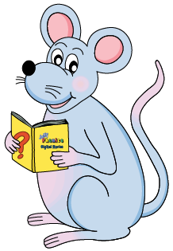
Mini Test 33

Slide 3
1. shook

Slide 4
1. shook
2. often

Slide 5
1. shook
2. often
3. picture

Slide 6
1. shook
2. often
3. picture
4. future

Slide 7
1. shook
2. often
3. picture
4. future
5. nature

Slide 8
6. creature
1. shook
2. often
3. picture
4. future
5. nature

Slide 9
6. creature
7. fracture
1. shook
2. often
3. picture
4. future
5. nature

Slide 10
6. creature
7. fracture
8. adventure
1. shook
2. often
3. picture
4. future
5. nature

Slide 11
6. creature
7. fracture
8. adventure
9. mouse
1. shook
2. often
3. picture
4. future
5. nature

Slide 12
6. creature
7. fracture
8. adventure
9. mouse
10. mice
1. shook
2. often
3. picture
4. future
5. nature

Slide 13
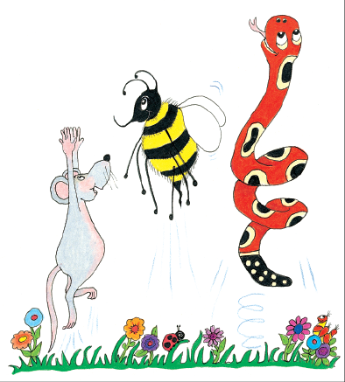
Let’s review
Comparatives &
Superlative

Slide 14
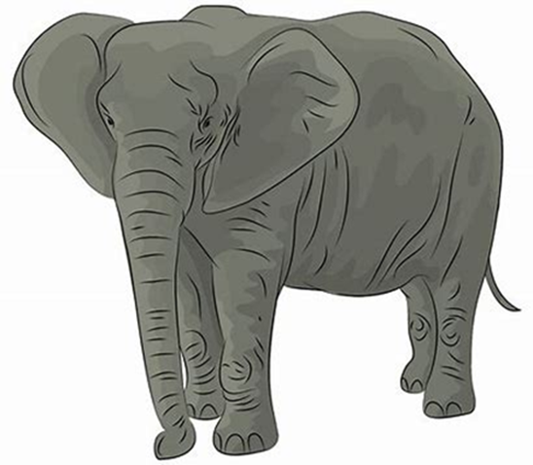
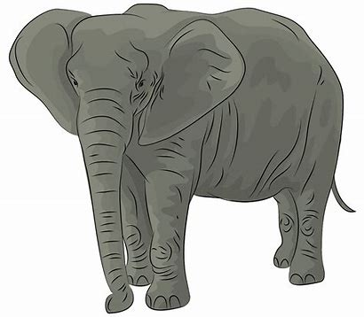
superlative
comparative
biggest
bigger
big

Slide 15
Use a comparative or a superlative to complete each sentence. Underline the adjectives in blue.
This drink is sweet, but that drink is .
I am slim, he is slimmer, and you are the .
All four dogs are wet, but our dog is the .
Kelly was friendly, and Ann was even .

Slide 16
Use a comparative or a superlative to complete each sentence. Underline the adjectives in blue.
This drink is sweet, but that drink is .
I am slim, he is slimmer, and you are the .
All four dogs are wet, but our dog is the .
Kelly was friendly, and Ann was even .

Slide 17
Use a comparative or a superlative to complete each sentence. Underline the adjectives in blue.
This drink is sweet, but that drink is sweeter .
I am slim, he is slimmer, and you are the .
All four dogs are wet, but our dog is the .
Kelly was friendly, and Ann was even .

Slide 18
Use a comparative or a superlative to complete each sentence. Underline the adjectives in blue.
This drink is sweet, but that drink is sweeter .
I am slim, he is slimmer, and you are the .
All four dogs are wet, but our dog is the .
Kelly was friendly, and Ann was even .

Slide 19
Use a comparative or a superlative to complete each sentence. Underline the adjectives in blue.
This drink is sweet, but that drink is sweeter .
I am slim, he is slimmer, and you are the slimmest.
All four dogs are wet, but our dog is the .
Kelly was friendly, and Ann was even .

Slide 20
Use a comparative or a superlative to complete each sentence. Underline the adjectives in blue.
This drink is sweet, but that drink is sweeter .
I am slim, he is slimmer, and you are the slimmest.
All four dogs are wet, but our dog is the .
Kelly was friendly, and Ann was even .

Slide 21
Use a comparative or a superlative to complete each sentence. Underline the adjectives in blue.
This drink is sweet, but that drink is sweeter .
I am slim, he is slimmer, and you are the slimmest.
All four dogs are wet, but our dog is the wettest .
Kelly was friendly, and Ann was even .

Slide 22
Use a comparative or a superlative to complete each sentence. Underline the adjectives in blue.
This drink is sweet, but that drink is sweeter .
I am slim, he is slimmer, and you are the slimmest.
All four dogs are wet, but our dog is the wettest .
Kelly was friendly, and Ann was even .

Slide 23
Use a comparative or a superlative to complete each sentence. Underline the adjectives in blue.
This drink is sweet, but that drink is sweeter .
I am slim, he is slimmer, and you are the slimmest.
All four dogs are wet, but our dog is the wetter .
Kelly was friendly, and Ann was even friendlier .

Slide 24
Interesting Words

Slide 25
I went home.
Their house has a big garden.

Slide 26
I went home.

Slide 27
I went home.
walked

Slide 28
I went home.
walked
ran

Slide 29
I went home.
walked
ran
strolled

Slide 30
I went home.
walked
ran
strolled
hurried

Slide 31
I went home.
walked
ran
strolled
hurried
cycled

Slide 32
I went home.
walked
ran
strolled
hurried
cycled
drove

Slide 33
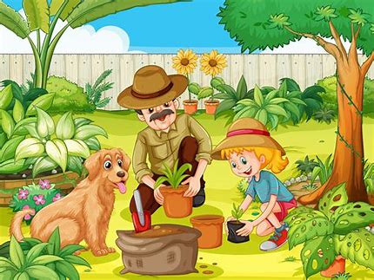
Their house has a big garden.

Slide 34
Their house has a big garden.
large

Slide 35
Their house has a big garden.
large
huge

Slide 36
Their house has a big garden.
large
huge
vast

Slide 37
Their house has a big garden.
large
huge
vast
enormous

Slide 38
Their house has a big garden.
large
huge
vast
enormous
long

Slide 39
Their house has a big garden.
large
huge
vast
enormous
long
wide

Slide 40
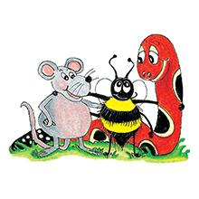
Activity page1
Interesting Words

Slide 41
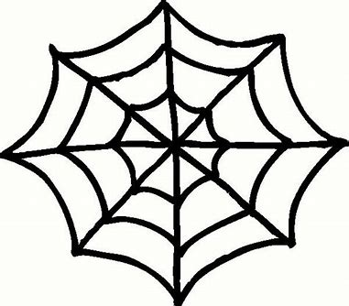
We use some words too often. Think of a more interesting word to replace each of the underlined words, and write it on the line. Use a different words in each sentence.
ran

Slide 42
We use some words too often. Think of a more interesting word to replace each of the underlined words, and write it on the line. Use a different words in each sentence.
The spider ran across the floor.
ran

Slide 43
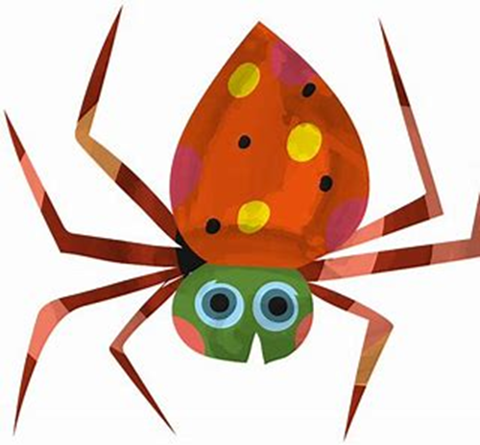
We use some words too often. Think of a more interesting word to replace each of the underlined words, and write it on the line. Use a different words in each sentence.
The spider ran across the floor.
scuttled, scurried
ran

Slide 44
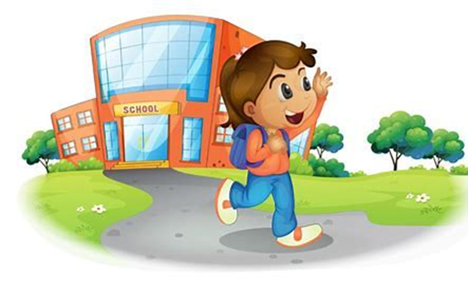
The spider ran across the floor.
Monica ran all the way home.
Their dog ran after our cat.

Slide 45
The spider ran across the floor.
scuttled/scurried
Monica ran all the way home.
Their dog ran after our cat.

Slide 46
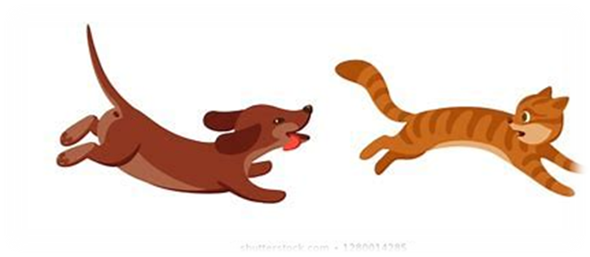
The spider ran across the floor.
scuttled/scurried
Monica ran all the way home.
rushed/hurried
Their dog ran after our cat.

Slide 47
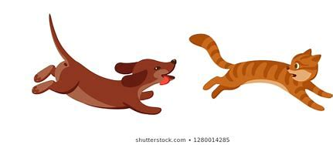
The spider ran across the floor.
scuttled/scurried
Monica ran all the way home.
rushed/hurried
Their dog ran after our cat.
chased/raced

Slide 48
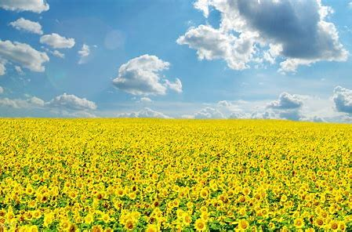
It was a nice day.
We had a nice lunch.
Everyone was very nice to me.

Slide 49
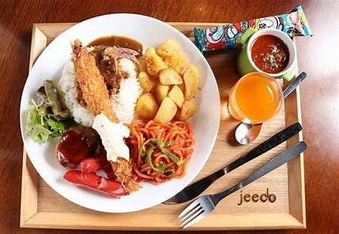
It was a nice day.
hot/sunny
We had a nice lunch.
Everyone was very nice to me.

Slide 50
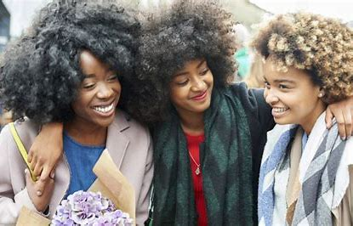
It was a nice day.
hot/sunny
We had a nice lunch.
delicious/tasty
Everyone was very nice to me.

Slide 51
It was a nice day.
hot/sunny
We had a nice lunch.
delicious/tasty
Everyone was very nice to me.
kind/sweet

Slide 52
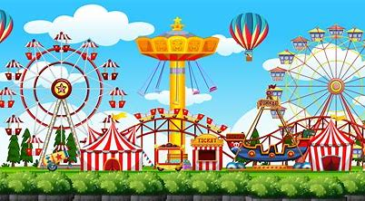
The amusement park was good.
The rides were good.
I had a good time.

Slide 53
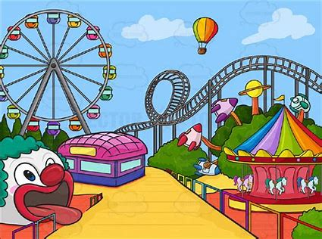
The amusement park was good.
brilliant/fantastic
The rides were good.
I had a good time.

Slide 54
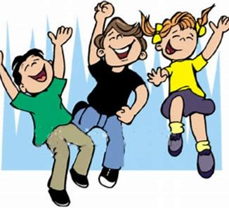
The amusement park was good.
brilliant/fantastic
The rides were good.
exciting/fun
I had a good time.

Slide 55
The amusement park was good.
brilliant/fantastic
The rides were good.
exciting/fun
I had a good time.
wonderful/great

Slide 56
“Sh! The baby is asleep,” said Dad.
“Stop!” said the policewoman.
“Come over here,” said the boys.

Slide 57
“Sh! The baby is asleep,” said Dad.
whispered/warned
“Stop!” said the policewoman.
“Come over here,” said the boys.

Slide 58
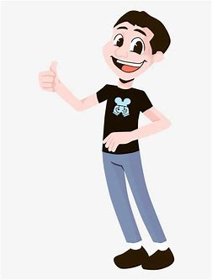
“Sh! The baby is asleep,” said Dad.
whispered/warned
“Stop!” said the policewoman.
ordered/insisted
“Come over here,” said the boys.

Slide 59
“Sh! The baby is asleep,” said Dad.
whispered/warned
“Stop!” said the policewoman.
ordered/insisted
“Come over here,” said the boys.
called/invited

Slide 60
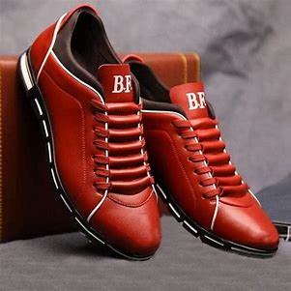
I want to get a new shoes.
Please get me a glass of water.
They will get tired.

Slide 61
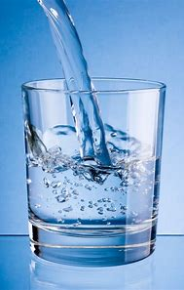
I want to get a new shoes.
buy/choose
Please get me a glass of water.
They will get tired.

Slide 62
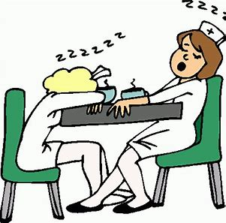
I want to get a new shoes.
buy/choose
Please get me a glass of water.
bring/fetch
They will get tired.

Slide 63
I want to get a new shoes.
buy/choose
Please get me a glass of water.
bring/fetch
They will get tired.
grow/become

Slide 64
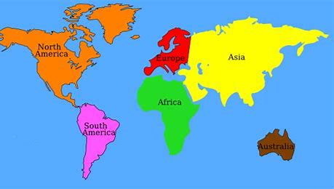
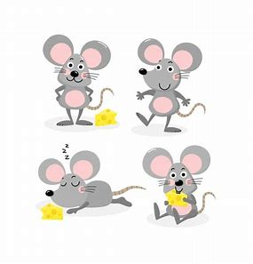
Tricky Plurals (and more)
child
children
woman
women
mouse
mice
library
computer
English
language
continent
world

Slide 65
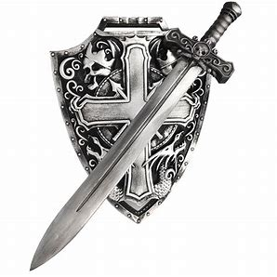
shield
/ee/

Slide 66
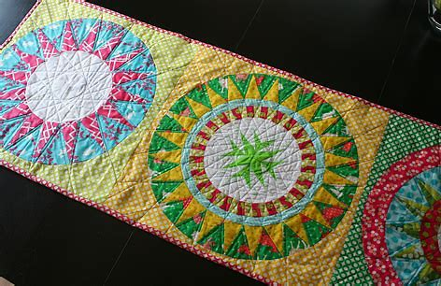
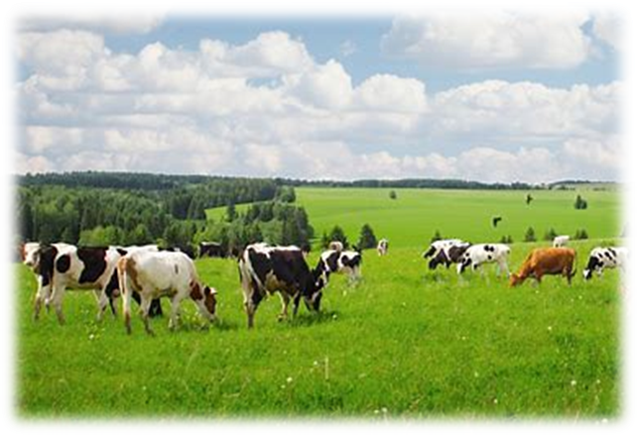
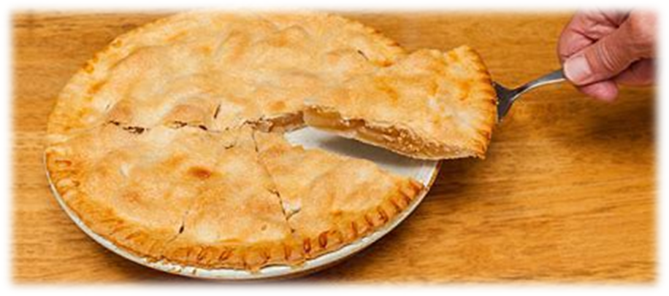
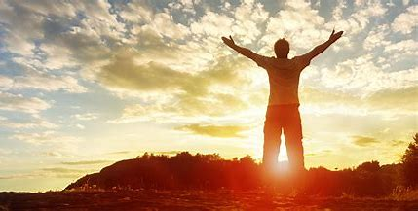
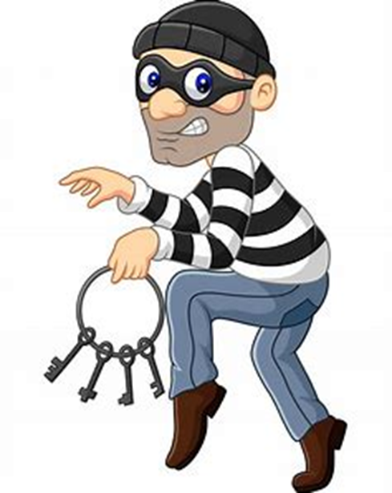
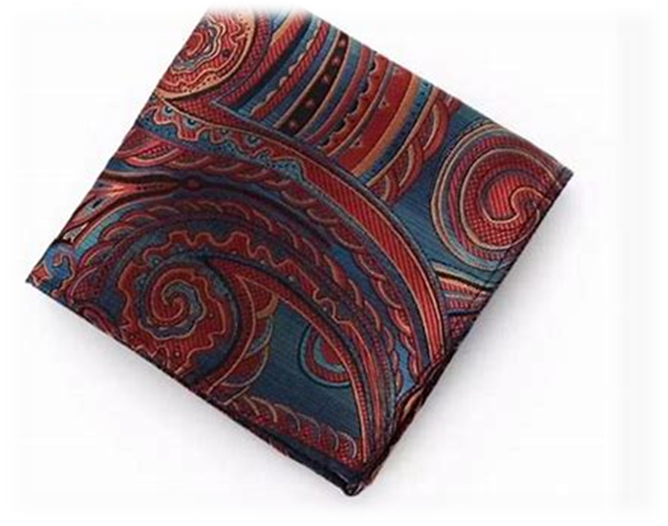
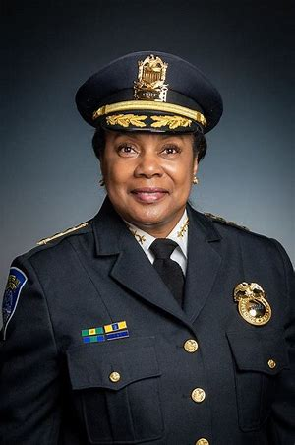
field
shield
wield
series
quilt
sweet
field
piece
chief
thief
shield
belief
library
computer
piece
belief
thief
handkerchief
chief
yield
relief
fiend

Slide 67
Activity page2

Slide 68
Dictation

Slide 69
Name:
1. 2. 3.
4. 5. 6.
7.
8.
9.

Slide 70
yield

Slide 71
yield 2. fiend

Slide 72
yield 2. fiend 3. wield

Slide 73
yield 2. fiend 3. wield
4. series

Slide 74
yield 2. fiend 3. wield
4. series 5. relief

Slide 75
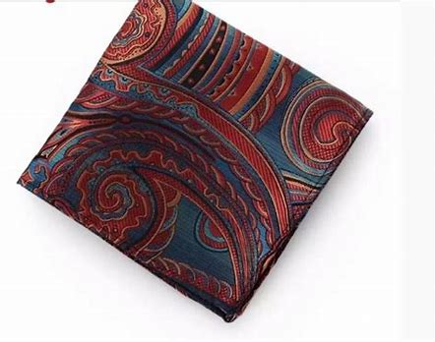
yield 2. fiend 3. wield
4. series 5. relief 6. handkerchief

Slide 76
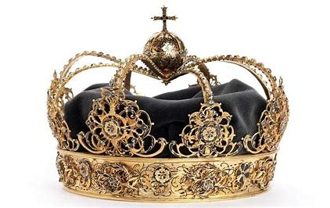
yield 2. fiend 3. wield
4. series 5. relief 6. handkerchief
7. A thief stole the royal crown.

Slide 77
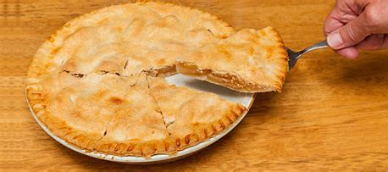
yield 2. fiend 3. wield
4. series 5. relief 6. handkerchief
7. A thief stole the royal crown.
8. “May I have a piece
of pie?” I asked.

Slide 78
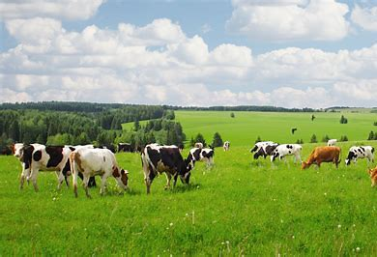
yield 2. fiend 3. wield
4. series 5. relief 6. handkerchief
7. A thief stole the royal crown.
8. “May I have a piece
of pie?” I asked.
9. John took a picture
of the cows in the field.

Slide 79
Homework

Slide 80
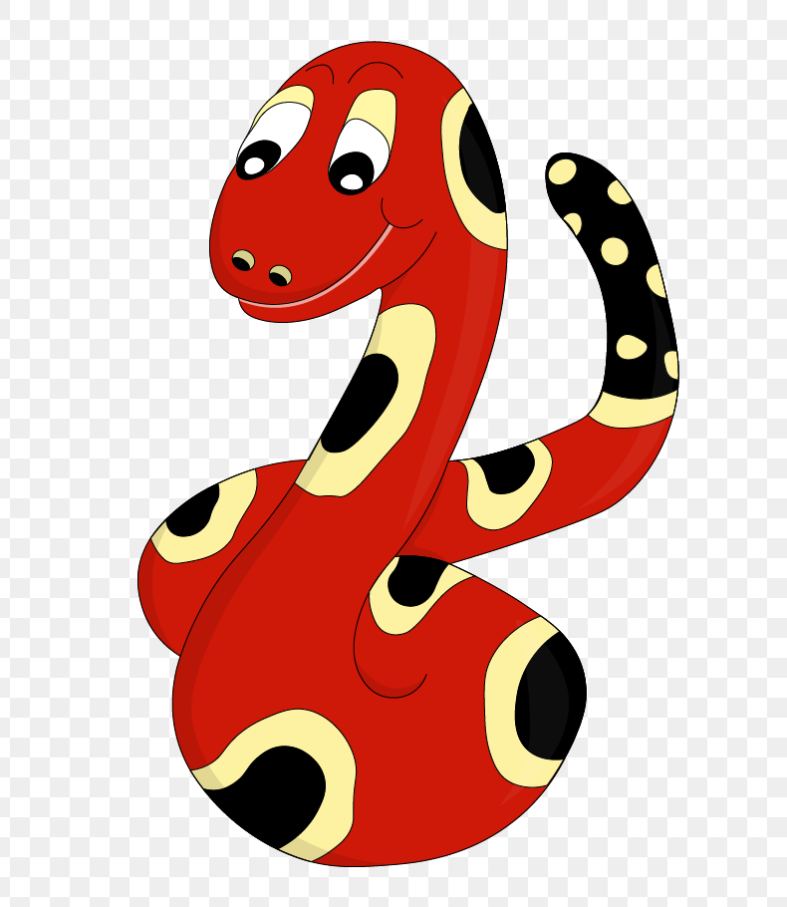
Thank you!
See you
next lesson.

