Slide 1
Jolly Grammar 1-34

Slide 2
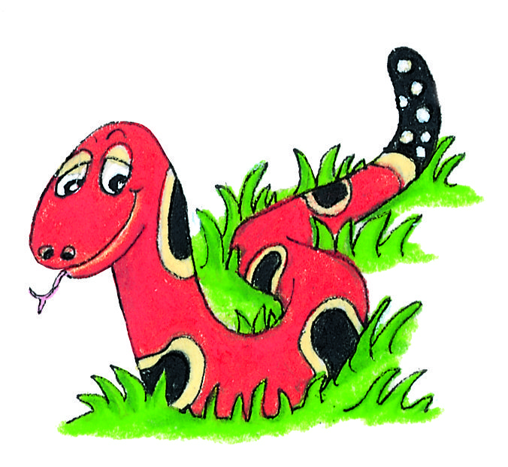
Spelling Test 33

Slide 3
yet

Slide 4
yet
hid

Slide 5
yet
hid
wept

Slide 6
yet
hid
wept
skirt

Slide 7
yet
hid
wept
skirt
girl

Slide 8
yet
hid
wept
skirt
girl
6. shirt

Slide 9
yet
hid
wept
skirt
girl
6. shirt
7. first

Slide 10
yet
hid
wept
skirt
girl
6. shirt
7. first
8. of

Slide 11
yet
hid
wept
skirt
girl
6. shirt
7. first
8. of
9. eight

Slide 12
yet
hid
wept
skirt
girl
6. shirt
7. first
8. of
9. eight
10. birthday

Slide 13
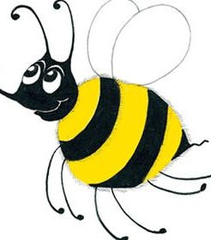
months

Slide 14
January
February
March
April
May
June
July
August
September
October
November
December
When is your birthday?

Slide 15
When is your birthday?
? ? ? ? ? ? ?

Slide 16
When is your birthday?
? ? ? ? ? ? ?
what why when
where who which

Slide 17
Activity Page:

Slide 18
What is your name?
2. Where do you live?
3. When is your birthday?

Slide 19
What is your name?
My name is Ms. Yano.
2. Where do you live?
3. When is your birthday?

Slide 20
What is your name?
My name is Ms. Yano.
2. Where do you live?
I live in Kitakyushu.
3. When is your birthday?

Slide 21
What is your name?
My name is Ms. Yano.
2. Where do you live?
I live in Kitakyushu.
3. When is your birthday?
My birthday is January 2nd.

Slide 22
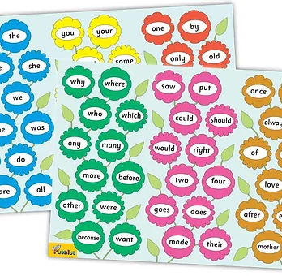
Tricky Words
^{6th} set

Slide 23
once

Slide 24
upon

Slide 25
always

Slide 26
also

Slide 27
of

Slide 28
eight

Slide 29
love

Slide 30
cover

Slide 31
after

Slide 32
every

Slide 33
mother

Slide 34
father

Slide 35
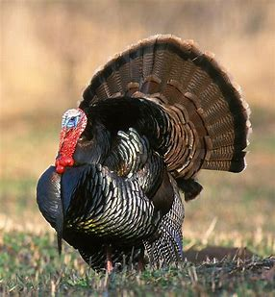

Slide 36
turkey

Slide 37
turkey
/er/

Slide 38
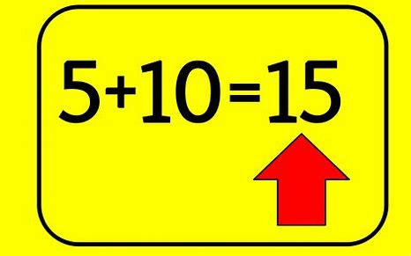
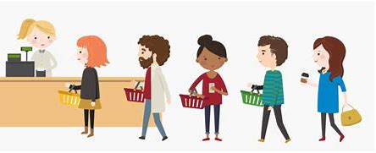
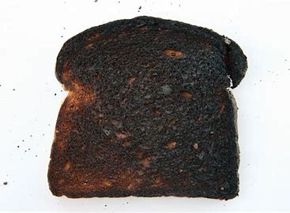
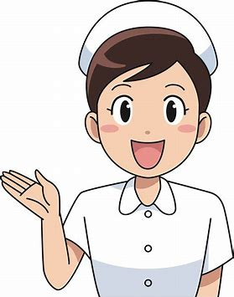
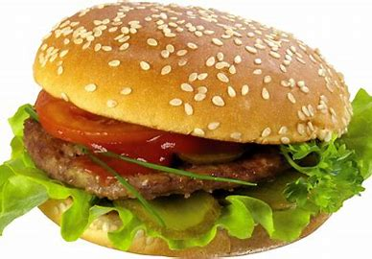
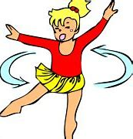
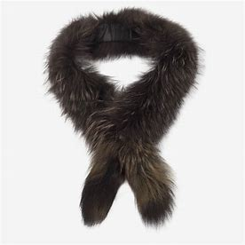
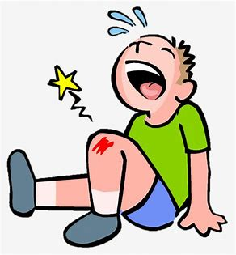
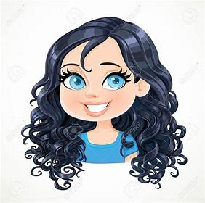
turn
purple
burst
burn
not
sum
next
turn
nurse
turkey
purple
love
cover
hamburger
nurse
hamburger
turning
turkey
fur
hurt
curly

Slide 39
Activity page

Slide 40
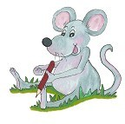
Dictation

Slide 41
fur

Slide 42
fur 2. burn

Slide 43
fur 2. burn 3. hurt

Slide 44
fur 2. burn 3. hurt
4. burst

Slide 45
fur 2. burn 3. hurt
4. burst 5. curly

Slide 46
fur 2. burn 3. hurt
4. burst 5. curly 6. turning

Slide 47
fur 2. burn 3. hurt
4. burst 5. curly 6. turning
7. The nurse visits on Thursday.

Slide 48
fur 2. burn 3. hurt
4. burst 5. curly 6. turning
7. The nurse visits on Thursday.
8. We always burn the toast.

Slide 49
fur 2. burn 3. hurt
4. burst 5. curly 6. turning
7. The nurse visits on Thursday.
8. We always burn the toast.
9. It is your turn next.

Slide 50
Thank you! See you next time.

