Slide 1
Jolly Grammar
5a-32

Slide 2
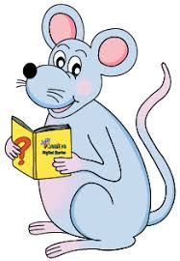
Spelling Test 16

Slide 3
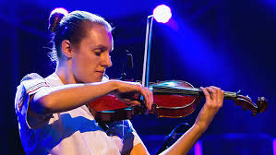
musician

Slide 4
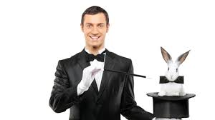
musician
magician

Slide 5
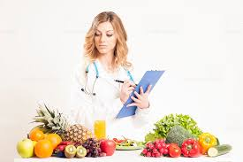
musician
magician
dietician

Slide 6
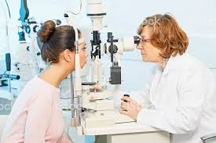
musician
magician
dietician
optician

Slide 7
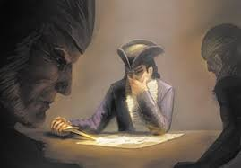
musician
magician
dietician
optician
tactician

Slide 8
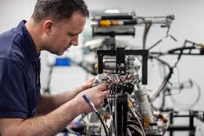
musician
magician
dietician
optician
tactician
technician

Slide 9
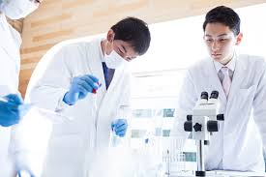
musician
magician
dietician
optician
tactician
technician
clinician

Slide 10
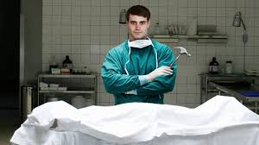
musician
magician
dietician
optician
tactician
technician
clinician
mortician

Slide 11
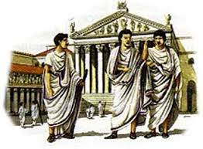
musician
magician
dietician
optician
tactician
technician
clinician
mortician
patrician

Slide 12
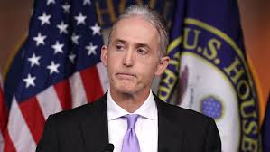
musician
magician
dietician
optician
tactician
technician
clinician
mortician
patrician
10. politician

Slide 13
musician
magician
dietician
optician
tactician
technician
clinician
mortician
patrician
10. politician
11. physician

Slide 14
musician
magician
dietician
optician
tactician
technician
clinician
mortician
patrician
10. politician
11. physician
12. electrician

Slide 15
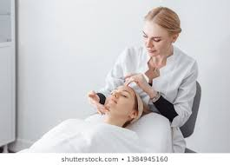
musician
magician
dietician
optician
tactician
technician
clinician
mortician
patrician
10. politician
11. physician
12. electrician
13. beautician

Slide 16
musician
magician
dietician
optician
tactician
technician
clinician
mortician
patrician
10. politician
11. physician
12. electrician
13. beautician
14. statistician

Slide 17
musician
magician
dietician
optician
tactician
technician
clinician
mortician
patrician
10. politician
11. physician
12. electrician
13. beautician
14. statistician
15. arithmetician

Slide 18
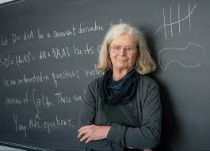
musician
magician
dietician
optician
tactician
technician
clinician
mortician
patrician
10. politician
11. physician
12. electrician
13. beautician
14. statistician
15. arithmetician
16. mathematician

Slide 19
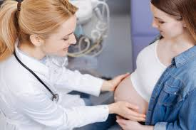
musician
magician
dietician
optician
tactician
technician
clinician
mortician
patrician
10. politician
11. physician
12. electrician
13. beautician
14. statistician
15. arithmetician
16. mathematician
17. obstetrician

Slide 20
musician
magician
dietician
optician
tactician
technician
clinician
mortician
patrician
10. politician
11. physician
12. electrician
13. beautician
14. statistician
15. arithmetician
16. mathematician
17. obstetrician
18. paediatrician

Slide 21
Let’s Review
sentences.

Slide 22
Ann had painted a beautiful sunset.

Slide 23
S
Ann had painted a beautiful sunset.

Slide 24
S
Ann had painted a beautiful sunset.

Slide 25
S
O
Ann had painted a beautiful sunset.

Slide 26
Inky and Bee are hungrily eating
jam sandwiches.

Slide 27
S
Inky and Bee are hungrily eating
jam sandwiches.

Slide 28
S
Inky and Bee are hungrily eating
jam sandwiches.

Slide 29
S
Inky and Bee are hungrily eating
jam sandwiches.
O

Slide 30
Inky and Bee are hungrily eating jam sandwiches.
Subject
Verb
Object

Slide 31
Inky and Bee are hungrily eating
jam sandwiches.
Subject
Verb
Object
Inky
and
Bee
are eating
sandwiches
hungrily
jam

Slide 32
Activity Page
Compound Subjects and Objects

Slide 33
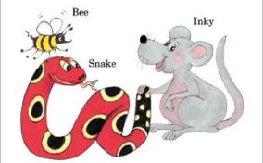
See you
next time!

