Slide 1
Jolly Grammar
6a-6

Slide 2
Spelling Test 3

Slide 3
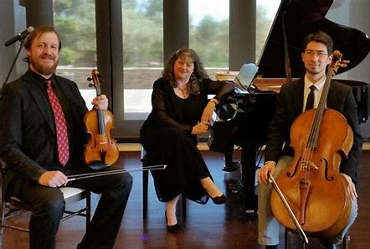
trio

Slide 4
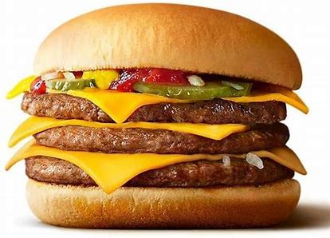
trio
triple

Slide 5
trio
triple
trident

Slide 6
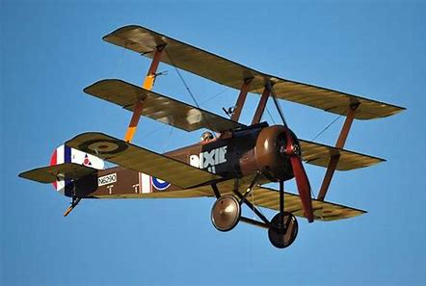
trio
triple
trident
triplane

Slide 7
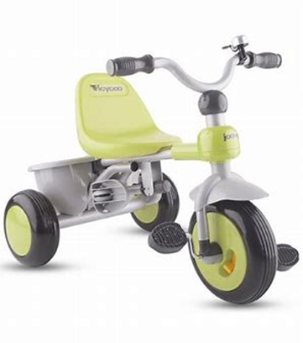
trio
triple
trident
triplane
tricycle

Slide 8
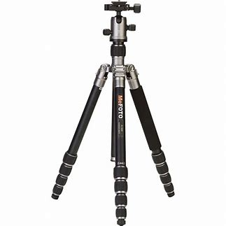
trio
triple
trident
triplane
tricycle
tripod

Slide 9
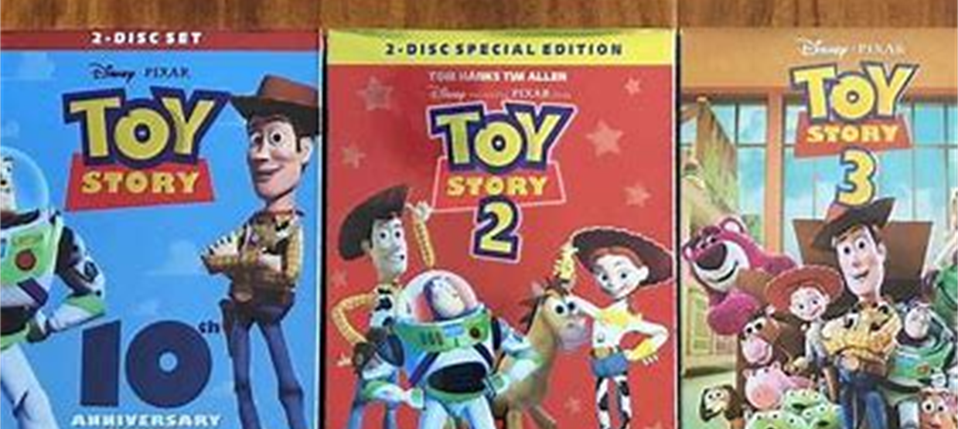
trio
triple
trident
triplane
tricycle
tripod
trilogy

Slide 10
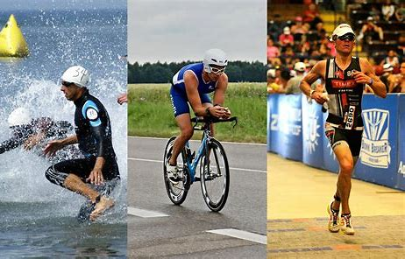
trio
triple
trident
triplane
tricycle
tripod
trilogy
triathlon

Slide 11
trio
triple
trident
triplane
tricycle
tripod
trilogy
triathlon
triangle

Slide 12
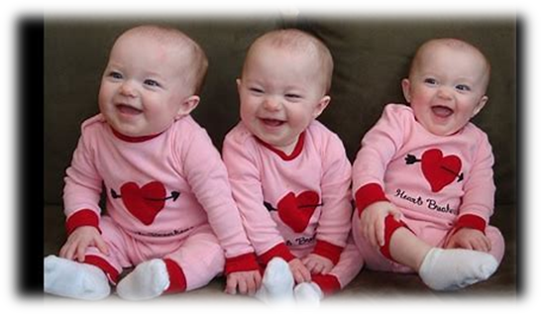
trio
triple
trident
triplane
tricycle
tripod
trilogy
triathlon
triangle
10. triplet

Slide 13
trio
triple
trident
triplane
tricycle
tripod
trilogy
triathlon
triangle
10. triplet
11. triceps

Slide 14
trio
triple
trident
triplane
tricycle
tripod
trilogy
triathlon
triangle
10. triplet
11. triceps
12. tricolour

Slide 15
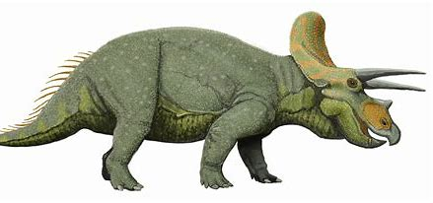
trio
triple
trident
triplane
tricycle
tripod
trilogy
triathlon
triangle
10. triplet
11. triceps
12. tricolour
13. triceratops

Slide 16
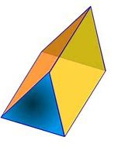
trio
triple
trident
triplane
tricycle
tripod
trilogy
triathlon
triangle
10. triplet
11. triceps
12. tricolour
13. triceratops
14. triangular

Slide 17
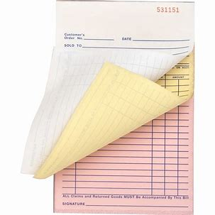
trio
triple
trident
triplane
tricycle
tripod
trilogy
triathlon
triangle
10. triplet
11. triceps
12. tricolour
13. triceratops
14. triangular
15. triplicate

Slide 18
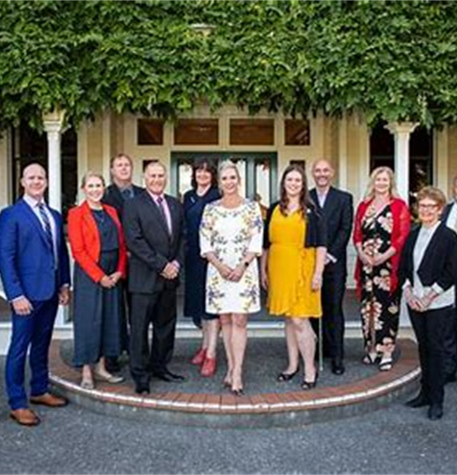
trio
triple
trident
triplane
tricycle
tripod
trilogy
triathlon
triangle
10. triplet
11. triceps
12. tricolour
13. triceratops
14. triangular
15. triplicate
16. triennial

Slide 19
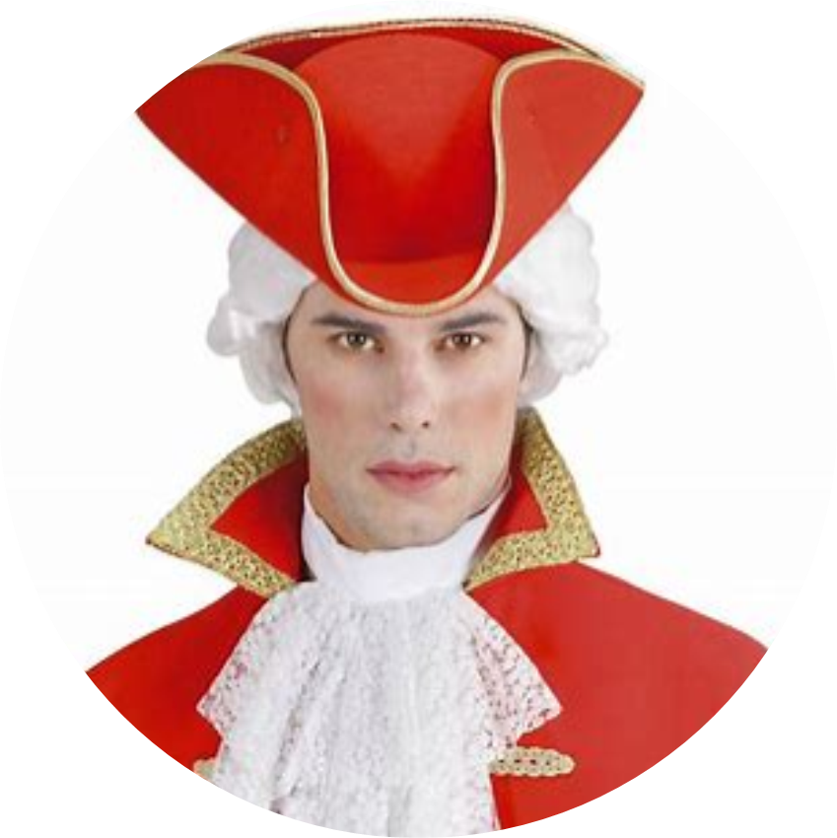
trio
triple
trident
triplane
tricycle
tripod
trilogy
triathlon
triangle
10. triplet
11. triceps
12. tricolour
13. triceratops
14. triangular
15. triplicate
16. triennial
17. tricorn

Slide 20
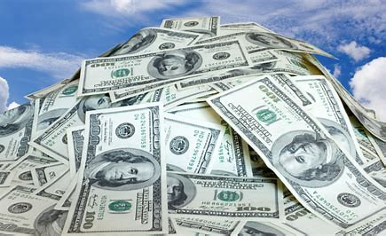
trio
triple
trident
triplane
tricycle
tripod
trilogy
triathlon
triangle
10. triplet
11. triceps
12. tricolour
13. triceratops
14. triangular
15. triplicate
16. triennial
17. tricorn
18. trillion

Slide 21
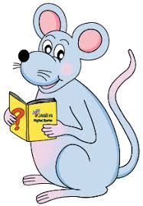
Let’s revise
Vowels.

Slide 22
Consonants

Slide 23
Question:
What is the most frequently used word in English?

Slide 24
the

Slide 25
the definite article

Slide 26
the definite article
a, an indefinite articles

Slide 27
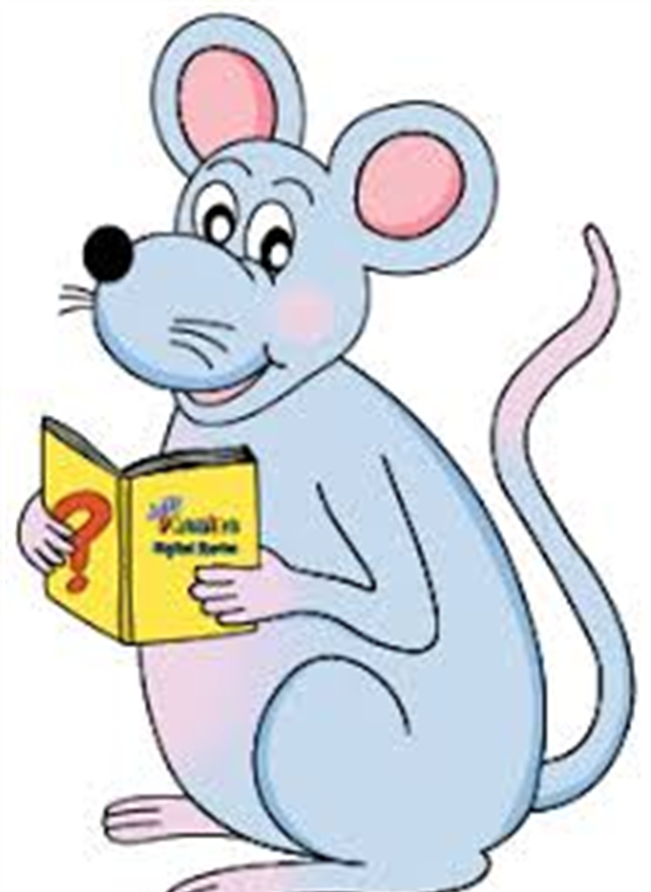
I saw a dog in the park.
The dog was barking.

Slide 28
I saw a dog in the park.
The dog was barking.
the tallest the strongest

Slide 29
a an
an ant
an arm
an empty nest
an eel
an inch
an order
an umbrella

Slide 30
a an
an ant
an arm
an empty nest
an eel
an inch
an order
an umbrella
a unicorn

Slide 31
a an
an ant
an arm
an empty nest
an eel
an inch
an order
an umbrella
an hour
an unicorn

Slide 32
Definite and Indefinite Articles

Slide 33
Which of the indefinite article
do these sentences need?

Slide 34
ostrich
emu
bicycle
horse
triangle
unicorn
hour
shell
umbrella

Slide 35
an
ostrich
emu
bicycle
horse
triangle
unicorn
hour
shell
umbrella

Slide 36
an
an
ostrich
emu
bicycle
horse
triangle
unicorn
hour
shell
umbrella

Slide 37
an
an
a
ostrich
emu
bicycle
horse
triangle
unicorn
hour
shell
umbrella

Slide 38
an
an
a
ostrich
emu
bicycle
a
horse
triangle
unicorn
hour
shell
umbrella

Slide 39
an
an
a
ostrich
emu
bicycle
a
a
horse
triangle
unicorn
hour
shell
umbrella

Slide 40
an
an
a
ostrich
emu
bicycle
a
a
a
horse
triangle
unicorn
hour
shell
umbrella

Slide 41
an
an
a
ostrich
emu
bicycle
a
a
a
horse
triangle
unicorn
an
hour
shell
umbrella

Slide 42
an
an
a
ostrich
emu
bicycle
a
a
a
horse
triangle
unicorn
an
a
hour
shell
umbrella

Slide 43
an
an
a
ostrich
emu
bicycle
a
a
a
horse
triangle
unicorn
an
a
an
hour
shell
umbrella

Slide 44
Which article should it be?

Slide 45
I have lost a shoe.
It was an honest mistake.
The triplets are three years old.
Ravi and his friends are in the kitchen.
The hotel we are staying in is fabulous.
Anna is the best swimmer in the class.

Slide 46
I have lost a shoe.
It was an honest mistake.
The triplets are three years old.
Ravi and his friends are in the kitchen.
The hotel we are staying in is fabulous.
Anna is the best swimmer in the class.

Slide 47
I have lost a shoe.
It was an honest mistake.
The triplets are three years old.
Ravi and his friends are in the kitchen.
The hotel we are staying in is fabulous.
Anna is the best swimmer in the class.

Slide 48
I have lost a shoe.
It was an honest mistake.
The triplets are three years old.
Ravi and his friends are in the kitchen.
The hotel we are staying in is fabulous.
Anna is the best swimmer in the class.

Slide 49
I have lost a shoe.
It was an honest mistake.
The triplets are three years old.
Ravi and his friends are in the kitchen.
The hotel we are staying in is fabulous.
Anna is the best swimmer in the class.

Slide 50
I have lost a shoe.
It was an honest mistake.
The triplets are three years old.
Ravi and his friends are in the kitchen.
The hotel we are staying in is fabulous.
Anna is the best swimmer in the class.

Slide 51
I have lost a shoe.
It was an honest mistake.
The triplets are three years old.
Ravi and his friends are in the kitchen.
The hotel we are staying in is fabulous.
Anna is the best swimmer in the class.

Slide 52
They have an interesting dilemma.
We are staying a fabulous hotel.
He bought a new pair of binoculars.
She really liked the kangaroos at the zoo.
Did you walk to school? The school is nearby.
The funniest clown was riding unicycle.

Slide 53
They have an interesting dilemma.
We are staying a fabulous hotel.
He bought a new pair of binoculars.
She really liked the kangaroos at the zoo.
Did you walk to school? The school is nearby.
The funniest clown was riding unicycle.

Slide 54
They have an interesting dilemma.
We are staying a fabulous hotel.
He bought a new pair of binoculars.
She really liked the kangaroos at the zoo.
Did you walk to school? The school is nearby.
The funniest clown was riding unicycle.

Slide 55
They have an interesting dilemma.
We are staying a fabulous hotel.
He bought a new pair of binoculars.
She really liked the kangaroos at the zoo.
Did you walk to school? The school is nearby.
The funniest clown was riding unicycle.

Slide 56
They have an interesting dilemma.
We are staying a fabulous hotel.
He bought a new pair of binoculars.
She really liked the kangaroos at the zoo.
Did you walk to school? The school is nearby.
The funniest clown was riding unicycle.

Slide 57
They have an interesting dilemma.
We are staying a fabulous hotel.
He bought a new pair of binoculars.
She really liked the kangaroos at the zoo.
Did you walk to school? The school is nearby.
The funniest clown was riding unicycle.

Slide 58
They have an interesting dilemma.
We are staying a fabulous hotel.
He bought a new pair of binoculars.
She really liked the kangaroos at the zoo.
Did you walk to school? The school is nearby.
The funniest clown was riding unicycle.

Slide 59
See you
next time!

