Slide 1
Jolly Grammar
6a-5

Slide 2
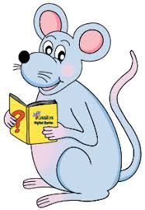
Let’s revise
Homophones.

Slide 3
Spelling Point

Slide 4
triangle
triplet
tricycle

Slide 5
triangle
triplet
tricycle

Slide 6
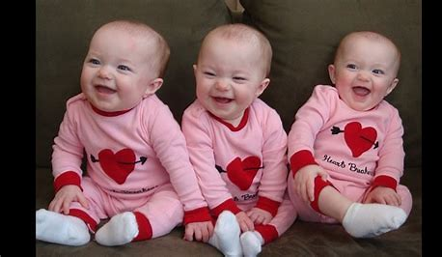
triangle
triplet
tricycle

Slide 7
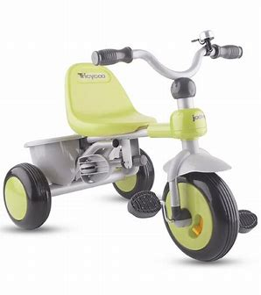
triangle
triplet
tricycle

Slide 8
triangle
triplet
tricycle
three

Slide 9
Spelling List
<tri->

Slide 10
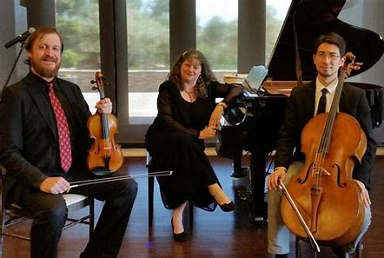
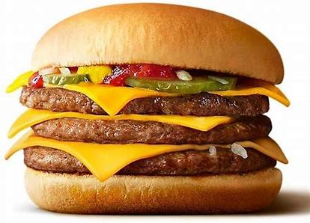
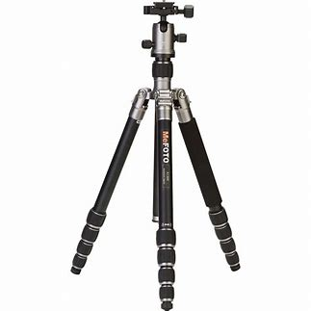
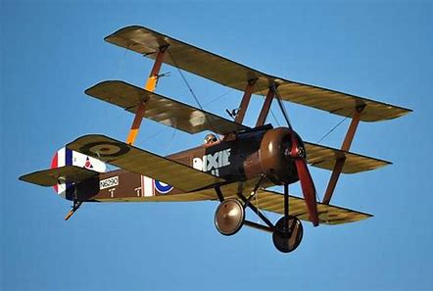
trio triple trident
triplane tricycle tripod

Slide 11
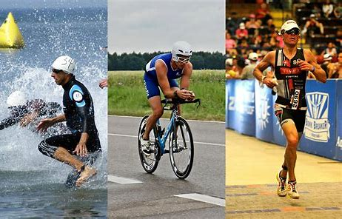
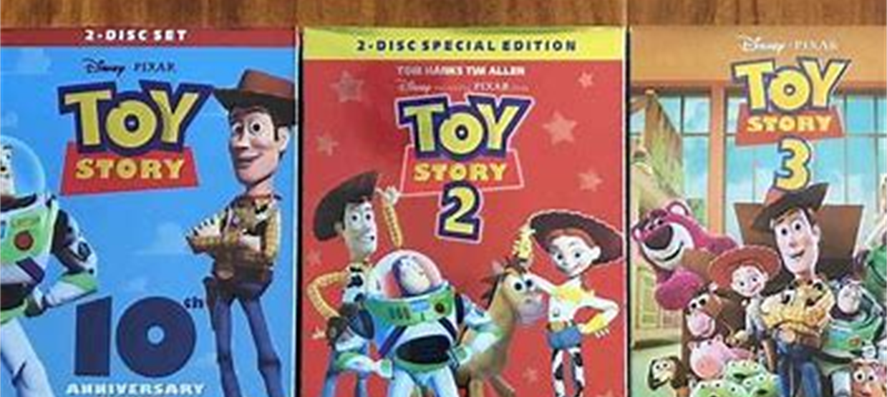
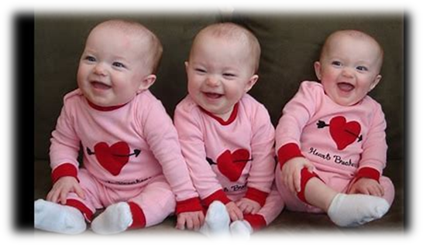
trilogy triathlon triangle
triplet triceps tricolour

Slide 12
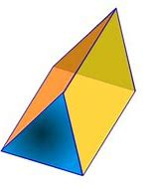
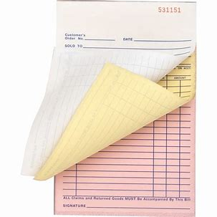
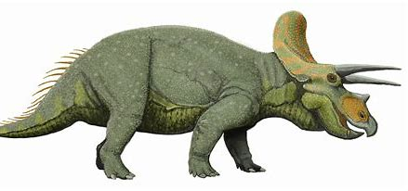
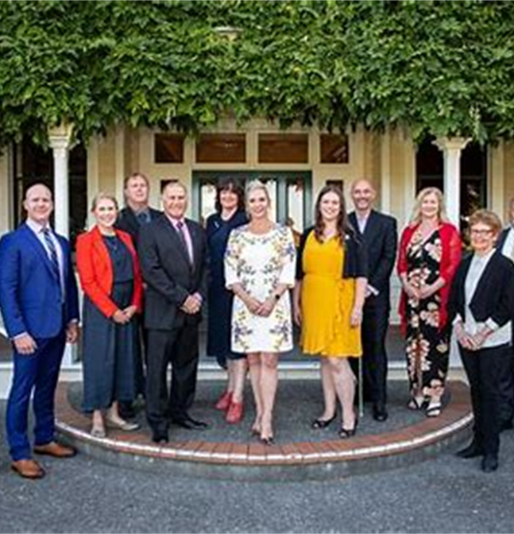
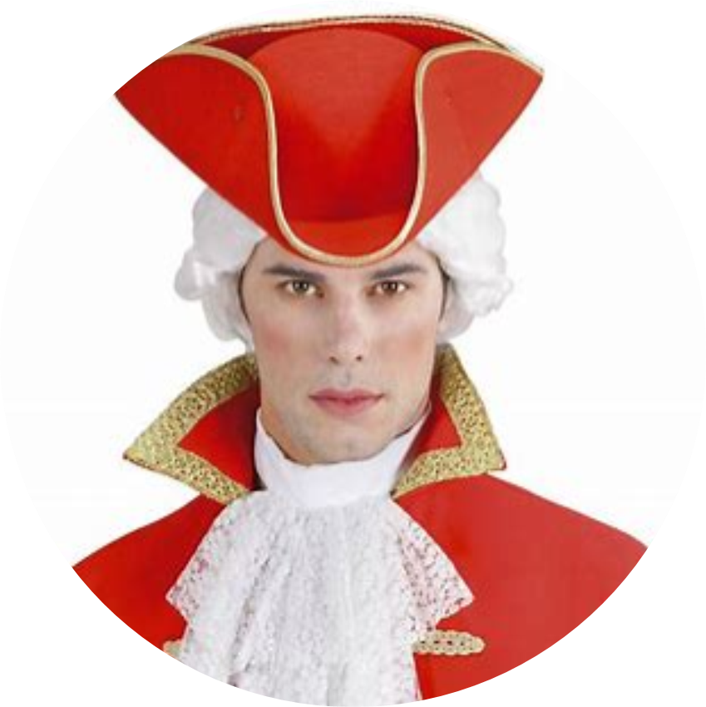
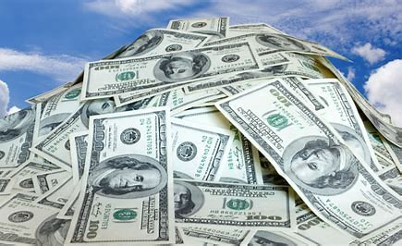
triceratops triangular triplicate
triennial tricorn trillion

Slide 13
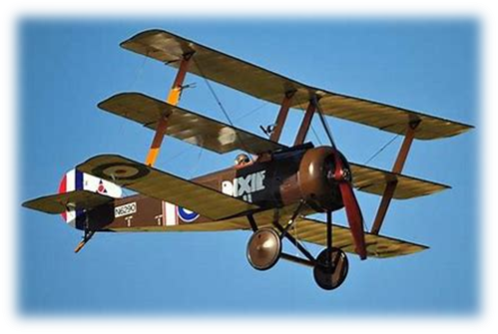
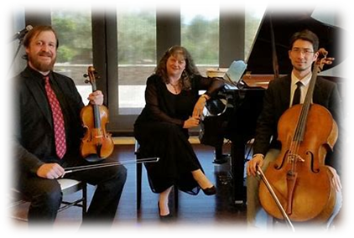
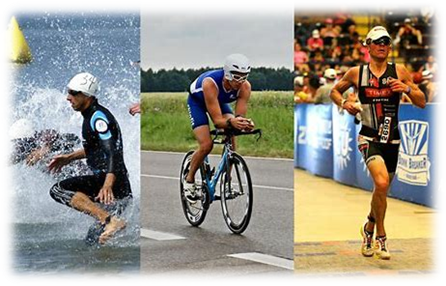
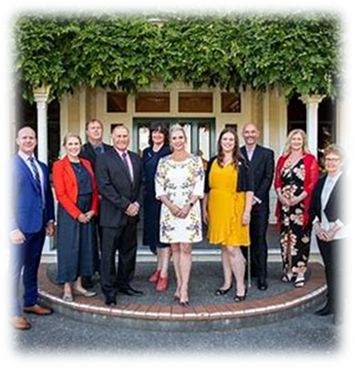
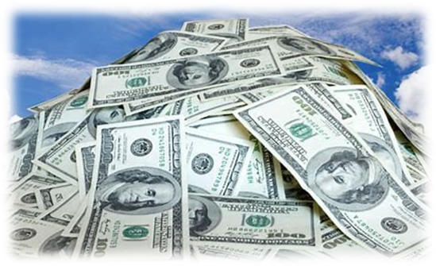

Slide 14
Activity Page
Spelling:
Numerical Prefixes for 3

Slide 15
are our hour

Slide 16
・I am wearing a tricorn hat in our school play.
・The lives of three families are told in the trilogy.
・It took less than an hour to complete the forms
and print them in triplicate.
・”Our acrobats do six triple somersaults in a row,”
said the ringmaster, proudly.
・We are taking two cameras, three lenses and a
tripod on our next trip.
・The trio of musicians will be performing for two
hours.
・There are three equal sides and three equal angles in
an equilateral triangle.
・In an hour we are going to see our friend in the
triathlon.

Slide 17
・I am wearing a tricorn hat in our school play.
・The lives of three families are told in the trilogy.
・It took less than an hour to complete the forms
and print them in triplicate.
・”Are acrobats do six triple somersaults in a row,”
said the ringmaster, proudly.
・We are taking two cameras, three lenses and a
tripod on our next trip.
・The trio of musicians will be performing for two
hours.
・There are three equal sides and three equal angles in
an equilateral triangle.
・In an hour we are going to see our friend in the
triathlon.

Slide 18
Megan had carefully drawn a triangular pattern.
Subject
Megan
Verb
had drawn
carefully
Object
pattern
a triangular
(transitive)

Slide 19
Dictation

Slide 20
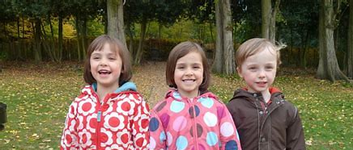
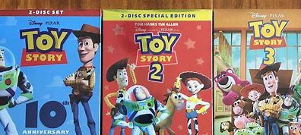

Slide 21
“Have you read the trilogy?” asked the triplets.

Slide 22
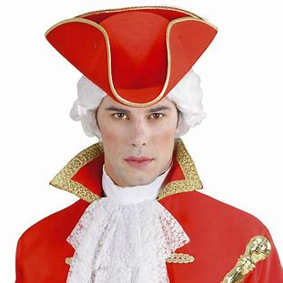

Slide 23
The mayor put on his red robe and tricorn hat.

Slide 24
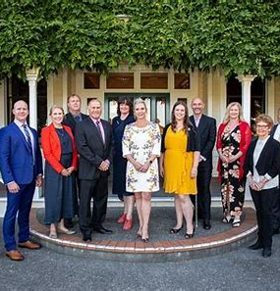

Slide 25
A triennial meeting takes place every three years.

Slide 26
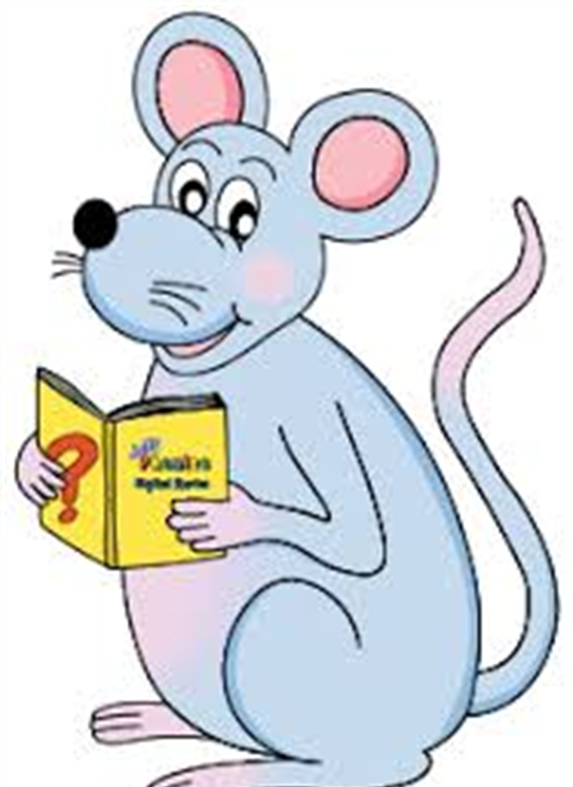
Assignment
Learn Words in the List
Complete Sentence Wall

Slide 27
See you
next time!

