Slide 1
Jolly Grammar
6a-4

Slide 2
Spelling Test 2

Slide 3
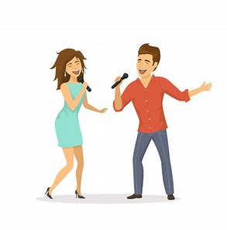
duo

Slide 4
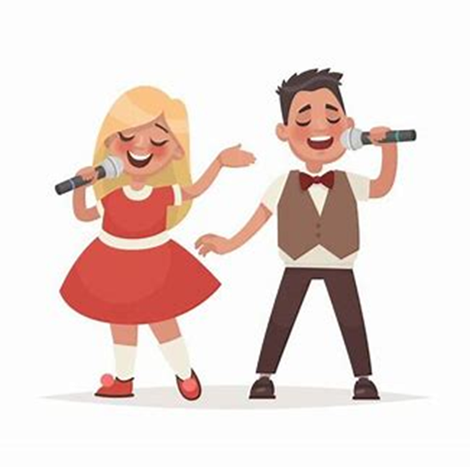
duo
duet

Slide 5
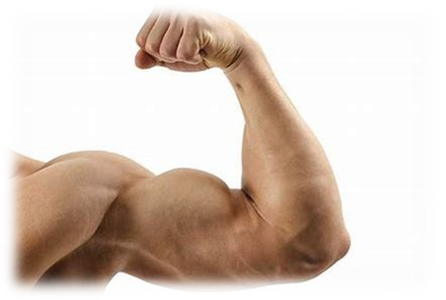
duo
duet
biceps

Slide 6
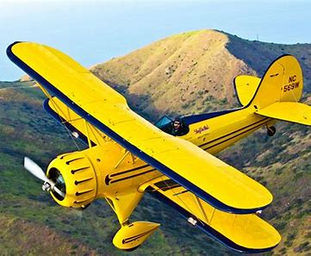
duo
duet
biceps
biplane

Slide 7
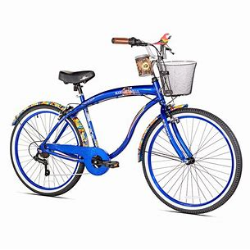
duo
duet
biceps
biplane
bicycle

Slide 8
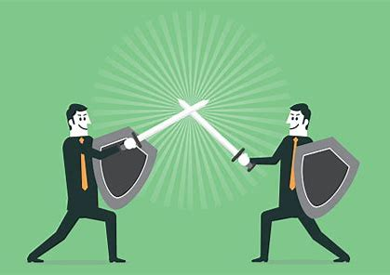
duo
duet
biceps
biplane
bicycle
duel

Slide 9
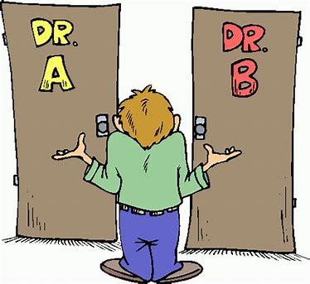
duo
duet
biceps
biplane
bicycle
duel
dilemma

Slide 10
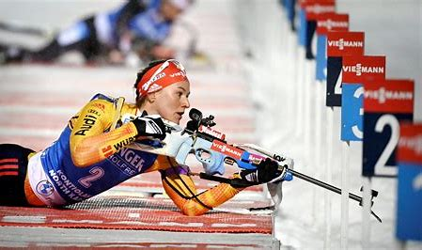
duo
duet
biceps
biplane
bicycle
duel
dilemma
biathlon

Slide 11
duo
duet
biceps
biplane
bicycle
duel
dilemma
biathlon
binary

Slide 12
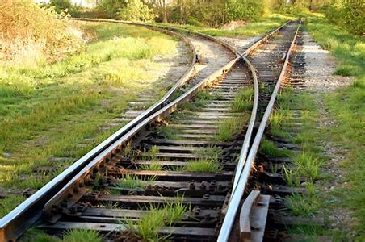
duo
duet
biceps
biplane
bicycle
duel
dilemma
biathlon
binary
10. diverge

Slide 13
duo
duet
biceps
biplane
bicycle
duel
dilemma
biathlon
binary
10. diverge
11. duplicate

Slide 14
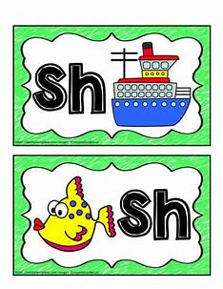
duo
duet
biceps
biplane
bicycle
duel
dilemma
biathlon
binary
10. diverge
11. duplicate
12. digraph

Slide 15
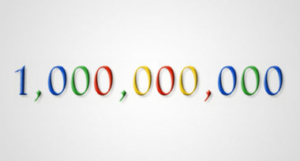
duo
duet
biceps
biplane
bicycle
duel
dilemma
biathlon
binary
10. diverge
11. duplicate
12. digraph
13. billion

Slide 16
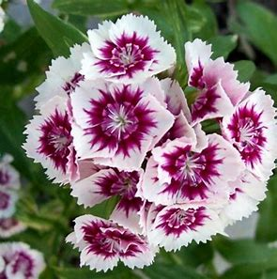
duo
duet
biceps
biplane
bicycle
duel
dilemma
biathlon
binary
10. diverge
11. duplicate
12. digraph
13. billion
14. biennial

Slide 17
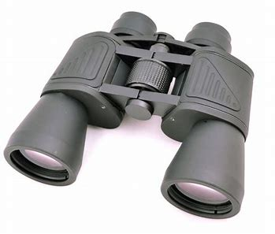
duo
duet
biceps
biplane
bicycle
duel
dilemma
biathlon
binary
10. diverge
11. duplicate
12. digraph
13. billion
14. biennial
15. binoculars

Slide 18
duo
duet
biceps
biplane
bicycle
duel
dilemma
biathlon
binary
10. diverge
11. duplicate
12. digraph
13. billion
14. biennial
15. binoculars
16. bicentenary

Slide 19
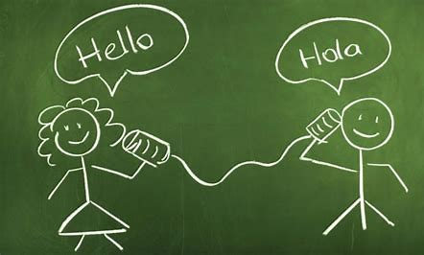
duo
duet
biceps
biplane
bicycle
duel
dilemma
biathlon
binary
10. diverge
11. duplicate
12. digraph
13. billion
14. biennial
15. binoculars
16. bicentenary
17. bilingual

Slide 20
duo
duet
biceps
biplane
bicycle
duel
dilemma
biathlon
binary
10. diverge
11. duplicate
12. digraph
13. billion
14. biennial
15. binoculars
16. bicentenary
17. bilingual
18. bicentennial

Slide 21
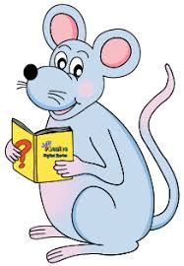
Let’s revise
Tenses.

Slide 22
to push

Slide 23
to push
(infinitive)

Slide 24
 |  | Present

Slide 25
 | Past | Present

Slide 26
 | Past | Present | Future

Slide 27
 | Past | Present | Future
Simple

Slide 28
 | Past | Present | Future
Simple |  | push / pushes

Slide 29
 | Past | Present | Future
Simple | pushed | push / pushes

Slide 30
 | Past | Present | Future
Simple | pushed | push / pushes | shall / will push

Slide 31
 | Past | Present | Future
Simple | pushed | push / pushes | shall / will push
Continuous

Slide 32
 | Past | Present | Future
Simple | pushed | push / pushes | shall / will push
Continuous |  | am / are / is pushing

Slide 33
 | Past | Present | Future
Simple | pushed | push / pushes | shall / will push
Continuous | was / were pushing | am / are / is pushing

Slide 34
 | Past | Present | Future
Simple | pushed | push / pushes | shall / will push
Continuous | was / were pushing | am / are / is pushing | shall / will be pushing

Slide 35
 | Past | Present | Future
Simple | pushed | push / pushes | shall / will push
Continuous | was / were pushing | am / are / is pushing | shall / will be pushing
Perfect

Slide 36
 | Past | Present | Future
Simple | pushed | push / pushes | shall / will push
Continuous | was / were pushing | am / are / is pushing | shall / will be pushing
Perfect |  | have / has pushed

Slide 37
 | Past | Present | Future
Simple | pushed | push / pushes | shall / will push
Continuous | was / were pushing | am / are / is pushing | shall / will be pushing
Perfect | had pushed | have / has pushed

Slide 38
 | Past | Present | Future
Simple | pushed | push / pushes | shall / will push
Continuous | was / were pushing | am / are / is pushing | shall / will be pushing
Perfect | had pushed | have / has pushed | shall / will have pushed

Slide 39
We rode our bicycles yesterday.
-The simple tenses describe actions that stat and finish within a specific time.
We were riding our bicycles to school.
-The continuous tenses describe actions that have started and are still happening.
We have ridden our bicycles recently.
-The perfect tenses describe general experiences that have already been completed, usually at an unspecified point in the past.

Slide 40
 | Past | Present | Future
Simple | pushed | push / pushes | shall / will push
Continuous | was / were pushing | am / are / is pushing | shall / will be pushing
Perfect | had pushed | have / has pushed | shall / will have pushed

Slide 41
Present | Past | Past participle
wear
play
sing
drink
eat
read
carry
run

Slide 42
Present | Past | Past participle
wear | wore | worn
play
sing
drink
eat
read
carry
run

Slide 43
Present | Past | Past participle
wear | wore | worn
play | played | played
sing
drink
eat
read
carry
run

Slide 44
Present | Past | Past participle
wear | wore | worn
play | played | played
sing | sang | sung
drink
eat
read
carry
run

Slide 45
Present | Past | Past participle
wear | wore | worn
play | played | played
sing | sang | sung
drink | drank | drunk
eat
read
carry
run

Slide 46
Present | Past | Past participle
wear | wore | worn
play | played | played
sing | sang | sung
drink | drank | drunk
eat | ate | eaten
read
carry
run

Slide 47
Present | Past | Past participle
wear | wore | worn
play | played | played
sing | sang | sung
drink | drank | drunk
eat | ate | eaten
read | read | read
carry
run

Slide 48
Present | Past | Past participle
wear | wore | worn
play | played | played
sing | sang | sung
drink | drank | drunk
eat | ate | eaten
read | read | read
carry | carried | carried
run

Slide 49
Present | Past | Past participle
wear | wore | worn
play | played | played
sing | sang | sung
drink | drank | drunk
eat | ate | eaten
read | read | read
carry | carried | carried
run | ran | run

Slide 50
Simple, Continuous and Perfect Tenses

Slide 51
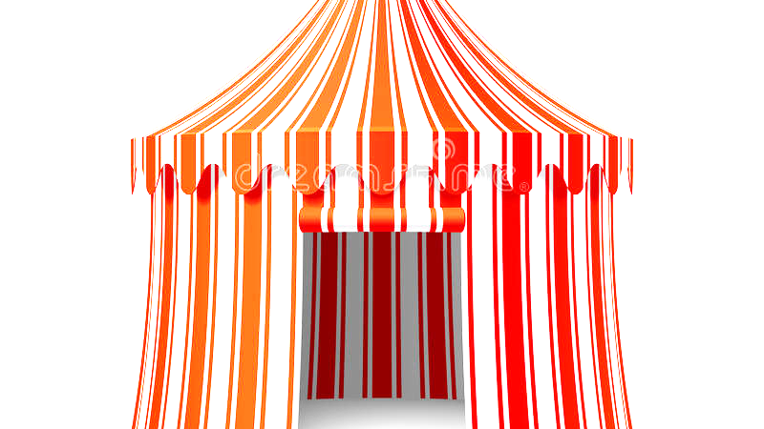
 | Past | Present | Future
Simple
Continuous
Perfect

Slide 52
 | Past | Present | Future
Simple |  | run away runs away
Continuous
Perfect

Slide 53
 | Past | Present | Future
Simple | ran away | run away runs away | shall / will run away
Continuous | was / were running away | am / are / is running away | shall / will be running away
Perfect | had run away | have / has run away | shall / will have run away

Slide 54
See you
next time!

