Slide 1
Jolly Grammar
6a-3

Slide 2
Let’s revise
Homophones.

Slide 3
Spelling Point

Slide 4
bicycle
digraph
duet

Slide 5
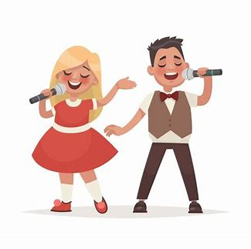
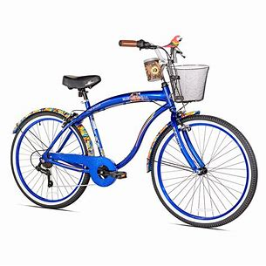
bicycle
digraph
duet

Slide 6
bicycle
digraph
duet
two, twice or double

Slide 7
Spelling List
<bi-><di-><du->

Slide 8
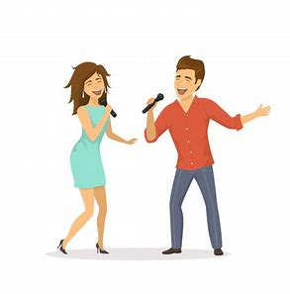
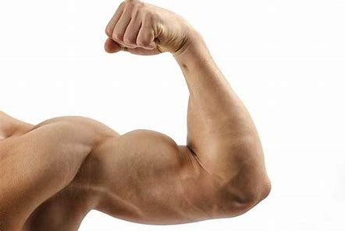
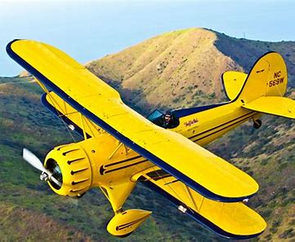
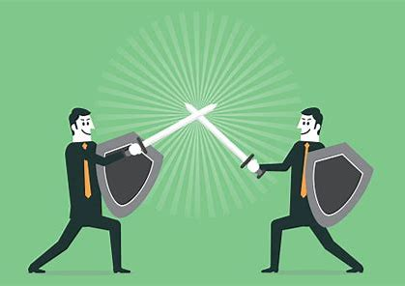
duo duet biceps
biplane bicycle duel

Slide 9
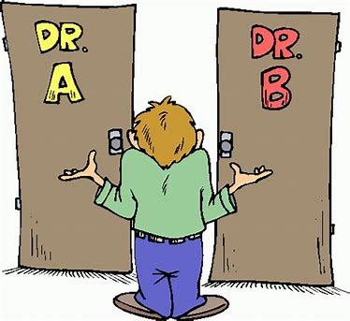
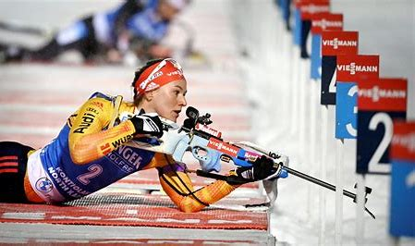
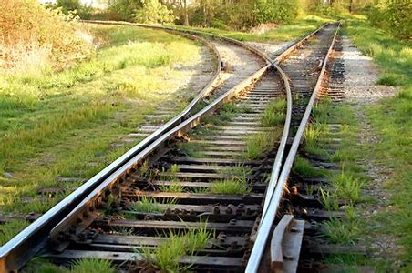
dilemma biathlon binary
diverge duplicate digraph

Slide 10
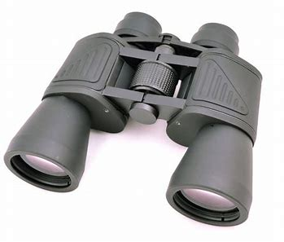
billion biennial binoculars
bicentenary bilingual bicentennial

Slide 11
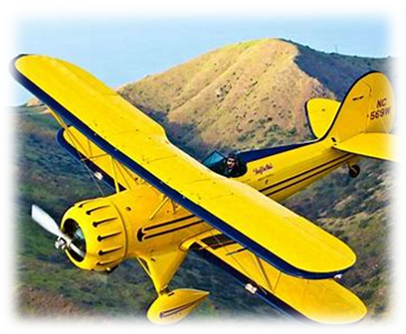
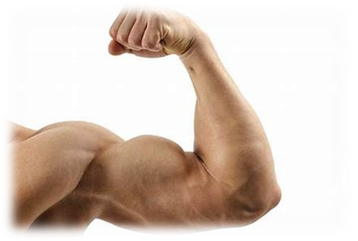
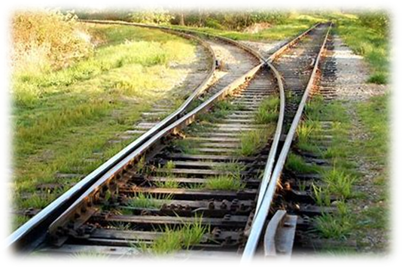
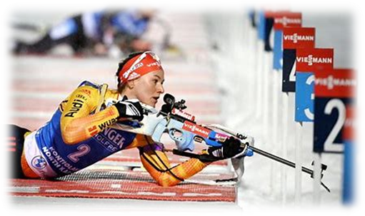

Slide 12
Activity Page
Spelling:
Numerical Prefixes for 2

Slide 13
・Was the pair of binoculars too expensive?

Slide 14
・Was the pair of binoculars too expensive?
・A good friend helped me to solve my dilemma.

Slide 15
・Was the pair of binoculars too expensive?
・A good friend helped me to solve my dilemma.
・The two young singers sang their duet beautifully.

Slide 16
・Was the pair of binoculars too expensive?
・A good friend helped me to solve my dilemma.
・The two young singers sang their duet beautifully.
・The air museum has jets, helicopters, and some old
biplanes, too.

Slide 17
・Was the pair of binoculars too expensive?
・A good friend helped me to solve my dilemma.
・The two young singers sang their duet beautifully.
・The air museum has jets, helicopters, and some old
biplanes, too.
・The two roads diverged, with one going to the east
and the other to the west.

Slide 18
・Was the pair of binoculars too expensive?
・A good friend helped me to solve my dilemma.
・The two young singers sang their duet beautifully.
・The air museum has jets, helicopters, and some old
biplanes, too.
・The two roads diverged, with one going to the east
and the other to the west.
・A weightlifter has a strong back, sturdy legs and
big biceps, too.

Slide 19
・Was the pair of binoculars too expensive?
・A good friend helped me to solve my dilemma.
・The two young singers sang their duet beautifully.
・The air museum has jets, helicopters, and some old
biplanes, too.
・The two roads diverged, with one going to the east
and the other to the west.
・A weightlifter has a strong back, sturdy legs and
big biceps, too.
・We bought the twins two bicycles for their
birthday. Anna’s is red and Kay’s is green.

Slide 20
・Was the pair of binoculars too expensive?
・A good friend helped me to solve my dilemma.
・The two young singers sang their duet beautifully.
・The air museum has jets, helicopters, and some old
biplanes, too.
・The two roads diverged, with one going to the east
and the other to the west.
・A weightlifter has a strong back, sturdy legs and
big biceps, too.
・We bought the twins two bicycles for their
birthday. Anna’s is red and Kay’s is green.
・The two great swordsmen agreed to fight a duel.

Slide 21
・Was the pair of binoculars too expensive?
・A good friend helped me to solve my dilemma.
・The two young singers sang their duet beautifully.
・The air museum has jets, helicopters, and some old
biplanes, too.
・The two roads diverged, with one going to the east
and the other to the west.
・A weightlifter has a strong back, sturdy legs and
big biceps, too.
・We bought the twins two bicycles for their
birthday. Anna’s is red and Kay’s is green.
・The two great swordsmen agreed to fight a duel.

Slide 22
Sam and Seth will be competing in the biathlon.
Subject
Sam
and
Seth
Verb
will be competing
in the biathlon
Object
(intransitive)

Slide 23
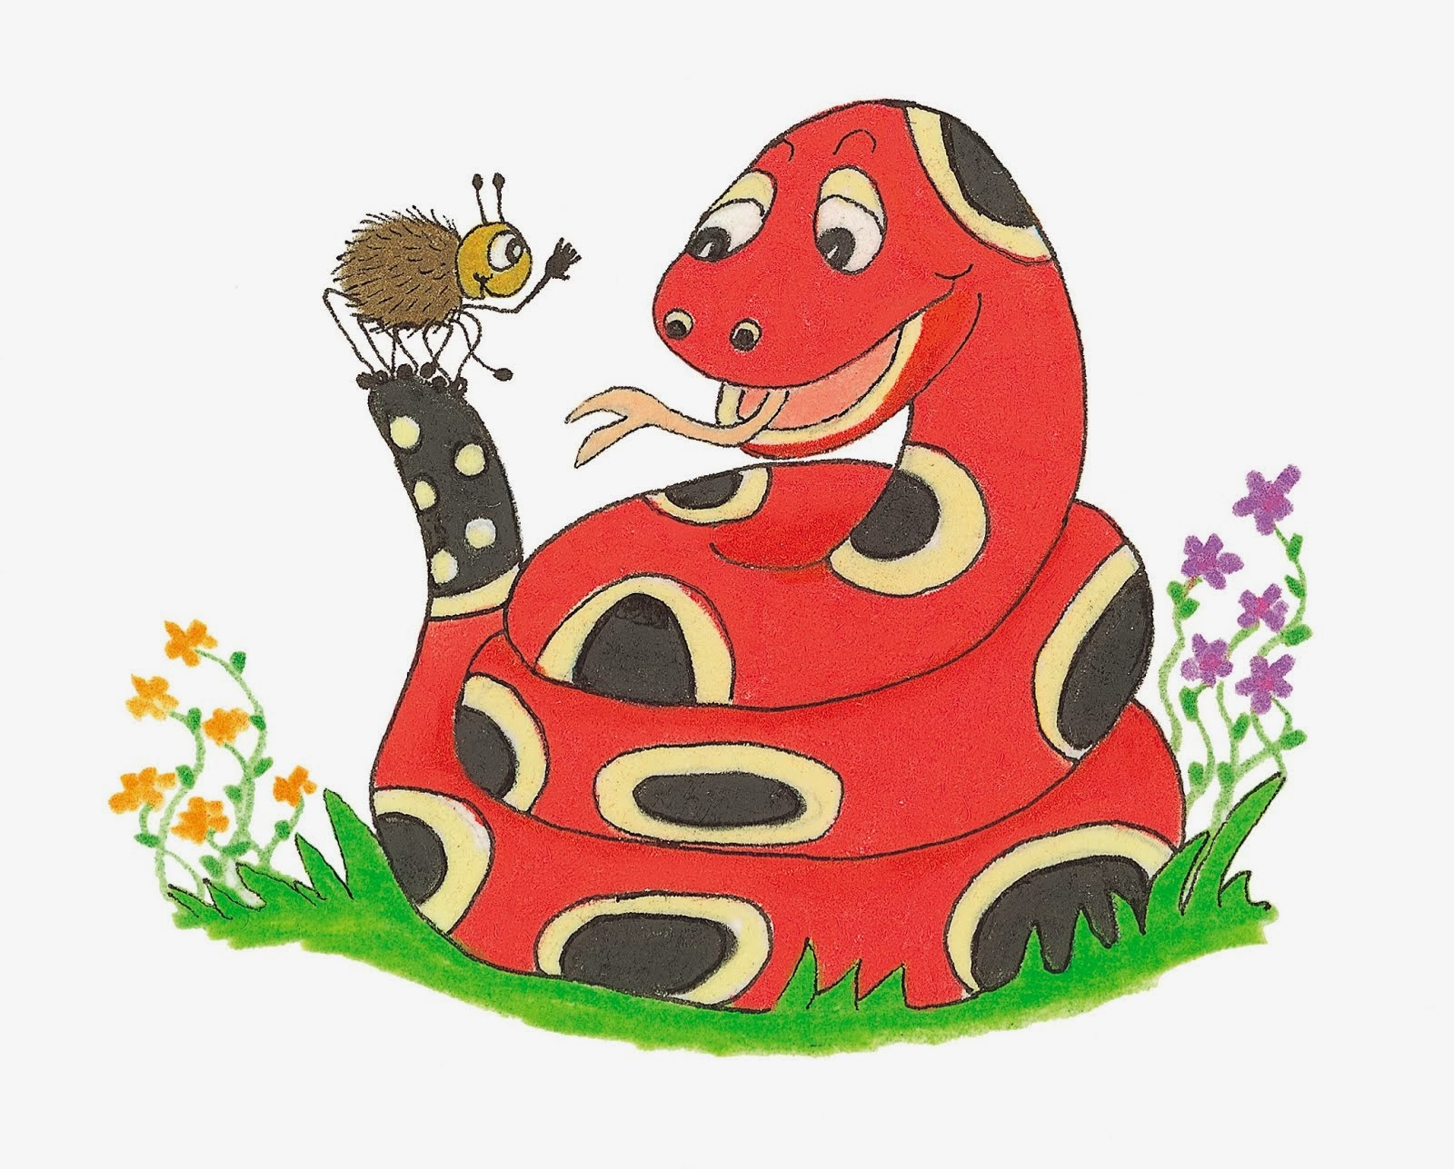
Dictation

Slide 25
There are over seven billion people on the planet.

Slide 26
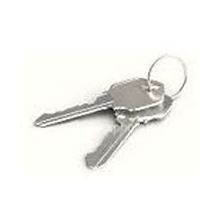

Slide 27
“Can you make me a duplicate set of keys?” he asked.

Slide 29
My parents gave me a new bilingual dictionary.

Slide 30
See you
next time!

