Slide 1
Jolly Grammar
6a-2

Slide 2
Spelling Test 1

Slide 3
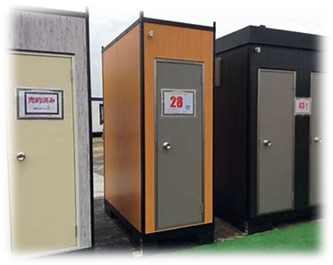
unit

Slide 4
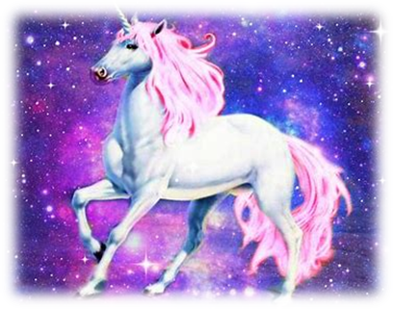
unit
unicorn

Slide 5
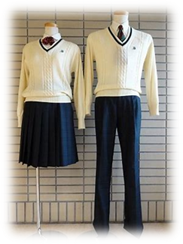
unit
unicorn
uniform

Slide 6
unit
unicorn
uniform
monogram

Slide 7
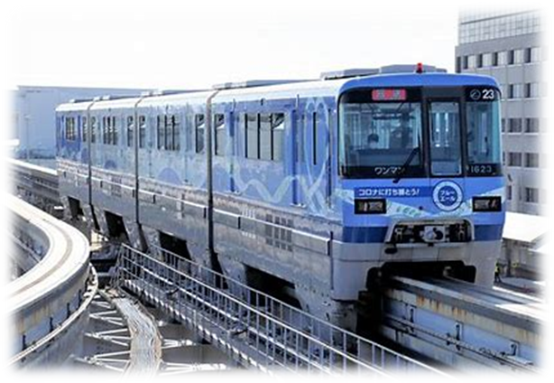
unit
unicorn
uniform
monogram
monorail

Slide 8
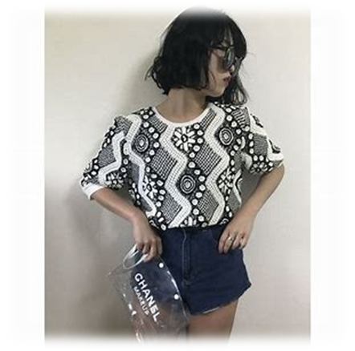
unit
unicorn
uniform
monogram
monorail
monotone

Slide 9
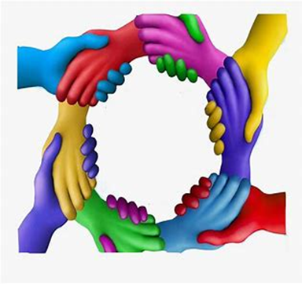
unit
unicorn
uniform
monogram
monorail
monotone
unify

Slide 10
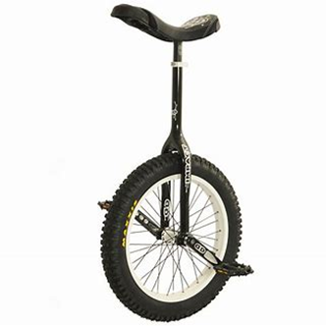
unit
unicorn
uniform
monogram
monorail
monotone
unify
unicycle

Slide 11
unit
unicorn
uniform
monogram
monorail
monotone
unify
unicycle
union

Slide 12
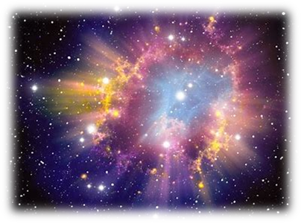
unit
unicorn
uniform
monogram
monorail
monotone
unify
unicycle
union
10. universe

Slide 13
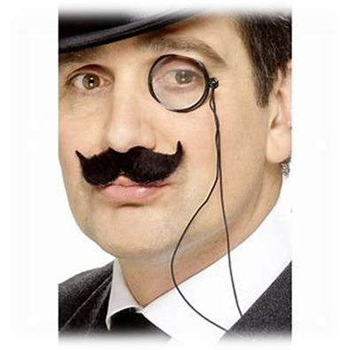
unit
unicorn
uniform
monogram
monorail
monotone
unify
unicycle
union
10. universe
11. monocle

Slide 14
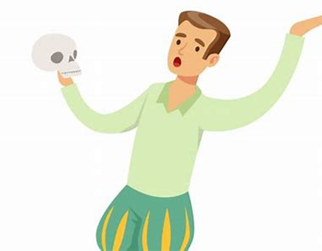
unit
unicorn
uniform
monogram
monorail
monotone
unify
unicycle
union
10. universe
11. monocle
12. monologue

Slide 15
unit
unicorn
uniform
monogram
monorail
monotone
unify
unicycle
union
10. universe
11. monocle
12. monologue
13. monosyllable

Slide 16
unit
unicorn
uniform
monogram
monorail
monotone
unify
unicycle
union
10. universe
11. monocle
12. monologue
13. monosyllable
14. universal

Slide 17
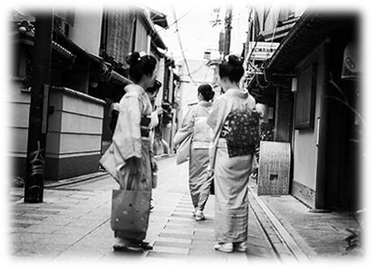
unit
unicorn
uniform
monogram
monorail
monotone
unify
unicycle
union
10. universe
11. monocle
12. monologue
13. monosyllable
14. universal
15. monochrome

Slide 18
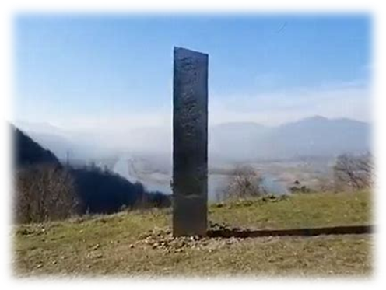
unit
unicorn
uniform
monogram
monorail
monotone
unify
unicycle
union
10. universe
11. monocle
12. monologue
13. monosyllable
14. universal
15. monochrome
16. monolith

Slide 19
unit
unicorn
uniform
monogram
monorail
monotone
unify
unicycle
union
10. universe
11. monocle
12. monologue
13. monosyllable
14. universal
15. monochrome
16. monolith
17. unification

Slide 20
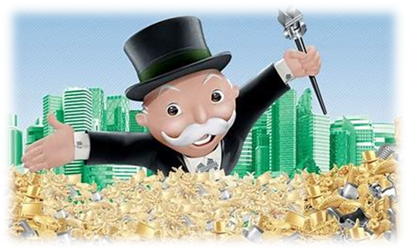
unit
unicorn
uniform
monogram
monorail
monotone
unify
unicycle
union
10. universe
11. monocle
12. monologue
13. monosyllable
14. universal
15. monochrome
16. monolith
17. unification
18. monopoly

Slide 21
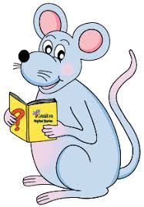
Let’s revise
Homophones.

Slide 22
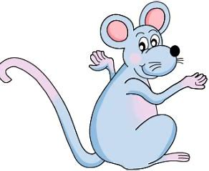
Possessive adjective
its
A contraction
it’s

Slide 23
Possessive adjective
its
your
A contraction
it’s
you’re

Slide 24
Possessive adjective
its
your
A contraction
it’s
you’re

Slide 25
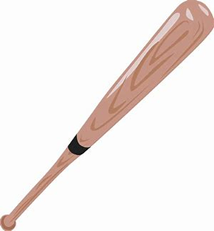
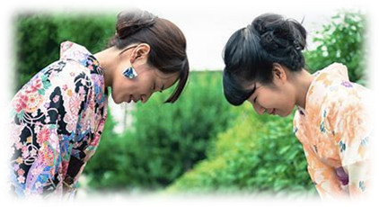
Homograph
Same spelling,
different meaning
Homophone
Same
pronunciation,
Different
spelling and
meaning
too/two
Homonym
Different
meaning
bat
bat
Heteronym
Different
pronunciation and
meaning
bow
bow

Slide 26
Homophones

Slide 27
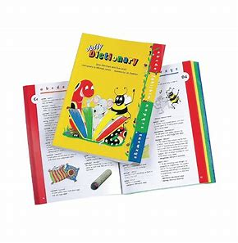
allowed & aloud
allowed is the simple past tense of the verb allow, made by adding the suffix <-ed>
aloud is an adverb meaning out loud.

Slide 28
led: a past tense of lead (to go in front and show people the way)
・My friend Tom led the discussion yesterday.
lead: a soft but very heavy metal
・The pipes were made of lead.
aloud: out loud
・He read her letter aloud to the rest of the family.
allowed: a verb tense of the verb allow
・Pets are not allowed in the hospital.
aisle: a space to walk between rows of seats or shelves
・Would you like an aisle seat or a window seat?
isle: an island, especially a small one
・Explore the more remote Caribbean isles.
precede: to be or go before something or someone in time or pace
・Verbs usually precede objects in English.
proceed: to continue as planned
・Preparations for the festival are now proceeding smoothly.

Slide 29
steal: to take something that belongs to
・She admitted stealing the money from her employers.
steel: a very strong metal made mainly from iron
・The concreate is strengthened with steel rods.
mourning: great sadness felt because someone has died
・Shops were closed as a sign of mourning for the king.
morning: the first part of the day between the time it gets light and midday
・She only works in the mornings.
bridal: a woman about to be married, or of a marriage ceremony
・The magazine had a section on bridal wear.
bridle: a set of leather straps that are put around a horse’s head to allow its rider to
control it
・She put a bridle on her horse.
compliment: a remark that expresses approval, admiration, or respect
・I take it as a compliment when people say I look like my mother.
complement: to make something else seem better or more attractive when combining
with it
・Strawberries and cream complement each other perfectly.

Slide 30
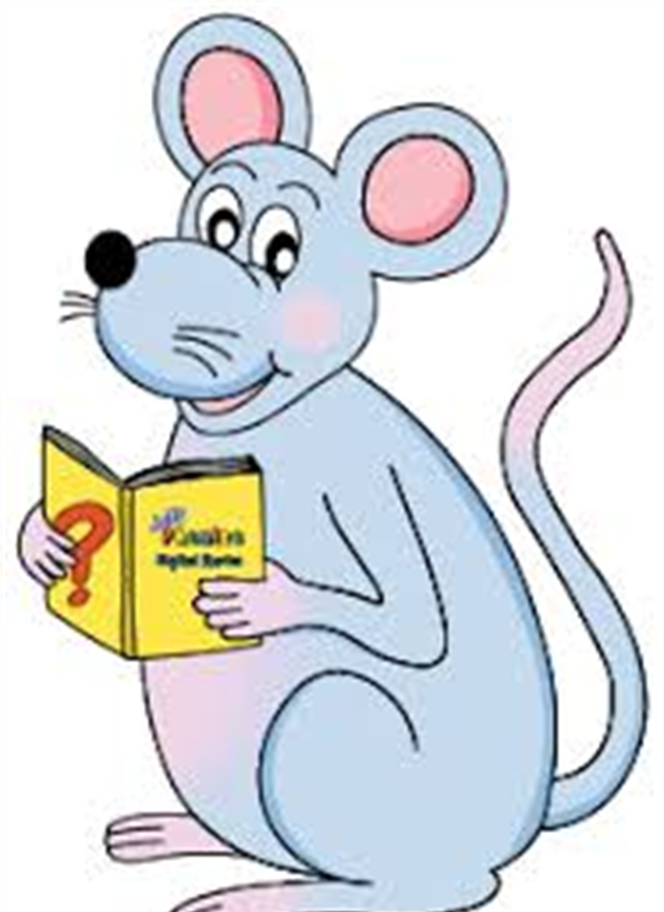
Assignment
Complete the sentences by writing in the correct homophone(s) in page 6.

Slide 31
See you
next time!

