Slide 1
Jolly Grammar
5a-23

Slide 2
Let’s review
prefixes

Slide 3
unafraid
unpleasant
unpopular
displease
discomfort
disapprove

Slide 4
superman
supermarket

Slide 5
Parsing & Sentence Walls

Slide 6
The tennis club is not postponing
tomorrow’s match.
Subject
club
The tennis
Verb
is postponing
not
Object
match
tomorrow’s

Slide 7
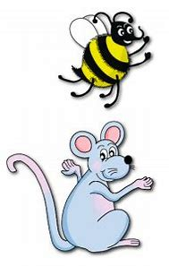
Spelling Point
<post->

Slide 8
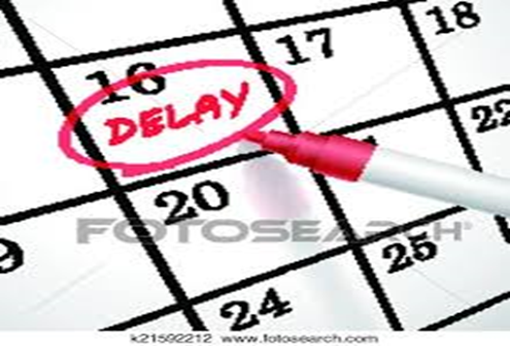
postpone
postscript
posterity

Slide 9
postpone
postscript
posterity
after, behind

Slide 10
Spelling List
<post->

Slide 11
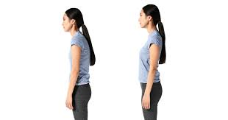
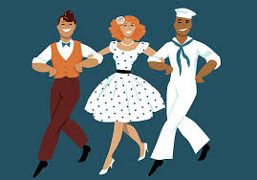
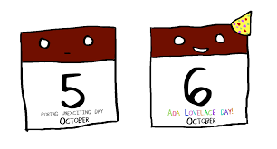
post
postcard
posture
postpone
postwar
postdate

Slide 12
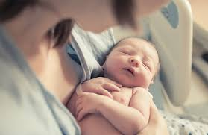
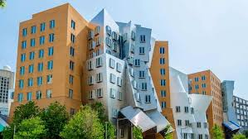
postscript
postnatal
posterity
posterior
postmodern
postmaster

Slide 13
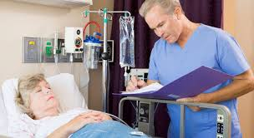
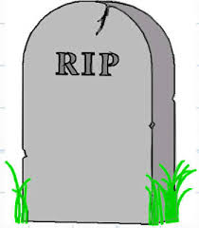
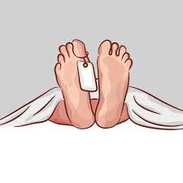
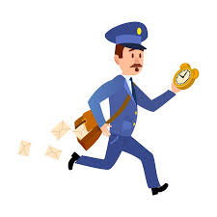
post-operative
posthumous
postmortem
post-
haste
postponement
postgraduate

Slide 14
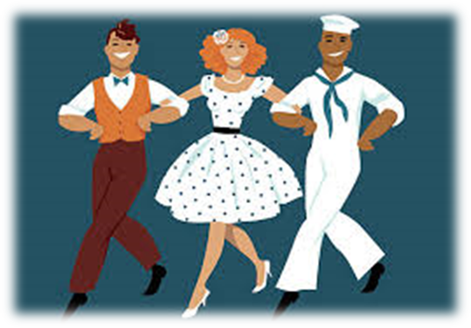
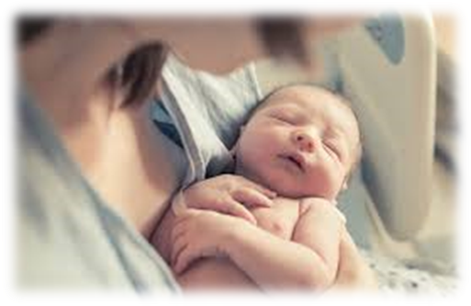
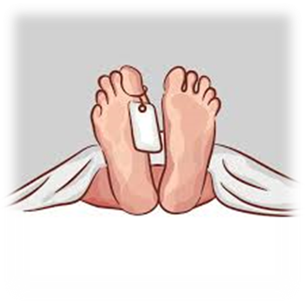

Slide 15
Activity Page:
Spelling
<post->

Slide 16
unfair
inactive
irresponsible
midway
disappear
illogical
incorrect
unlock
midnight
improbable
semicircle

Slide 17
Dictation

Slide 19
The author added a postscript at the end of the book.

Slide 20
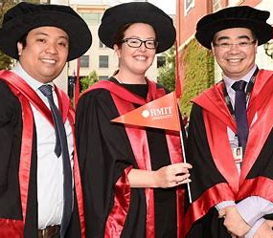

Slide 21
“My son is a postgraduate student,” the woman said proudly.

Slide 22
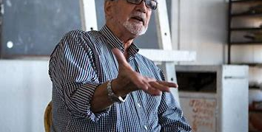

Slide 23
The art critic hates postmodernist paintings.

Slide 24
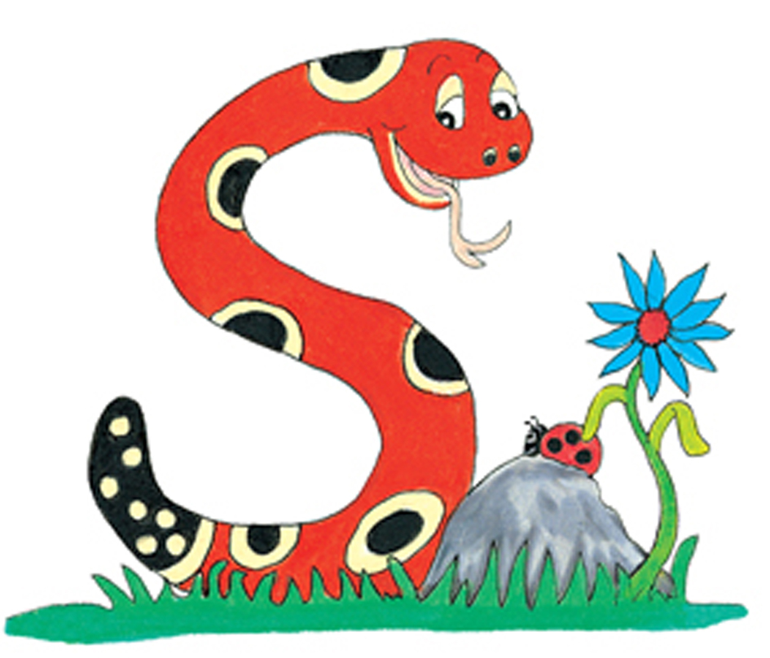
Thank you.
See you
next time!

