Slide 1
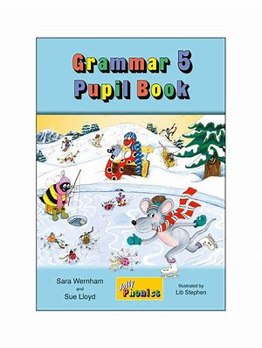
Jolly Grammar
5a-5

Slide 2
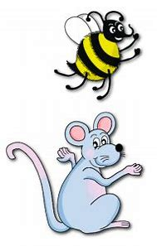
Let’s review
Parts of Speech.

Slide 3
Activity Page
Prefixes

Slide 4
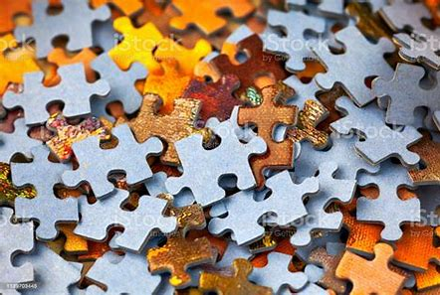
puzzle
noun
・He is clever enough to solve this puzzle.
・My sister loves jigsaw puzzle.
verb
・Her attitude puzzled me.

Slide 5
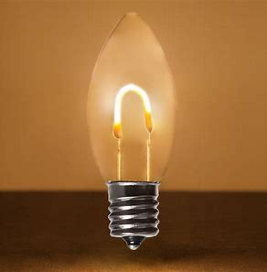
light
noun
・Light is useful.
adjective
・I like light blue.
・It is light green.
・This bag is light.

Slide 6
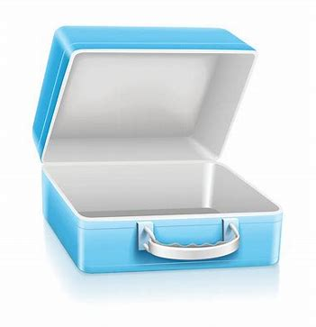
empty
verb
・I emptied the box.
adjective
・The box is empty.

Slide 7
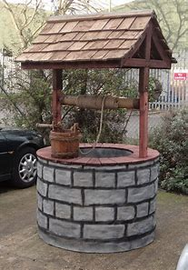
well
adverb
・I can draw well.
・I can swim well.
noun
・I saw an old well.
・I have never seen a well.

Slide 8
Spelling Point

Slide 9
important
assistant
ignore
guide

Slide 10
important
assistant
ignore
guide
importance

Slide 11
important
assistant
ignore
guide
importance
assistance

Slide 12
important
assistant
ignore
guide
importance
assistance
ignorance

Slide 13
important
assistant
ignore
guide
importance
assistance
ignorance
guidance

Slide 14
Spelling List
<-ance>

Slide 15
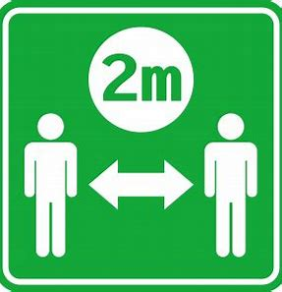
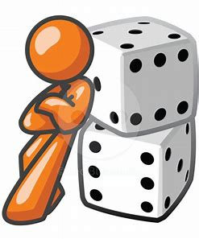
distance advance balance
entrance chance acceptance

Slide 16
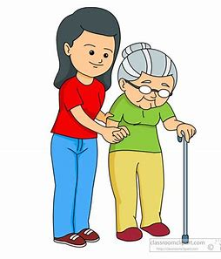
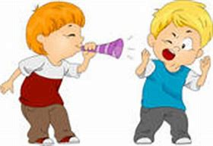
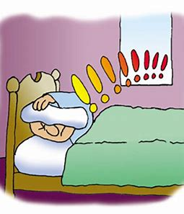
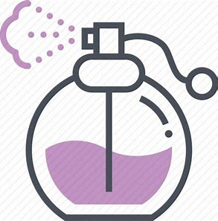
admittance annoyance assistance
clearance disturbance fragrance

Slide 17
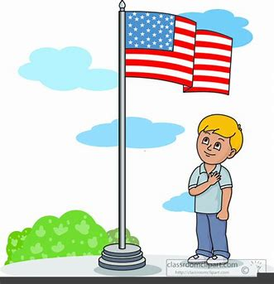
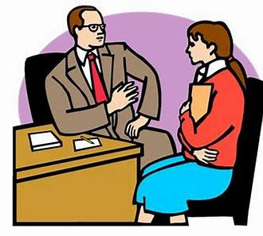
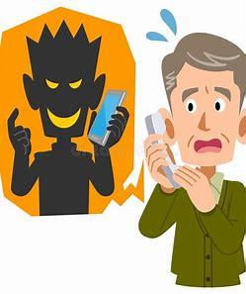
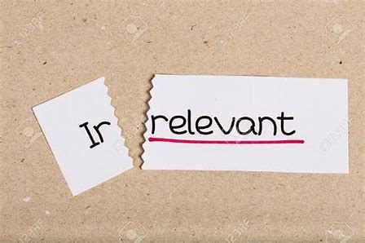
allegiance guidance nuisance
hindrance irrelevance acquaintance

Slide 18
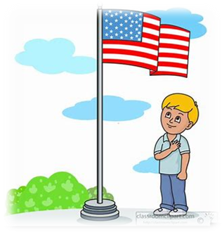
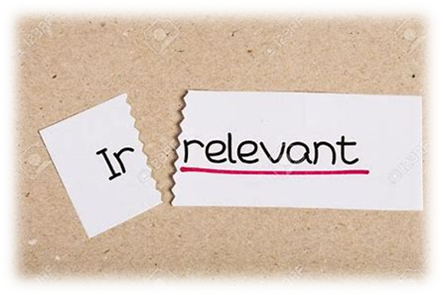

Slide 19
Activity Page:
Spelling

Slide 20
avoidance
delivery
utterance
allowance
endurance
insurance

Slide 21
parsing

Slide 22
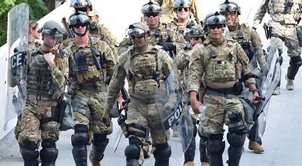
The army’s advance was causing a great disturbance.

Slide 23
The army’s advance was causing a great disturbance.

Slide 24
The army’s advance was causing a great disturbance.

Slide 25
The army’s advance was causing a great disturbance.

Slide 26
The army’s advance was causing a great disturbance.

Slide 27
The army’s advance was causing a great disturbance.

Slide 28
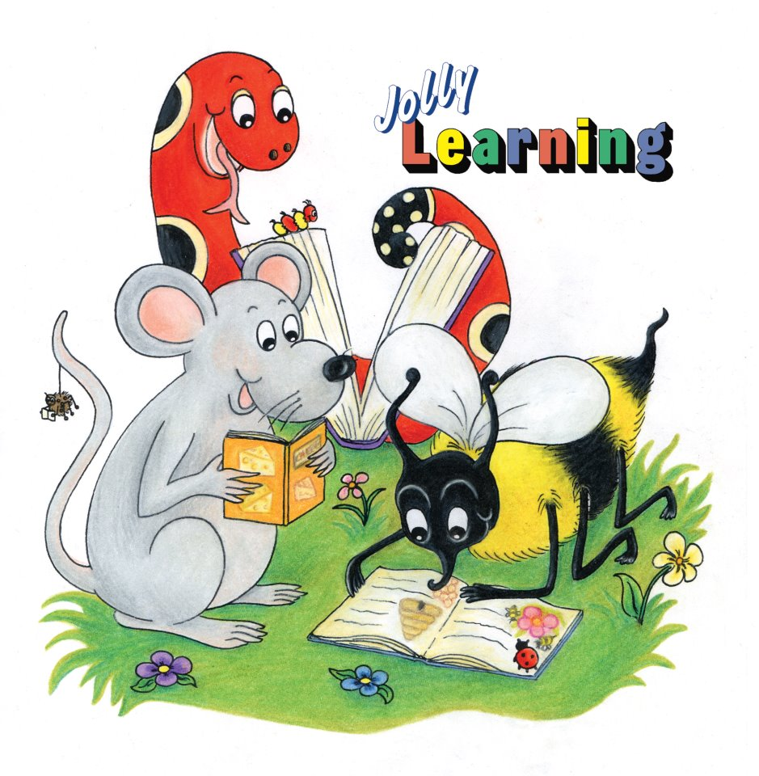
Dictation

Slide 29
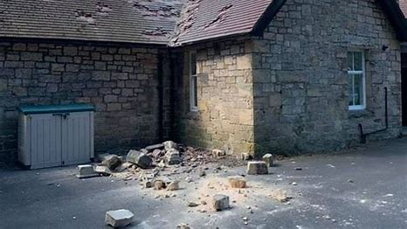
The cottage was seriously damaged during the disturbance.

Slide 30
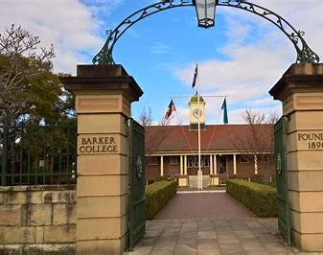
They saw the entrance to the college in the distance.

Slide 31
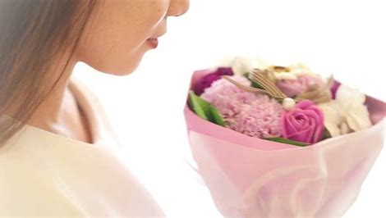
“The flowers have an elegant fragrance,” the florist observed.

Slide 32
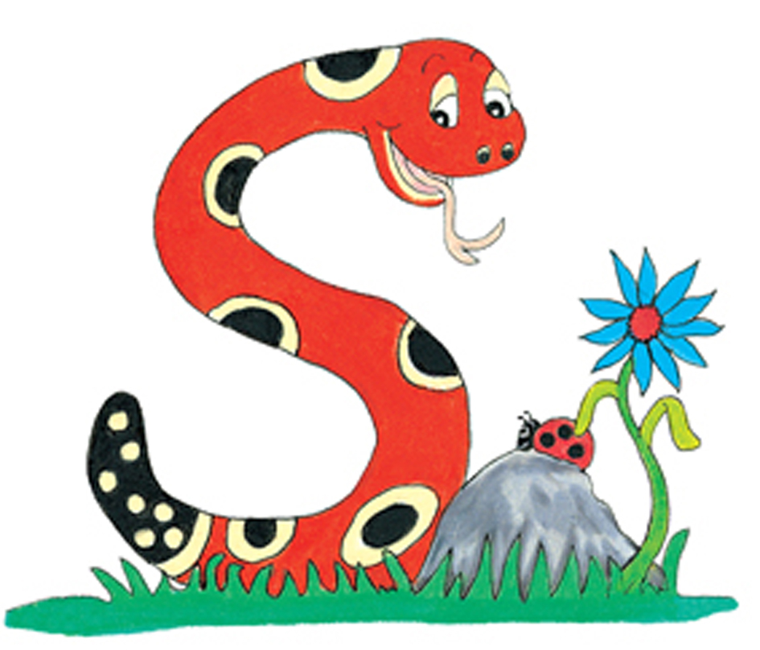
Thank you.
See you
next time!

